Slide 1
Cross Site Request Forgery
New Attacks and Defenses
Collin Jackson
Stanford University
collinj@cs.stanford.edu
(206) 963-0724
Joint work with Adam Barth and John C. Mitchell
6/25/2008

Slide 2
Outline
CSRF Defined
Attacks Using Login CSRF
Existing CSRF Defenses
CSRF Defense Proposal
Identity Misbinding

Slide 3


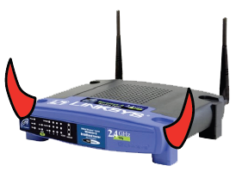
Threat Models
Forum Poster
  Injects content onto trusted site
  Sanitized (hopefully)
Web Attacker
  Owns https://www.attacker.com
  Free user visit
Network Attacker
  Eavesdrop/corrupt normal traffic
  Cannot eavesdrop/corrupt HTTPS

Slide 4
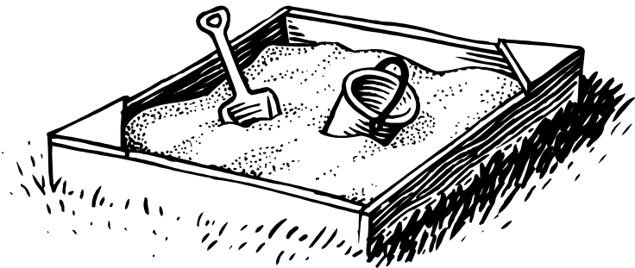
Browser vs. Web Attacker
Isolate sites
Sites can opt in to sharing information
Prevent attacker from
  Abusing user’s IP address
  Reading browser state associated with other sites
  Writing browser state associated with other sites

Slide 5
Browser Security Policy
Same-origin policy
<iframe src="http://www.bank.com/">
<script>
alert(frames[0].document.cookie);
</script>
Library import
<script src="https://www.verisign.com/seal.js">
Data export
<form action="https://www.bank.com/login">

Slide 6
Problems with Data Export
Abusing user’s IP address
  Can issue commands to servers inside firewall
Reading browser state
  Can issue requests with cookies attached
Writing browser state
  Can issue requests that cause cookies to be overwritten
“Session riding” is a misleading name

Slide 7
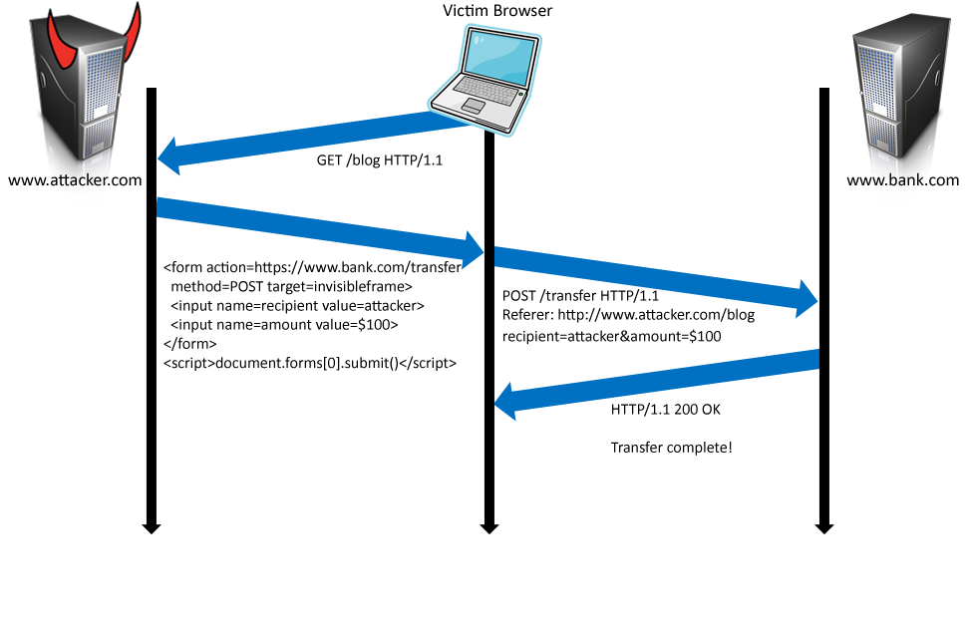
Cross-Site Request Forgery

Slide 8
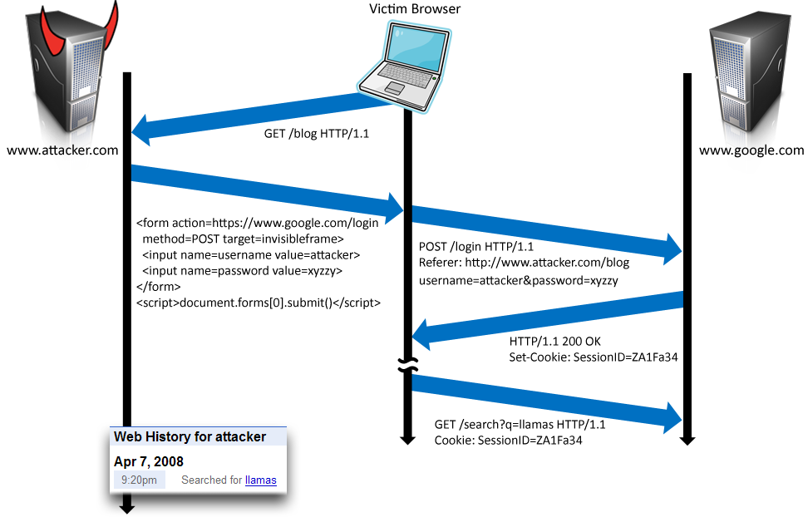
Login CSRF

Slide 9
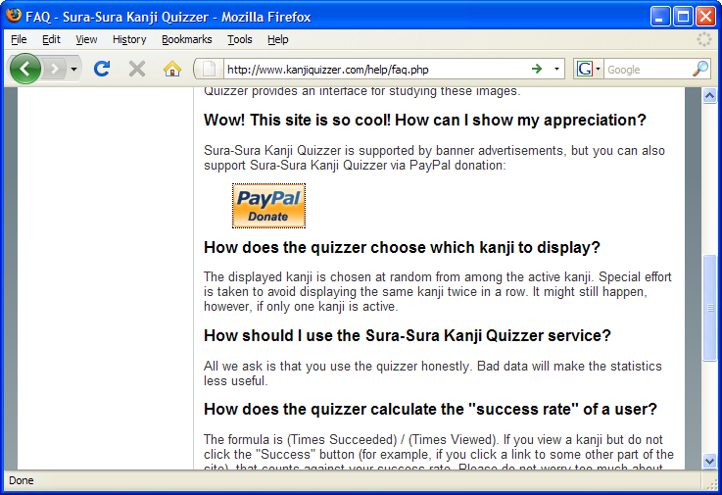
Payments Login CSRF

Slide 10
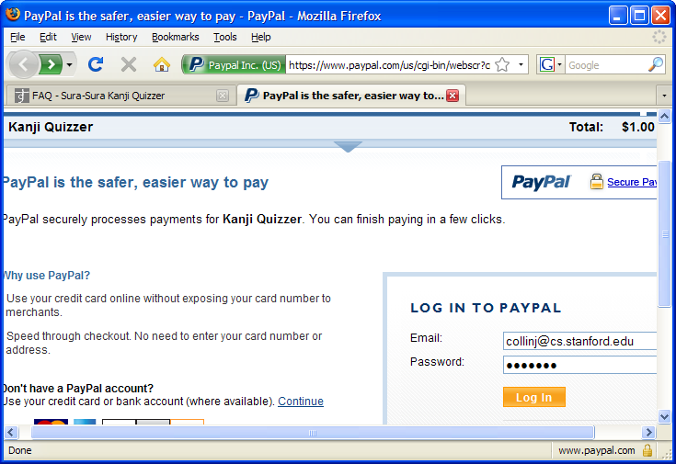
Payments Login CSRF

Slide 11
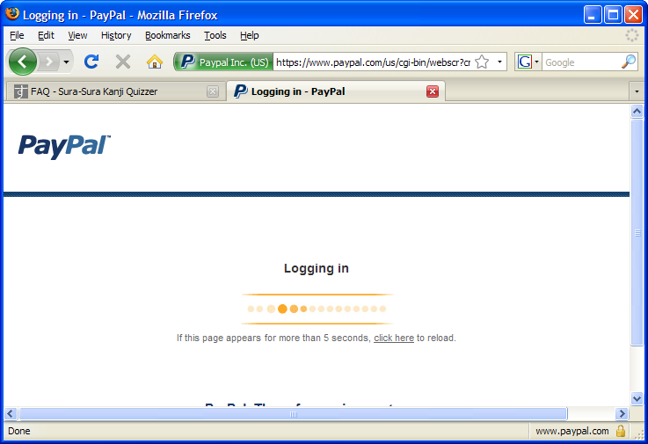
Payments Login CSRF

Slide 12
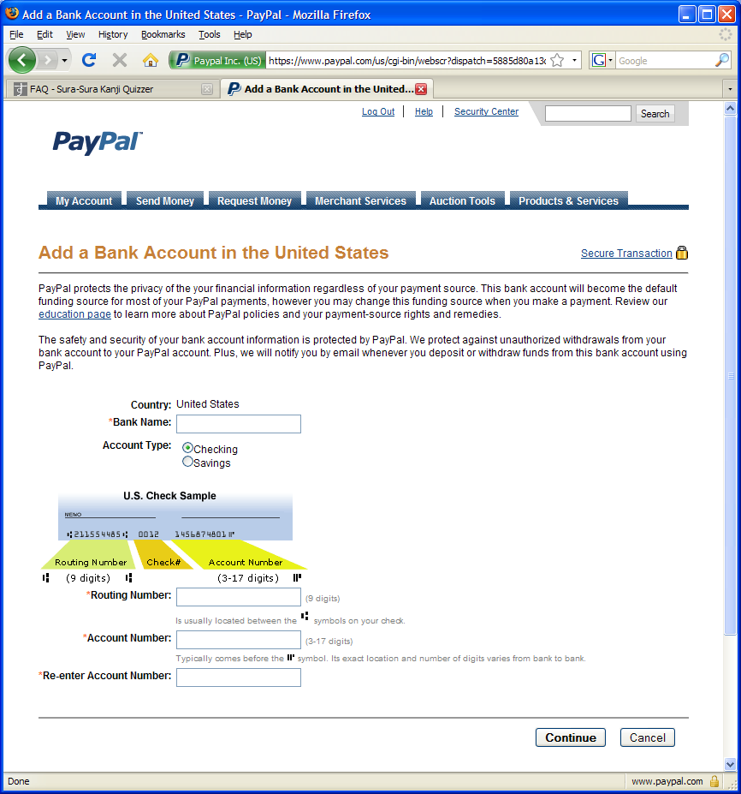
Payments Login CSRF

Slide 13
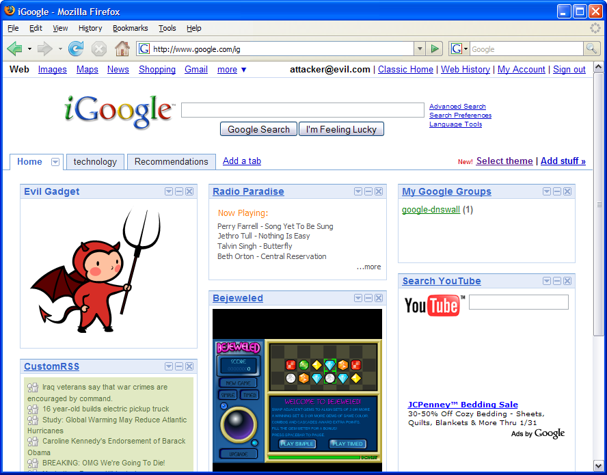
Inline Gadgets

Slide 14
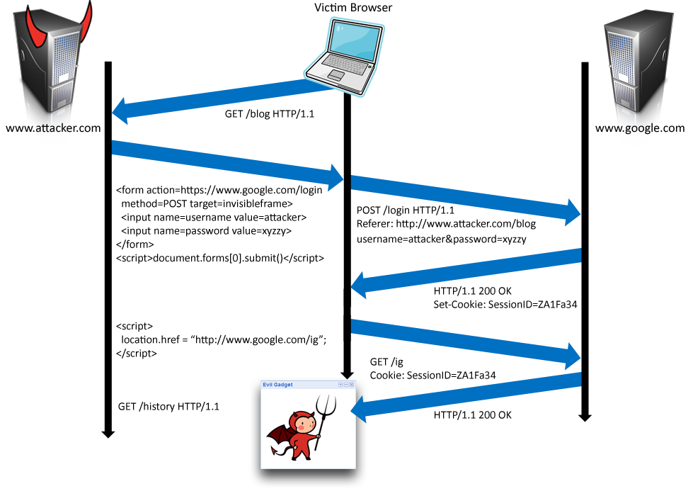
Using Login CSRF for XSS

Slide 15
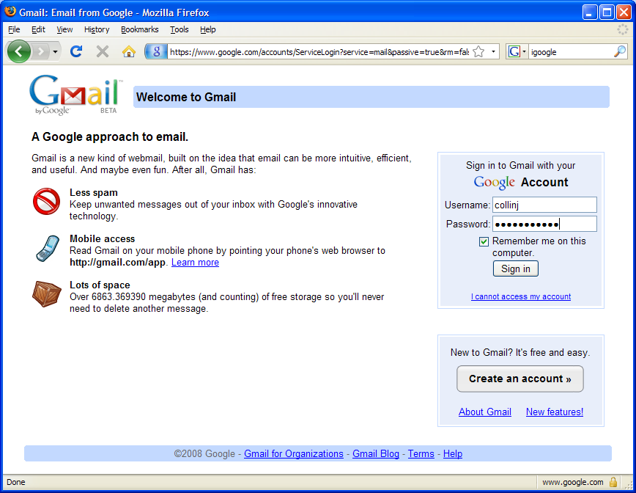
Post-XSS

Slide 16




CSRF Defenses
Secret Validation Token
Referer Validation
Custom HTTP Header
<input type=hidden value=23a3af01b>
Referer: http://www.facebook.com/home.php
_{X-Requested-By: XMLHttpRequest}

Slide 17
Secret Validation Token vs. Web Attacker
Hash of User ID
  Attacker can forge
Session ID
  Save to HTML does allow session hijacking
Session-Independent Nonce (Trac)
  Can be overwritten by subdomains, network attackers
Session-Dependent Nonce (CSRFx, CSRFGuard)
  Requires managing a state table
HMAC of Session ID
  No extra state required
<input type=hidden value=23a3af01b>

Slide 18
Keeping Secrets in NoForge
Parses HTML and appends token to hyperlinks
Dynamically created HTML lacks token
  Legacy application may break unexpectedly
Token appended to all external links
  Remote site can immediately CSRF referrer
No login CSRF defense
  Requires a session before token is validated

Slide 19
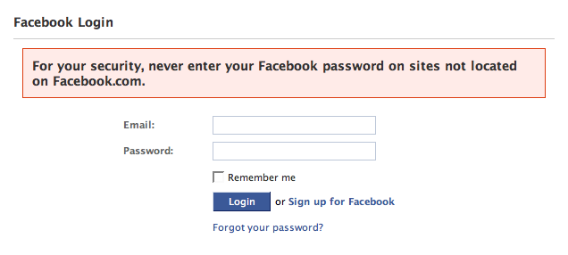
Referer Validation
✓
Lenient Referer checking – header is optional
Strict Referer checking – header is required
Referer: http://www.facebook.com/
✗
Referer: http://www.evil.com/attack.html
?
_{Referer:}

Slide 20
Why use Lenient Referer Checking?
Referer may leak privacy-sensitive information
http://intranet.corp.apple.com/
projects/iphone/competitors.html
Common sources of blocking:
  Network stripping by the organization
  Network stripping by local machine
  Stripped by browser for HTTPS -> HTTP transitions
  User preference in browser
  Buggy user agents
Site cannot afford to block these users

Slide 21
Lenient Referer Checking vs. Web Attacker
ftp://www.attacker.com/index.html
javascript:"<script> /* CSRF */ </script>"
data:text/html,<script> /* CSRF */ </script>
… and many more
Lenient Referer Checking is not secure!
Don’t use it!
✓
_{Referer:}
_{M. Johns '06}

Slide 22
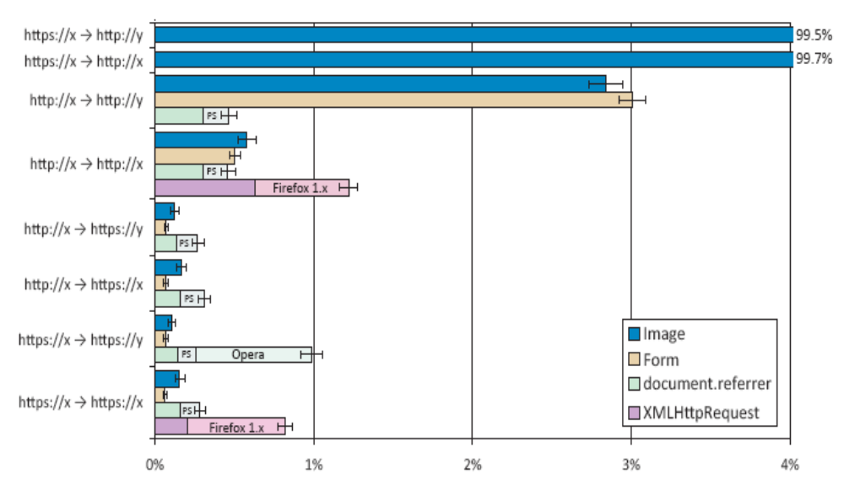
Is Strict Referer Checking Feasible?
283,945 advertisement impressions from 163,767 IP addresses

Slide 23
Custom Header
XMLHttpRequest is for same-origin requests
  Can use setRequestHeader within origin
Limitations on data export format
  No setRequestHeader equivalent
  XHR2 has a whitelist for cross-site requests
Issue POST requests via AJAX:
No secrets required
_{X-Requested-By: XMLHttpRequest}

Slide 24

Can browsers help sites with CSRF?
Does not break existing sites
Easy to use
Allows legitimate cross-site requests
Reveals minimum amount of information
No secrets to leak
Standardized

Slide 25
Proposal: Origin Header
Origin: http://www.evil.com
Privacy
  Identifies only principal that initiated the request (not path or query)
  Sent only for POST requests; following hyperlink reveals nothing
Usability
  Authorize subdomains and affiliate sites with simple firewall rule
  No need to manage secret token state
  Can use redundantly with existing defenses to support legacy browsers
Standardization
  Supported by W3C XHR2 and JSONRequest
  Expected in IE8’s XDomainRequest
SecRule REQUEST_HEADERS:Host !^www\.example\.com(:\d+)?$ deny,status:403
SecRule REQUEST_METHOD ^POST$ chain,deny,status:403
SecRule REQUEST_HEADERS:Origin !^(https?://www\.example\.com(:\d+)?)?$

Slide 26
Identity Misbinding
User is logged in to trusted site as attacker
Does not always require login CSRF
  OpenID
  PHP Cookieless Authentication
  “Secure” cookies

Slide 27
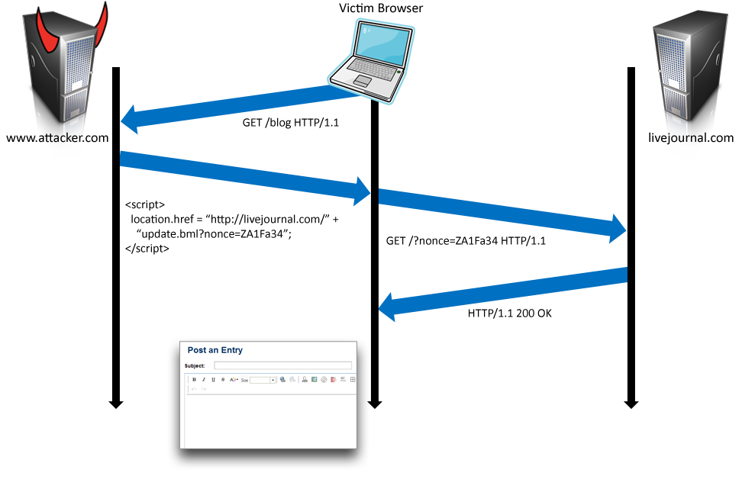
Web Attacker vs. OpenID

Slide 28
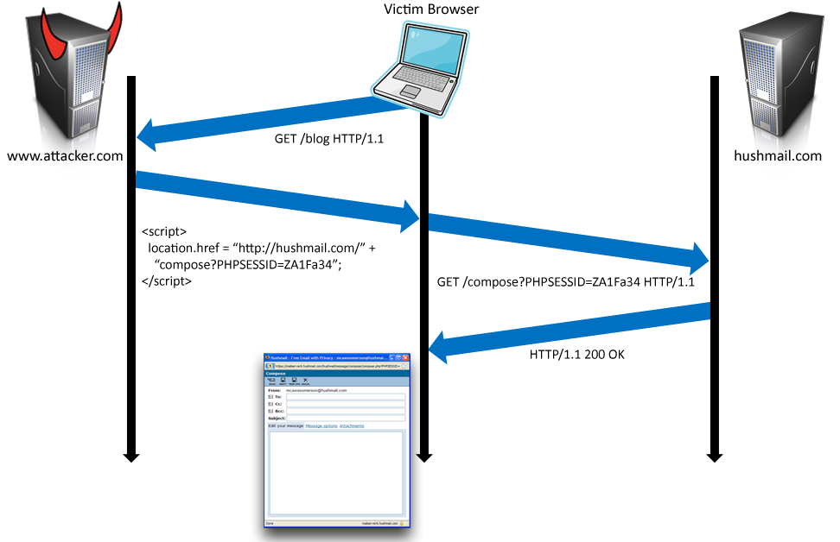
Web Attacker vs. PHP Cookieless Authentication

Slide 29
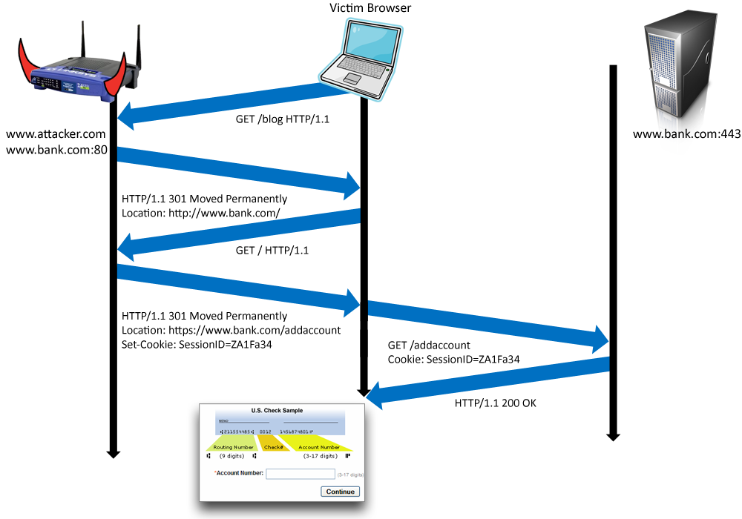
Network Attacker vs. “Secure” Cookies
Need a browser-based solution
Cookie-Integrity
Mitigation: Don’t allow self-XSS over HTTPS

Slide 30
Conclusions
Beware of:
  State-modifying GET requests
  Login CSRF
  Lenient Referer checking
  Sloppy secret token validation
  OpenID without binding to browser
  PHP cookieless authentication
  User opt-in to self-XSS (especially over HTTPS)
OK:
  Careful secret token validation
  Strict Referer checking over HTTPS
  Custom headers

