Slide 1
Selenium: Test Automation
January 2013
Aazim Lakhani

Slide 2
Selenium
Automation tool for functional regression testing of Web applications.
Supports a variety of platforms: Windows, Mac OS X, Linux.
Tests can then be run against most modern web browsers.
Selenium Components.
Selenium Web Driver : Successor to Selenium RC . With the release of Selenium 2, Selenium RC has been officially deprecated in favor of Selenium Web Driver. Test scripts in multiple languages : Java, C#, Ruby, HTML, Python.
Selenium Remote Control (RC) : Makes it possible to write automated tests for a web application in any programming language, which allows for better integration of Selenium in existing unit test frameworks.
Selenium IDE – Implemented as a FireFox extension which provides a record/playback tool for authoring tests without learning a test scripting language. Test suite can be exported in multiple languages & support Web Driver ,Remote Control .
Selenium Web Driver versus Selenium IDE
Decoupling test script code & test data.
Recommended by Selenium for robust, large scale application testing

Slide 3
Why do we need Selenium ?
Allows frequent regression testing.
Provides rapid feedback to developers, through the reporting system.
Can execute test cases, virtually unlimited times iteratively.
Supports Agile and extreme development methodologies.
Provides customized defect reporting.
Finds defects missed by manual testing.

Slide 4
Web Driver Versus Selenium RC
Selenium RC requires a proxy server. Web Driver requires no such proxy server.
Selenium RC has been deprecated. Selenium Web driver is its successor, which is actively supported.
Selenium Web driver is faster than Selenium RC.

Slide 5
Generic Testing Framework
Automation Testing requires testers to program test cases. Our framework DOES NOT REQUIRE a tester to program test cases. The framework manages the programming of test cases.
The framework is built on top of Selenium Web Driver. Hence, it provides all advantages of Web Driver.
A tester need not have expertise in creating test scripts.
Test cases are prepared in Microsoft Excel.
Provides support for browsers such as Firefox, Internet Explorer.
Has in-built ability to verify test results.
Takes screenshot at various points within a test case.
Generates customized reports for the executed test cases.
Provides useful information to debug failed test cases.
The next slide explains how test cases would be created.

Slide 6
Create Test Cases
Test cases would be created in Excel files.
A test case would contain test data, which would be used by the framework to execute a test case.
Rules defined within a test case would minimize typos.
The next slide displays a sample test case.

Slide 7
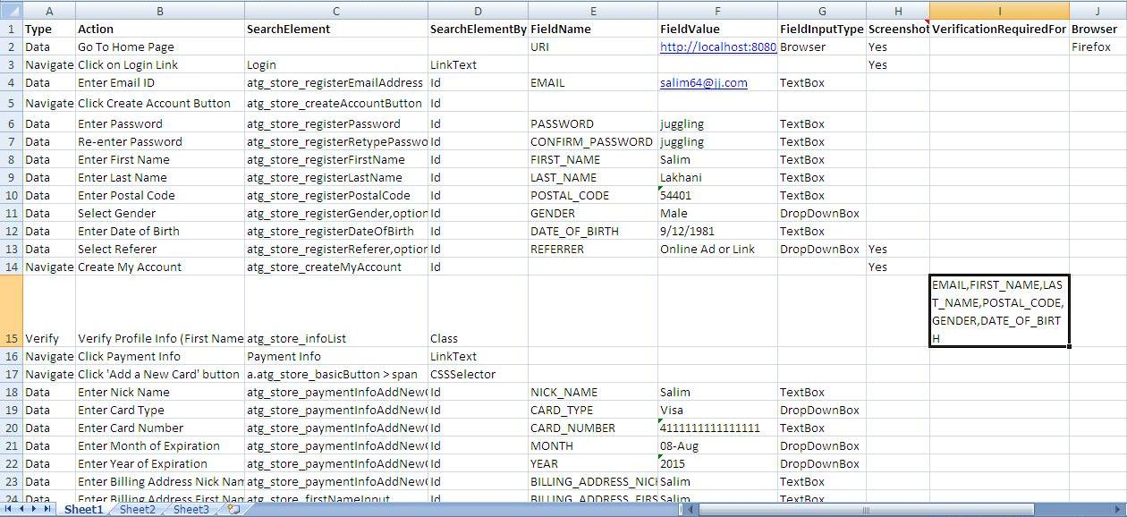

Slide 8
Executing Test Cases
After test cases have been created, the framework would start executing them.
During execution the framework performs a number of functionalities. Some of which are listed below.
Data entry (such as filling HTML forms) on behalf of the tester.
Navigating through various web pages to execute the test case.
Verifying data whenever required.
Taking screenshots on behalf of the tester.
Running test cases across different browsers .
Provides useful insights for failed test cases.

Slide 9
Test Reports
After a test case has been executed reports will be generated by the framework.
Reporting system shows the outcome of executing a test cases.
It displays screenshots taken while executing test cases.
Provides debugging information , cause for failure messages for failed test cases.
These reports are customizable.
The next 2 slides display a sample report.

Slide 10
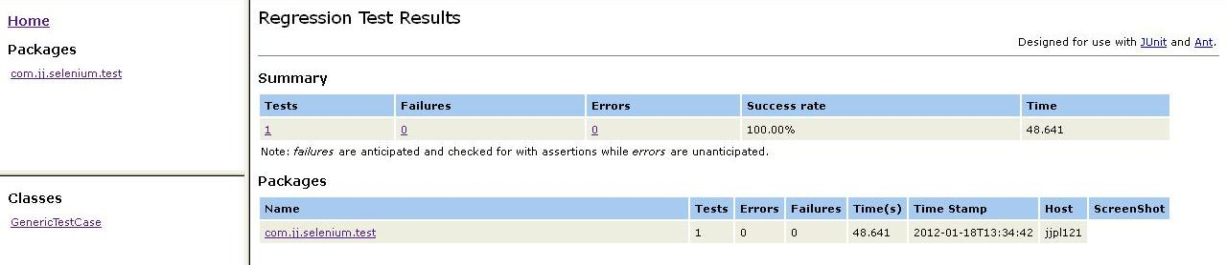
Reporting System

Slide 11
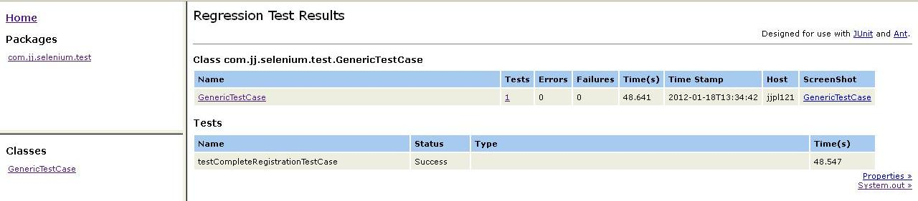
Reporting System … contd

Slide 12
Summary
Since, it is build on top of Selenium Web Driver, it provides all advantages that come along with Web Driver.
The framework allows the tester to focus of creating effective test cases. It manages the execution of test cases, verifies data, takes screenshot on behalf of the tester.
A tester need not have knowledge of creating test scripts. Just knowledge of Excel is sufficient.
The framework verifies data entered through forms, verifies derived data ( such as discounts obtained through promotions) as well as data stored in database.
Quick & easy to execute test cases.

Slide 13
Thank you

Slide 14
Demo
Test Cases Executed.
- User Registration & Checkout.
- Site Navigation
Run a suite of test cases through Ant.
Test Data can be imported from an external source.
Ability to control the build process, based on the outcome of the test results.
Quick & Easy to run test cases.
Can be integrated with Continuous Integration tools like Hudson, to display test results in a unified system.

