Slide 1


By,
Aazim Lakhani
Moiz Bhukhiya
Moiz Pardawala
Javed Palanawala
Notes:
javed

Slide 2







Notes:
javed

Slide 3


Verification
Security
Notes:
javed

Slide 4

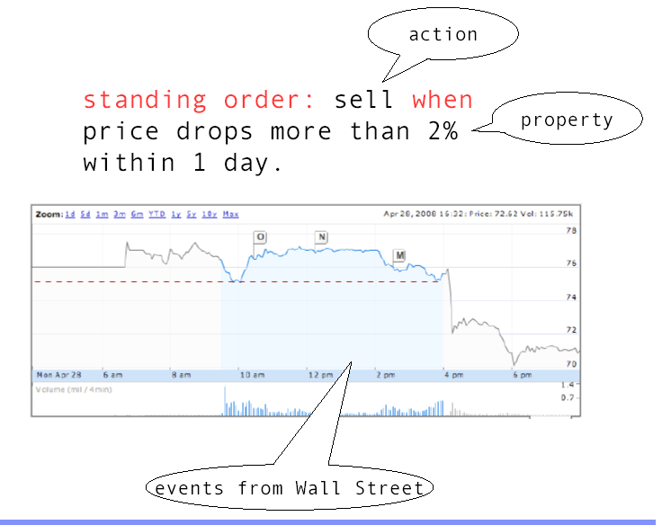
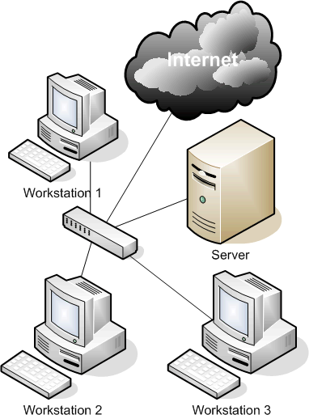
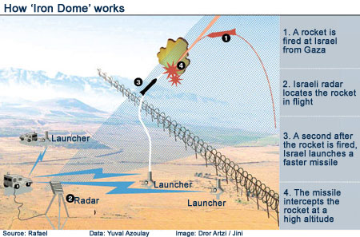

Slide 5

Informal Version
Run Time Monitoring is a study of how to get as much out of your runs as possible.
Formal Version
Run Time Monitoring is a study of how to design artifacts for monitoring and analyzing system executions. Such artifacts can be used for a variety of purposes, including testing /program understanding and fault detection.
Notes:
javed

Slide 6

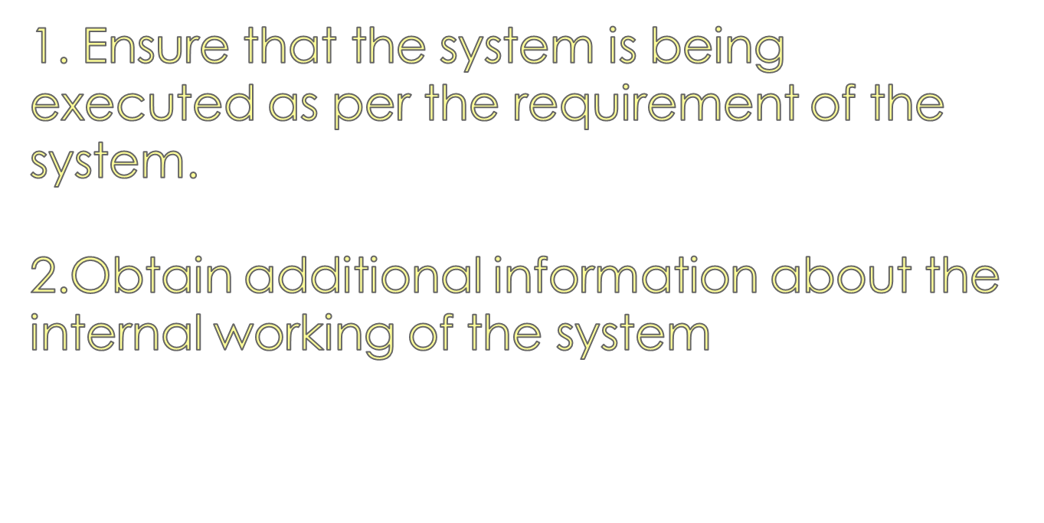

Slide 7

Software’s are getting complicated.
Designs are difficult to implement.
Runtime Verification of Software.
Failure of Traditional Methods when dealing with complex systems.
Modularity of cross-cutting concerns
Notes:
moiz

Slide 8

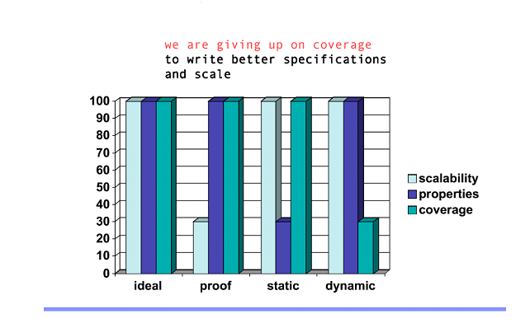
Notes:
moiz

Slide 9
RUNTIME MONITORING &
SOFTWARE VERIFICATION
Scalability
Expressiveness
Automated via Executable Specification
Notes:
moiz

Slide 10
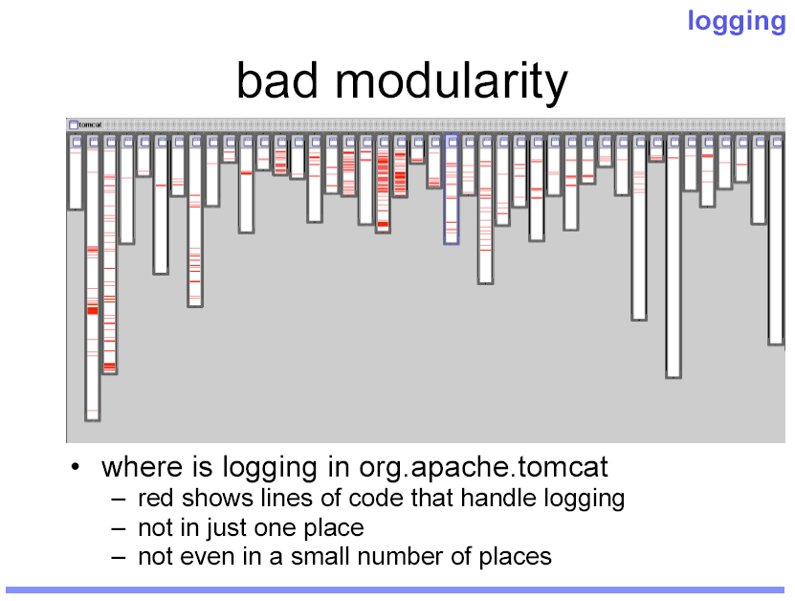
Notes:
moiz

Slide 11
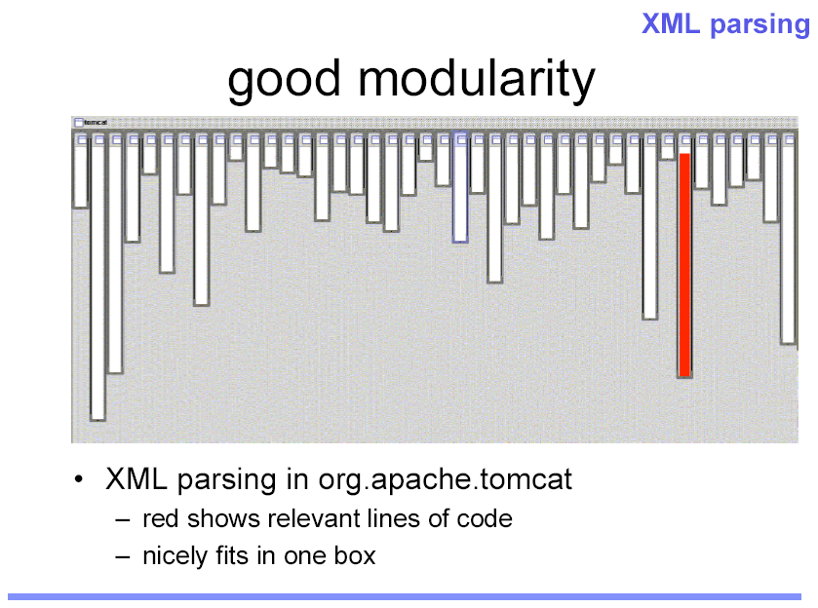
Notes:
moiz

Slide 12
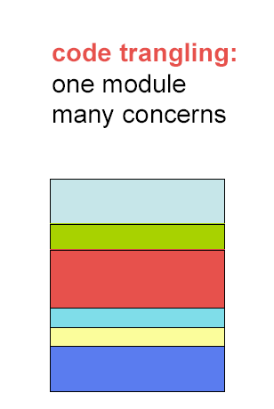
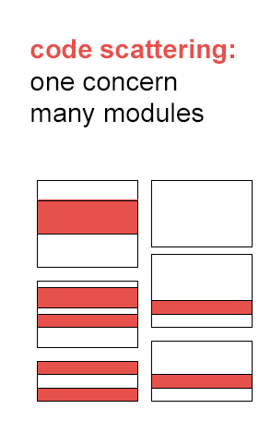
Two Central Problems in Traditional Systems
Example: Logging
Notes:
moiz

Slide 13

Implementation of AOP in Java
Improves modularization of cross cutting concerns.
Easy integration with Java .
Aspect Weaver

Slide 14
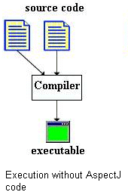
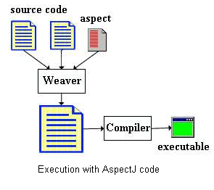

Slide 15

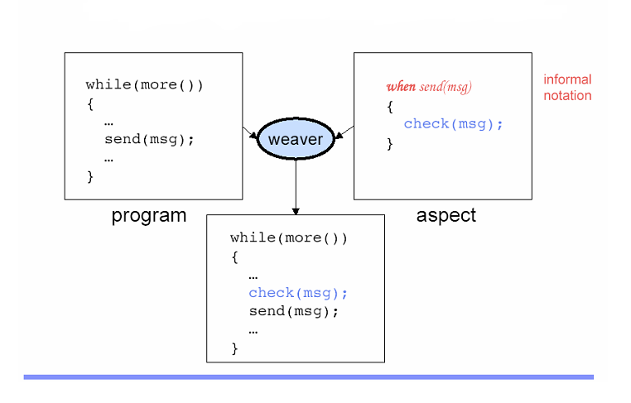

Slide 16
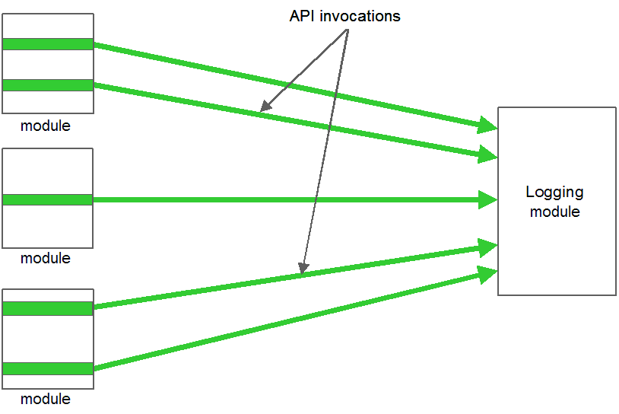
Figure : Code for logging is scattered across different modules

Slide 17

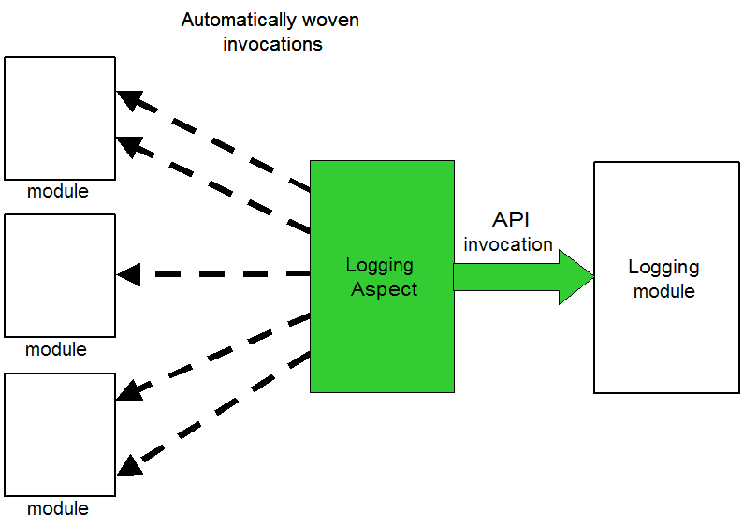
Figure 2 shows the overview of AspectJ based logging

Slide 18
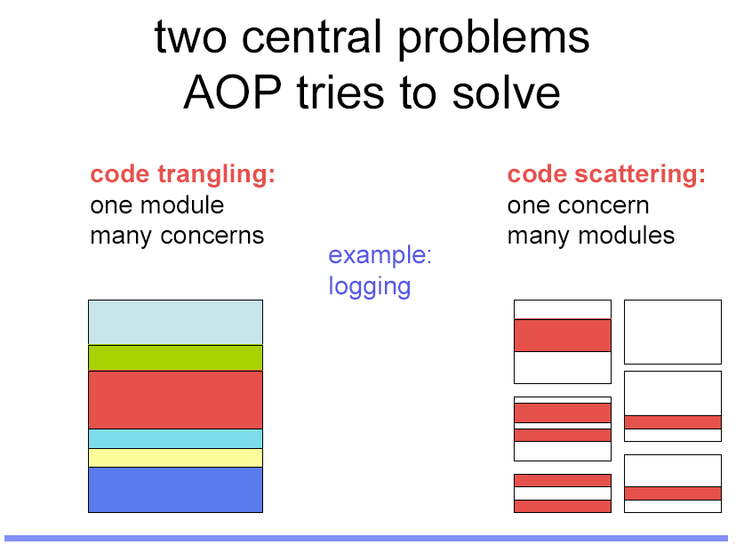
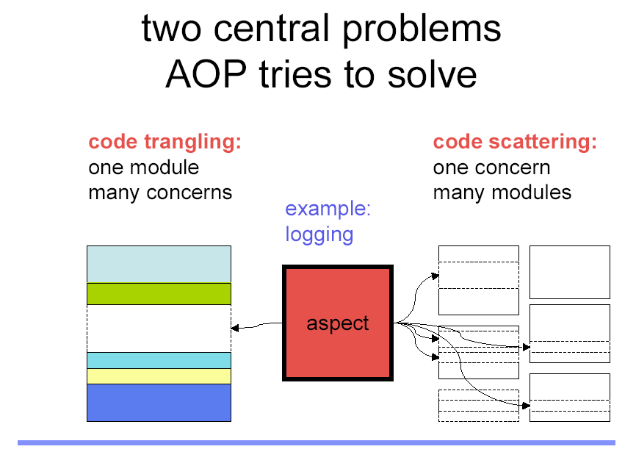

Slide 19

Code is not scattered .
Code tangling is avoided .
Easy to maintain .
Development is easier .
Makes optimal use of memory.

Slide 20

To Monitor the following System:
Multi User Transaction Processing ATM System.
Embedded Lift Control System.

Slide 21
QDDC-LOC-JAVA Framework
Specification
System to be monitored
Aspect
Network of Mealy Machines
Aspect Weaver
Instrumented Code
Evaluate()
METHOD CALL

Slide 22

Performance monitoring ( e.g. : time taken by ATM to respond to customer request for withdrawal of cash , or depositing cash or time taken to transfer funds from one account to another )
Monitoring the access to the ATM machines , and recording number of users accessing it at different intervals of time during the day, so as to dispense cash reserve in those ATM's where access is frequent.
If customer ejects his ATM card then the card should be dispensed within 30 sec.
If the cancel key is pressed before the transaction completes then the transaction must be aborted. If the cancel key is pressed after the transaction is complete then no effect of the cancel key. Priority should be given to cancel key .
Performance
Timing
Logging
Behavioral
Atomicity
Consistency
Security
If an account is a joint account of a number of customers and if there are various instances of the ATM machines such that the customers related to the account access it from various other machines then consistency and mutual exclusion needs to be maintained.
If the customer is idle for a certain period then the card should automatically be ejected.
Atomicity of transaction should be maintained.
In the event of a transfer transaction the amount transferred from one account should be equal to the amount credited in the other account.
If the PIN is entered wrongly 3 times then card should be made invalid.
Alert message should be sent if more than 5 transactions are (successfully) attempted from the same card within a day.

Slide 23



Once a request is send the lift should arrive within 2 minutes.
Monitor the time taken for the doors of the lifts to open and close.
Performance
Timing
Logging
Behavioral
Atomicity
Consistency
Security
Performance
Timing
Behavioral
If a lift passes a floor and there are pending request to go in the same direction then the lift will stop.
The lift should service all pending request in the direction of its motion (up or down)

Slide 24

THANK YOU
With the desire to make software’s that can do many things at the same time, complexity is bound to increase. Hence , its just a matter of time before run time monitoring systems get their due place in the industry.

