Slide 1

DAY 10
Vulnerability Assessment: CVSS Scoring, Scanner Mechanics, and Why "Patched" Banners Lie
Security Tutor — CEH-Track Program

Slide 2
THE HOOK
Here's a sentence that sounds boring until you understand what it actually means: "Server leaks inodes via ETags, header found with file /, fields: 0x689caadf 0x267." That's a real line from a real scan I ran against a real server, five minutes before recording this.
And the question I had to answer wasn't "is this scary." It was "is this even real." Because here's the thing nobody tells you when you start learning security tools: half of what a vulnerability scanner reports is noise.
And figuring out which half is the actual skill.

Slide 3
WHAT WE'LL COVER
three kinds of vulnerabilities
reading a CVSS score
how a scanner actually works
the real lab — nikto against my own server
Common mistake & correction
Recap & quiz

Slide 4
CONCEPT
three kinds of vulnerabilities
Let's start with something simple that I hadn't thought about clearly before today: "vulnerability" isn't one category of thing.
There are three.
The first is a **missing patch**.
This is the easy case — there's a known, published vulnerability, the vendor already shipped a fix for it, and...

Slide 5
CONCEPT
reading a CVSS score
Every vulnerability gets scored from 0 to 10 using something called CVSS — the Common Vulnerability Scoring System.
And it's built from a vector string that looks intimidating the first time you see it: Here's how to actually...
AV is attack vector — how close does the attacker need to be.
N means network, so they can be anywhere on the internet.

Slide 6
CONCEPT
how a scanner actually works
So where do these findings even come from?
Tools like nikto, Nessus, OpenVAS — they're not intelligent in the way people assume.
They do three mechanical things.
They fingerprint your server's version banner and check it against a database of known CVEs for that version.

Slide 7
CONCEPT
the real lab — nikto against my own server
So let's make this concrete.
I spun up a plain nginx container on an isolated Docker network — bound only to localhost on my own...
It came back with two findings.
First: the server leaks inode numbers through its ETag header.

Slide 8
COMMON MISTAKE
I want to flag two mistakes from today specifically, because they're the kind of thing you'll probably do too.
First, on the CVSS ranking drill, I initially ranked the "easiest to exploit, worst impact" vector as the lowest severity...
Second, on a question about verifying a Heartbleed vulnerability, my first instinct was to check if port 80 was open...
I'd conflated the two protocols.

Slide 9
RECAP
Three things to hold onto: vulnerabilities split into missing patches, misconfigurations, and design flaws, and each needs a different fix.
CVSS severity is really just "how many barriers does the attacker have to clear" — fewer barriers, higher score.
And scanners pattern-match, they don't understand — which means every finding needs a human to verify the actual behavior before...
Here are the three questions from today — pause and think before I give you the shape of the answer.

Slide 10
QUIZ — PAUSE AND THINK
One: a scanner flags an outdated OpenSSL version vulnerable to Heartbleed — what's the one thing you have to check before reporting that as real?
Three: what's the actual difference in how you'd fix a missing-patch vulnerability versus a misconfiguration?

Slide 11
TAKEAWAY
If there's one line to take away from today, it's this: a scanner's output is a lead, not a verdict — always verify the actual behavior before you act on...
That's not just a security lesson, honestly, it's a decent life lesson too. Next time we're covering the flip side of today — false negatives, and why a scan can...

Slide 12
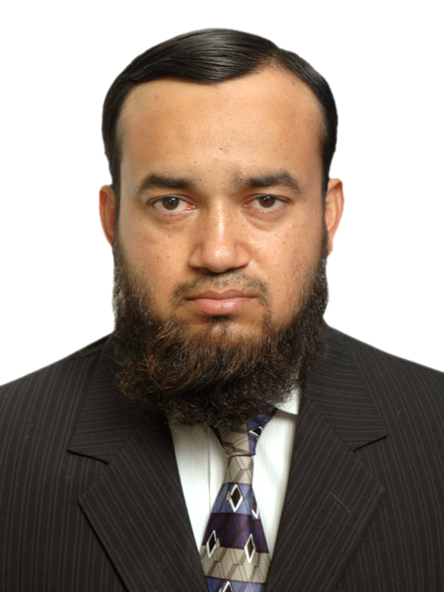
ABOUT THE TRAINER
Abdul Aziz Khan
Trainer, BrainsWork
Abdul Aziz Khan is a seasoned Telecom and IT professional, currently working as a DevOps engineer for a Fortune 500 financial company. A long-time practitioner turned teacher, he built this course to make security concepts concrete through real, hands-on labs rather than slides alone. Open, candid, and always glad to talk shop.
khan.abdulaziz@gmail.com | linkedin.com/in/abdulazizk

