Slide 1
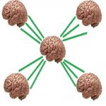
DAY 18
Session Hijacking via XSS: Stealing a Cookie Instead of Stealing a Password
Security Tutor — CEH-Track Program

Slide 2
THE HOOK
[SCREEN: terminal showing the attacker collector's log line] Here's a line I watched scroll across my screen a few minutes into today's lab: `GET /steal?c=session_id=330c79bc050105142d6410058cd5f95b`.
That's it.
That one line meant I now had full, working access to someone else's logged-in account — not their password, not their email, nothing they typed.

Slide 3
WHAT WE'LL COVER
what a session hijack actually needs
reintroducing the XSS hole, on purpose
building the theft payload
watching the theft happen
proving the hijack is real, not theoretical
Common mistake & correction
Recap & quiz

Slide 4
CONCEPT
what a session hijack actually needs
Quick refresher on the mechanics, because it matters for what's coming.
When you log into a site, the server doesn't re-check your password on every click — it hands your browser...
The server looks up that ID and treats you as whoever it belongs to.
No further questions asked.

Slide 5
CONCEPT
reintroducing the XSS hole, on purpose
I went back to the exact same vulnerable app from Day 14 — a small Flask app with a guestbook...
Back then, I fixed its stored-XSS bug by removing a template filter called `|safe`, which tells Flask to skip its...
For today's lab, I deliberately put that vulnerability back, and I added something Day 14's app didn't have: an actual...
Two realistic vulnerabilities, stacked, which honestly isn't rare — a lot of real breaches come from exactly this kind of...

Slide 6
CONCEPT
building the theft payload
Here's the payload I submitted into the guestbook as my "name": an image tag pointing at a URL that doesn't...
Browsers are very good at silently failing to load broken images — but that `onerror` event still fires, and it'll...
That's a classic way to sneak script execution past a filter that only thinks to block literal `<script>` tags.
Inside that handler, I called `fetch()`, pointed at a second little server I'd stood up on port 8000, and appended...

Slide 7
CONCEPT
watching the theft happen
On the other side, I had Python's built-in `http.server` running — nothing fancy, it's not even built to receive stolen...
The moment I, playing the victim, loaded the guestbook page while logged in, that terminal lit up with a request...
My browser did exactly what browsers always do — attached the cookie automatically and ran the page's JavaScript — and...

Slide 8
CONCEPT
proving the hijack is real, not theoretical
This is the part I think matters most, and it's the part that turns "huh, interesting" into "oh no." I...
The response: "Welcome, alice!" No password.
No login form.
No second factor.

Slide 9
COMMON MISTAKE
I want to flag a mix-up I made myself in the review questions, because I think it's a genuinely common...
I answered a question about `SameSite=Strict` by saying it would have blocked today's attack, reasoning that it stops cross-site scripts...
That's wrong, and it's worth being precise about why: `SameSite` controls one narrow thing — whether a browser attaches a...
It has nothing to do with where JavaScript is allowed to execute, and nothing to do with whether `document.cookie` can...

Slide 10
RECAP
Three things to hold onto from today.
First: a live session cookie is just as valuable to an attacker as a password, and in some ways more...
Second: `HttpOnly` blocks JavaScript from reading a cookie, but it does not stop the browser from sending that cookie automatically...
Third: fixing the symptom isn't the same as fixing the cause — after I applied `HttpOnly`, the stolen cookie came...

Slide 11
QUIZ — PAUSE AND THINK
One: what's the structural difference between what I did today and session fixation from Day 17, in terms of what the attacker needs to obtain?
Two: does `HttpOnly` stop a browser from sending a cookie on a normal request, like a `fetch()` call with credentials included?
Three: would `SameSite=Strict` have prevented today's specific attack — cookie theft via a stored XSS payload on the same site as the cookie?

Slide 12
TAKEAWAY
If there's one line to take away from today, it's this: cookie-protection attributes are narrow, single-purpose tools, not general-purpose session security — real defense needs several of them layered together,...
If you've been following this series, you've now seen the full session-attack trio — CSRF, SSRF, and both flavors of session hijacking — all built, exploited, and fixed by hand....

Slide 13
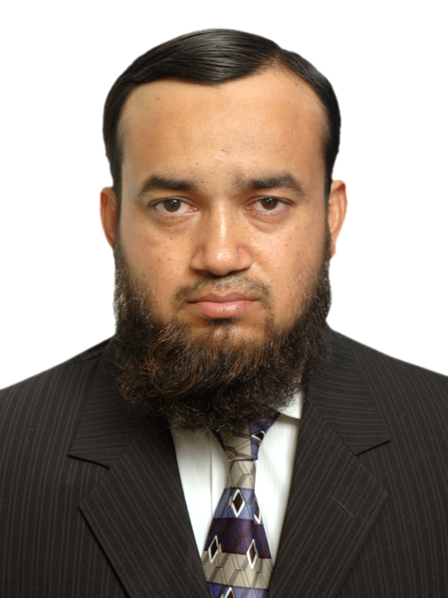
ABOUT THE TRAINER
Abdul Aziz Khan
Trainer, BrainsWork
Abdul Aziz Khan is a seasoned Telecom and IT professional, currently working as a DevOps engineer for a Fortune 500 financial company. A long-time practitioner turned teacher, he built this course to make security concepts concrete through real, hands-on labs rather than slides alone. Open, candid, and always glad to talk shop.
khan.abdulaziz@gmail.com | linkedin.com/in/abdulazizk

