Slide 1
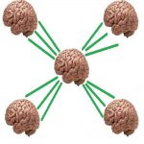
DAY 19
SameSite Cookies, CSRF Token Delivery, and Origin vs. Site
Security Tutor — CEH-Track Program

Slide 2
THE HOOK
Here's a weird one: I built a lab specifically to prove that a cookie marked `SameSite=Strict` — the strictest possible cookie protection a browser offers — gets sent on a forged cross-site attack anyway.
Not a bug in the browser.
Not a bug in my code.

Slide 3
WHAT WE'LL COVER
what SameSite actually governs
building the test lab [REAL LAB]
the confusing first result
the real result
CSRF token delivery, revisited
Common mistake & correction
Recap & quiz

Slide 4
CONCEPT
what SameSite actually governs
Quick recap of cookies: a cookie is just a name/value pair the server tells your browser to store, and the...
That auto-attach behavior is exactly what makes CSRF (cross-site request forgery) possible: an attacker's page can trigger a request to...
`SameSite` is the attribute designed to stop that.
It has three values.

Slide 5
CONCEPT
building the test lab [REAL LAB]
To actually see this in action, I extended an existing CSRF lab from a few weeks back — a Flask...
I added three parallel cookies on login: `session` (no explicit SameSite, relying on browser default), `session_lax`, and `session_strict`.
Then a new endpoint, `/csrf-test`, that does zero CSRF-token checking — pure cookie auth — specifically so SameSite was the...
On the attacker side, I built two attack vectors: an auto-submitting form that fires a cross-site POST the instant the...

Slide 6
CONCEPT
the confusing first result
Here's where it got interesting.
I ran the attack — both apps on `127.0.0.1`, just different ports, `5000` for the bank and `5001` for evil.
The result: *all three cookies arrived*, including `session_strict`.
That should be impossible.

Slide 7
CONCEPT
the real result
This time, the POST attack came back with all three cookies as `null` — blocked, across the board, including the...
That's actually expected too: modern browsers silently default unattributed cookies to `Lax` behavior, and Lax blocks cross-site POSTs regardless.
Then the GET link-click test: `session` and `session_lax` came through with their real value, `session_strict` came back `null`.
That's the textbook asymmetry, finally proven for real: `Strict` blocks everything, no exceptions, even a plain link click.

Slide 8
CONCEPT
CSRF token delivery, revisited
With SameSite nailed down, I asked for a refresher on how a CSRF token actually reaches the browser in the...
The answer: the server generates a random, unguessable token and embeds it directly in the HTML of a page the...
The attacker's page can *trigger* a request to the real site (that's the whole CSRF problem), but it can't *read...
So the attacker has no way to ever get a valid token into their forged request.

Slide 9
COMMON MISTAKE
My review-question answers needed two real corrections today.
First, I described `HttpOnly` as stopping JavaScript from running or reading the page — way too broad.
It actually does one narrow thing: it hides that *specific* cookie's value from `document.cookie`.
JavaScript keeps running completely normally otherwise; if a page has three cookies and only one is `HttpOnly`, the other two...

Slide 10
RECAP
Three things to hold onto: `SameSite` controls whether a cookie is *sent*, `HttpOnly` controls whether a cookie is *readable* by...
"Site" (scheme + registrable domain) is a broader category than "origin" (scheme + host + port) — every origin belongs...
And a CSRF token works because the attacker can trigger a request but can never read the response that would...
Think about browser compliance, and about what counts as "the same site."

Slide 11
QUIZ — PAUSE AND THINK
Pause here and answer this one yourself: if a cookie had `SameSite=Strict` set, would you still need a CSRF token on that endpoint?
Why or why not?

Slide 12
TAKEAWAY
Operational takeaway for today: never trust a `SameSite`/CSRF test run locally on the same host with just different ports — use genuinely different hostnames, because port is invisible to the...
If you're working through your own security fundamentals, follow along for Day 20 — drop your answer to today's quiz question in the comments first.

Slide 13
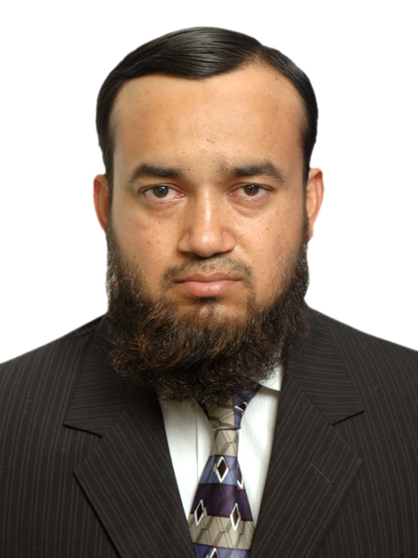
ABOUT THE TRAINER
Abdul Aziz Khan
Trainer, BrainsWork
Abdul Aziz Khan is a seasoned Telecom and IT professional, currently working as a DevOps engineer for a Fortune 500 financial company. A long-time practitioner turned teacher, he built this course to make security concepts concrete through real, hands-on labs rather than slides alone. Open, candid, and always glad to talk shop.
khan.abdulaziz@gmail.com | linkedin.com/in/abdulazizk

