Slide 1
GROUP 4 · CSCI 5502 · SPRING 2026
CORE RESEARCH QUESTION
Grid Resilience
& Carbon Analytics
Can hazardous grid events be automatically characterized by distinct electricity demand
and marginal CO₂ emission profiles using publicly available, high-resolution data?
DATA PIPELINE
📡
⚡
🚨
⚙️
Characterizing Electricity Demand and
Marginal CO₂ Emissions During Hazardous Grid Events
WattTime API
EIA-930 API
Event Catalog
Feature Eng.
5–15 min MOER
(lbs CO₂/MWh)
CAISO region
Hourly electricity
demand (MW)
2019–2026
52 hazardous events
PSPS · weather
equipment failures
Rolling stats · lag
features · deviation
baselines · encoding
WHY THIS MATTERS
APPROACH
Hazardous grid events — PSPS, extreme heat, equipment failures — force utilities to activate carbon-intensive peakers, spiking marginal CO₂ emissions 15–40%.
This cost is invisible in annual averages. We build the first reproducible pipeline to couple demand and emissions analysis across 52 documented events (2019–2026).
01
Baseline construction
02
Feature extraction
Seasonal matching + moving avg + ML-predicted baselines — triangulated for robustness
Peak magnitude · duration · volatility · recovery · coupling coefficients per event
03
Clustering & pattern mining
04
Supervised learning
K-Means archetypes + FP-Growth co-occurrence rules across 1,725 observations
Logistic + Linear regression to quantify predictive signal and demand–MOER decoupling
3.5M+
42%
40%
2.1M
96.8%
52
15 features
Customers affected
by PSPS (2019–24)
Increase in
grid disruptions
Emissions spike
during events
Records post-cleaning
Data completeness
Validated events
Per 15-min observation
TEAM
Moulik Kumar · Atharva Zodpe · Pratik Patil
🌐 aazodpe.github.io | github.com/aazodpe/aazodpe.github.io
Data Mining · CSCI 5502 · University of Colorado Boulder · Spring 2026

Slide 2
CHALLENGES IN DATA COLLECTION, PROCESSING & MODELING
Milestones 2 & 3
DATA COLLECTION & PROCESSING
MODELING CHALLENGES
CODE HIGHLIGHT
🔗
Multi-resolution alignment
🎯
K-Means: limited temporal window
# K-Means sweep
for k in range(2, 9):
WattTime at 5–15 min vs. EIA-930 at hourly — demanded resampling, forward-fill, and uniform 15-min UTC indexing across both streams without losing event signal.
18-day window anchors clusters to single heat-wave episode. Mitigated by weighting hour + is_weekend alongside instantaneous readings.
km = KMeans(
n_clusters=k,
n_init=10)
sil.append(
silhouette_score(
X_sc, labels))
❌
Missing & corrupt values
📉
Logistic Reg: tiny event sample
# Best k=4
3.2% missing demand, 1.8% missing MOER. Forward-fill for <30 min gaps; linear interpolation for 30 min–2 hr; 142 negative demand values and 28 physically impossible emissions corrected.
Only 23 event-level records. 5-fold CV folds have ~5 samples each — accuracy is volatile. ROC-AUC (0.65) prioritized as the stable ranking metric.
best_k = range(2,9)[
np.argmax(sil)]
# FP-Growth
freq = fpgrowth(
📋
No API for hazardous events
📐
Linear Reg: OLS vs. non-linearity
te_df,
min_support=0.30)
Hand-compiled 52 events from CPUC filings, NOAA alerts, utility press releases. PDF extraction + cross-validation against news archives. High labor, irreplaceable for event-level labels.
Emergency dispatch breaks the merit-order demand–MOER curve. is_event indicator added iteratively; low R²=0.237 treated as the finding, not a failure.
rules = assoc_rules(
freq,
metric='confidence',
min_threshold=0.60)
📊
Baseline construction complexity
🌳
FP-Growth: event period too rare
# Logistic pipeline
pipe = Pipeline([
Three parallel strategies required — seasonal matching, moving average, and ML-based prediction — to triangulate event impact without attributing normal seasonal variation to events.
Event windows are only 22.3% of obs (support < 0.30). Event rules present but below top-10 lift. min_support not artificially lowered.
('imp', SimpleImputer()),
('sc', StandardScaler()),
('clf', LogisticRegression(
class_weight='balanced',
max_iter=1000))])
# CV ROC-AUC = 0.65
WHAT THESE CHALLENGES REVEALED
cv = StratifiedKFold(5)
cross_validate(pipe,X,y)
⚡ Two granularities, two datasets
📉 Low R² = the signal, not noise
🔬 Event rarity limits supervised learning
15-min time-series (1,725 rows) for clustering & regression; 23-row event-level CSV for classification. Same project, two fundamentally different analytical units.
OLS explains only 23.7% of MOER — intentionally. Emergency dispatch overrides the normal demand–carbon curve. Richer features (fuel mix, weather) are the Milestone 4 extension.
52 events over 7 years → only 23 usable for event-level ML. The small-n constraint drove every pipeline decision: stratified CV, balanced classes, AUC over accuracy.
Grid Resilience & Carbon Analytics · Group 4

Slide 3
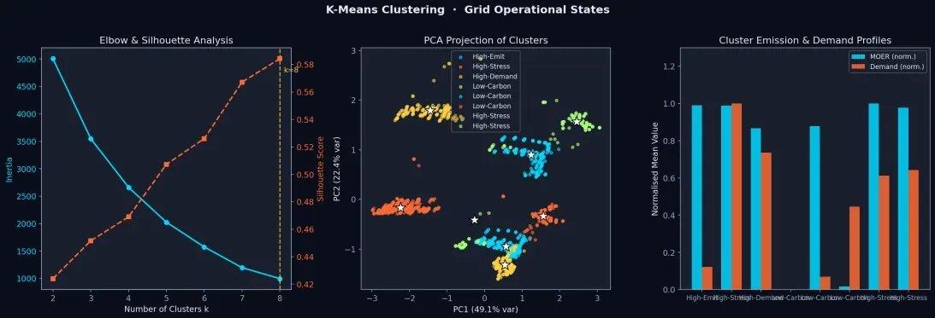
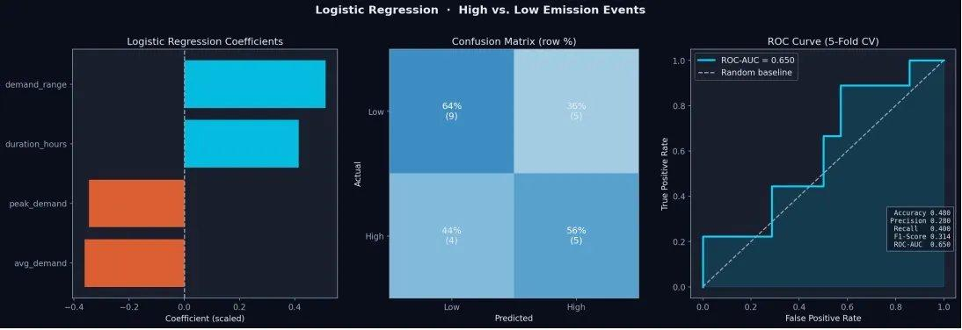
MODEL RESULTS & KEY LESSONS LEARNED
Milestones 3 & 4
MODEL PERFORMANCE SUMMARY
UNSUPERVISED
CLASSIFICATION
REGRESSION
PATTERN MINING
K-Means Clustering
Logistic Regression
Linear Regression
FP-Growth
Silhouette
Davies-Bouldin
CV ROC-AUC
CV F1-Score
R²-Score
RMSE
Max Lift
Rules
0.584
0.632
0.65
0.314
0.237
105.4
1.77
34
4 grid archetypes: High-Stress · High-Emit · High-Demand · Low-Carbon
demand_range & duration_hours are strongest predictors of high-emission events
76% of MOER variance unexplained — demand alone cannot represent emergency dispatch
off_peak → high_demand rule reveals heat-wave demand shifts normal diurnal patterns
K-MEANS · GRID STATE ARCHETYPES
LOGISTIC REG · ROC CURVE
KEY LESSONS LEARNED
1
Events decouple demand & emissions
R²=0.237 is the finding — emergencies break the normal demand–carbon curve, not a model failure.
2
Duration > peak intensity
Event duration (r=0.84 with total excess CO₂) dominates over peak spike size (r=0.29).
3
API-first pays off
CONVERGING FINDING
Reproducible, real-time capable pipeline vs. static Kaggle data. Code publicly released.
The low R² of Linear Regression, the modest ROC-AUC of Logistic Regression, and the off_peak → high_demand FP-Growth rule all converge on the same conclusion: hazardous grid events do not simply amplify normal operating patterns — they create fundamentally different demand–carbon dynamics that standard demand-driven models cannot represent.
4
Two granularities needed
15-min time-series for clustering/regression; event-level for classification. Different questions, different units.
aazodpe.github.io · github.com/aazodpe/aazodpe.github.io · Group 4 · CU Boulder

