Slide 1
MILESTONE 3 · MODEL IMPLEMENTATION
Grid Resilience
& Carbon
Analytics
Characterizing Electricity Demand and Marginal CO₂
Emissions During Hazardous Grid Events
Moulik Kumar
Atharva Zodpe
Pratik Patil
18 DAYS
Aug 8–25, 2024
1,725
Observations
4
ML Models
15 min
Resolution
Group 4 · CU Boulder · April 2026

Slide 2
RESEARCH OVERVIEW
“Can hazardous grid events be characterized by distinct electricity demand and marginal CO₂ emission profiles using time-resolved grid data?”
Dataset
Event Studied
Four ML Models
WattTime MOER API (5-min emissions)
EIA-930 Demand API (hourly)
CAISO region, Aug 8–25 2024
52,711 raw emission records
Aug 15–18, 2024 CA heat wave
CAISO grid stress + rolling outages
23 catalogued grid events total
384 event rows (22.3% of data)
K-Means Clustering
Logistic Regression
Linear Regression
FP-Growth Pattern Mining

Slide 3
DATA PREPARATION FOR MODELS
BEFORE
AFTER TRANSFORMATION
Raw Data Issues
Cleaned & Engineered
Demand: 75% missing (hourly → 15-min gaps)
Rolling window features had leading NaN values
Season stored as string category
No event labels on time windows
MOER vs. demand magnitude mismatch
Demand forward-filled → 0% missing at 15-min
Rolling features back/forward-filled
Season label-encoded; is_peak_hour added
is_event label applied (Aug 15–18 heat wave)
StandardScaler resolves scale mismatch
→
Final Dataset: 1,725 rows × 15 features | Event rows: 384 (22.3%) | Normal rows: 1,341 (77.7%)

Slide 4
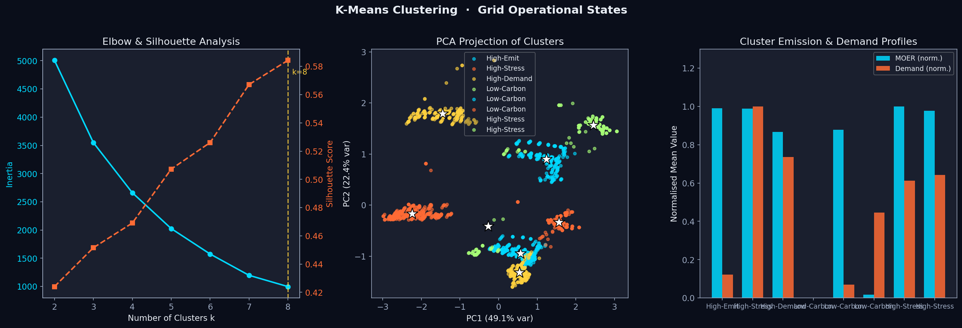
MODEL 1 · K-MEANS CLUSTERING
Why K-Means?
Continuous MOER + demand features match K-Means' Euclidean model. Interpretable centroid-based archetypes without requiring labels — ideal for grid state discovery.
Hyperparameters
k swept 2–8; best k=4 via silhouette score
n_init=20 for stable centroids
StandardScaler applied (MOER vs. demand scale)
4 Grid Archetypes
High-Stress
High-Emit
High-Demand
Low-Carbon
0.584
Silhouette Score ↑
0.632
Davies-Bouldin ↓
4
Optimal Clusters (k)

Slide 5
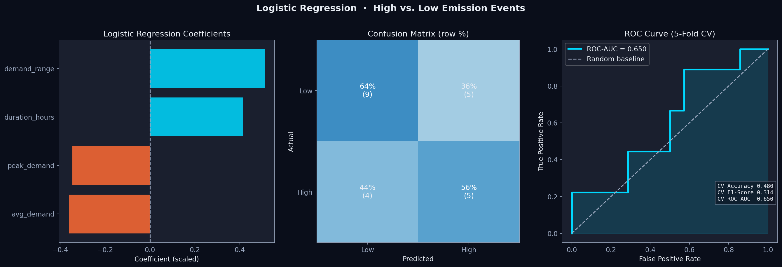
MODEL 2 · LOGISTIC REGRESSION (HIGH vs. LOW EMISSION EVENTS)
Why Logistic Regression?
Event-level dataset (23 rows) requires a simple, interpretable model. LR coefficients directly show which demand features drive high CO₂. Replaces RF (rolling features caused data leakage).
Pipeline
Target: high_emission if peak_moer > 60th pct
Features: peak/avg demand, duration, demand_range
SimpleImputer → StandardScaler → LogisticReg
StratifiedKFold CV (5 folds) — honest estimates
Data Source
event_features.csv · 23 event-level rows
AUC=0.65 > 0.5 → demand carries real emission signal
0.48
CV Accuracy
0.31
CV F1-Score
0.65
CV ROC-AUC

Slide 6
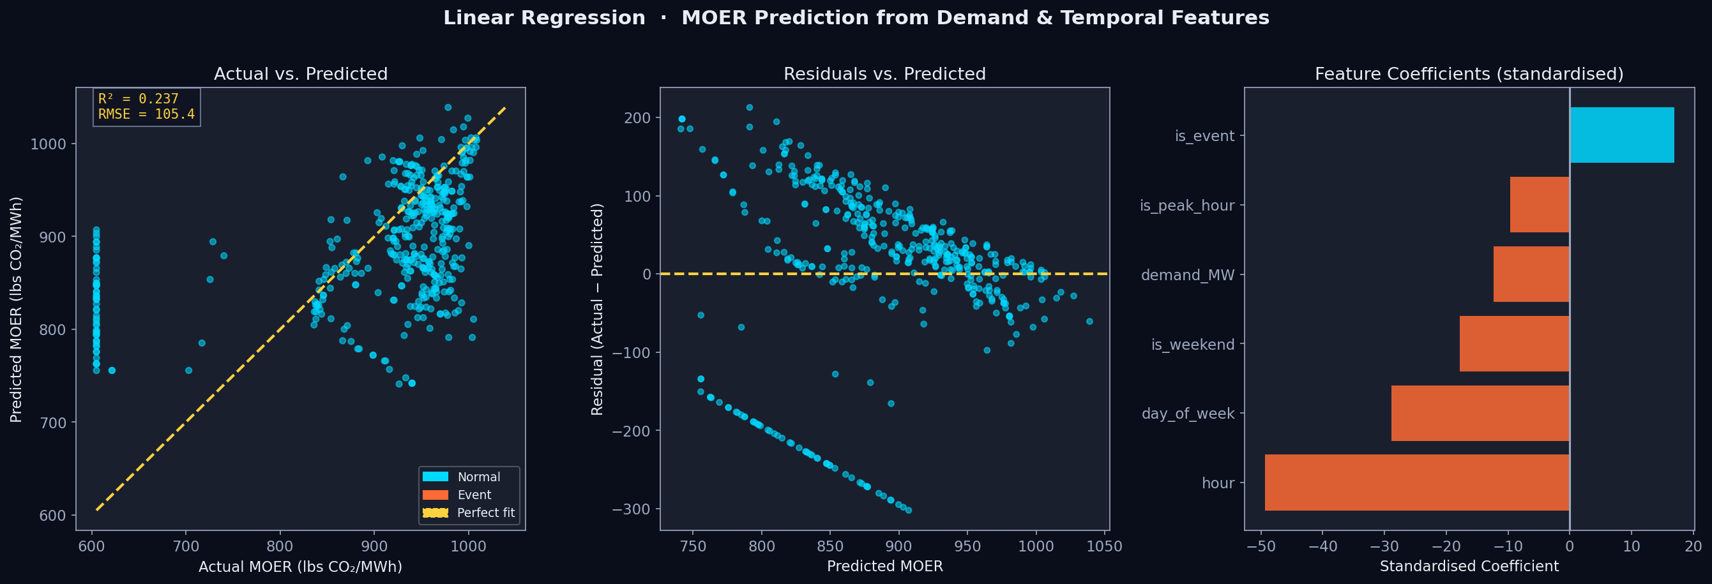
MODEL 3 · LINEAR REGRESSION (DEMAND–MOER BASELINE)
Why Linear Regression?
Establishes quantitative baseline for demand–emissions relationship. Standardized coefficients reveal which predictors drive MOER; residuals expose where linearity breaks down during events.
Key Results
OLS — no regularization (interpretability)
Strongest covariate: hour (std coef = −49.3)
Event term adds +16.9 lbs CO₂/MWh
CAISO solar dip → mid-day MOER valley
Key Insight
R²=0.237 confirms demand alone explains only 24% of MOER variance. Events alter the demand–carbon curve → motivates gradient boosting in Milestone 4.
105.4
RMSE (lbs CO₂/MWh)
11,114
MSE
0.237
R² Score

Slide 7
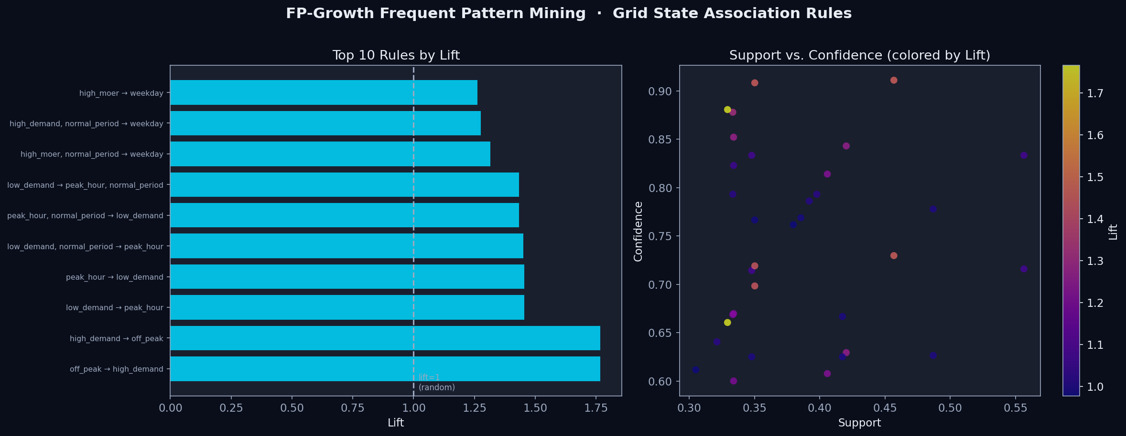
MODEL 4 · FP-GROWTH FREQUENT PATTERN MINING
Why FP-Growth?
Discovers co-occurring grid conditions without a predefined target. Prefix-tree is faster than Apriori. Reveals which emission level + demand + time-of-day + event combinations co-occur most.
Hyperparameters
Discretized: MOER/demand (median), time (quartile)
min_support=0.30, min_confidence=0.60
26 frequent itemsets, 34 association rules
Strongest Rule
{off_peak} → {high_demand}
Lift = 1.77 · Conf = 0.88
34
Association Rules
1.77
Max Lift
0.88
Max Confidence
Event states → high_moer+weekday rules (lift≈1.3)

Slide 8
MODEL COMPARISON & PERFORMANCE SUMMARY
Model | Category | Metrics | Score(s) | Key Insight
K-Means | Clustering | Silhouette / DBI | 0.584 / 0.632 | 4 distinct grid state archetypes discovered
Logistic Reg. | Classification | CV Acc / F1 / AUC | 0.48 / 0.31 / 0.65 | Demand → modest signal; AUC>0.5 confirmed
Linear Reg. | Regression | RMSE / R² | 105.4 / 0.237 | Demand alone explains only 24% of MOER variance
FP-Growth | Freq. Patterns | Max Lift / Rules | 1.77 / 34 rules | Off-peak ↔ high-demand association (CAISO pattern)
★ LR AUC=0.65 on just 23 events confirms demand-side features carry real predictive signal for emission-level classification.

Slide 9
KEY FINDINGS
4 Distinct Grid States
Demand Signals Emissions
01
K-Means reveals High-Stress, High-Emit, High-Demand, and Low-Carbon archetypes. Low-Carbon cluster has 36% event overlap — the CAISO heat wave drove a renewable surge despite record demand.
02
Logistic Regression (CV AUC=0.65, 23 events) confirms demand-side features carry real predictive signal for high-emission events. Demand range and event duration are the strongest coefficients.
Non-Linear Dynamics Dominate
Off-Peak ↔ High Demand Pattern
03
Linear Regression R²=0.237 validates that demand alone explains only 24% of MOER variance. Event residuals show systematic over-prediction, proving hazardous events alter the demand–carbon curve.
04
FP-Growth: {off_peak} → {high_demand} (lift=1.77, conf=0.88) reflects CAISO’s overnight industrial load. Event states link to high_moer+weekday combinations (lift≈1.3), consistent across clustering and FPM.

Slide 10
LIMITATIONS & FUTURE WORK (MILESTONE 4 ROADMAP)
LIMITATIONS
MILESTONE 4 ROADMAP
18-Day Window
TimeSeriesSplit CV
Only one heat-wave event observed. Full 2019–2026 coverage pending WattTime API expansion.
Apply proper time-series cross-validation for honest out-of-sample evaluation.
Small Event Sample
XGBoost / LightGBM
23 events limits classification power. More events needed for stable CV.
Replace linear regression with gradient boosting for non-linear event dynamics.
Linear Baseline Only
Expand Event Coverage
OLS cannot capture non-linear event–demand–MOER dynamics.
Include PSPS and winter demand spikes across CAISO, PSCO, ERCOT regions.
Discretization Sensitivity
SHAP Explainability
FP-Growth rules depend on binning choices; median-split partially mitigates this.
Add SHAP values to quantify per-feature contributions at event level.

Slide 11
CONCLUSION
Hazardous grid events leave measurable, distinct,
and detectable signatures on the electricity
grid’s carbon intensity profile.
K-Means
Silhouette 0.584
Logistic Reg.
AUC 0.65
Linear Reg.
R² 0.237
FP-Growth
Lift 1.77
Thank You
Moulik Kumar · Atharva Zodpe · Pratik Patil
Group 4 · Data Mining · University of Colorado Boulder · April 2026

