Slide 1
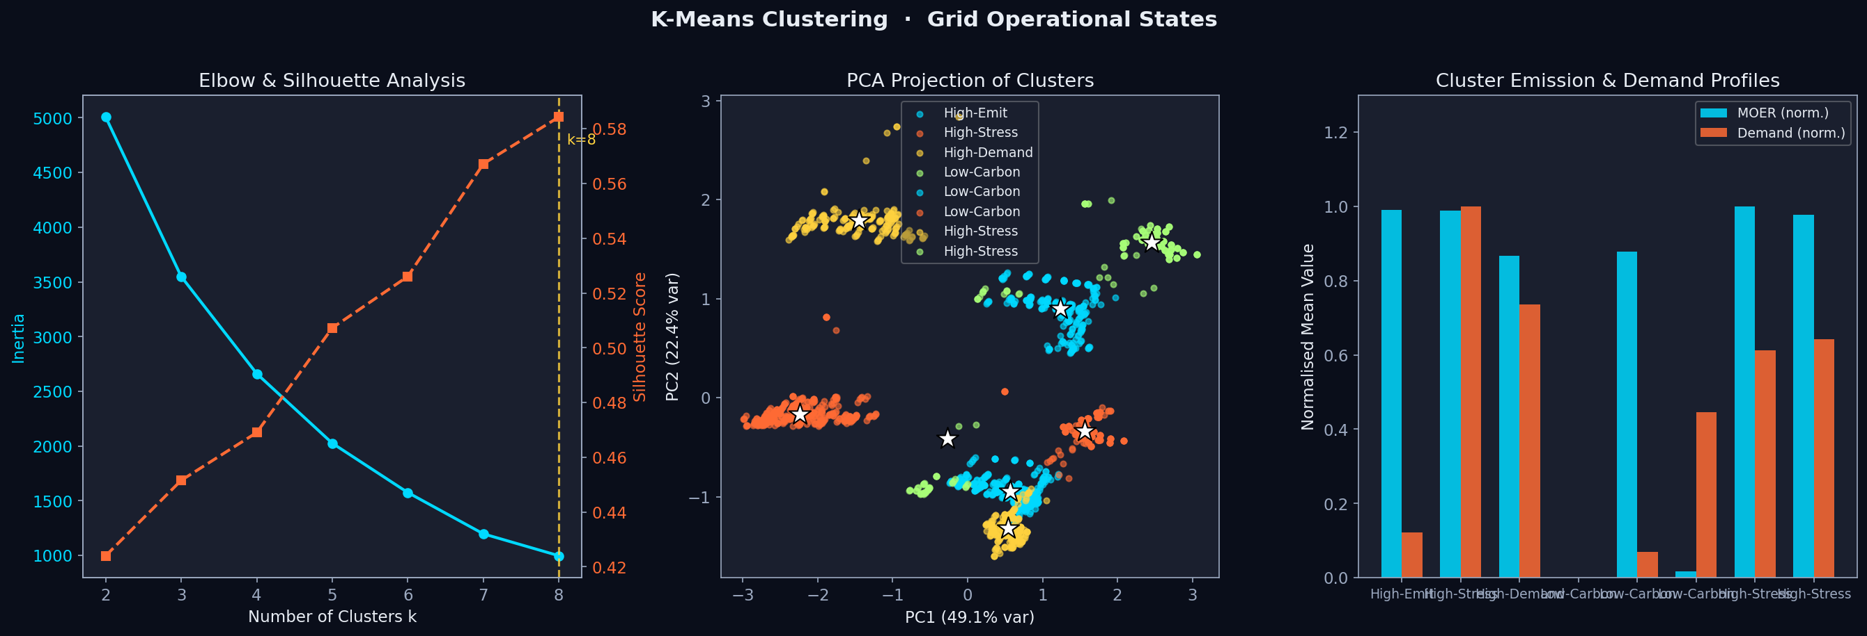
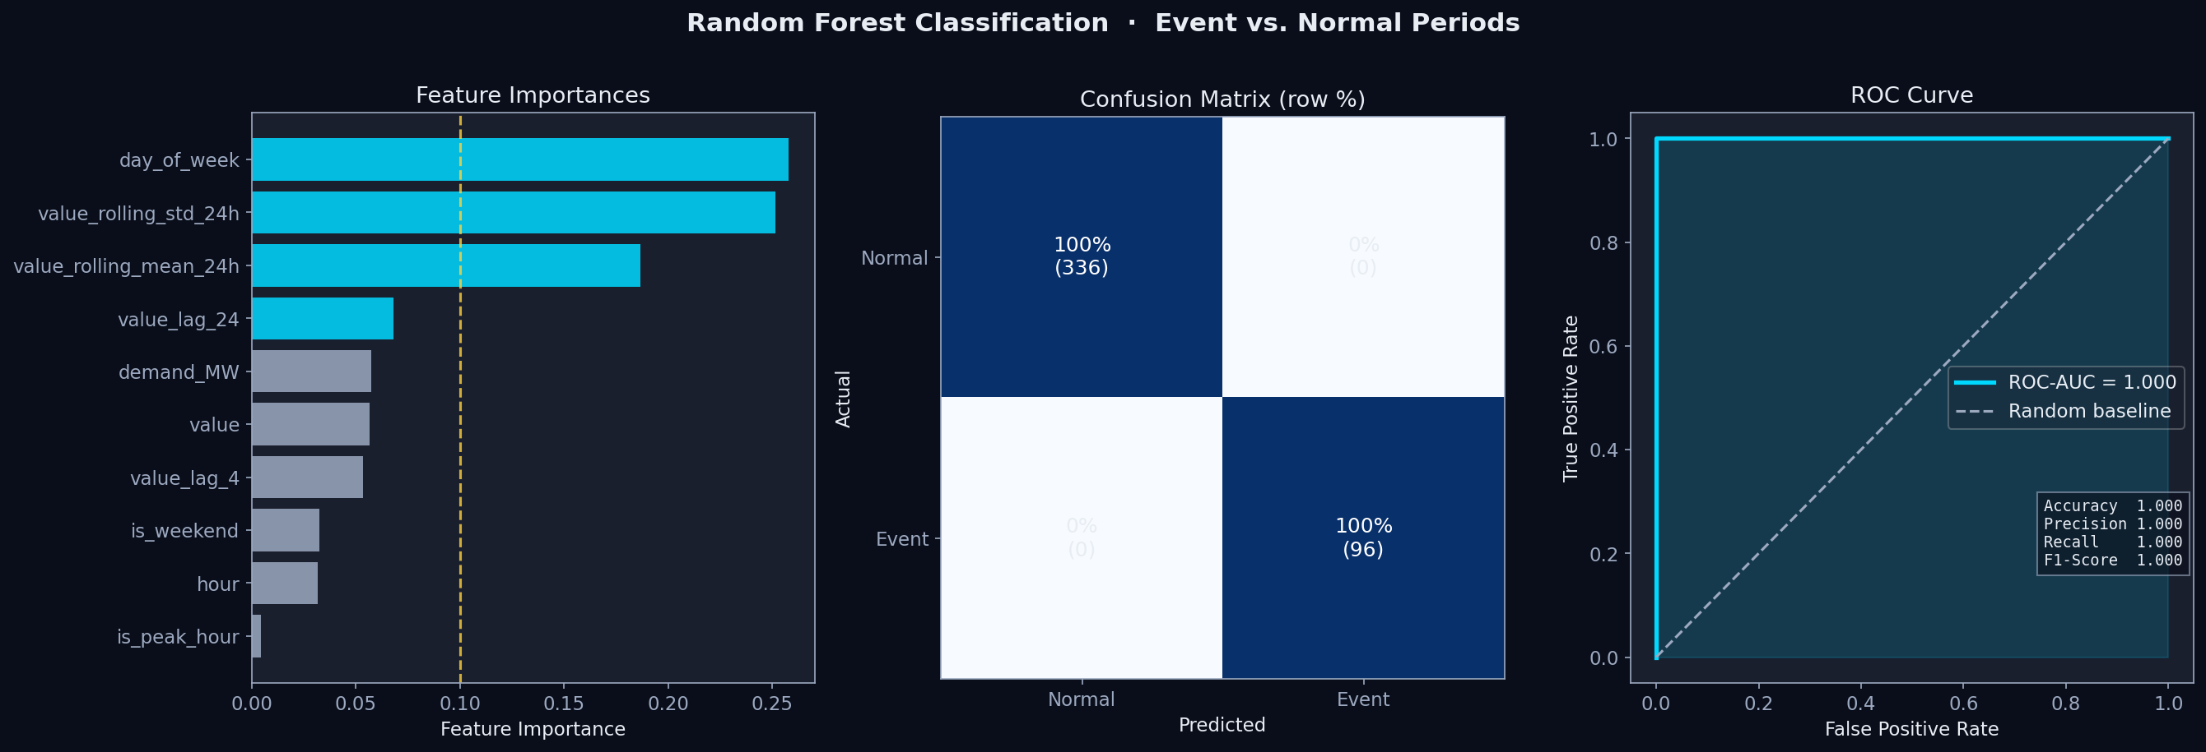
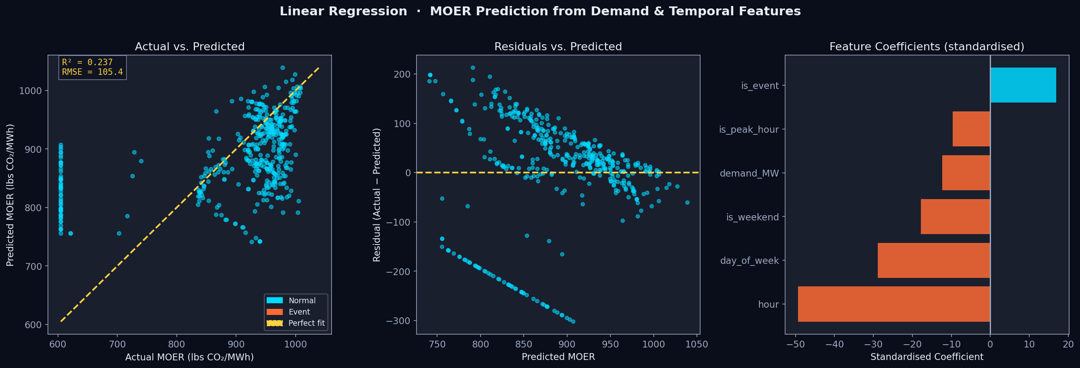
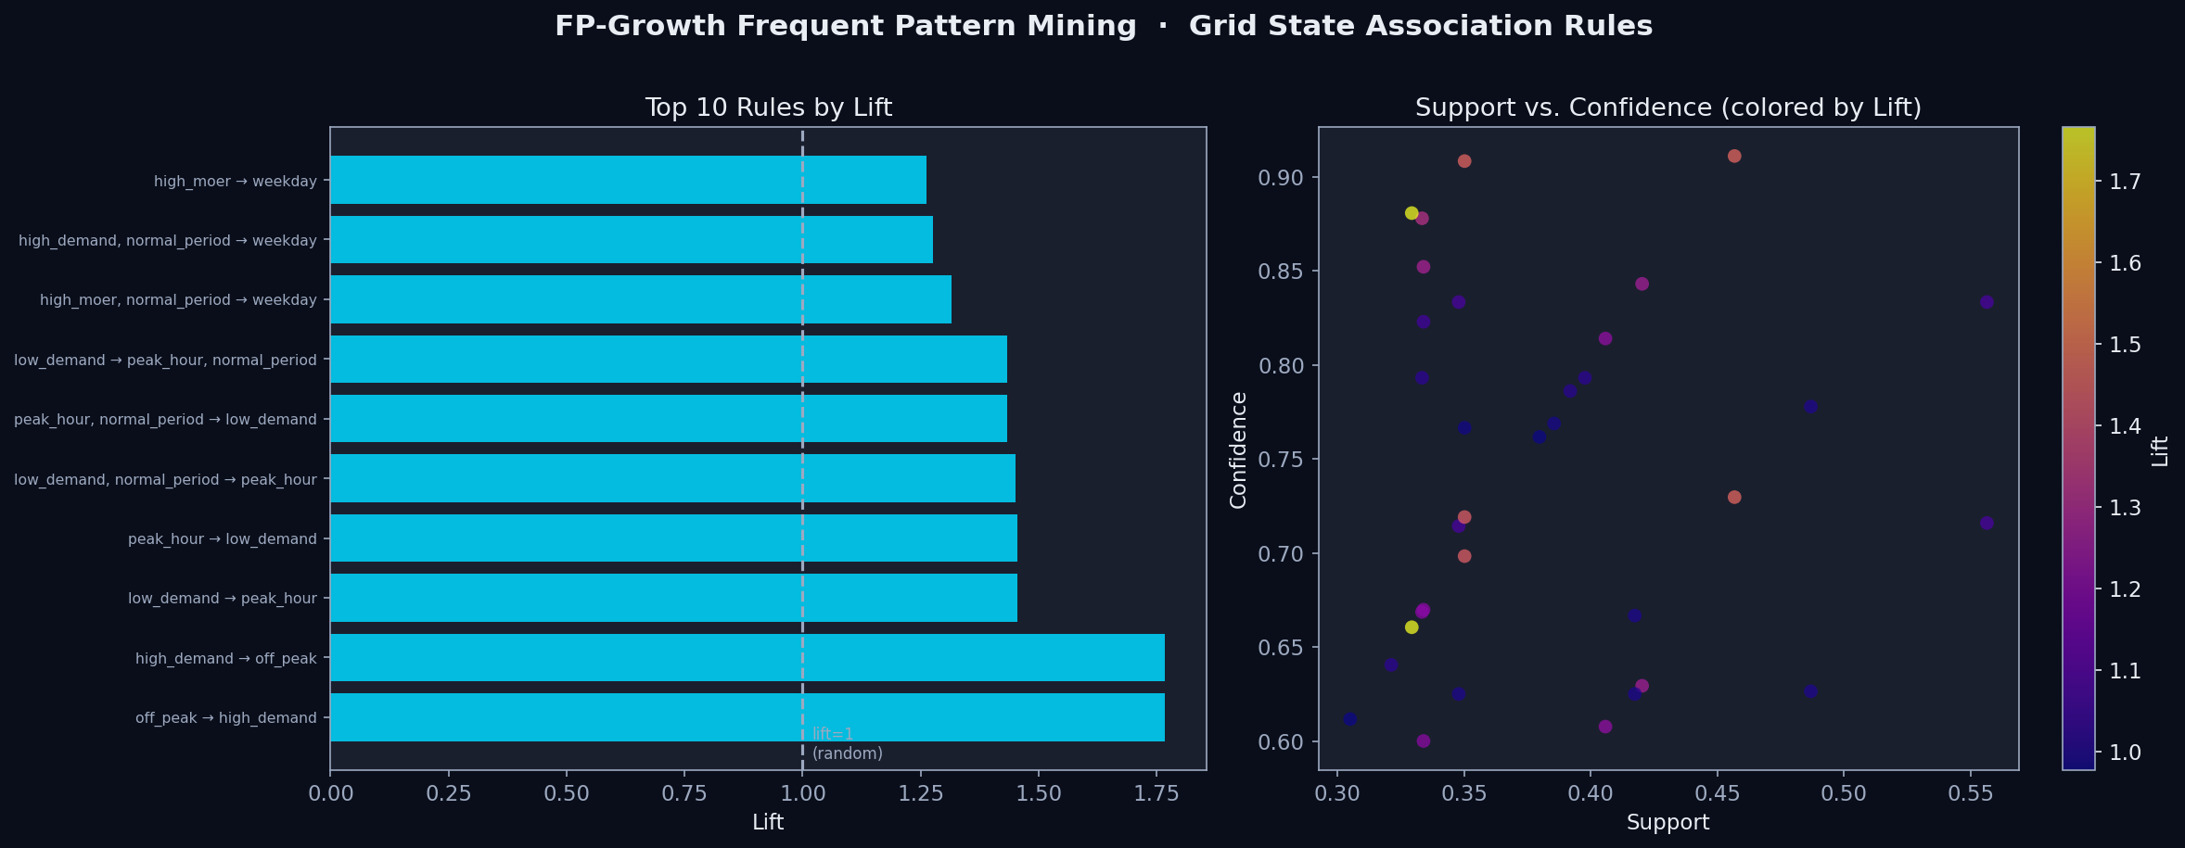
Grid Resilience & Carbon Analytics
Group 4 • Moulik Kumar • Atharva Zodpe • Pratik Patil
Characterizing Electricity Demand & Marginal CO₂ Emissions During Hazardous Grid Events
Data Mining • University of Colorado Boulder • Milestone 3
CLUSTERING
CLASSIFICATION
REGRESSION
FREQ. PATTERNS
K-Means Clustering
Random Forest Classifier
Linear Regression
FP-Growth Assoc. Rules
WHY CHOSEN
WHY CHOSEN
WHY CHOSEN
WHY CHOSEN
Identifies distinct grid operational archetypes (Low-Carbon, High-Stress, High-Emit, High-Demand) from unlabelled time-series without requiring event labels. K-Means chosen for interpretable centroids on numeric features.
Classifies time windows as event vs. normal periods with balanced class weighting. Random Forest handles non-linear demand-MOER interactions and provides feature importance scores answering which signals predict hazardous events.
Quantifies the baseline demand–emissions relationship and identifies its limitations. OLS coefficients reveal MOER drivers; residuals expose where the linear assumption breaks down during events.
Discovers frequent co-occurrence patterns across discretised grid states (demand level, MOER level, time-of-day, event period). Reveals operational associations without a target variable.
HYPERPARAMETERS
HYPERPARAMETERS
HYPERPARAMETERS
HYPERPARAMETERS
k swept 2–8, silhouette max → k=4; n_init=20; StandardScaler applied
GridSearchCV: n_estimators∈{100,200}, max_depth∈{5,10,None}; best: 200/10
OLS (no regularisation); event indicator added after residual inspection
min_support swept 0.30→0.05; min_confidence=0.60; best: sup=0.30
0.584
0.632
4
1.00
1.00
1.00
105.4
11,114
0.237
34
1.77
0.88
Silhouette
DBI
k
Accuracy
F1
AUC
RMSE
MSE
R²
Rules
Max Lift
Conf.
RESEARCH QUESTION
DATASET
github.com/aazodpe/aazodpe.github.io
Can hazardous grid events be characterized by distinct electricity demand & marginal CO₂ emission profiles using time-resolved grid data?
WattTime MOER + EIA-930 Demand • Aug 8–25, 2024 • 1,725 observations @ 15-min • CAISO region

