Slide 1

High Avaibility & Load Balaning
Services and networks administration

Slide 2
PLAN
Definition
Clustering
Load Balancing
Redondance
Duplication
Conclusion

Slide 3








Introduction

Slide 4

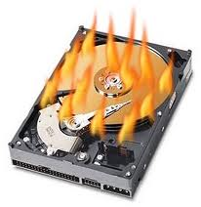


Problematic 1/3
Users dissatisfaction
Data Loss
Money loss

Slide 5






Problematic 2/3
$21,800,000,000
691.27 $/second
$19,166,000,000
607.75 $/second
$7,200,000,000
228.31 $/second
$6,290,000,000
199.45 $/second
$3,214,000,000
101.92 $/second
* In 2009 from www.chrogeek.com

Slide 6



Problematic 3/3
207 381 $
182325 $
68493 $
5 min of Downtime
59835 $
30576 $

Slide 7


High Avaibility
system design approach and associated service implementation that ensures continuity of service.
Reduce the downtime

Slide 8
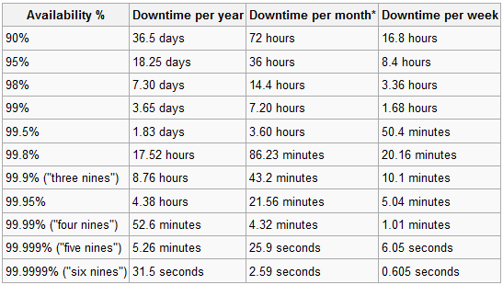
Downtime
Availability % | Downtime per year
90% | 36,5 days
95% | 18,25 days
97% | 10,96 days
98% | 7,30 days
99% | 3,65 days
99,5% | 1,83 days
99,8% | 17,52 hours
99,9% | 8,76 hours
99,95% | 4,38 hours
99,99% | 52,56 minutes
99,999% | 5,26 minutes
99,9999% | 31,5 seconds

Slide 9
What is the High Availability?
A Highly Available material is a material
providing full-time availability even when
failures occurs.
What is the Fault Tolerance?
The Fault Tolerance is the capacity of a material to ensure the data availability in case of a failure occurs. It provides full-time checking and
redundancy devices to perform high availability.

Slide 10

Unplanned Downtime: Causes

Slide 11

Downtime costs

Slide 12
Measuring Availability
MTTF : Mean Time To Failure : time before the failure
MTBF : Mean Time Between Failure : time between two breakdowns
MTTR : (Mean Time to Resolution) : estimated time to restore the system
MTBF = MTTF + MTTR

Slide 13
Measuring Availability
MDT : Mean Down Time : the average time that a system is non-operational
MUT : Mean Up Time : is defined as the continuous operational time
MTBF = MUT + MDT
Availability = MTTF/MTBF

Slide 14

How to reduce downtime ?
Reducing downtime
Avoiding Single points of failure

Slide 15






Single point of failure
SPOF is a part of a system that, if it fails, will stop the entire system from working.
Redundancy

Slide 16
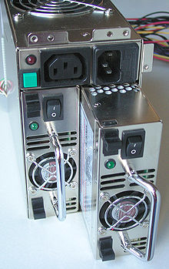
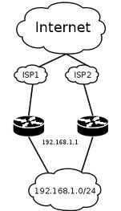
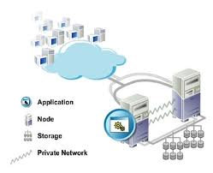

Redundancy
The redundancy is the duplication of critical components or functions of a system.
Internet Connection
Geographic location
servers
power supply

Slide 17


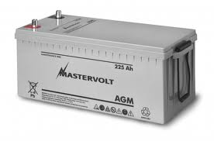
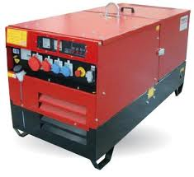

Power source redundancy

Slide 18

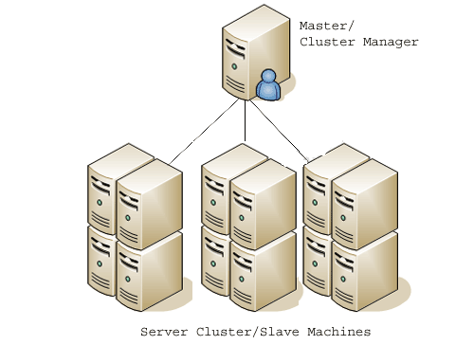
Server Clustering 1/2
Cluster = Grappe de serveurs ou Ferme de serveurs.
A computer cluster consists of a set of loosely connected computers that work together so that in many respects they can be viewed as a single system.

Slide 19
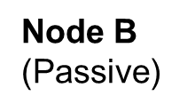







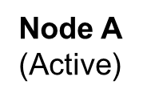
Server Clustering 2/2
Node B
(Active)
Node B
(Passive)
Shared Disk
Node A
(reestablished )
Node A
(Service Down)

Slide 20
Internet connection redundancy
Node B
(Passive)
Shared Disk

Slide 21
High Avalaibility Solutions Active/Passive & Active/Active
The difference between the two is that a cluster configured as active/passive has at least one server in the cluster that remains idle. The passive server has no other responsibilities during normal day-to-day operations.

Slide 22
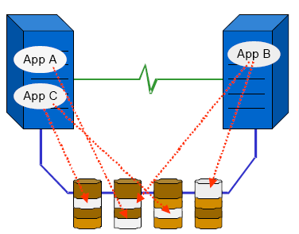
High Avalaibility Solutions
Active/Active
An active-active cluster consists of servers that work together and provide a pool of given services. If one of the servers stops unfortunately, location-based services on it are automatically deported to other servers.

Slide 23
High Avalaibility Solutions
Active-Passive
An active-passive cluster usually consists of two servers, the first dealing with all services installed on it, the other waiting to take over if the first is down
The passive server has no other responsibilities during normal day-to-day operations.

Slide 24

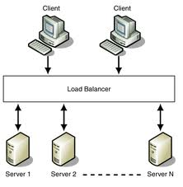
Load Balancing
Is a methodology to distribute workload across multiple computers or a computer cluster, network links, central processing units, disk drives, or other resources.

Slide 25

Response Time
Is the time between the end of an inquiry or demand on a computer system and the beginning of a response

Slide 26

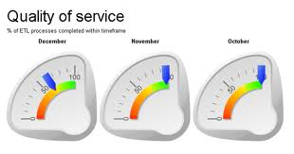



Response Time & QoS

Slide 27




Factors influencing response time
Overloaded Servers
Bandwidth
Scale IN
Scale OUT

Slide 28
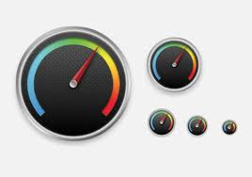
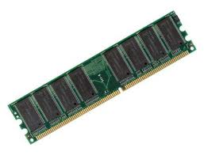

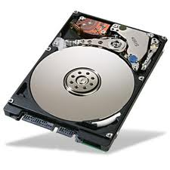
Scaling In servers
Add resources to servers
Increasing Internet connection bandwidth

Slide 29
Scaling Out Servers
Load Balancer

Slide 30
Load Balancer
Hardware Load Balancing
Provide a robust topology with high availability.
Higher costs compared to software versions.
Software Load Balancing
Cheaper than hardware load balancers.
More configurable based on requirements.

Slide 31

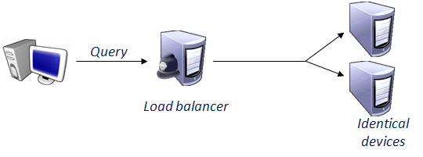

Load-Balancing Algorithms
Least connections

Slide 32
Load-Balancing Algorithms
Round robin
1/2
1/2

Slide 33





Load-Balancing operating
Cluster
Director
Load balancer
Client
VIP@
Load balancer
Standby

Slide 34
Load-Balancing operating
Cluster
LB - Director
Client
VIP@
LB - Standby

