Slide 1
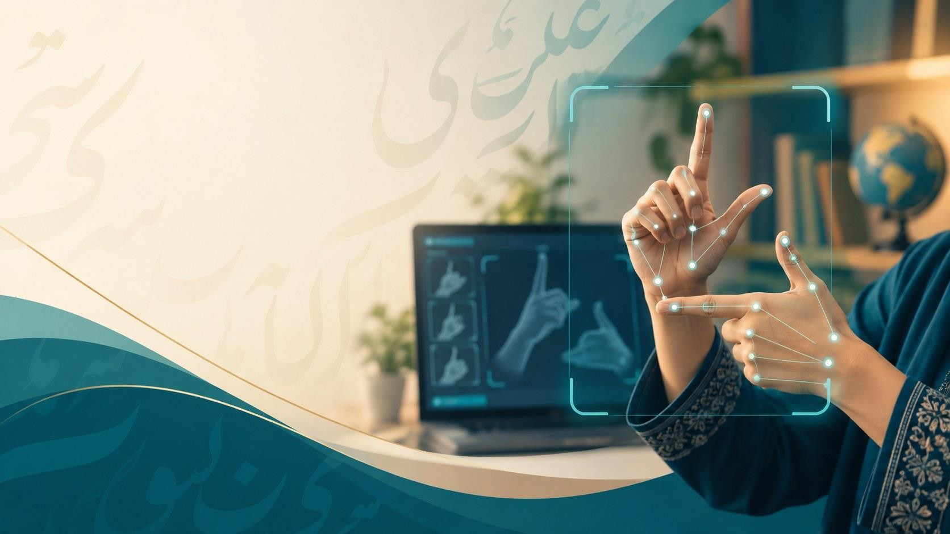
Urdu Sign Language
اردو اشاروں کی زبان کی شناخت
Detection & Classification
Using a Custom Dataset
PRESENTED BY
SUPERVISOR
Malaika Nasir (F2023-736)
Ms. Noreen Khalid
Abeeha Maryam (F2023-515)
Zukhruf Javaid (F2023-273)

Slide 2

The Problem
01
1

Slide 3
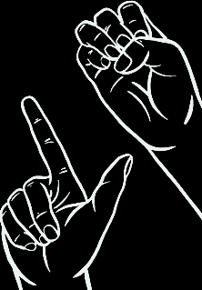
01 · PROBLEM STATEMENT
“
Deaf & Mute people face communication difficulties with anyone who does not understand USL. Existing research focuses mainly on alphabet recognition, leaving sentence-level USL recognition under-explored. There is a need for an accessible system that recognises common USL signs and sentences and turns them into understandable output.
”
2

Slide 4





No signer nearby? The conversation stops.
USL user signs a message
Hearing person tries to understand
Yes
Message delivered
Understood?
No
Yes
Teacher, family member or interpreter nearby?
No
Communication breaks down
3

Slide 5
9 Research Papers what it lacks
Study | Sign language | Model / technique | Input | Recognises | Accuracy | Sentences | Face cues
Saeed 2024 | BSL | ResNet50, VGG16, InceptionV3 | UWB radar | 10 isolated signs | 92% (ResNet50) | No | No
Paul 2024 | ASL | CNN + LSTM / GRU, MediaPipe | Camera + MediaPipe | 26 letters, 3 dynamic signs | 94.3% (LSTM) | No | No
Patel 2023 | ASL | R-CNN, MobileNet, YOLOv8 | Camera | Individual letters | 95% (YOLOv8) | No | No
Rahman 2023 | PSL | SVM, MLP, ANN, KNN | Sensor glove | 10 gestures | Over 96% | No | No
Saleem 2023 | ASL · PSL · SSL | CNN + supervised ML | Leap Motion | Letters and numbers | 93.1% (PSL) | No | No
Shin 2023 | KSL | Hybrid CNN + Transformer | Camera (video) | Isolated words (77) | 89–98.3% | No | No
Azimi 2023 | Gesture | MediaPipe + MobileNet | Camera + MediaPipe | 1 help signal | ≈ 91.25% | No | No
Miah 2022 | BdSL | BenSignNet CNN | Camera (images) | Alphabet | 94–99.6% | No | No
Zakariah 2022 | ArSL | EfficientNetB4 (transfer) | Camera (images) | Alphabet (32) | 95% (test) | No | No
Our proposal | USL | EfficientNetV2-S · LSTM · MediaPipe | Ordinary camera | 37 letters + 24 sentences | To be measured | Yes · 24 | Yes · 5
.

Slide 6
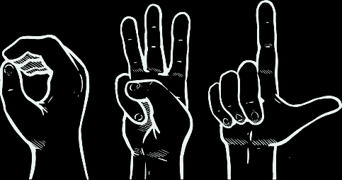
Target Market & Users
02
6

Slide 7






From industry to end user
SECONDARY USERS: WHERE THEY MEET USL USERS
INDUSTRY
Education
Healthcare
AI, computer vision & assistive technology
Teachers, students, interpreters
Doctors, nurses, front desks
MARKET
Assistive technology & accessibility in Pakistan
SEGMENT
Public services
Customer service
People who use USL and those who communicate with them
NADRA and government offices
Banks, shops, service counters
END USER
Workplaces
Families
Deaf USL users in Pakistan
Employers and colleagues
Parents, friends, caregivers
Primary Users
Deaf and Mute people
7

Slide 8
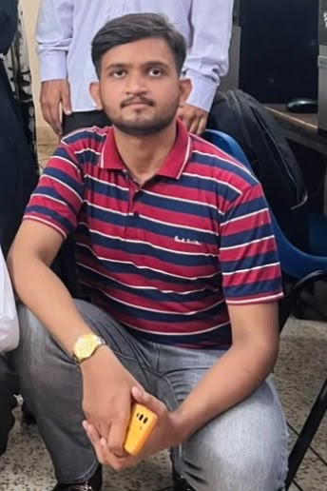
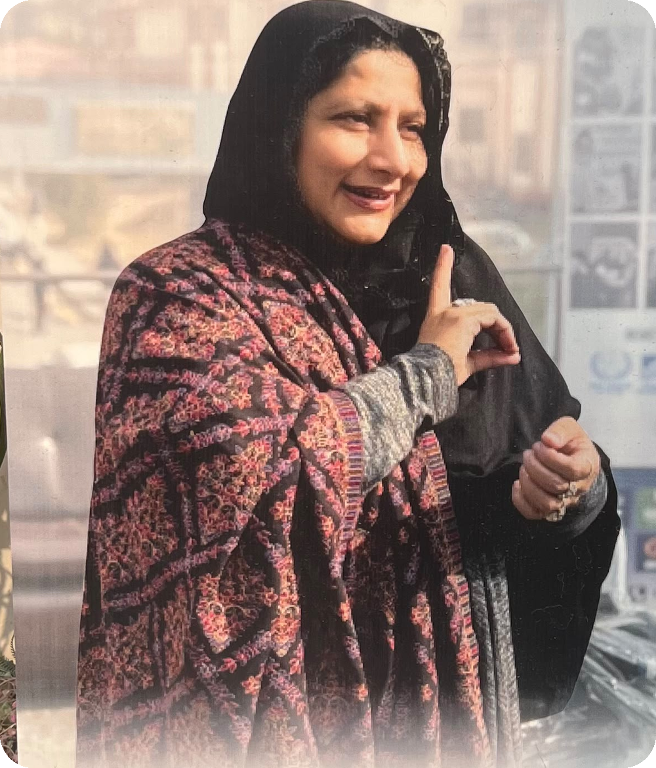
Two personas from our DWAF analysis
PRIMARY PERSONA
SECONDARY PERSONA
Ali, 19
Farhat Javed, 36
Ali wants to communicate with hearing people without depending on an interpreter or family member. Most people around him don't understand USL, and spelling long messages letter by letter is slow. He needs a system that recognises both alphabets and everyday sentences.
Farhat teaches deaf students.Whenever a third person comes and they want to communicate with the students she is disturbed everytime from her work to act as an interpreter.She needs a system to atleast translate basic sentences,
8

Slide 9

Requirement Elicitation
03
9

Slide 10

How we gathered requirements
Step 1
Step 2
Step 3
Step 4
Step 5
Literature review
Online meeting
On-site visit
Student feedback
Analysis
9 papers
DWAF principal
DWAF campus
Deaf students
Requirements
10

Slide 11
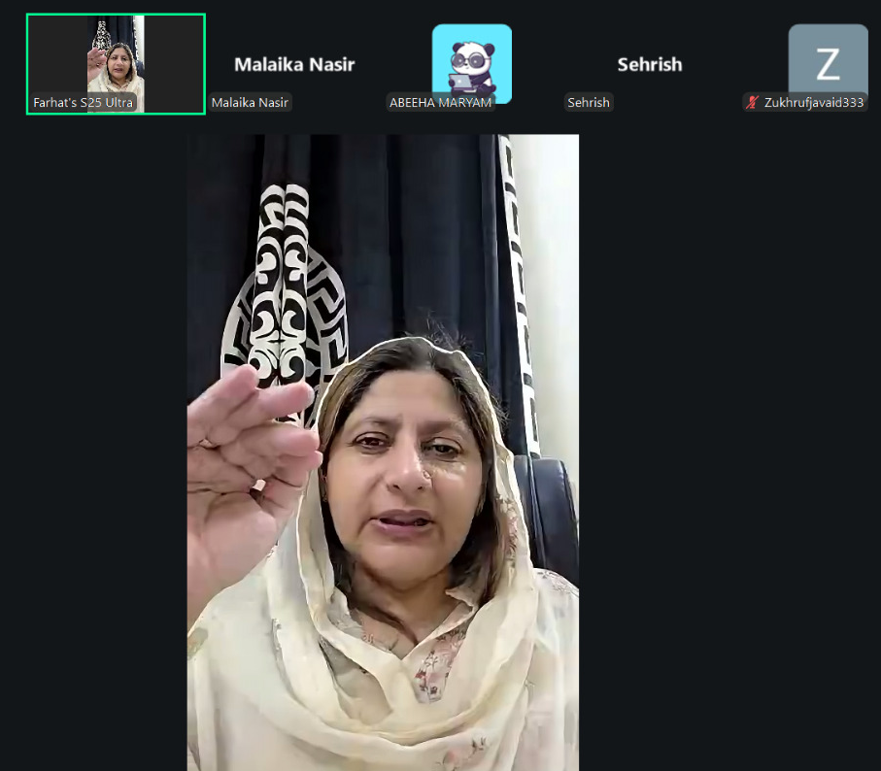
Online Meeting with DWAF’s principal
82
deaf students at DWAF, all aged 18+
Daily
teachers are pulled away to interpret, many times a day
0
tools at DWAF that recognise signing: the PSL app in use is a dictionary
Stage 1 · Online meeting with DWAF’s principal
4

Slide 12
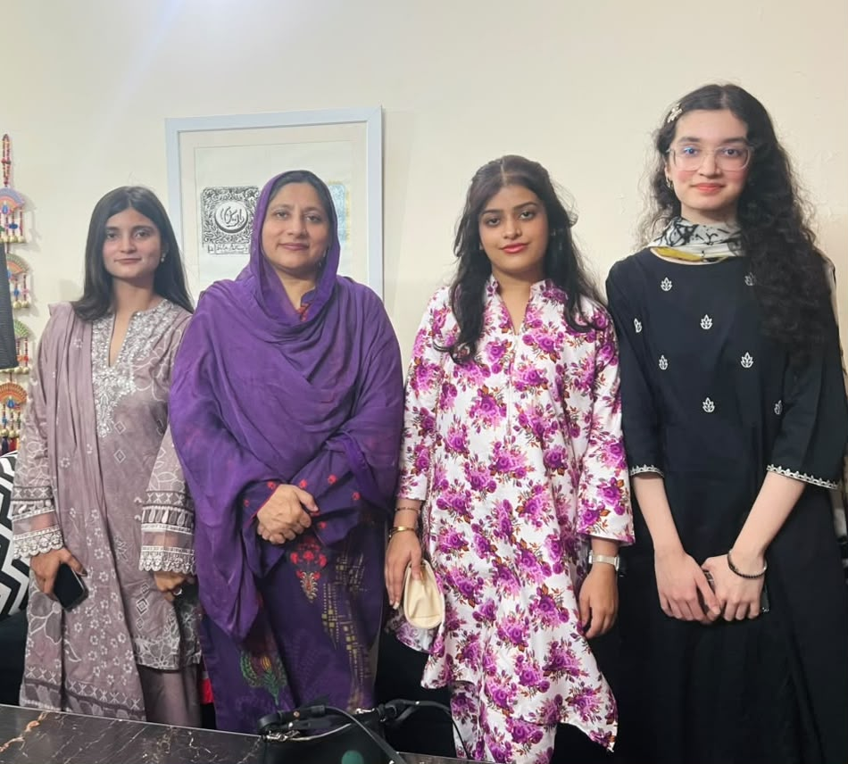
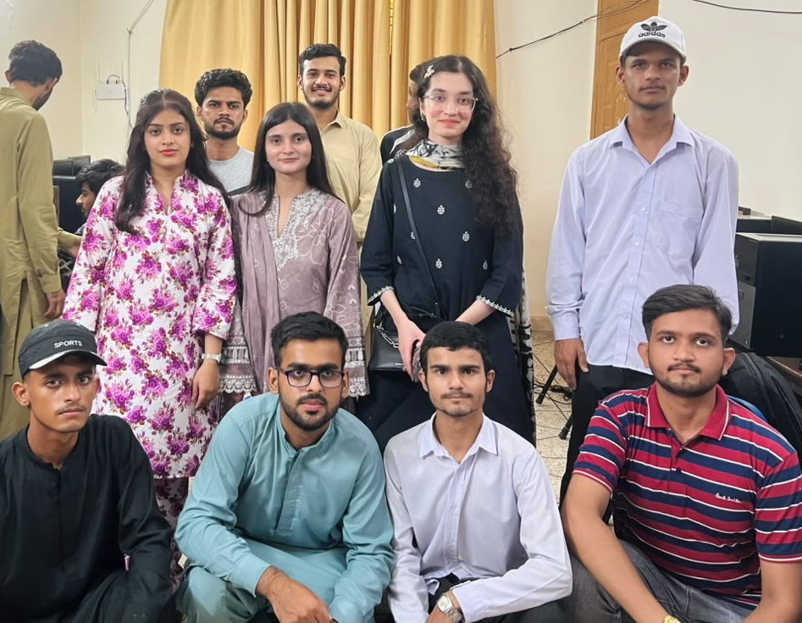
Stage 2: On-site visit and student interaction
11

Slide 13
24 everyday sentences, chosen with the students
Greetings & courtesy · 10
Questions & introductions · 5
Needs & feelings · 9
Assalam-o-Alaikum
Wa Alaikum Assalam
Allah Hafiz
Khushamdeed
Peace be upon you (hello)
And upon you (reply)
Goodbye
Welcome
Shukriya
JazakAllah
Alhamdulillah
Baad mein milte hain
Thank you
May God reward you
Praise be to God
See you later
Aapse mil kar khushi hui
Bohat achay
Aap kaise ho?
Aapka naam kya hai?
Nice to meet you
Very good
How are you?
What is your name?
Aap kahan rehte ho?
Mera naam…
Main theek hoon
Madad karo
Where do you live?
My name is…
I am fine
Help me
Main bemaar hoon
Main bol nahi sakti
Main sun nahi sakti
Ghabrana nahi
I am sick
I cannot speak
I cannot hear
Don’t worry
Ye bohat zaroori hai
Mujhe maaf kar do
Main aapse mohabbat karti hoon
Main aapse nafrat karti hoon
This is very important
Please forgive me
I love you
I hate you
12

Slide 14
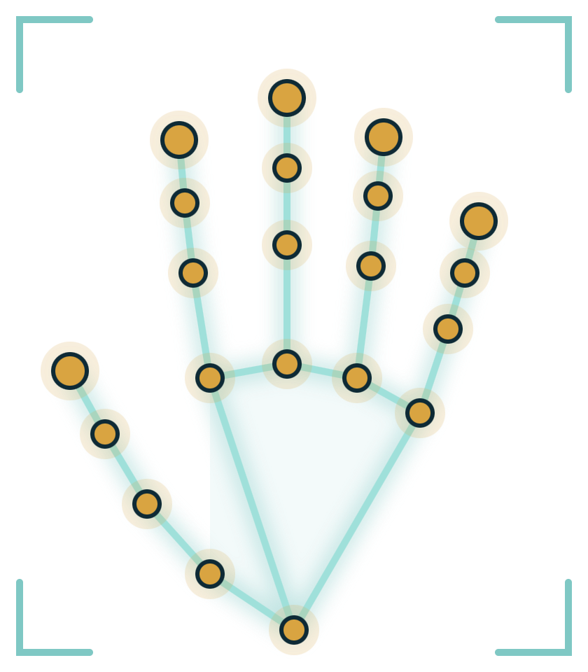
Product Vision & Scope
04
13

Slide 15
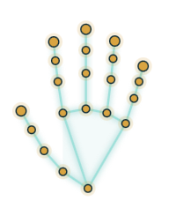

Product vision
Step 1
Step 2
Step 3
Step 4
Step 5
Capture
Track
Recognise
Evaluate
Output
Ordinary webcam or phone camera.
OpenCV preprocessing; MediaPipe hand and face landmarks per frame.
1) Alphabet Model
2) Sentence Model
3) Expression Model
Accuracy, precision, recall, F1, confusion matrix.
Recognised class shown as an Urdu / English text label.
14

Slide 16
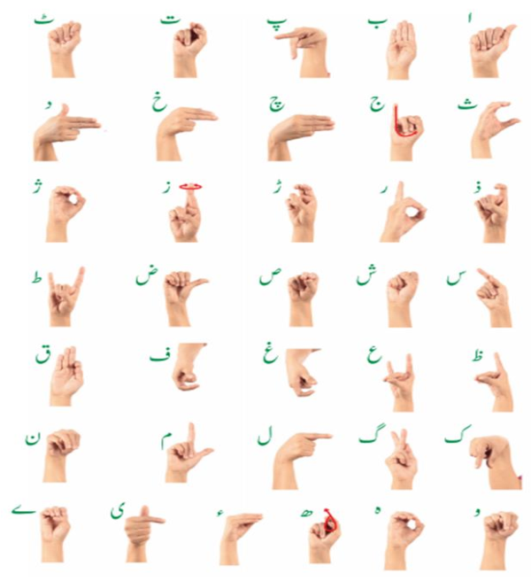
A focused dataset: 66 classes, three tasks
37
Urdu alphabet signs
Alif to Bari Ye: static handshapes for spelling names and words
24
Everyday sentences
Chosen with DWAF students; two-hand, moving, continuous signs
5
Facial expressions
Happy, sad, angry, neutral and surprise (FE-01 to FE-05)
Reference chart: PSL signs for the Urdu alphabet

Slide 17
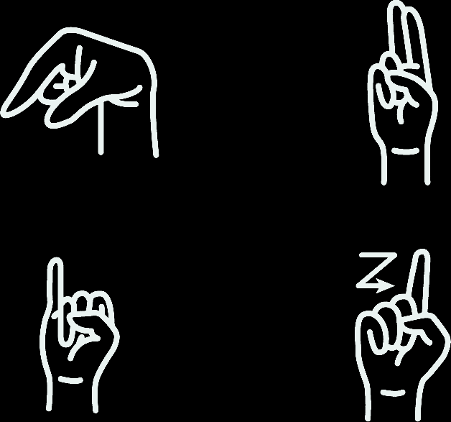
Requirements
05
16

Slide 18



Functional requirements: data and alphabet model
Must
core research deliverable
Should
planned, high value
Custom dataset
FR-01 – FR-06
Preparation & alphabet model
FR-07 – FR-12
FR-01
The dataset shall hold labelled samples for all 37 Urdu alphabet classes.
Must
FR-07
Every sample shall be labelled and checked before it is used for training.
Must
FR-02
The dataset shall hold labelled samples for the 24 everyday sentence classes.
Must
FR-08
Recorded frames and videos shall be preprocessed with OpenCV.
Must
FR-03
The dataset shall hold labelled samples for the 5 facial-expression classes.
Must
FR-09
MediaPipe shall extract hand landmarks from every frame.
Must
FR-04
The dataset shall include one-hand, two-hand and movement-based signs.
Must
FR-10
MediaPipe shall locate the face region for the expression model.
Must
FR-05
Sentence samples shall capture continuous signing in 2–5 second clips.
Must
FR-11
The alphabet CNN shall classify a static handshape into 1 of 37 classes.
Must
FR-06
Samples shall come from multiple group members signers to capture variation.
Should
FR-12
The alphabet model shall be trained and tested on the custom dataset.
Must
17

Slide 19


Functional requirements: models and evaluation
Sentence & expression models
FR-13 – FR-17
Integration, evaluation & validation
FR-18 – FR-22
FR-13
The sentence LSTM shall classify a landmark sequence into 1 of 24 sentences.
Must
FR-18
The three models shall work as one system, without manual model selection.
Should
FR-14
The sentence model shall use hand movement over time, not single frames.
Must
FR-19
Model shall output the predicted class label for each valid input video sample after detecting and recognizing the sign.
Must
FR-15
Sentence classes shall match the expressions chosen by DWAF students.
Must
FR-20
Data shall be split into training, validation and test sets for each model.
Must
FR-16
The expression CNN shall classify happy, sad, angry, neutral or surprise.
Must
Expression output shall be used where it changes a sign’s meaning.
FR-21
Each model shall report accuracy, precision, recall, F1 and a confusion matrix.
Must
FR-17
Should
FR-22
A DWAF teacher shall validate sampled predictions against the intended signs.
Must
18

Slide 20
Feasibility, Impact & Plan
06
19

Slide 21
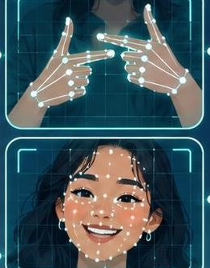




Why this plan is feasible
Technical
Data & access
Our methods are proven in prior research: an LSTM on MediaPipe landmarks reached 94.3% on dynamic signs (Paul 2024), and CNN alphabet models report 94–99.6% (Miah 2022; Zakariah 2022).
Our team and volunteers will record a custom dataset of about 4,500 videos across the 66 classes. Let a teacher validate our labels and predictions.
Operational
Schedule & adoption
Recording and testing need only an ordinary webcam or phone camera, with no sensor gloves, radar or Leap Motion. Free, open-source tools like OpenCV and MediaPipe keep costs low.
A closed set of 66 classes (37 letters, 24 sentences, 5 expressions) fits our two semester plan. DWAF's 82 deaf students and their teachers give us a ready group for testing and feedback.
20

Slide 22
SDG alignment: three goals our research serves
9
WHAT WE BUILD
10
WHO BENEFITS
4
WHERE IT HELPS
Industry, Innovation & Infrastructure
Reduced Inequalities
Quality Education
TARGET 9.5
TARGET 10.2
TARGETS 4.5 & 4.A
Enhance scientific research and upgrade technological capabilities, encouraging innovation.
Promote the social, economic and political inclusion of all, irrespective of disability.
Equal access to education for persons with disabilities, in inclusive learning environments.
How our project contributes
How our project contributes
How our project contributes
A new custom USL dataset: 37 + 24 + 5 labelled classes
Research toward communication that doesn’t depend on an interpreter being present.
A local USL dataset others can extend for teaching and future research
21

Slide 23


Project timeline: September 2026 – June 2027
Done
Data
FYP-I · Fall 2026
FYP-II · Spring 2027
Models
Evaluate
Sep
Oct
Nov
Dec
Jan
Feb
Mar
Apr
May
Jun
Milestones
Proposal defense
FYP-I evaluation
Final defense
D1 · Target market
D2 · Problem & elicitation
D3 · Requirements spec
Custom Dataset recording
Labelling
Alphabet model 9((((EfficientNetV2-S )
Expression model
Sentence model (LSTM)
Integration & evaluation
Testing & validation
Final report & documentation
Today
22

Slide 24
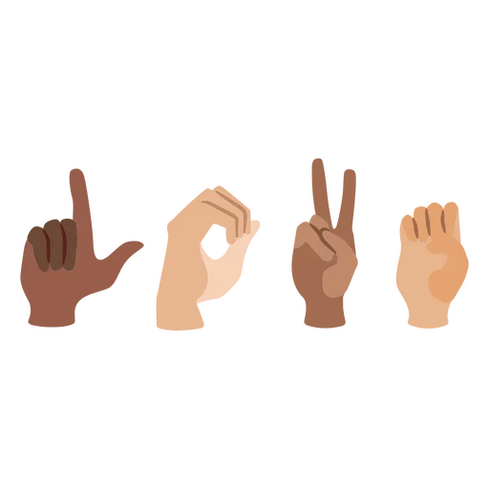
Shukriya
THANK YOU
شکریہ
We welcome your questions and feedback.
37
24
5
3
alphabets
sentences
expressions
SDGs

