Slide 1
CONTROLLER
E-COMMERCE CAPSTONE
▼
Backend System & New Endpoints
SERVICE
▼
MODEL
Name: Abdullah Alasmari

Slide 2
System Overview
A layered Spring Boot backend for a simple e-commerce marketplace
ARCHITECTURE
FIVE CORE DOMAINS
Controller
U
User
Accounts, roles (Admin / Customer), wallet balance
Receives HTTP requests, validates input, returns ResponseEntity + status code
P
Product
Catalog items — name, price, category
Service
C
Category
Groups products for browsing
Business logic — in-memory ArrayList storage, lookups, int result codes
M
Merchant
Sellers on the marketplace
Model
MerchantStock
Bridge table — which merchant stocks which product, and how much
MS
Data classes with Lombok + validation annotations
2

Slide 3
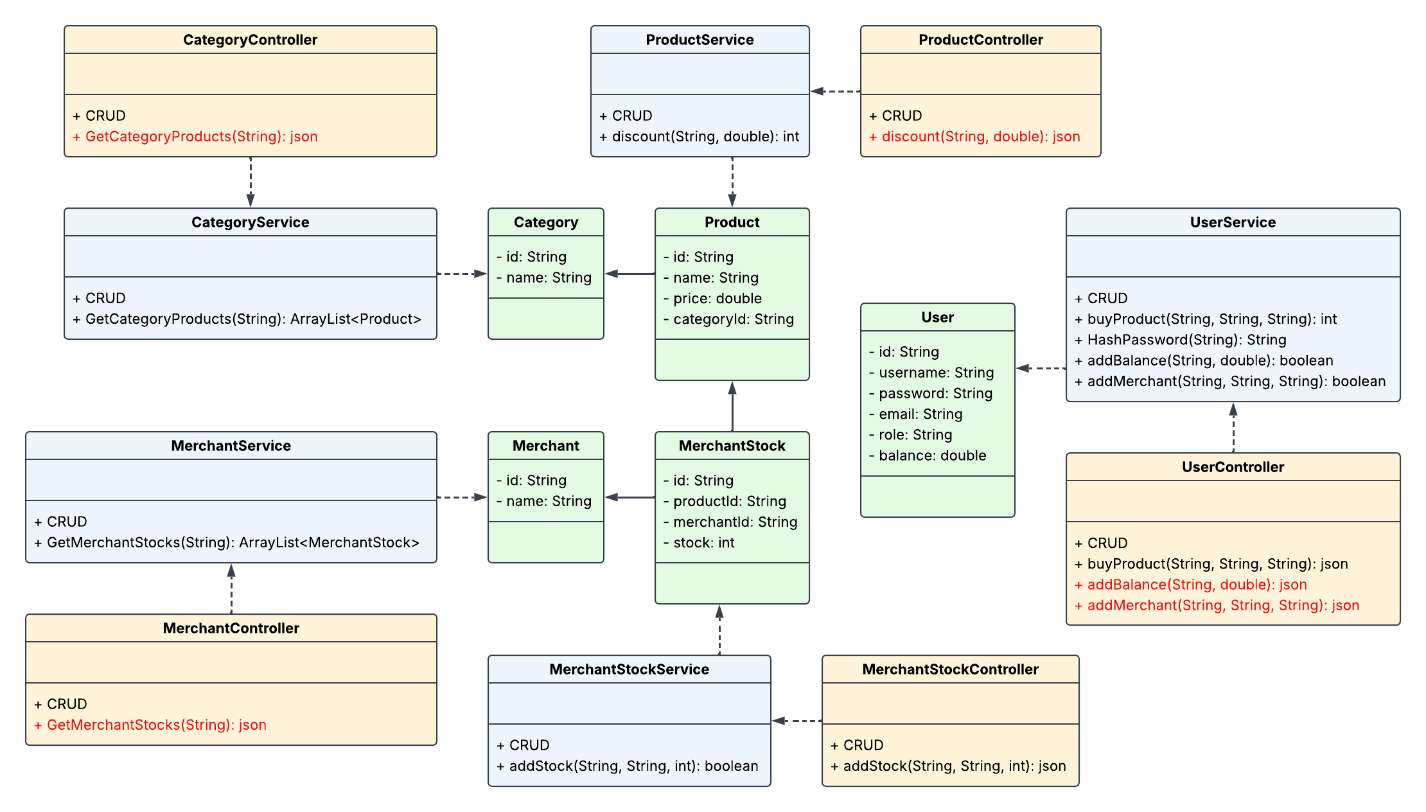
Complete System UML
Controller
Controller · Service · Model across all five domains
Service
Model
3

Slide 4
Consistent Design Conventions
Patterns applied across every controller, service, and model
0/1
ID
!
Int Result Codes
Prefixed Identifiers
Validation Messages
Services return 0 for success and a distinct int per failure reason, so a controller can report exactly what went wrong.
Every id is validated with a class-specific prefix, catching a mismatched id before it ever reaches a lookup.
Every @NotEmpty / @Pattern / @Size constraint carries a clear message, surfaced via Errors in the controller.
buyProduct → 0 success · 1 user · 2 product · 3 merchant · 4 stock · 5 balance
U- User P- Product C- Category M- Merchant MS- MerchantStock
"Role must be either 'Admin' or 'Customer'"
4

Slide 5
New Endpoint — discount()
ProductService.discount(String productId, double percentage) → int
1
Find the product
Search the in-memory product list by productId
RESULT CODES
▼
0
Discount applied successfully
2
Validate the percentage
Reject if not strictly between 0 and 100
1
Product was not found
▼
3
Apply the new price
2
Invalid discount percentage
price = price × (1 − percentage / 100), then save
Why it matters: powers flash sales and seasonal promotions without adding a single new field or class.
5

Slide 6
New Endpoints — Wallet & Onboarding
Two UserService additions: growing a customer's wallet, and admin-controlled merchant onboarding
$
addBalance
A
addMerchant
addBalance(String userId, double amount) → int
addMerchant(String userId, String id, String name) → int
Finds the user by id
Finds the requesting user by id
Rejects an amount ≤ 0
Requires role == "Admin"
Adds the amount to the user's balance
Creates and registers the new Merchant
0
Balance added successfully
0
Merchant added successfully
1
UserId was not found
1
UserId was not found
2
Invalid amount
2
User is not an Admin
6

Slide 7
New Endpoints — Browsing & Inventory
Two read endpoints that join existing data instead of adding anything new
C
GetCategoryProducts
MS
getMerchantStocks
CategoryService.GetCategoryProducts(String id) → ArrayList<Product>
MerchantService.getMerchantStocks(String merchantId) → ArrayList<MerchantStock>
Category
→
Products
Merchant
→
Stock
Filters the existing product list by categoryId and returns every match. Powers a storefront category page — "Show me everything in Electronics" — without touching the Product or Category models.
Filters the existing MerchantStock list by merchantId. Gives a merchant a single call to see their full inventory — every product they stock and how much — for a seller dashboard view.
7

Slide 8
Why It Matters
Five endpoints, five real marketplace capabilities — zero new attributes or classes
%
$
A
C
MS
Promotions
Customer Wallet
Marketplace Growth
Better Browsing
Merchant Insights
discount() enables flash sales & seasonal pricing
addBalance() lets customers top up before checkout
addMerchant() onboards sellers, gated to Admins only
GetCategoryProducts() drives category storefront pages
getMerchantStocks() gives sellers a full inventory view
8

Slide 9
CONTROLLER
Thank You
Questions?
SERVICE
Controller → Service → Model · 5 new endpoints · 0 new classes
MODEL
Name: Abdullah Alasmari

