Slide 1
Parliament Petition Site
github.com/alphagov/e-petitions

Slide 2
STANDARD DISCLAIMER APPLIES
(I don’t speak for Parliament – only myself!)
(I don’t speak for Unboxed either!)
(And… it’s not actually up and running yet…)

Slide 3
Questions
(For YOU…)
Notes:
Questions:
Who’s using Cloudformation
Who’s doing Autoscaling?
Who’s using Elastic Load Balancers?
Who’s using CodeDeploy?
Who’s using OpsWorks?
Who’s heard of the “12 Factor App” principles?

Slide 4
Project: Update Everything
New functionality. New Look and
Feel. New Domain. Upgrade Rails.
And.. finally… new Infrastructure.

Slide 5
What Infrastructure Changes Needed?

Slide 6
“PSA: Hosting companies are terrible” – @pixeltrix
(Unboxed CTO)

Slide 7
The Problem Domain

Slide 8
Busy Site
Problem Domain
https://gds.blog.gov.uk/2012/08/16/happy-birthday-e-petitions-a-year-in-numbers/
Notes:
https://gds.blog.gov.uk/2012/08/16/happy-birthday-e-petitions-a-year-in-numbers/
2012 stats:
68 Million page views in first year
6.4 million signatures
350,000 visitors on the busiest day
Only 2,000 visitors on the slowest day
36,000 petitions
Running costs of £30,000 per annum (not just servers, presumably)

Slide 9
No Permanent Ops Team
Problem Domain

Slide 10
Security is Important
Problem Domain
(We are a target…)

Slide 11
Uptime is Important
Problem Domain
(Surprised?)

Slide 12
Cost is a factor
Problem Domain
(Still surprised?)

Slide 13
Like many others… we went AWS

Slide 14
Some AWS Implementation Principles
Going AWS

Slide 15
AWS isn’t a Hosting Provider, so do things the AWS way!
Going AWS

Slide 16
- Disposable Servers (No named servers: Cattle & Pets) - Avoid single points of failure - Rely only on AWS services where possible - Try avoid building it ourselves - Try avoid new-and-shiny AWS services - Keep the security auditors happy
Going AWS
Notes:
Single points of Failure would include a central Ansible server with callbacks - http://www.ansible.com/blog/autoscaling-infrastructures

Slide 17
(One Possible) Solution

Slide 18
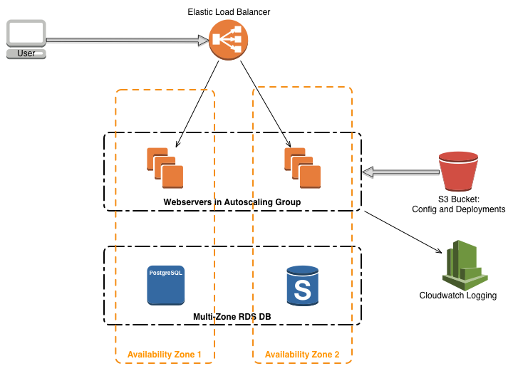
Solution Architecture
Notes:
Cloudwatch logging so that we don’t need to maintain an ELK stack. And we can supply logs from short-lived servers to security auditors.

Slide 19
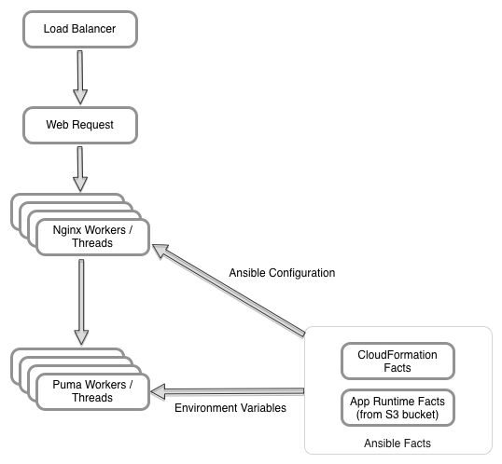
Solution – Ansible Facts and 12 Factor

Slide 20
Ansible is the Glue:
Builds servers in the Autoscaling Group
Configures services like Nginx
Creates 12 factor app Environment Variables
Configures Services to start

Slide 21
Principle: Disposable Servers
(via Autoscaling)

Slide 22
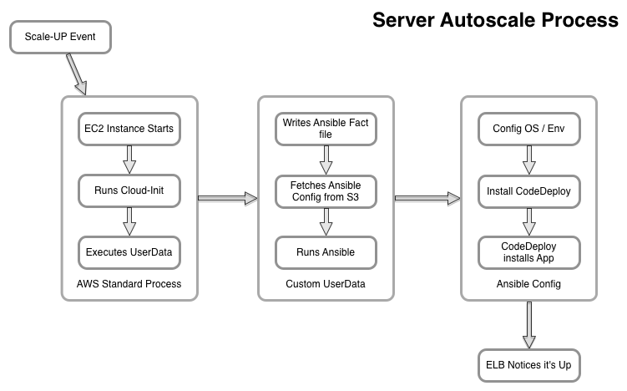
Autoscaling Flow

Slide 24
Why Not Opsworks?
(AWS Chef as a Service)

Slide 25
We’ve just migrated to Ansible
Why not Opsworks?
(Staff expertise)

Slide 26
Ansible Lets us use Galaxy Roles that match our other projects
Why not Opsworks?
(NTP, SSH Server,
Apt upgrades, etc)

Slide 27
Linear nature of Ansible is simple
Why not Opsworks?

Slide 29
Let’s talk about App Releases

Slide 30
App Releases Don’t use Ansible
(i.e. we differentiate
between OS setup
and App setup)

Slide 31
1: Copy Tar file to S3 bucket
App Releases
2: Tell CodeDeploy to Deploy it

Slide 32
CodeDeploy reads embedded Appspec file and runs commands
App Release Flow
(Commands could use
Ansible – we just use Bash)

Slide 33
De-list from Load Balancer, Apply the upgrade, Re-list with Load Balancer
App Release Flow

Slide 34
CodeDeploy is reasonably new
App Releases
(We’ve had 1 problematic day)

Slide 36
Let’s talk building the AWS Stack
(No – let’s not use the UI)

Slide 37
Infrastructure Config is in CloudFormation JSON file
AWS Configuration

Slide 38
Ansible can’t (easily) build the CF Stack yet
AWS Configuration
(Using it seems “Hacky”, and
It doesn’t include all the AWS
features we needed)

Slide 39
In Future: Define Stack in Code
AWS Configuration
(Ansible – once it’s ready. Or
something like Troposphere)

Slide 40
In Future: Nested Stacks
AWS Configuration
(50KB size limit to a stack)

Slide 42
Example Codebase

Slide 43
Demo Codebase Assumptions:
Example Codebase
Codebase assumes EU-WEST-1 region
Ubuntu 14.04 only
Automatic O/S security upgrades
SSL-Only website
Individual user accounts
SSH Keys only
Optimised: Busy site (sysctls etc)

Slide 44
github.com/unboxed/aws-ansible-autoscaling-and-code-deploy github.com/unboxed/aws-ansible-autoscaling-and-code-deploy-app
Example Codebase

Slide 45
17KB README.md 59 steps to get it up and running 40 files
Deployment Repo
(Excluding Galaxy Ansible Roles)
Notes:
Logs of manual steps to get people familiar with the principles. Many can be wrapped into a script.

Slide 46
App Repo: A Classic Empty Rails App, with some modifications
App Repo
(12 factor app, ping URL, AWS codedeploy config, and Puma server. 5 separate commits)
Notes:
Ping URL tells the Elastic Load Balancer that the app is alive and well.

Slide 47
What Next?

Slide 48
Get Petitions Into Production
What Next?
(Real Soon Now)

Slide 49
Implement Autoscaling based on Load
What Next?
(Need real-world data)

Slide 50
Still some external dependencies
What Next?

Slide 51
See if it’s useful to other people
What Next?

Slide 52
ubxd.com or @ubxd
oskar.pearson@ubxd.com
or @oskarpearson on Twitter

Slide 53
Questions?

