Slide 1
MODELLING & SIMULATION OF SELF-DRIVEN CARS AT PEDESTRIAN CROSSING
ADITYA BHAMIDIPATI
SHIVAM JAITLY

Slide 2
Next Steps…
Problem Statement
Modeling and Simulation Goals
Overview and Description of our model
Simulation Demo
Future Works

Slide 3
Problem Statement
Pedestrians pose one of the biggest challenges for self driving cars.
Pedestrian behaviors are random so it can result in erratic result for the self driving cars.
Human drivers can understand behavior of other humans and so they are confident drivers.
It is hard to achieve this in self driving cars.
So simulation plays an important role in designing and training the self driving car systems.

Slide 4
Modeling and Simulation Goals
By modeling this we want to learn-
To model self driving cars at pedestrian crossing using DEVS JAVA.
How to train different machine learning models for self driving cars to increase the efficiency of the system.
What is the behavior of the cars with real time simulation of the pedestrian crossing.

Slide 5
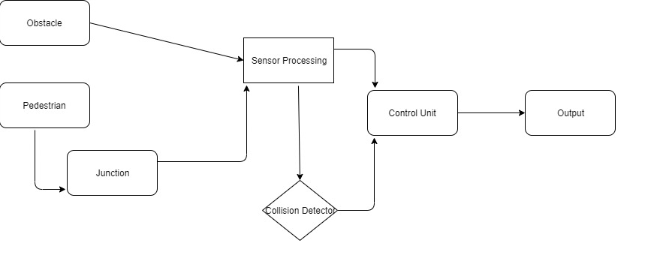
Modelling Flow

Slide 6
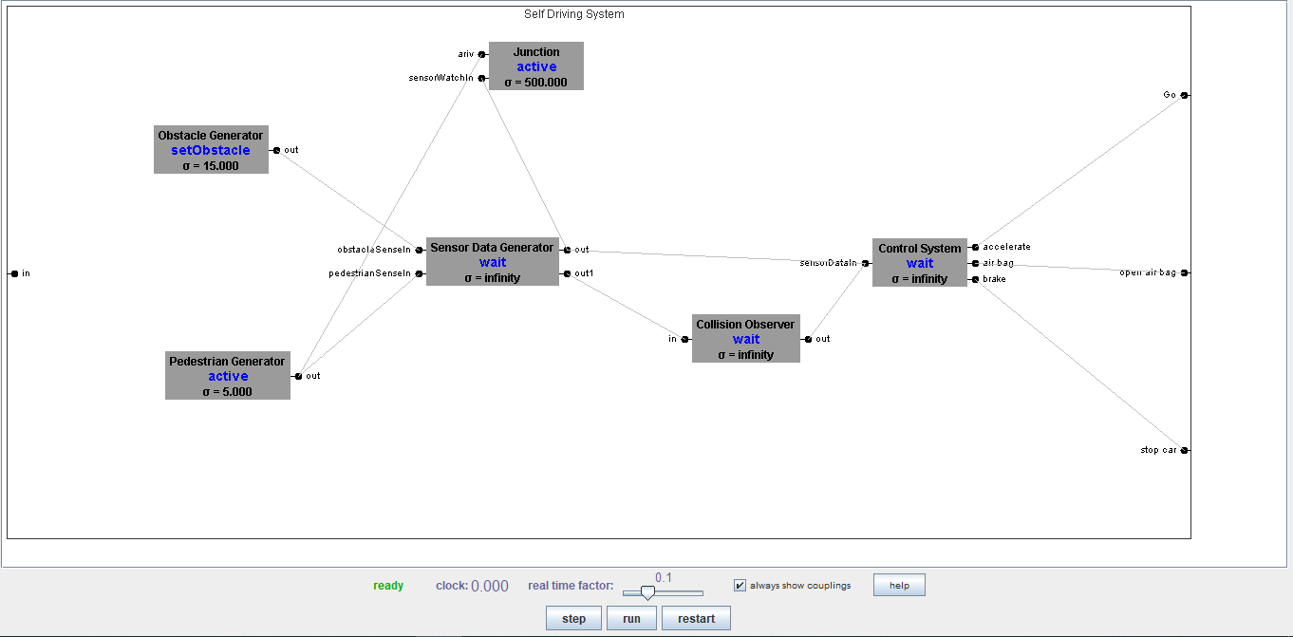
Model Design

Slide 7
DEMO

Slide 8
Experimentation Results
At clock = 127.591
Total pedestrians = 22
Number of Pedestrians sensed = 18
Number of Pedestrian sensor data in the queue = 4
Total Obstacles = 5
Number of Obstacles Sensed = 4
Number of Obstacle sensor data in the queue = 1
Number of Pedestrian sensor data processed by control unit = 9
Number of Obstacle sensor data processed by control unit = 2

Slide 9
Conclusions and Discussions
Learnt and implemented basics of DEVS- JAVA.
This project helps us understand the challenges in self driving cars.
Using the simulation results the self driving systems can be trained better for the real world.

Slide 10
FUTURE WORK
Handle obstacle cases with better efficiency.
Scenario of junction crossing with traffic signal.
Better decision making by the self driving modules.

Slide 11

THANK YOU

