Slide 1

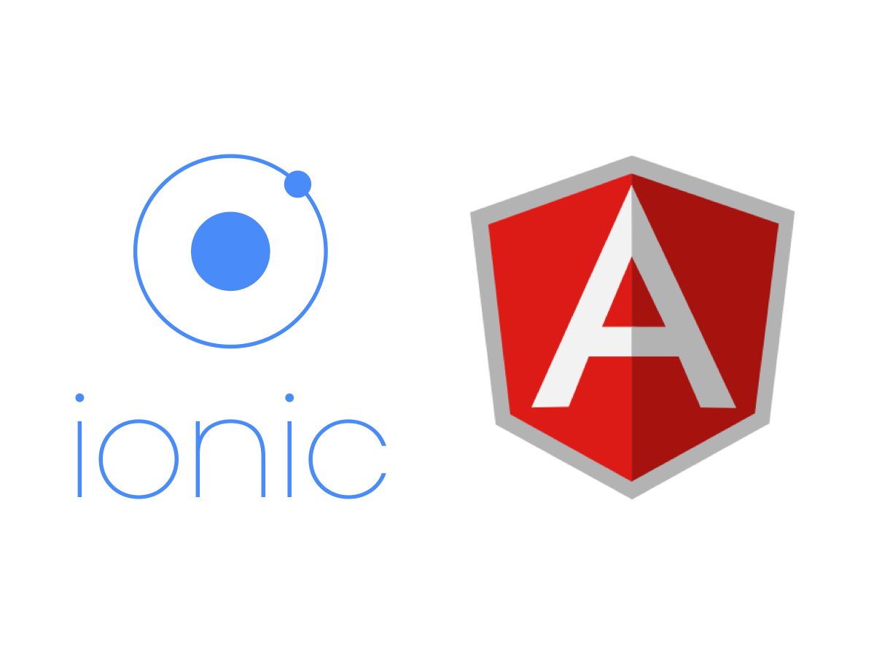


Ionic Framework
Write once, run anywhere.

Slide 2
Motivation
Ionic is created to enable web developers to become mobile developers, using technologies they already know well.
to learn hybrid mobile Application development
It is the only mobile app stack which allows developers to design apps for all app stores and the mobile web, using a unique code base.

Slide 3
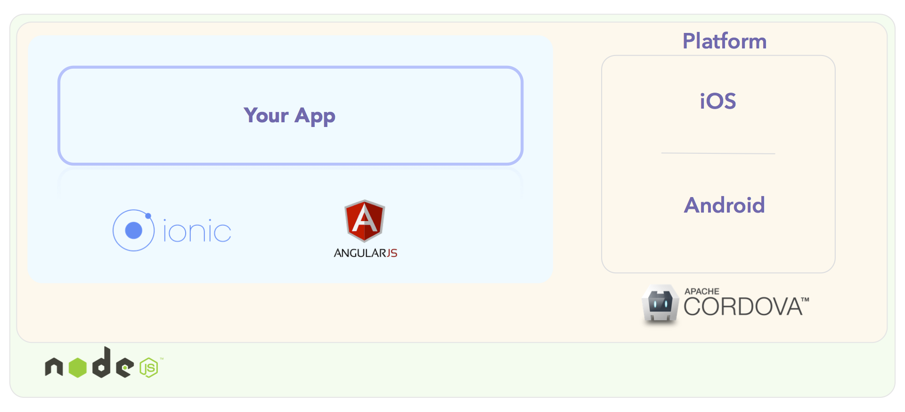
Ionic Architecture
NodeJs acts as a backend server for the ionic apps
Create the app in the framework using the ionic template (Angular)
Install the Capacitor/Apache Cordova plugin. It is used to deploy our app onto the devices
Build the ionic app to create all the web assets
Using capacitor create an android/iOS project and open it in development environments and run the app on the device with the pseudo-native build.

Slide 4
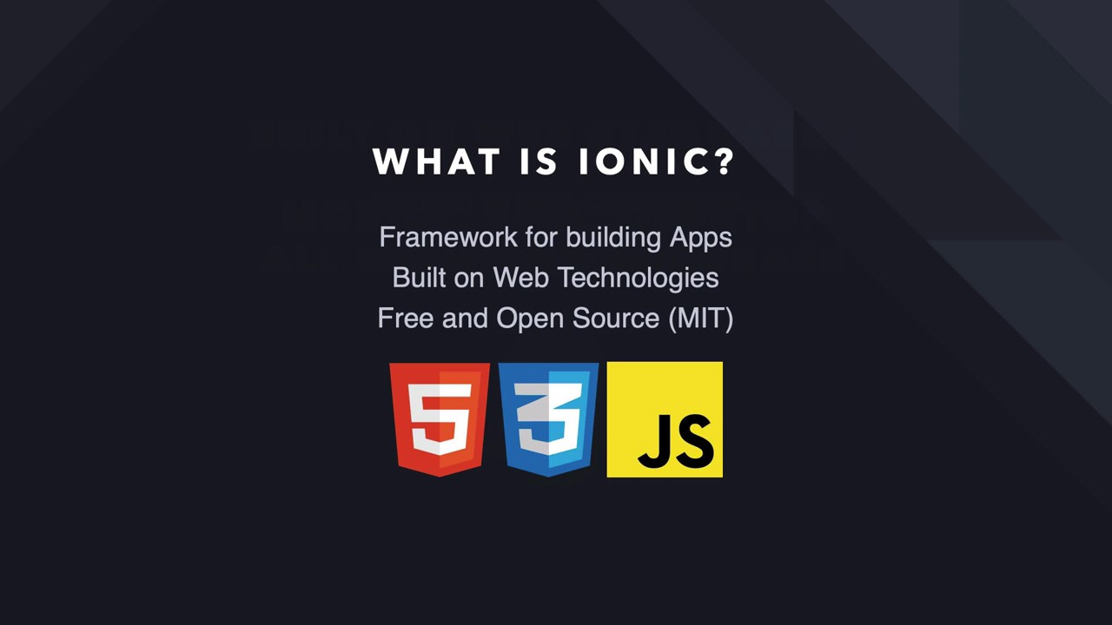
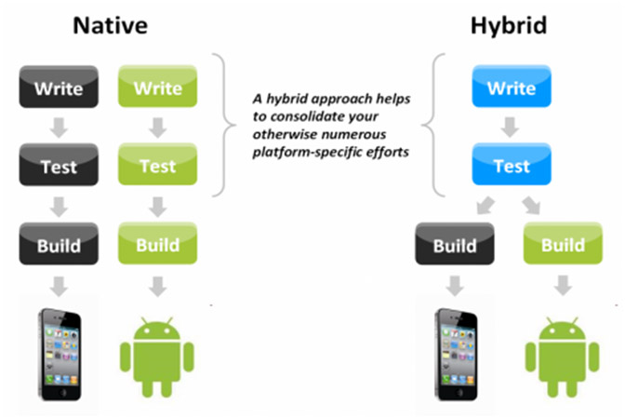
Ionic is focused mainly on the look and feel, and UI interaction of your app. That means it isn’t a replacement for PhoneGap or your favorite JavaScript framework.
Ionic Framework is focused on the frontend user experience, or UI interaction of an app (controls, interactions, gestures, animations).
It’s easy to learn, and integrates nicely with other libraries or frameworks, such as Angular, or can be used standalone without a frontend framework using a simple script include.

Slide 5
Next Steps
Installations
NodeJs
Ionic CLI
Capacitor integration
Create an ionic app
Blank app
Type Angular
Structure of Ionic App
Pages
Routing
Services
Web Assets
Working with Capacitor
Build for Android
git
Build for iOS

Slide 6


Installation
NodeJs
https://nodejs.org/en/download/
Add ~YOUR_NODE_PATH~\nodejs to your PATH environment system variable.
Git
https://git-scm.com/book/en/v2/Getting-Started-Installing-Git
Ionic
npm –g install ionic – this installs ionic globally
Capacitor integration can be done later

Slide 7
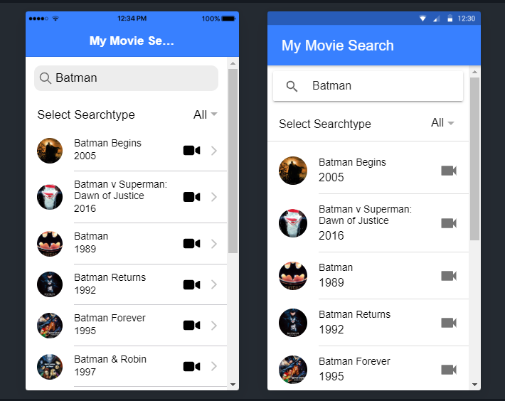
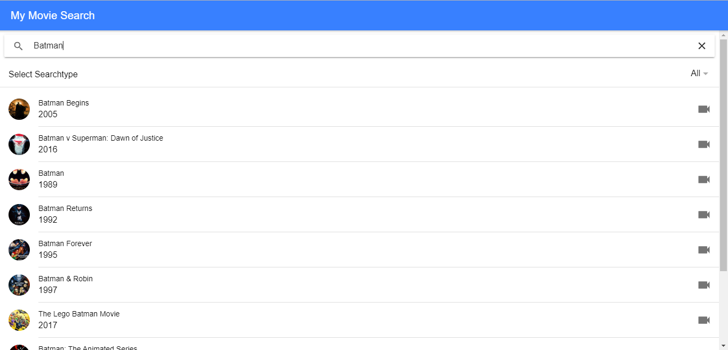
Ionic App with API Calls
Refer here – to create an ionic app with API Call to Movie services
https://www.freecodecamp.org/news/how-to-build-your-first-ionic-4-app-with-api-calls-f6ea747dc17a/

Slide 8
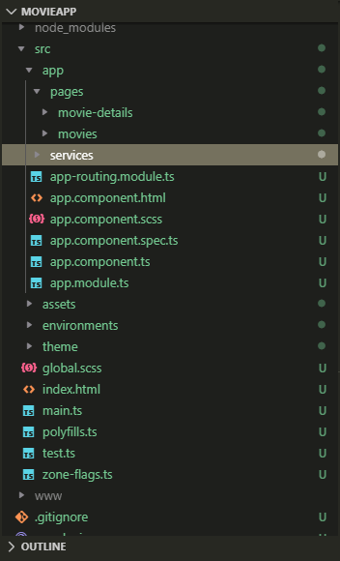
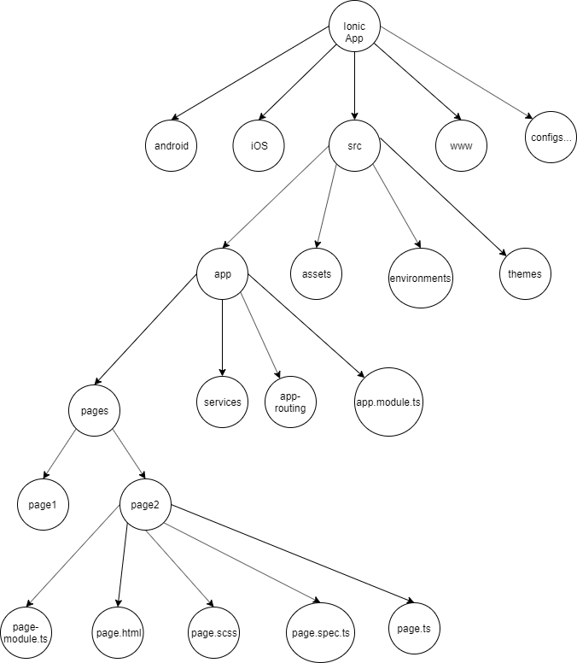
Structure of Ionic App

Slide 9
Deploying on the Devices
Capacitor is a cross-platform app runtime that makes it easy to build web apps that run pseudo-natively on iOS, Android, Electron, and the web. It was created -and is maintained- by the Ionic Framework team.
ionic build – builds a www directory
ionic capacitor add android – builds an android project using the www directory
npx cap open android – opens the project in the android studio

Slide 10
Comparison between ionic and other Hybrid/Cross App platforms
Flutter, React Native, Xamarin, PhoneGap
Ionic
Cost effective (Ionic CLI is Free)
Languages used to build (HTML, CSS, JavaScript). Uses Web view to build apps.
Time Saving (Write once and run anywhere)
Large community support - The Ionic community allows developers to share ideas, ask questions and build
Apache Cordova and Capacitor integrations to enable plug and play
MarketWatch, Sworkit (fitness App), McDonald’s Türkiye, Diesel, McLaren Automotive etc., are some of the famous apps built using ionic
Flutter –
Dart (inexpensive)
Hot reload – great feature of flutter
React Native – Built using JS and React
It provides users with the native components having superior UI feel.
React native is better than ionic to build only a mobile app
iOS via expo
Xamarin
Only one language C# - .Net developers
Cost ineffective (almost ~$1000 for an app)
PhoneGap
Used to build light apps that don’t rely on device native features
No steady support for native APIs

Slide 11
Conclusion
Advantages:
Develop an app once, and deploy across iOS, Android, and Windows devices
The use of JavaScript frameworks like AngularJS, React and Vue creates a powerful SDK, for building rich and robust applications.
Framework’s focus on HTML, CSS, and JS enables quick development, low costs, and minimal maintenance.
Disadvantages:
In-app performance may not be as swift as if the application were developed natively for each device.
The use of AngularJS demands that developers have a specific skillset for building complex apps.
Building in-app navigation can be notably complex, as the ui-router can be tricky to maneuver.

Slide 12

Questions?

Slide 13

References
Mobile App Development with Ionic – Cross platform Apps with ionic, Angular and Cordova by Chris Griffith, Second Edition
https://ionicframework.com/docs/
https://medium.com/@thinkwik/why-the-world-is-crazy-about-ionic-4370b0528353
https://medium.com/@sumitjaju/ionic-overall-architecture-and-its-cheat-sheet-a2794b56273a
https://ionicthemes.com/tutorials/
https://www.freecodecamp.org/news/how-to-build-your-first-ionic-4-app-with-api-calls-f6ea747dc17a/
Git - https://github.com/ab07max/Masters/tree/master/GSU-Semester-1/MAD/movieApp

Slide 14

That’s all Folks!
Aditya Bhamidipati
Master’s Computer Science at
Georgia State University

