Slide 1


Advance Javascript
Let’s Begin !!!

Slide 2

What we will discuss
Arrow Functions
Map(), Filter(), Reduce(),
Sync and Async functions
Fetch Api
Api
Let’s Build

Slide 3
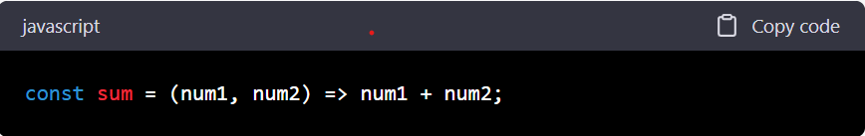
Arrow Functions

Slide 4

What are Arrow
Functions
feature in JavaScript introduced in ES6
provide a concise syntax for writing function expressions.
referred to as "fat arrow" functions
they are not always the best choice
They are not preferred while using ‘this’ or dealing with complex control flows

Slide 5

Map Function ( )
method is used to create a new array
calls a provided function on every element in the original array
It does not modify the original array

Slide 6
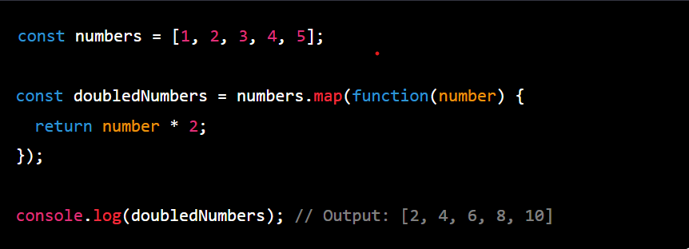

Slide 7

Filter Function ( )
method creates a new array with all elements that pass the test implemented by the provided function
It does not modify the original array

Slide 8
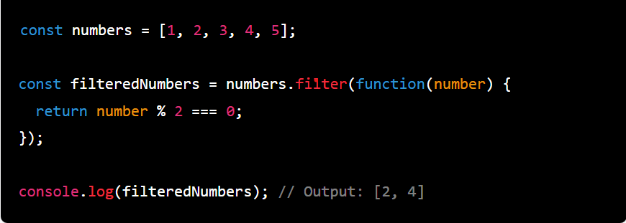

Slide 9
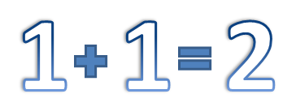
Reduce Function ( )
method returns a single value that results from applying the provided function to each element in the array

Slide 10
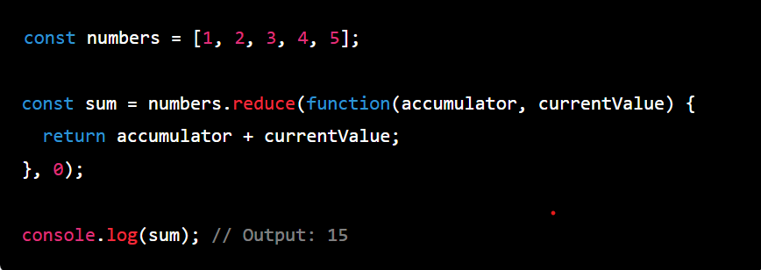

Slide 11
Sync
A synchronous function executes in a blocking manner
meaning that it will stop the execution of the program until it completes its task
This means that any code that comes after the synchronous function call will not be executed until the function has completed
and
Async Functions

Slide 12
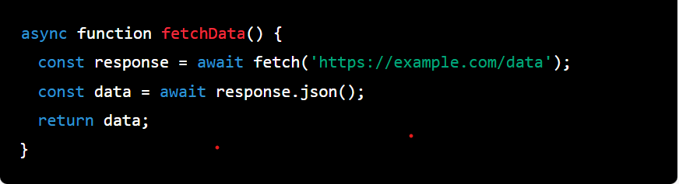
Asynchronous function executes non-blocking
meaning that it will not stop the execution of the program while it is running
it will allow other code to continue running in parallel with the asynchronous function
When the asynchronous function is done executing, it will notify the program that it has completed its task

Slide 13

set of programming instructions and standards that allow developers to access a web-based software application or web tool
it is a collection of methods and protocols that enable developers to interact with other software components or systems
API
Steps to use an API
first find the API documentation which will provide information about the API's endpoints, parameters, and authentication methods
use JavaScript code to make API requests and receive responses
This can be done using various JavaScript libraries and frameworks like Axios, jQuery, and Fetch.

Slide 14
This returns a Promise that resolves to the Response object
We then use the then method to handle the response asynchronously. In the first then callback, we check if the response was successful using the ok property of the Response object. If the response was not successful, we throw an error.
If the response was successful, we call the json method on the Response object to parse the response body as JSON and return it as a Promise. We then use the second then method to handle the parsed JSON data asynchronously and log it to the console.
Finally, we use the catch method to handle any errors that occurred during the fetch operation, such as network errors or errors parsing the response body.
Fetch API
The Fetch API is a modern web API in JavaScript that provides a way to make asynchronous HTTP requests to a server and handle the responses using Promises
The Fetch API provides a simpler and more powerful interface than traditional XMLHttpRequest (XHR) and supports a wider range of data formats, including JSON, text, and binary data

Slide 15
LET’S
DEVELOP

