Slide 1







Harsh
Paresh
Pinaki
Anand
Rama
Gaurav

Slide 2
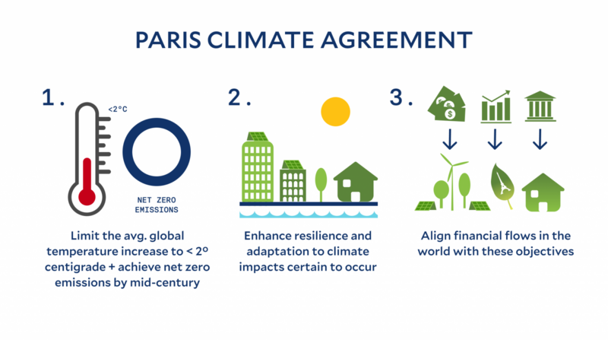
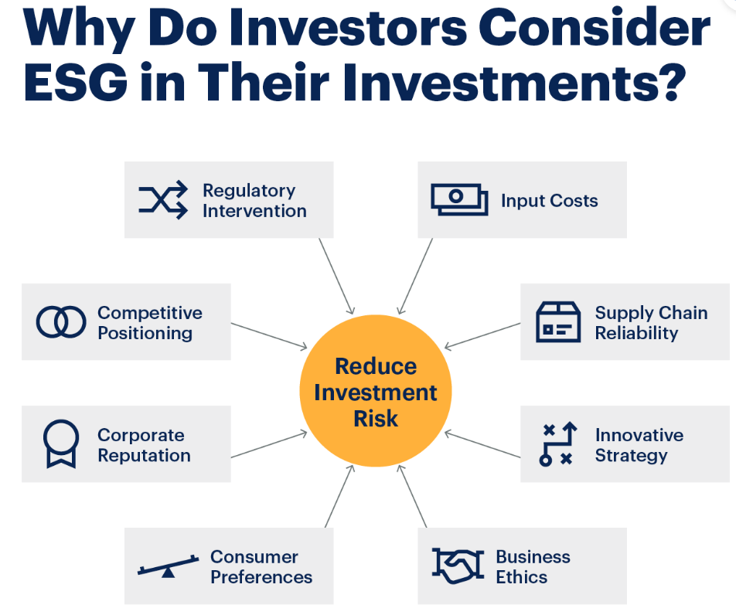

Between 1901 and 2018, the average global sea level rose by 15–25 cm (6–10 in), or 1–2 mm per year.
This rate is increasing; sea levels are now rising at a rate of 3.7 mm (0.146 inches) per year.

Slide 3
Approach we took…
Prepared a diverse portfolio with 680 tickers
We have used Yahoo Finance, S&P to get the tickers detail
Using CLIMADA libraries for Impact/Damage ratio calculation
Calculating total ESG scores for each ticker
On based on above we have derived portfolio weights- Portfolio Index
Added a New ticker from UI
Recalculated portfolio index based on ESG scores
Historic performance comparison between S&P 500 and our port folio - Graph View
Changes in portfolio when an ESG event occurs projecting future prices using Linear regression - Graph View
Architecture Diagram – Gaurav

Slide 4
Assumptions
We are only considering adding new tickers to portfolio
We are calculating climate impact on domicile basis
We are using closing prices for all calculations
Tech Stack
Python, Flask, Scikit Learn, React JS, AG GRID, Docker, Git, Azure Cloud
Challenges
CLIMADA Integration
Lack of open source data on ESG
Steep domain learning curve

Slide 5
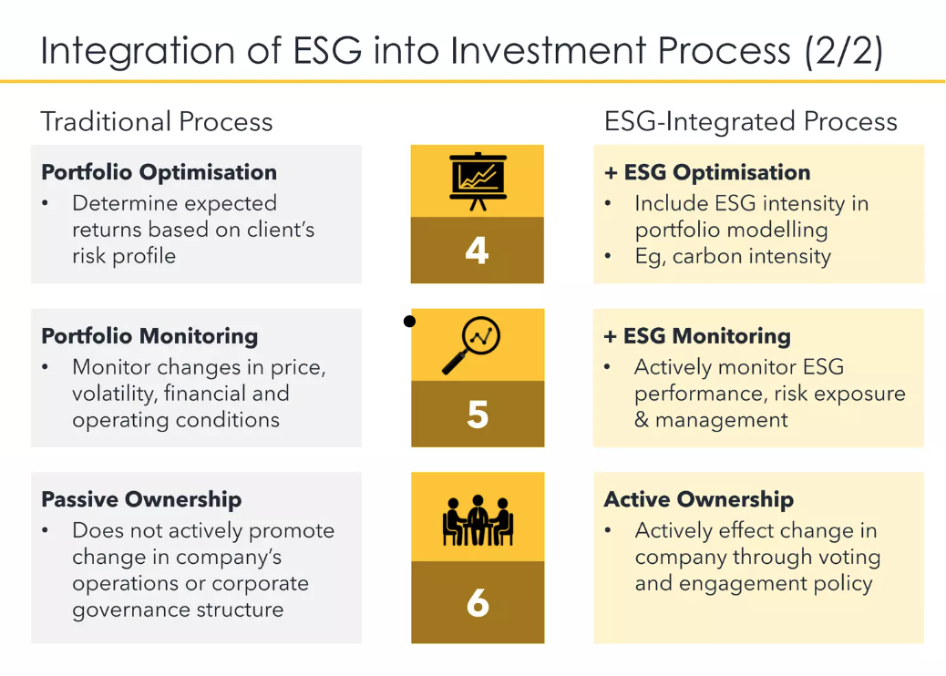

Slide 6


