Slide 1







GRAPPHITE Engine – ESG Portfolio Analyzer
H
P
P
A
R
G

Slide 2

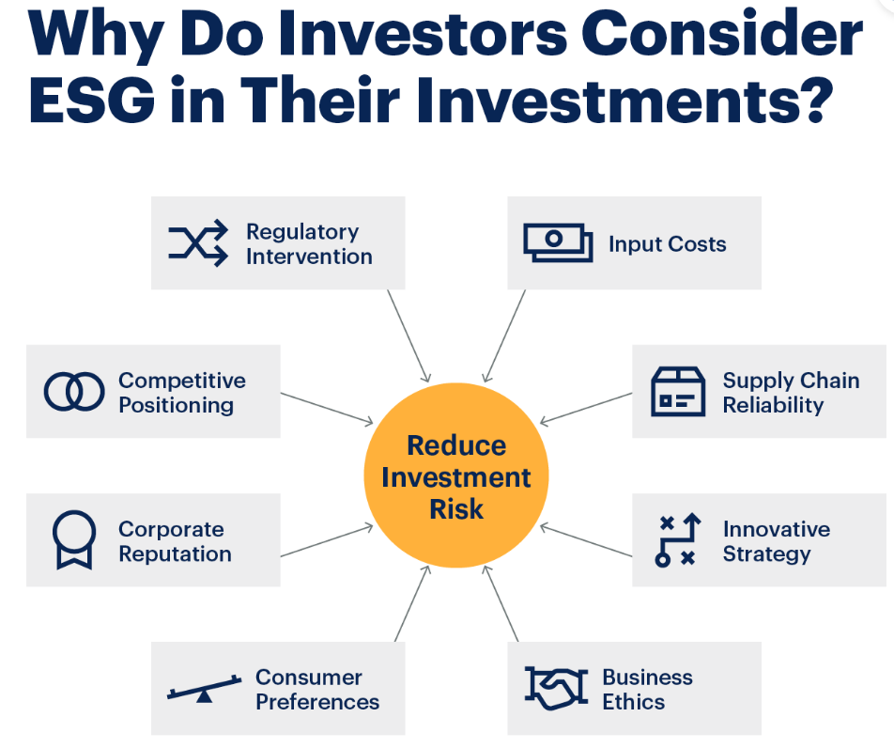
Why ESG is important

Slide 3
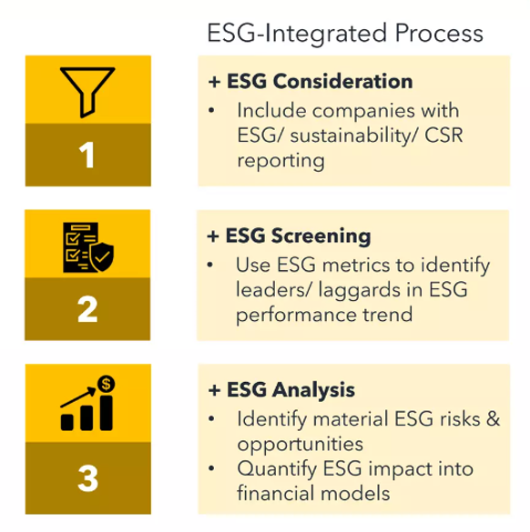
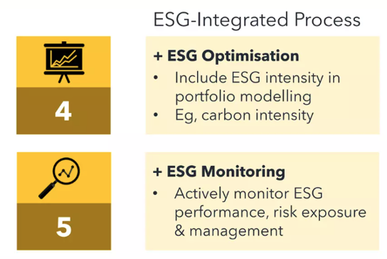


Dealing with ESG Impact

Slide 4
GRAPPHITE Engine – Explained!
Data Engine
Market Data and ESG Scores
ESG maximized Portfolio preparation
Computation
Portfolio index computation
Future projections based on ESG events
Portfolio Management
Add/Remove stocks from portfolio
What-if analysis for ESG events
Impact/Damage calculation
Portfolio performance comparison with S&P500
Assumptions
Only considering adding new stock to the portfolio
Calculating climate impact on domicile basis
Using closing prices for all calculations
Challenges
CLIMADA Integration
Lack of open source data on ESG
Steep domain learning curve

Slide 5
GRAPPHITE Engine – Design
Yahoo Finance
CLIMADA
Tech Stack
Python
Flask
Climada libraries
Scikit Learn
React JS
AG GRID
Docker
Git
Azure Cloud
Engineering Practice
OneClick Deployment- GIT HUB Action
Azure Cloud-Scale Up/Scale Down
Climada libraries
Scikit Learn
6S Factors-
Scalability
Speed
Success
Market Data
Impact Data
Azure Cloud
Docker
GRAPPHITE Engine
Portfolio Index Calculator
Impact Analyser
Projection Model
Portfolio Events
Portfolio Manager UI

Slide 6

Team GRAPPH

Slide 7
Appendix

Slide 8
Cloud Native – 15 Factors
One codebase, one application
API first
Dependency management
Logs
Disposability
Backing services
Port binding
Stateless processes
Concurrency
Design, build, release, and run
Configuration, credentials, and code
Environment parity
Administrative processes
Telemetry
Authentication and authorization

