Slide 1







GRAPPHTE Engine – ESG Portfolio Analyzer
H
P
P
A
R
G

Slide 2

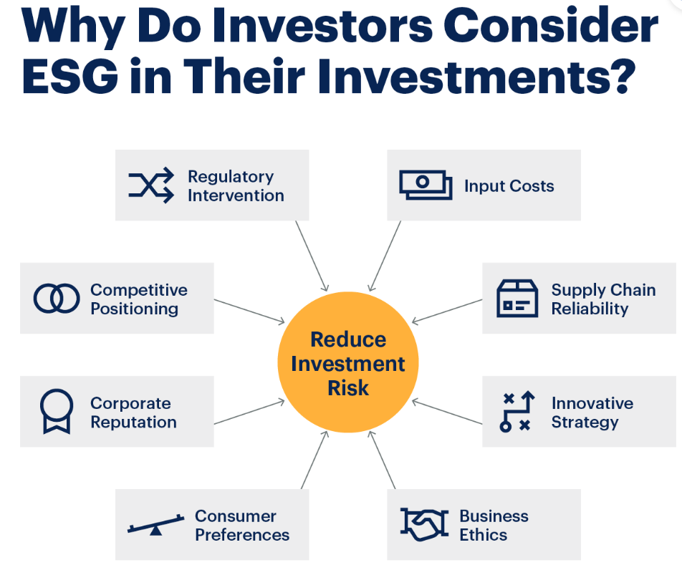
Why ESG is important

Slide 3
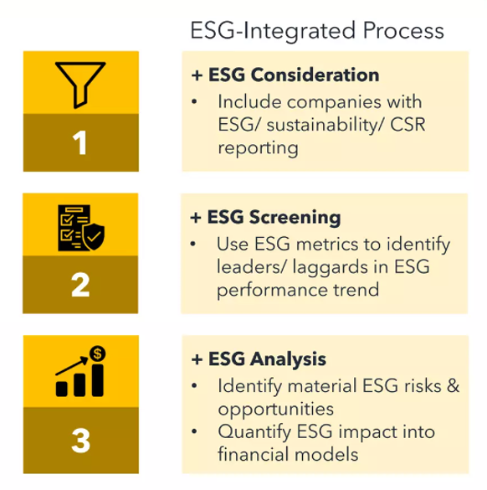
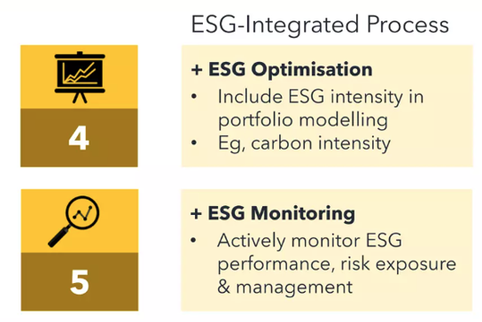
Dealing with ESG Impact

Slide 4
GRAPPHITE Engine – Explained!
Our Approach
Prepared a diverse portfolio with 680 tickers
We have used Yahoo Finance, S&P to get the tickers detail
Using CLIMADA libraries for Impact/Damage ratio calculation
Calculating total ESG scores for each ticker
On based on above we have derived portfolio weights- Portfolio Index
Added a New ticker from UI
Recalculated portfolio index based on ESG scores
Historic performance comparison between S&P 500 and our port folio - Graph View
Portfolio impact when an ESG event occurs – Graph View
Projecting future prices using Linear regression - Graph View
Assumptions
We are only considering adding new tickers to portfolio
We are calculating climate impact on domicile basis
We are using closing prices for all calculations
Challenges
CLIMADA Integration
Lack of open source data on ESG
Steep domain learning curve

Slide 5
GRAPPHITE Engine – Design
Yahoo Finance
CLIMADA
Tech Stack
Python
Flask
Scikit Learn
React JS
AG GRID
Docker
Git
Azure Cloud
Market Data
Impact Data
Azure Cloud
Docker
GRAPPHITE Engine
Portfolio Index Calculator
Impact Analyser
Projection Model
Portfolio Events
Portfolio Manager UI

