Slide 1







GRAPPHTE Engine – ESG Portfolio Analyzer
H
P
P
A
R
G

Slide 2

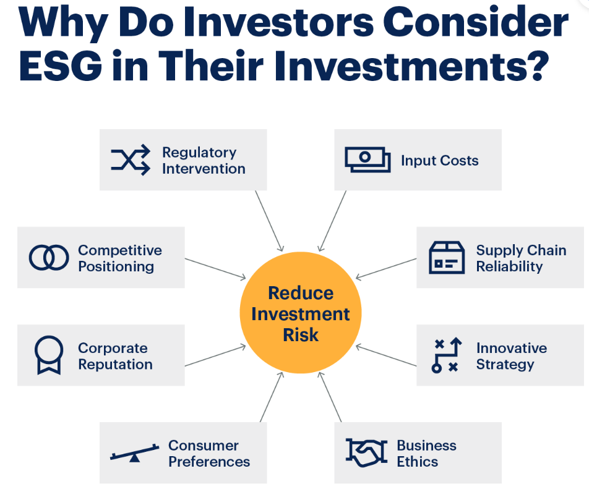
Why ESG is important

Slide 3
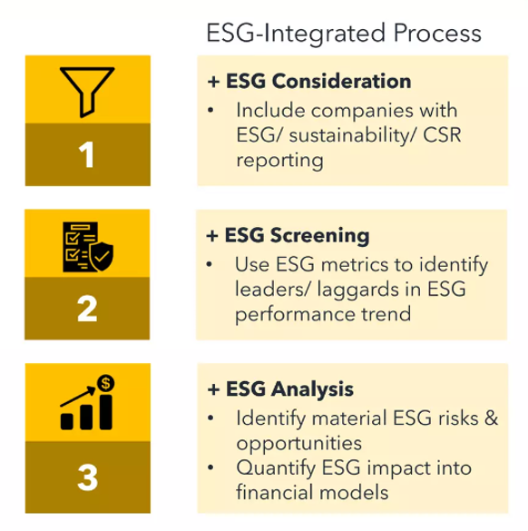
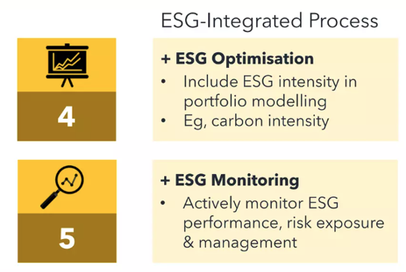

Slide 4
Our Approach
Prepared a diverse portfolio with 680 tickers
We have used Yahoo Finance, S&P to get the tickers detail
Using CLIMADA libraries for Impact/Damage ratio calculation
Calculating total ESG scores for each ticker
On based on above we have derived portfolio weights- Portfolio Index
Added a New ticker from UI
Recalculated portfolio index based on ESG scores
Historic performance comparison between S&P 500 and our port folio - Graph View
Portfolio impact when an ESG event occurs – Graph View
Projecting future prices using Linear regression - Graph View
Architecture Diagram
Yahoo Finance
Market Data
GRAPPHITE Engine
CLIMADA
Portfolio Index Calculator
Impact Analyser
Projection Model
Impact Data
Portfolio Events
Portfolio Manager UI

Slide 5
Assumptions
We are only considering adding new tickers to portfolio
We are calculating climate impact on domicile basis
We are using closing prices for all calculations
Tech Stack
Python, Flask, Scikit Learn, React JS, AG GRID, Docker, Git, Azure Cloud
Challenges
CLIMADA Integration
Lack of open source data on ESG
Steep domain learning curve

