Slide 1
Project Telepathy

Slide 2
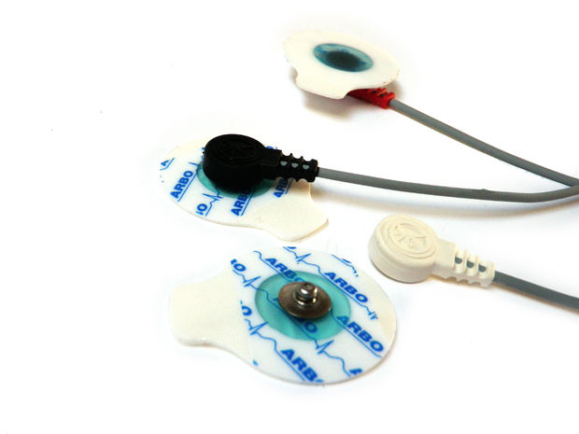
EMG Electrodes
Measures electrical activity produced by muscles
Potential difference between two separate electrodes
Non intrusive electrodes

Slide 3
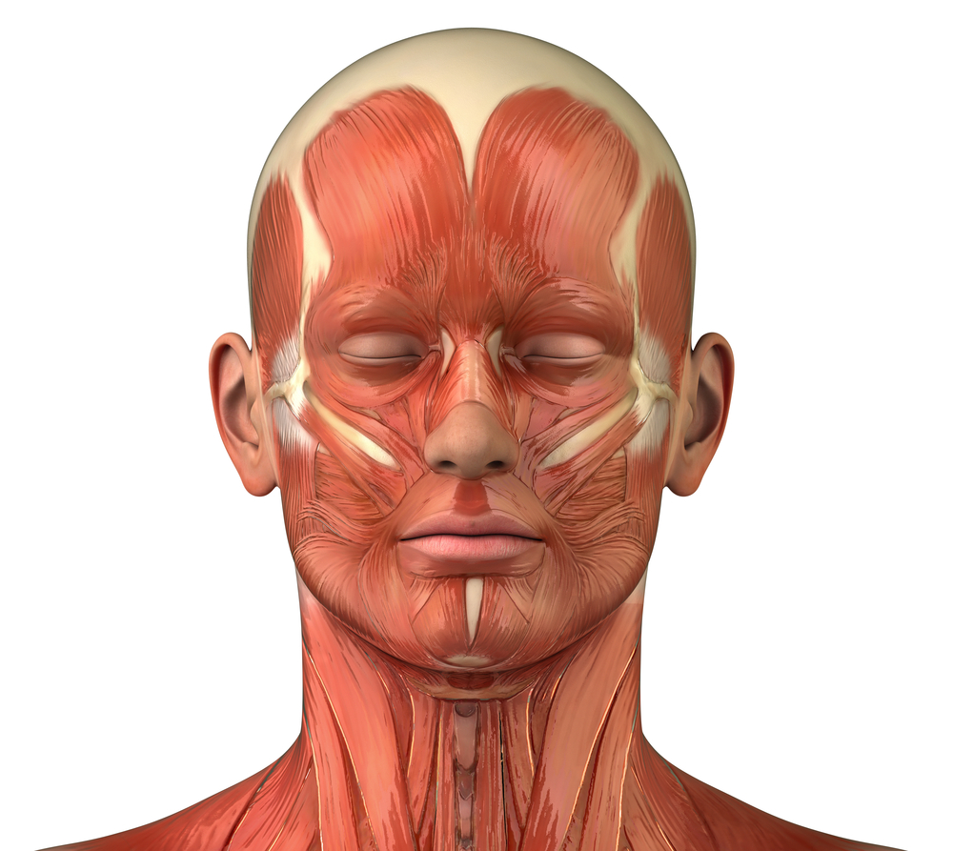
Muscles chosen
orbicularis oris upper
orbicularis oris lower
depressor labii inferioris
mylohyoid

Slide 4
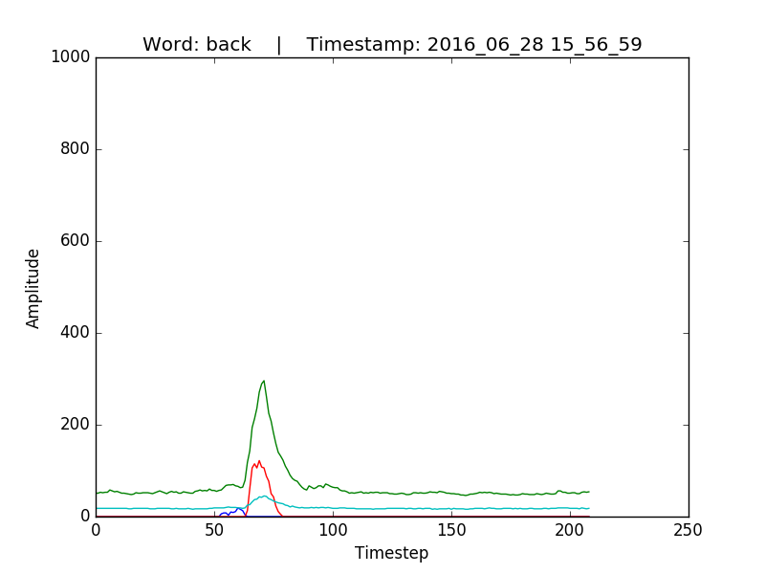
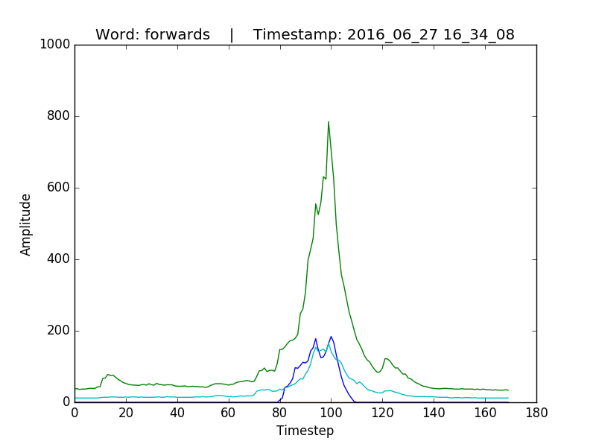
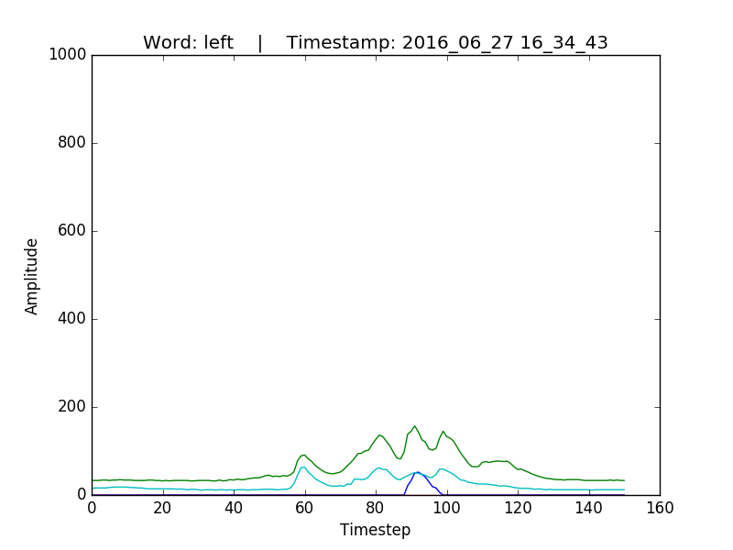
Data obtained:

Slide 5
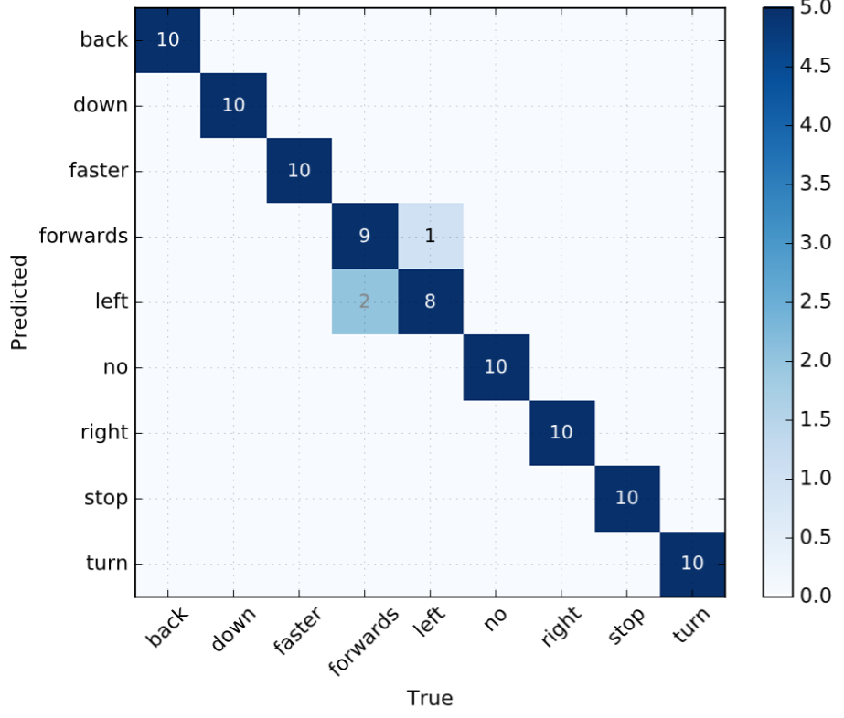
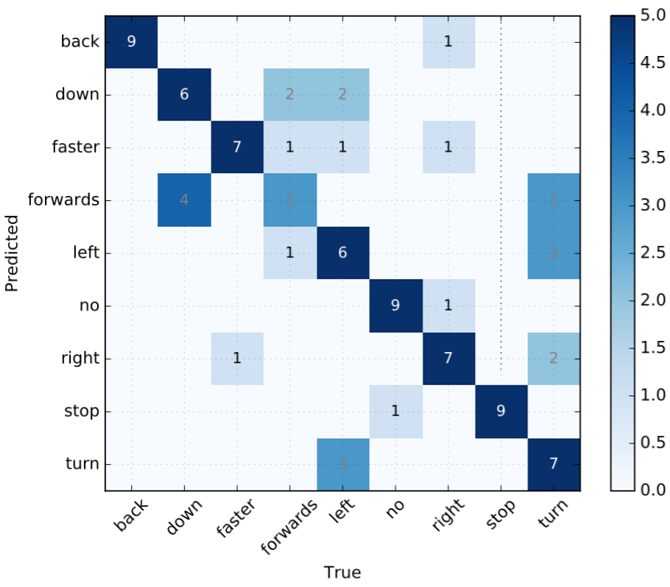
Results
LDA classifier better than SVM and NN
Rate of accuracy varies between 60-95%
Depends on different feature combinations

