Slide 1
MongoDB 3.x

Slide 2
ACID
Atomicity
"all or nothing": if one part of the transaction fails, the entire transaction fails, and the database state is left unchanged
Consistency
Ensures that any transaction will bring the database from one valid state to another. Any data written to the database must be valid according to all defined rules (constraints, cascades, triggers etc).

Slide 3
ACID
Isolation
Ensures that the concurrent execution of transactions results in a system state that could have been obtained if transactions are executed serially
Durability
Means that once a transaction has been committed, it will remain so, even in the event of power loss, crashes, or errors

Slide 4
CAP Theorem
Consistency
A service that is consistent should follow the rule of ordering for updates that spread across all replicas in a cluster - “what you write is what you read”, regardless of location.
Availability
A service should be available. There should be a guarantee that every request receives a response about whether it was successful or failed.
Partition Tolerance
The system continues to operate despite arbitrary message loss or failure of part of the system.

Slide 5
CAP Theorem continued…
Though its desirable to have Consistency, High-Availability and Partition-tolerance in every system, unfortunately no system can achieve all three at the same time.

Slide 6
BASE Model
Basic Availability:
Data will be available even in case of multiple failures. This is possible by spreading the data across many storage systems with a high degree of replication.
Soft state:
The state of the system could change over time, so even during times without input there may be changes going on due to ‘eventual consistency,’ thus the state of the system is always ‘soft.’
Eventual consistency:
The system will eventually become consistent once it stops receiving input. The data will propagate to everywhere it should sooner or later, but the system will continue to receive input and is not checking the consistency of every transaction before it moves onto the next one.

Slide 7
Eventual Consistency
Given a sufficiently long period of time over which no changes are sent, all updates can be expected to propagate eventually through the system and all the replicas will be consistent
Conflict resolution:
Read repair: The correction is done when a read finds an inconsistency. This slows down the read operation.
Write repair: The correction takes place during a write operation, if an inconsistency has been found, slowing down the write operation.
Asynchronous repair: The correction is not part of a read or write operation.

Slide 8
ACID vs. BASE
Sr.No. | ACID (used in RDBMS) | BASE (used in NoSQL)
1. | Strong consistency | Weak consistency (Stale data OK)
2. | Isolation | Last write wins
3. | Transaction | Program managed
4. | Robust database | Simple database
5. | Consistent & Partion-tolerant | Available & Partition-tolerant

Slide 9
RDBMS vs NoSQL
Sr.No. | RDBMS | NoSQL
1. | Handles Limited Data Volumes | Handles Huge Data Volumes
2. | Vertically scaled (Scale-in) | Horizontally scaled (Scale-out)
3. | SQL is used as query language | No declarative query language
4. | Predefined Schema | Schema less
5. | Supports relational data and its relationships are stored in separate tables | Supports unstructured and unpredictable data
6. | Based on ACID model | Based on BASE model
7. | Transaction Management is strong | Transaction Management is weak

Slide 10

NoSQL introduction
NoSQL is a non-relational database management system, different from traditional RDBMS in some significant ways
Carlo Strozzi used the term NoSQL in 1998 to name his lightweight, open-source relational database that did not expose the standard SQL interface

Slide 11

NoSQL introduction
In 2009, Eric Evans reused the term to refer databases which are non-relational, distributed, and does not conform to ACID
The NoSQL term should be used as in the Not-Only-SQL and not as No to SQL or Never SQL

Slide 12
When to use NoSQL
You need to handle extremely large data sets.
You need extremely fast in-memory data.
You need Schema less & de-normalized database.
You want to handle database in Object oriented fashion.

Slide 13









NoSQL (Not only SQL)
Document DBs
MongoDB, CouchDB, …
Graph DBs
Neo4j, FlockDB…
Column oriented DBs
HBase, Cassandra, BigTable…
Key-Value DBs
Memcache, MemcacheDB, Redis,
Voldemort, Dynamo…

Slide 14
Document based DBs
The data which is a collection of key value pairs is compressed as a document store quite similar to a key-value store. However, the only difference is that the values stored (referred as “documents”) provide some structure and encoding of the managed data. XML, JSON, BSON (Binary JSON) are some common standard encodings.

Slide 15
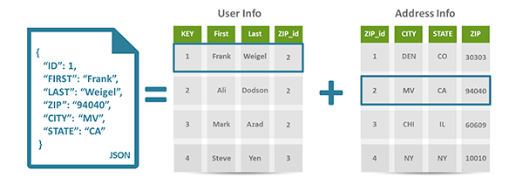
Document based DBs continue…

Slide 16
Graph based DBs
In Graph based databases, data is stored using flexible graph based representation. It uses the following terms:
Node: Nodes represent entities such as people, businesses, accounts, or any other item you might want to keep track of.
Properties: Properties are pertinent information that relate to nodes. For instance, if "Account" were one of the nodes, one might have it tied to properties such as "accno", "acc_name".
Edges: Edges are the lines that connect nodes to nodes or nodes to properties and they represent the relationship between the two.

Slide 17
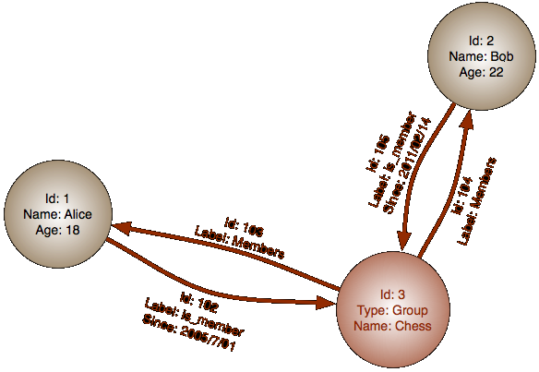
Graph based DBs continue…

Slide 18
Column based DBs
In column-oriented NoSQL database, data is stored in cells grouped in columns of data rather than as rows of data. Columns are logically grouped into column families. Column families can contain a virtually unlimited number of columns that can be created at runtime or the definition of the schema. Read and write is done using columns rather than rows.

Slide 19
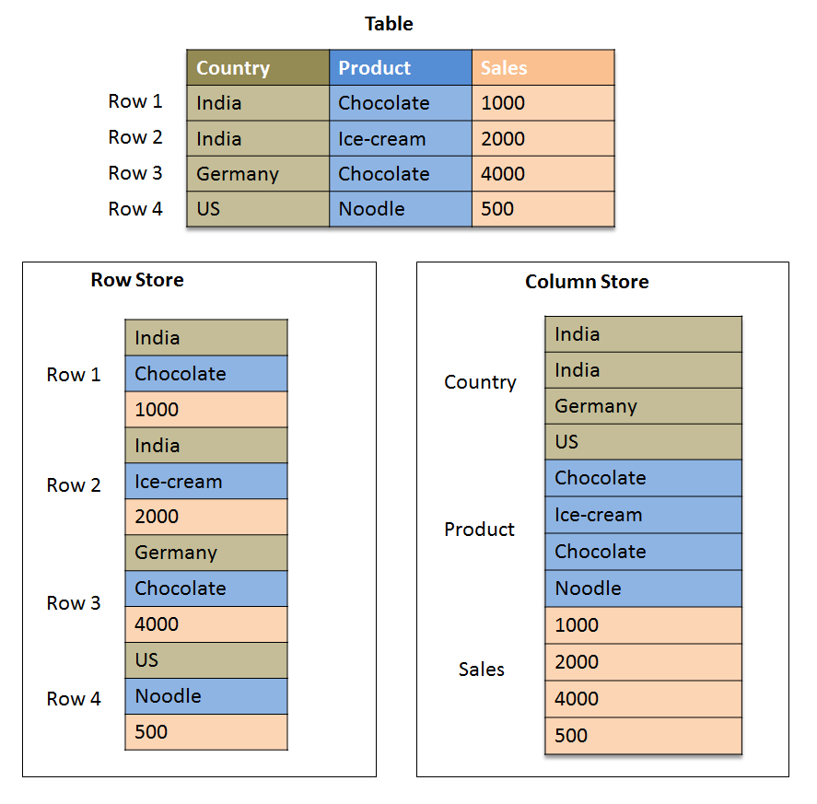
Column based DBs continue..

Slide 20
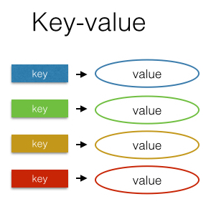
Key-value based DBs
The key-value NoSQL database uses a hash table in which there exists a unique key and a pointer to a particular item of data.

Slide 21
Introduction to MongoDB
MongoDB was developed in 2007 by a New York based organization '10gen' which is now called as MongoDB Inc.
The word Mongo is derived from the word Humongous means very large.
MongoDB is developed using C++ & JavaScript programming languages.
Download MongoDB & refer its documentation at https://www.mongodb.org/
Mongo works on default port 27017.

Slide 22
Advantages of MongoDB
Simplicity
Mongo adopts storage in JSON format makes it simple database rather than adding complexities that come with relational databases.
Data Replication and Reliability
MongoDB allow users to replicate data on multiple mirrored servers which ensures data reliability. In case a server crashes, its mirror is still available and database processing remains unaltered.
NoSQL Queries
Mongo JSON Based document oriented queries are extremely fast as compared to traditional sql queries.
Schema Free Migrations
In MongoDB, schema is defined by the code. Hence, in case of database migrations, no schema compatibility issue arises.
Open Source
MongoDB is a database server that is open source and customizable according to the requirements of the organization.

Slide 23
MongoDB installation
Download MongoDB from https://www.mongodb.org/downloads
Install the .msi file. Note that Mongo goes not support windows XP.
Create a directory c:\data\db since MongoDB’s default data directory is located there.
You may override the default directory using following command:
%MONGO_HOME%\bin>mongod.exe –dbpath c:\mongodb\db
In order to start mongodb, use the command mongod.exe.
In order to fire queries, use the command mongo.exe
More info at https://docs.mongodb.org/manual/tutorial/install-mongodb-on-windows/

Slide 24
MongoDB GUI clients
MongoVUE (http://www.mongovue.com/)
Robomongo (http://robomongo.org/)
RockMongo (http://rockmongo.com/)

Slide 25
MongoDB Terminologies
RDBMS | MongoDB
Database | Database
Table | Collection
Tuple/Row | Document
Column | Field
Table Join | Embedded documents
Primary key | Primary key supplied by MongoDB itself

Slide 26
MongoDB datatypes
Double
String
Object
Array
Binary Data
ObjectId
Boolean
Date
Null
Integer
Timestamp

Slide 27
Mongo queries
Create new database: >use xordb
Find the current database: >db
List down all databases: >show dbs
Delete database: >use xordb THEN >db.dropDatabase()
Create collection: >db.createCollection("orders")

Slide 28
Mongo queries continued…
List all collection from database: >show collections
Drop collection: >db.COLLECTION_NAME.drop()
Insert document: >db.COLLECTION_NAME.insert({ name: 'Chairs', quantity: 35, price: 5000})
Display all documents within collection: >db.COLLECTION_NAME.find().pretty()

Slide 29
Mongo queries continued…
Find documents based upon filter criteria:
>db.Orders.find({name: 'Bag Purchase'}).pretty()
>db.Orders.find({price: {$lt: 60000}}).pretty()
>db.Orders.find({$or: [ { price: {$lt: 60000}}, {name: 'Bag Purchase'} ] }).pretty()
Update document:
>db.Orders.update({name: 'Car Purchase'}, {$set: {name: 'Car sale' }})

Slide 30
Mongo queries continued…
Save document:
>db.Orders.save({
"_id": ObjectId("565bbac2c95843b6ef06c00a"), "name": "Handbag purchase", "price": 2300
})
Delete document:
>db.Orders.remove({ name: "Handbag purchase" })
>db.Orders.remove({ name: "Handbag purchase" }, 1)
>db.Orders.remove()

Slide 31
Mongo queries continued…
Projection in document:
>db.Orders.find({name: 'Laptop Purchase'}, {price: 1}).pretty()
Limiting documents:
>db.Orders.find().limit(2).pretty()
Skipping documents:
>db.Orders.find().limit(1).skip(1).pretty()
Sorting documents:
>db.Orders.find().sort({price: 1}).pretty()

Slide 32
Capped collections
db.createCollection("logs",{capped:true,size:10000,max:1000})
Capped collections are fixed-size circular collections.
Capped collection will start deleting the oldest document in the collection without providing any explicit command.
Capped collection follows FIFO(First in first out) model.
The aggregation pipeline operator $out cannot write results to a capped collection.
If the size field is less than or equal to 4096, then the collection will have a cap of 4096 bytes.
You cannot shard a capped collection.

Slide 33
Capped collections continue…
We cannot delete a document from capped collection.
db.logs.remove({status: ‘DONE’) // Error
Convert existing collection to capped:
db.runCommand({"convertToCapped":“logs",size:10000})
Find out whether a collection is capped or not:
db.logs.isCapped()
Performing find() operation on capped collection gives results ordering same as the insertion order. However, if we wish to reverse it, for example I wish to find out last 5 logs from ‘logs’ collection then use:
db.logs.find().sort( { $natural: -1 } )

Slide 34
Mongo shell methods
Mongo provides extensive support of built-in methods that helps to write complex query. You can find the complete list of methods at:
https://docs.mongodb.org/manual/reference/method/

Slide 35
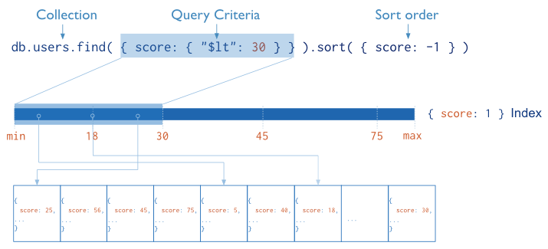
Mongo Indexing
Indexes are special data structures that store a small portion of the collection’s data set in an easy to traverse form.
The index stores the value of a specific field or set of fields, ordered by the value of the field.

Slide 36
Why Indexing?
Using indexing, mongo need not scan every document in a collection.
Indexing improves query execution performance.

Slide 37
Index types
_id (default)
All MongoDB collections have an index on the _id field that exists by default.
Single Field
db.users.createIndex( { "name" : 1 } )
Compound Index
db.users.createIndex( { "name" : 1, “marks “: -1} )
Multikey Index
Multikey indexes are applicable for the fields that hold an array value.
db.users.createIndex({ users.phones: 1})
Notes:
Prove that if we add index then mongo scans less number of documents. Steps:
for(i=0;i<1000;i++) db.orders.insert({price: i, quantity: i})
db.orders.find({price: 500}).pretty().explain("executionStats"): It will show "totalDocsExamined" : 1000
Now add index price field: db.orders.createIndex({price: 1})
Run the same query again: db.orders.find({price: 500}).pretty().explain("executionStats"): It will show "totalDocsExamined" : 1
This proves that adding index improves the efficiency.

Slide 38
Index types continue…
Geospatial Index
To execute queries on geospatial co-ordinate data, mongo provides geospatial index.
Text Indexes
MongoDB provides text indexes to support text search of string content in documents of a collection.
db.feedback.createIndex( { comments: "text" } )
Hashed Indexes
Hashed index type indexes the hash of the value of a field. It is used in hash based sharding.

Slide 39
Key points about indexes
You can drop a mongo index using following query:
db.users.dropIndex( { “name": 1 } )
You can drop all the indexes on your collection using:
db.users.dropIndexes();
You can list down all indexes applied on any collection using:
db.getCollection('Orders').getIndexes()
In order to improve the query performance, no of indexes on a collection needs to be optimized. It means, no index or many indexes on collection, both will increase the query execution time.
To analyze the query execution, use .explain().

Slide 40
Covered queries
Indexes improve the efficiency of read operations by reducing the amount of data that query operations need to process. Hence it is recommended to index the fields which are mentioned in your query.
A query is called as ‘Covered Query’ if:
all the fields in the query are part of an index, and
all the fields returned in the results are in the same index.
For example:
db.users.createIndex( { "name" : 1, “marks “: -1} )
db.users.find({marks: 75}, {name: 1})

Slide 41
MongoDB Text Search
Using "text indexes", we can achieve text search in mongo documents. For example:
db.logs.createIndex( { description: "text" } //text index on description field
db.logs.createIndex( { "$**": "text" } //wildcard index: text index on all string based fields within "logs" collection
"text indexes" can include any field whose value is string or array of string elements.
We can use $text operator to search text through mongo query.
$text operator searches the whole word only.
Notes:
Demo:
db.logs.insert({level: "info", desc: “Apple is a fruit"})
db.logs.insert({level: "debug", desc: “Banana is a fruit"})
db.logs.insert({level: "debug", desc: “Orange is a fruit"})
db.logs.insert({level: "info", desc: “Watermelon is a fruit"})
db.logs.find().pretty()
db.logs.createIndex({"desc": "text"})
db.logs.find({$text: {$search: “Apple"} })
db.logs.aggregate([{$match: {$text: {$search: “Apple"} } }])

Slide 42
MongoDB Text Search
Using $text operator inside find() method:
db.logs.find({$text: {$search: "apple"} })
Using $text operator in aggregation pipeline:
db.logs.aggregate([{$match: {$text: {$search: "apple"} } }])
In order to search the string anywhere within a field:
db.logs.find({"desc": /apple/ })

Slide 43
Mongo Regular Expression ($regex)
$regex operator provides regular expression capabilities for pattern matching strings in queries. The basic syntax is:
{ <field>: { $regex: 'pattern', $options: '<options>' } } OR
{ <field>: { $regex: /pattern/<options> } }
{ name: { $regex: /acme.*corp/, $options: "si" } }
The character ‘^’ means start & ‘$’ means end.
Option | Description
i | Case insensitive pattern match
m | Indicates multiline match
x | Extended capability to ignore all white spaces in $regex pattern.
s | Allows dot character(.) to match all characters including newline characters.

Slide 44
Regular expression examples
Find documents where country starts with ‘Al’ in case insensitive manner:
db.worldinfo.find( { country: { $regex: /^AI/i } } )
Find the multi line feedbacks starting with word ‘You’:
db.feedback.find( { description: { $regex: /^You/, $options: “m” } } )
Find feedbacks starting with word ‘You’ & ignore white spaces, comments (#) & \n:
db.feedback.find( { description: { $regex: /^You/, $options: “x” } } )
Match all characters including new line as well as case insensitive search.
db.feedback.find( { description: { $regex: /m.*line/, $options: “si” } } )
Notes:
db.feedback.insert({ description: "You performed well in first line\nYo yo.. Hahaha!!"})
db.feedback.insert({ description: "You took initiative\nYou are great!!"})
db.feedback.insert({ description: "This is my feedback\nYou are welcome"})
db.feedback.insert({ description: "This is our feedback\nYo yo are welcome"})
db.feedback.insert({ description: "I am writing feedback\nYo u r session was nice"})
db.feedback.find( { description: { $regex: /^yo/i } } )
db.feedback.find( { description: { $regex: /^You/, $options: "m" } } )
db.feedback.find( { description: { $regex: /^You/, $options: "i" } } )
db.feedback.find( { description: { $regex: /^You/, $options: "ix" } } )

Slide 45
MongoDB Aggregation Framework
Sometimes Mongo developer wants to analyze and crunch it in interesting ways. Here we can use aggregation facility provided by Mongo.
Aggregation groups values from multiple documents together, and can perform a variety of operations on the grouped data to return a single result.

Slide 46
Aggregation Framework
The aggregation framework lets you transform and combine documents in a collection. Basically, you build a pipeline that processes a stream of documents through several building blocks: filtering, projecting, grouping, sorting, limiting, and skipping.
Take an example of collection ‘Magazine’ having following fields:
{
"_id" : ObjectId("565c22ba95c0b732f6f6eede"),
"name" : "India Today",
"price" : 150,
"author" : “Ivan"
}

Slide 47
Query example
List down the first 3 authors based upon number of magazines they have published. In order to write Mongo query for this, lets first categorize the steps:
Project the authors out of each magazine document.
Group the authors by name, counting the number of occurrences.
Sort the authors by the occurrence count, descending.
Limit results to the first three.

Slide 48
Query example continued…
In order to project the author from magazine, we use $project operator:
{"$project" : {"author" : 1}}
Grouping by author name & count number of authors within collection, we use $group operator:
{"$group" : {"_id" : "$author", "count" : {"$sum" : 1}}}
Sorting based number of upon magazines published by an author, we use $sort:
{"$sort" : {"count" : -1}}
Show only limited number of records, use $limit:
{"$limit" : 3}

Slide 49
Query example continued…
Final query:
db.magazine.aggregate(
{"$project" : {"author" : 1}},
{"$group" : {"_id" : "$author", "count" : {"$sum" : 1}}},
{"$sort" : {"count" : -1}},
{"$limit" : 2}
)

Slide 50
Pipeline operations
The aggregation framework extensively uses pipeline operations. Here one operator generate document & it becomes input to another operator & so on.. Finally the last operator returns the result to the client.
The operators can be combined in any order & repeated many times as necessary.

Slide 51
Pipeline operators
$project
{ "$project" : {"author" : "$author"} }
$group
{ "$group": { "_id": "$author", "count": {"$sum": 1} } }
$sort
{ "$sort": {count: -1 } }
$limit
{ "$limit": 2 }
$skip
{ $skip : 5 }
$match
{ $match : { author : “Ivan" } }
$unwind
{ $unwind : "$prices" }

Slide 52
$group operators
$sum
"$group" : { "totalRevenue" : {"$sum" : "$revenue"} }
$avg
"$group" : {“averageRevenue" : {"$avg" : "$revenue"}}
$max, $min
"$group" : { “costlyBook”: {“$max”: “$bookPrice”} }
$first, $last
$group: { _id: "$item", firstSalesDate: { $first: "$date" } } }
$addToSet
$group: { _id: { day: { $dayOfYear: "$date"}, itemsSold: { $addToSet: "$item" } } }
$push
$group: { _id: { day: { $dayOfYear: "$date"}, itemsSold: { $push: { item: "$item", quantity: "$quantity" } } } }

Slide 53
Pipeline expressions
Pipeline expressions allow us to perform more powerful operations in aggregation framework like manipulating numeric values, playing with date fields, performing operations on strings, adding various logical conditions etc.
Pipeline expressions are divided into following types:
Mathematical expressions
Date expressions
String expressions
Logical expressions

Slide 54
Mathematical expressions
Mathematical expressions let you to manipulate numeric values.
$add
{ $project: { item: 1, total: { $add: [ "$price", "$fee" ] } } }
$subtract
{ $project: { item: 1, dateDifference: { $subtract: [ "$date", 5 * 60 * 1000 ] } } }
$multiply
{ $project: { date: 1, item: 1, total: { $multiply: [ "$price", "$quantity" ] } } }
$divide
{ $project: { name: 1, workdays: { $divide: [ "$hours", 8 ] } } }
$mod
{ $project: { remainder: { $mod: [ "$hours", "$tasks" ] } } }

Slide 55
Date expressions
Using date expressions, we can perform several operations on date field. For example, in order to find month for a date:
month: { $month: "$date" }
$dayOfYear
$dayOfMonth
$dayOfWeek
$year
$month
$week
$hour
$minute
$second
$milisecond
$dateToString

Slide 56
String expressions
Spring expressions can be used to perform basic operations on string.
$substr
{"$substr" : ["$firstName", 0, 1]}
$concat
{“$concat”: [ “$firstName”, “$lastName” ] }
$toLower
{“$toLower”: “$firstName” }
$toUpper
{“$toUpper”: “$firstName” }

Slide 57
Logical expressions
Logical expressions are used to perform conditional operations.
$cmp
isHighQuantity: { $cmp: [ "$qty", 250 ] }
$strcasecmp
isNameMatching: { $strcasecmp: [ "$firstName", “TOM" ] }
$eq, $ne, $gt, $gte, $lt, $lte
isQuantity250: { $eq: [ "$qty", 250 ] }
$and, $or
result: { $or: [ { $gt: [ "$qty", 250 ] }, { $lt: [ "$qty", 200 ] } ] }
$not
result: { $not: [ { $gt: [ "$qty", 250 ] } ] }
$cond
discount: { $cond: { if: { $gte: [ "$qty", 250 ] }, then: 30, else: 20 } }
$ifNull
description: { $ifNull: [ "$description", "Unspecified" ] }

Slide 58
Useful links
SQL to aggregation mapping chart:
https://docs.mongodb.org/manual/reference/sql-aggregation-comparison/
Aggregation Pipeline Operators
https://docs.mongodb.org/manual/reference/operator/aggregation/

Slide 59
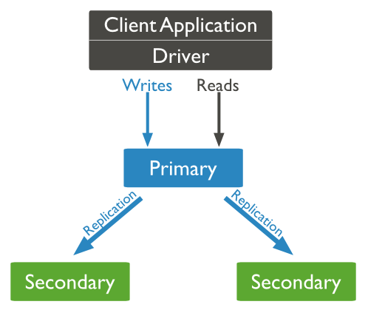
MongoDB Replication

Slide 60
MongoDB replication continued..
What is replication?
Replication is the process of synchronizing data across multiple mongo servers.
Why replication?
High availability of data
Data safety
Disaster recovery
No system downtime for maintenance
Efficient reading due to extra copies of db servers

Slide 61
Replication concepts
The heart of replication is replica set. A replica set is a group of mongod instances that host the same data set. These mongod instances are also called as nodes.
Every replica set should have 2 or more nodes.
Every replica set has one & only one primary node & remaining secondary nodes.
Primary node can be used to read & write the data.
Secondary node is used to only read the data.
In case of primary node failure, election is conducted & any one secondary node becomes primary node.

Slide 62
Setting up Replica set
Create 3 directories for mongo data: c:\data\node1, c:\data\node2, c:\data\node3.
Start 3 mongo instances with different port & different database path:
start mongod --replSet myRes --logpath “c:\data\Node1\1.log" –dbpath " c:\data\Node1” --port 27017
start mongod --replSet myRes --logpath “c:\data\Node2\2.log" –dbpath " c:\data\Node2” --port 27018
start mongod --replSet myRes --logpath “c:\data\Node3\3.log" –dbpath " c:\data\Node3” --port 27019
Connect to mongo default port no instance.
mongo --port 27017

Slide 63
Setting up Replica set continued…
Specify the replica set configuration:
rsconf = {
_id: "myRS",
members: [ { _id: 0, host: “Onkar-Des:27017" } ]
}
Initiate the replica set configuration:
rs.initiate(rsconf)
Configure the replica set:
rs.conf()
Add two secondary nodes in replica set:
rs.add("Anand-KU:27018")
rs.add("Anand-KU:27019")

Slide 64
Testing replica set
Connect to default mongo i.e. 27017
Insert a document in ‘contact’ collection:
db.contact.insert({name: “Tom", phone: 11111})
Connect to mongo at 27018
Enable reading from secondary node:
db.getMongo().setReadPref('secondary')
Read all documents within ‘contact’ collection:
db.contact.find().pretty()
You should get the document inserted inside 27017 mongo instance. This proves that mongo data is getting replicated across all the nodes. You can also try for 27019 port.

Slide 65
MongoDB data backup
The mongodump tool reads data from a MongoDB database and creates high fidelity BSON files. To run mongodump, make sure mongod is running.
To backup complete data of default mongod instance:
>mongodump
To backup complete data of specific mongod instance:
>mongodump --host comp-12 --port 27018
To backup complete data from specified db path to specified backup directory:
>mongodump --dbpath c:\data\db --out c:\data\backup
To backup specified collection of specified database:
>mongodump --collection accounts --db test
To find more details of mongodump command:
>mongodump --help

Slide 66
Restoring mongo dump
mongorestore command is used to restore backup data.
To restore data from ‘dump’ directory to data\db:
>mongostore
To restore data from specified host & port:
>mongorestore --host COMP-12 --port 27018
OR
>mongorestore --host COMP-12:27018
To restore data from accounts collection belonging to test db:
>mongorestore --db test dump\test\accounts.bson --collection accounts

Slide 67
Mongo atomicity & transactions
Write operation is always atomic on a single document.
This atomicity is also applicable on multiple embedded documents within a single document.
However $isolated operator usage achieves multi-document level write operation in atomic fashion.
db.foo.update( { status : "A" , $isolated : 1 } )
$isolated operator ensures that no client sees the changes until write operation on multiple documents is completed.
$isolated is not "all-or-nothing" atomicity.
$isolated operator does not work on sharded clusters.
Notes:
Note that if two simultaneous operations are reading the same document then there is no lock. However if one operation between them is writing/updating the document & another is reading the same document then there would be document level locking applied by MongoDB.

Slide 68
Mongo GridFS
Maximum size of any Mongo document can be 16 MB.
If we wish to add a file into mongo document having length more than 16 MB then we need GridFS.
GridFS can be used where you wish to read small part of large file.
GridFS is a specification for storing and retrieving files that exceed the BSON-document size limit of 16MB.
Instead of storing a file in a single document, GridFS divides a file into parts, or chunks, and stores each chunk as a separate document.
Default chunk size is 255 KB.

Slide 69
Mongo GridFS query
GridFS has two collections for file storage:
fs.chunks (Stores file chunks)
fs.files (Stores file's metadata)
Adding a file into mongo GridFS:
>mongofiles.exe -d testdb put order_details.docx
To see your file call the find() function on fs.files collection:
>db.fs.files.find()
In order to see the chunks stored in fs.chunks:
db.fs.chunks.find({files_id:ObjectId(‘639a811bf8b4aa4d33fdf33f')})
// where ‘639a811bf8b4aa4d33fdf33f’ is a file_id referred from fs.files collection.

Slide 70
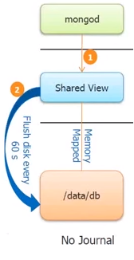
Mongo Journaling
Journaling is a methodology of ‘write ahead logging’ to on-disk journal files.
Any data write without journaling goes to ‘shared view’ which is flushed to persistent file after every 60 sec.
If there is any failure going to happen during 60 sec then shared view data will not be written into file. This is against principle of data durability.

Slide 71
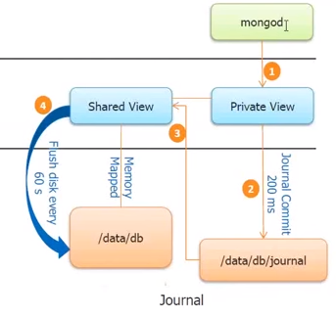
Mongo with Journaling support

Slide 72
Mongo with Journaling support continue…
Journaling is by default enabled in MongoDB 3.0
When we write data using mongo query, the ‘Private view’ registers the query & write it into journal files in every 200 ms. Note that ‘Private view’ does not hold the data.
Now the query is executed & data is written into ‘Shared view’ which flushes the data into file in every 60 sec.
Suppose data is written into ‘Shared view’ but before flushing data into file there is a failure. In such case when we start the mongo db, it looks into journal files & executes the queries which are not flushed into file by ‘Shared view’.

Slide 73
Mongo Sharding
RDBMS uses vertical scaling where as NoSQL uses horizontal scaling. Horizontal scaling is nothing by sharding.
Sharding is a method for storing data across multiple machines.
Sharding, or horizontal scaling, divides the data set and distributes the data over multiple servers, or shards.
Database systems with large data sets and high throughput applications use sharding.

Slide 74
Data distribution in sharding

Slide 75
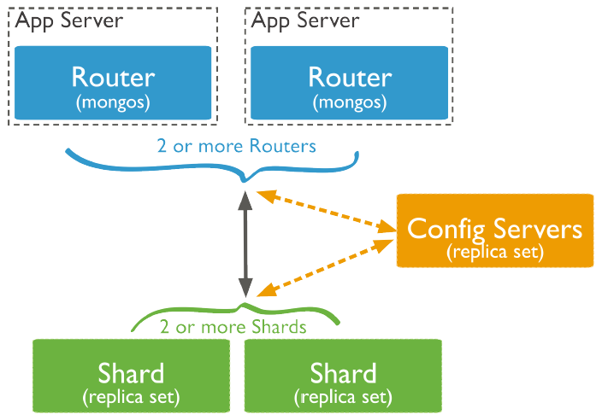
Sharding components

Slide 76
Sharding components continue…
Shard:
Shard stores the data. Each shard is a replica set.
Query routers or mongos:
Query router acts as an interface between client & appropriate shard or shards. A client sends requests to mongos, which then routes the operations to the shards and returns the results to the clients.
Config servers:
Config servers store the cluster’s metadata. This data contains a mapping of the cluster’s data set to the shards. The query router uses this metadata to target operations to specific shards.

Slide 77
Shard keys
To shard a collection, we need to select a shard key from collection fields.
A shard key is either an indexed field or an indexed compound field that exists in every document in the collection.
MongoDB divides the shard key values into chunks and distributes the chunks evenly across the shards.
MongoDB’s division of shard keys into chunks is based upon 2 partitioning principles:
Range based partitioning
Hash based partitioning

Slide 78
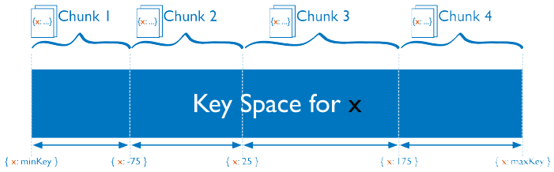
Range based partitioning
In range-based sharding, MongoDB divides the data set into ranges determined by the shard key values to provide range based partitioning.
Documents with “close” shard key values are likely to be in the same chunk, and therefore on the same shard.
Range based partitioning may lead to uneven distribution of data.
Range based partitioning is efficient in case of range based query execution.

Slide 79
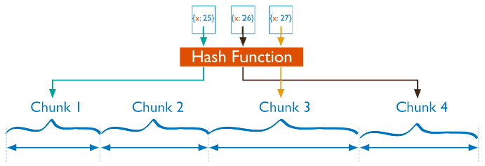
Hash based partitioning
In hash based partitioning, MongoDB computes a hash of a field’s value, and then uses these hashes to create chunks.
With hash based partitioning, two documents with “close” shard key values are unlikely to be part of the same chunk.
We can specify hash based sharding for collection using the following command:
sh.shardCollection( “xordb.users", { username: "hashed" } )

Slide 80
Tag aware sharding
We can achieve customized data distribution using ‘Tag aware sharding’.
‘Tag aware sharding’ allows MongoDB administrators to direct the balancing policy.
Tags are the primary mechanism to control the behavior of the balancer and the distribution of chunks across shards.

Slide 81
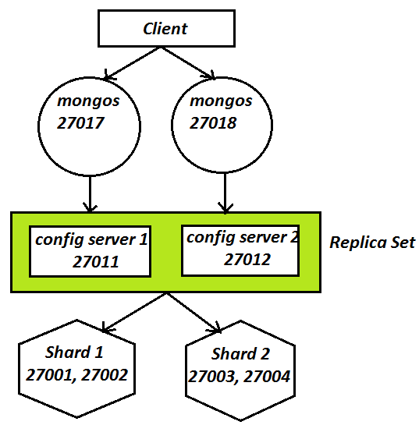
Applying sharding

Slide 82
Steps for applying sharding
Configure multiple shards i.e. replica sets.
Configure replica set for config server.
Configure query router or mongos.
Add shard information to mongos.
sh.addShard("RS_1/COMP12:27001")
Enable sharding on database.
sh.enableSharding("xordb")
Enable sharding on collection.
sh.shardCollection("xordb.users", {_id: 1}, true)
sh.shardCollection("xordb.contacts", {fname: “hashed”})
Try to insert multiple documents into the collection & notice the chunks distribution using sh.status() method.
Notes:
mkdir c:\data\shard1\node1
mkdir c:\data\shard1\node2
mkdir c:\data\shard2\node1
mkdir c:\data\shard2\node2
mkdir c:\data\cfg1
mkdir c:\data\cfg2
start mongod --shardsvr --replSet RS_1 --logpath "shard_1_1.log" --dbpath c:\data\shard1\node1 --port 27001 --logappend --smallfiles --oplogSize 50
start mongod --shardsvr --replSet RS_1 --logpath "shard_1_2.log" --dbpath c:\data\shard1\node2 --port 27002 --logappend --smallfiles --oplogSize 50
start mongod --shardsvr --replSet RS_2 --logpath "shard_2_1.log" --dbpath c:\data\shard2\node1 --port 27003 --logappend --smallfiles --oplogSize 50
start mongod --shardsvr --replSet RS_2 --logpath "shard_2_2.log" --dbpath c:\data\shard2\node2 --port 27004 --logappend --smallfiles --oplogSize 50
start mongo --port 27001
rs_1_conf = {
_id: "RS_1",
members: [
{
_id: 0,
host: "COMP-12:27001"
}
]
}
rs.initiate(rs_1_conf)
rs.conf()
rs.add("COMP-12:27002")
start mongo --port 27002
db.getMongo().setReadPref('secondary')
start mongo --port 27003
rs_2_conf = {
_id: "RS_2",
members: [
{
_id: 0,
host: "COMP-12:27003"
}
]
}
rs.initiate(rs_2_conf)
rs.conf()
rs.add("COMP-12:27004")
start mongo --port 27004
db.getMongo().setReadPref('secondary')
start mongod --configsvr --replSet RS_CONFIG --dbpath c:\data\cfg1 --port 27011 --logpath cfg1.log --logappend
start mongod --configsvr --replSet RS_CONFIG --dbpath c:\data\cfg2 --port 27012 --logpath cfg2.log --logappend
start mongo --port 27011
rs_config_1_conf = {
_id: "RS_CONFIG",
members: [
{
_id: 0,
host: "COMP-12:27011"
}
]
}
rs.initiate(rs_config_1_conf)
rs.conf()
rs.add("COMP-12:27012")
start mongos --configdb RS_CONFIG/COMP-12:27011,COMP-12:27012 --logappend --logpath mongos_1.log --port 27017
start mongos --configdb RS_CONFIG/COMP-12:27011,COMP-12:27012 --logappend --logpath mongos_2.log --port 27018
//Connect to default mongos
start mongo --port 27017
use config
show collections
db.chunks.find()
db.databases.find()
db.shards.find()
mongos>sh.help()
mongos>sh.addShard("RS_1/COMP-12:27001") //any one node is fine.
mongos>sh.addShard("RS_2/COMP-12:27003") //any one node is fine.
mongos>sh.status()
mongos>use config
mongos>show collections
mongos>db.shards.find() //you should get list of all shards configured.
//Lets shard collections now
mongos>sh.help()
mongos>db
mongos>sh.enableSharding("xordb")
mongos>sh.shardCollection("xordb.users", {_id: 1}, true)
mongos>sh.status() //You can find the users collection is sharded
mongos>for(var i=0;i<20000;i++) {
db.xordb.users.insert({x: i, y: 3, z: "test test"});
}
mongos>sh.status() //Notice chunks distribution across shards. ("xordb.users chunks:")
//Try with hashed partitioning
mongos>sh.shardCollection( "xordb.contacts", { name: "hashed" } )
mongos>for(var i=0;i<1000;i++) {
db.xordb.contacts.insert({x: i, y: 3, z: "test test"});
}
mongos>sh.status() //Notice chunks distribution across shards. ("xordb.contacts chunks:")

Slide 83
Questions

