Slide 1

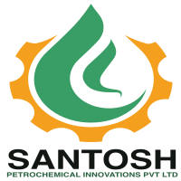
SANTOSH PETROCHEMICAL INNOVATIONS PVT. LTD.
PARTNERSHIP PROPOSAL · MARCH 2026
Group II+ Re-Refined Base Oil
Presented to Indian Oil Corporation Limited 65 TPD Plant · Ghaziabad, UP
₹159 Cr
65 TPD
Total Investment
Plant Capacity
35 Yrs
₹169 Cr+
IOCL Relationship
Revenue by Year 4
Santosh Petrochemical Innovations Pvt. Ltd. · Confidential

Slide 2
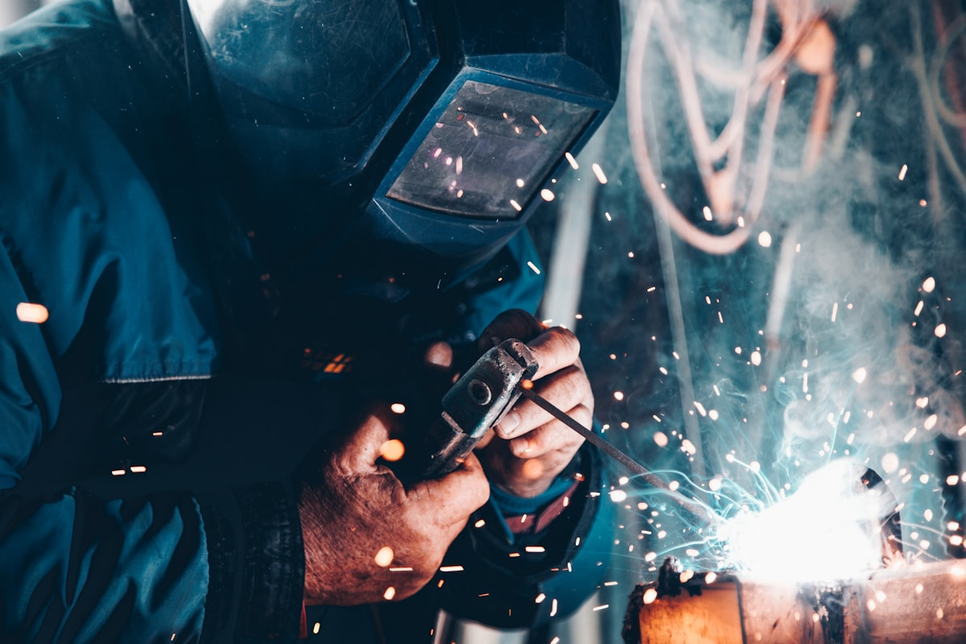
GROUP HISTORY
Two Decades of Partnership with India's Oil Majors
IOCL SSI Stockist (Est. 2003)
SERVO lubricants distributor across 6 districts of Western UP
One of IOCL's longest-standing petroleum product partners
HPCL LPG Bottling (Since Dec 2018)
Private bottler at Amroha, UP — 30 TMT/yr cylinder bottling
Distributing for HPCL dealers across Amroha region
HPCL O&M Contract (Sitarganj Plant)
5-year O&M contract for HPCL Sitarganj LPG Plant
340 TMT total bottling across contract tenure
Santosh Petrochemical Innovations Pvt. Ltd. · Confidential

Slide 3

COMPANY OVERVIEW
India's Next-Gen Group II+ RRBO Producer
Company
Santosh Petrochemical Innovations Pvt. Ltd.
Technology
REVA Process Technologies, Pune (European)
Plant Location
Western Uttar Pradesh (Ghaziabad)
Capacity
65 TPD feed (designed for 200 TPD expansion)
Output
API Group II+ Re-Refined Base Oil (RRBO/LOBS)
By-products
Fuel oil, Asphalt Extender (Residue)
EPR MANDATE TAILWIND
CPCB mandates 5% RRBO blending in FY25, scaling to 50% by FY31. Santosh Group II+ RRBO is purpose-built to fulfil this mandate.
Santosh Petrochemical Innovations Pvt. Ltd. · Confidential

Slide 4
LEADERSHIP TEAM
Experienced Leadership with Deep IOCL Roots
Lalit Bindal
Abhinav Bindal
Pooja Bindal
Robin Kumar
Founder & Managing Director
Director — Engineering & Operations
Director — Administration
Director — Operations
• 35+ years in oil & energy sector
• Structural Engineer, Nabih Youseef Associates, LA
• 8 years independent business management
• Based in Noida, Gautam Budh Nagar
• IOCL SSI Stockist since 2003
• Expertise in large-scale infrastructure design
• Proprietor, Bindal Creation (garments & retail)
• Operations & logistics management
• 6-district SERVO network, Western UP
• Driving digital & commercial strategy
• Financial oversight & administrative leadership
• Supply chain for feedstock collection
Santosh Petrochemical Innovations Pvt. Ltd. · Confidential

Slide 5

MARKET OPPORTUNITY
India's Used Oil Crisis — A ₹28,000 Cr Market
1.3 MMT
<15%
Used lubricating oil generated in India annually
Formally recycled — rest burned or dumped
257
~0
CPCB-registered re-refiners in India
Group II+ RRBO producers in North India
THE SANTOSH ADVANTAGE
Only Group II+ producer in North India. Hydrotreating eliminates sulfur to <300 ppm — competitors (IFP) stuck at Group I via adsorption. EPR-compliant output.
Santosh Petrochemical Innovations Pvt. Ltd. · Confidential

Slide 6

MARKET ANALYSIS
High Growth, Policy-Backed Market
USD 3.38B
~7.9% CAGR
India waste oil market (2025)
Growth to USD 6.22B by 2033
4.2 MMT
5–6 MMT
India lubricant market (FY22)
Projected lubricant market FY31
Regulatory Push
EPR mandate drives formal collection; informal burning criminalised
Rising Vehicle Ownership
Auto sector growth = more used oil generated annually
Import Substitution
Group II+ RRBO replaces costly virgin base oil imports
IOCL-Re MOU (Mar 2026)
India's first national Group II+ RRBO circular economy framework
Santosh Petrochemical Innovations Pvt. Ltd. · Confidential

Slide 7
TECHNOLOGY & PROCESS
6-Step Distillation & Hydrotreating
REVA Process Technologies — European Technology, Indian Scale
01
02
03
04
05
06
Collection & Pre-Screening
Dehydration
Vacuum Distillation
Hydrotreating
Fractionation
QC & Dispatch
Used oil collected. Feed filtered to 150–250 micron at tank farm.
Heated to 120°C. Water, glycol, solvents removed under vacuum.
Heated 280–300°C. Two-step evaporation separates LOBS.
H₂ + metallic catalysts at high pressure. Sulfur → <300 ppm.
Cuts separated: SN 150, SN 500, Bright Stock equivalent.
Viscosity, sulfur, VI, flash point tested. Bulk / drum / IBC.
▶
▶
▶
▶
▶
OUTPUT →
API Group II+ RRBO
VI ≥ 95
Sulfur <300 ppm
Flash Point >200°C
Santosh Petrochemical Innovations Pvt. Ltd. · Confidential

Slide 8
INFRASTRUCTURE
World-Class Plant — SCADA-Controlled, CPCB-Compliant
A. Distillation
Dehydration column, vacuum distillation, WFE (REVA), asphalt collector
B. Hydrotreating
3 reactors with metallic catalysts, heat exchangers, H₂ recycle compressor
C. Fractionation
Fractionation column, pre-heaters, pressure vessels, pumps & coolers
D. Tank Farm
Storage: 1000 KL×2, 500 KL×2, 200 KL×2, 100 KL×2 + vapor recovery
E. Utilities
Thermal oil heater, cooling tower, compressed air, 4 chemical injection systems
F. Control System
SCADA + PLC plant-wide, remote monitoring, VFDs on all pumps
Santosh Petrochemical Innovations Pvt. Ltd. · Confidential

Slide 9

LOCATION STRATEGY
Ghaziabad — Heart of India's Industrial Lubricant Belt
Proximity to NCR, Western UP, and major lubricant blending hubs
NCR Proximity
Delhi-Meerut corridor — access to India's largest auto & industrial cluster
IOCL Distribution Network
Existing 6-district SERVO network = immediate feedstock & customer reach
Western UP Industrial Belt
Ghaziabad, Meerut, Muzaffarnagar, Baghpat — consistent used oil volumes
Highway Connectivity
NH-58 & NH-9 — excellent tanker logistics for inbound feedstock & outbound RRBO
Used Oil Catchment
30M+ vehicles in NCR alone; 200,000+ KL used oil/yr in catchment area
Competitor Gap
IFP (Sahibabad) is only re-refiner nearby — cannot produce Group II+
Santosh Petrochemical Innovations Pvt. Ltd. · Confidential

Slide 10
PROJECT STATUS
Commissioning in Progress — Production Imminent
Pre-Project
Construction
Commissioning
Full Operations
Scale-Up
Year 1
Year 2
Year 3 — NOW
Year 4
Year 5–7
✓ COMPLETE
✓ COMPLETE
> IN PROGRESS
PLANNED
PLANNED
• Company incorporation & DPR
• Civil works, foundations, buildings
• Plant commissioning underway
• 65 TPD full capacity
• Expand to 200 TPD capacity
• Technology partner (REVA) selected
▶
• REVA plant equipment ordered & delivered
▶
• CPCB registration & QC lab (27 instruments)
▶
• Revenue target: ₹169 Cr+
▶
• Pan-India RRBO supply capability
Santosh Petrochemical Innovations Pvt. Ltd. · Confidential

Slide 11

CAPITAL STRUCTURE
Total Project Outlay: ₹159.87 Crore
30% Promoter Equity | 70% Term Loan | 9% Interest Rate
Promoters' Contribution
₹46.62 Cr
30%
Self-funded equity
Term Loan (Plant)
₹94.79 Cr
70%
Bank financing for plant
Working Capital Loan
₹14.00 Cr
70% of WC
Operational working capital
Interest Rate: 9% p.a. (Term Loan & Working Capital)
Santosh Petrochemical Innovations Pvt. Ltd. · Confidential

Slide 12
FINANCIAL MODEL
Revenue ₹169 Cr+ by Year 4
PRODUCTION PROFILE
46 KL/day
65 KL/day
Year 3 — 15,243 KL/yr RRBO
Year 4+ — 21,775 KL/yr RRBO
REVENUE PROJECTION (₹ Crore)
₹280Cr
KEY METRICS
₹240Cr
RRBO Pricing
₹80,000/KL (Y3) → ₹88,305/KL (Y7)
₹200Cr
Feedstock Cost
₹45,000/KL (Y3, rising ~3%/yr)
₹169Cr
Gross Margin
~43–44% on RRBO sales
₹122Cr
Y3
Y4
Y5
Y6
Y7
Santosh Petrochemical Innovations Pvt. Ltd. · Confidential

Slide 13
SCALE-UP PLAN
65 TPD Today → 200 TPD Tomorrow
Designed for scale from day one — infrastructure ready for 3× expansion
PHASE 1
PHASE 2
PHASE 3
Current
Year 5–6
Year 7+
COMMISSIONING
PLANNED
DESIGNED CAPACITY
Feed Capacity
Feed Capacity
Feed Capacity
65 TPD
130 TPD
200 TPD
RRBO Output
→
RRBO Output
→
RRBO Output
~16,000 KL/yr
~32,000 KL/yr
~50,000 KL/yr
Revenue Target
Revenue Target
Revenue Target
₹169 Cr by Year 4
₹320–340 Cr
₹450–500 Cr
EPR mandate scaling from 5% (FY25) → 50% (FY31) will create demand for 650,000+ KL of RRBO annually — far exceeding current formal supply. Santosh is positioned to be North India's primary Group II+ supplier.
Santosh Petrochemical Innovations Pvt. Ltd. · Confidential

Slide 14

FEEDSTOCK STRATEGY
Building a Reliable Feedstock Network
Automotive Workshops
Car/truck service centres — largest used engine oil source in NCR
Industrial Plants
Manufacturing units using hydraulic, gear and cutting oils
Transport Fleets
Commercial trucking & bus depots — regular oil change cycles
IOCL Dealer Network
SERVO stockist relationships enable formal collection
EPR-Registered Collectors
CPCB-registered aggregators incentivised to deliver to re-refiners
15,243 KL
21,775 KL
Year 3 Feed Target
Year 4+ Feed Target
₹45,000/KL
150–200 km
Feedstock Cost (Y3)
Collection Radius
Santosh Petrochemical Innovations Pvt. Ltd. · Confidential

Slide 15

PARTNERSHIPS
Built on Trusted Relationships
REVA Process Technologies, Pune
Technology Partner
• European vacuum distillation + hydrotreating technology
• 70–75% base oil recovery guarantee; ongoing catalyst supply
Indian Oil Corporation Ltd.
23+ Year Partner (SSI since 2003) + IOCL-Re MOU Mar 2026
• 6-district SERVO distribution network; deep trust established
• MOU creates framework for Group II+ RRBO circular economy
Hindustan Petroleum Corp. Ltd.
O&M & Bottling Partner
• LPG Bottling: Amroha — 30 TMT/yr; O&M: Sitarganj — 340 TMT tenure
• Validates Santosh's capacity to operate large-scale energy assets
Santosh Petrochemical Innovations Pvt. Ltd. · Confidential

Slide 16
IOCL PARTNERSHIP ASK
Three Strategic Pillars of Partnership
Together: India's first integrated Group II+ RRBO circular economy in North India
01
02
03
Offtake Agreement — RRBO Supply
Feedstock Collection — Used Oil Network
Strategic Investment & Technical Support
• Preferred supplier for Group II+ RRBO to IOCL blending plants
• Leverage IOCL SERVO dealer network as used oil collection points
• IOCL equity or debt participation to accelerate 200 TPD scale-up
• 3–5 year structured offtake, volume-tiered, aligned to EPR ramp
• IOCL dealers earn collection incentives; IOCL earns EPR credit
• Technical validation from IOCL R&D (Faridabad)
• SN 150, SN 500, Bright Stock grades available
• Santosh provides containers, logistics, EPR certificates
• Joint branding: IOCL-certified Group II+ RRBO
• Enables IOCL SERVO to meet CPCB EPR mandates
• Formalised, traceable feedstock pipeline — replaces informal burning
• LOI/MOU to unlock bank financing at preferential rates
Santosh Petrochemical Innovations Pvt. Ltd. · Confidential

Slide 17
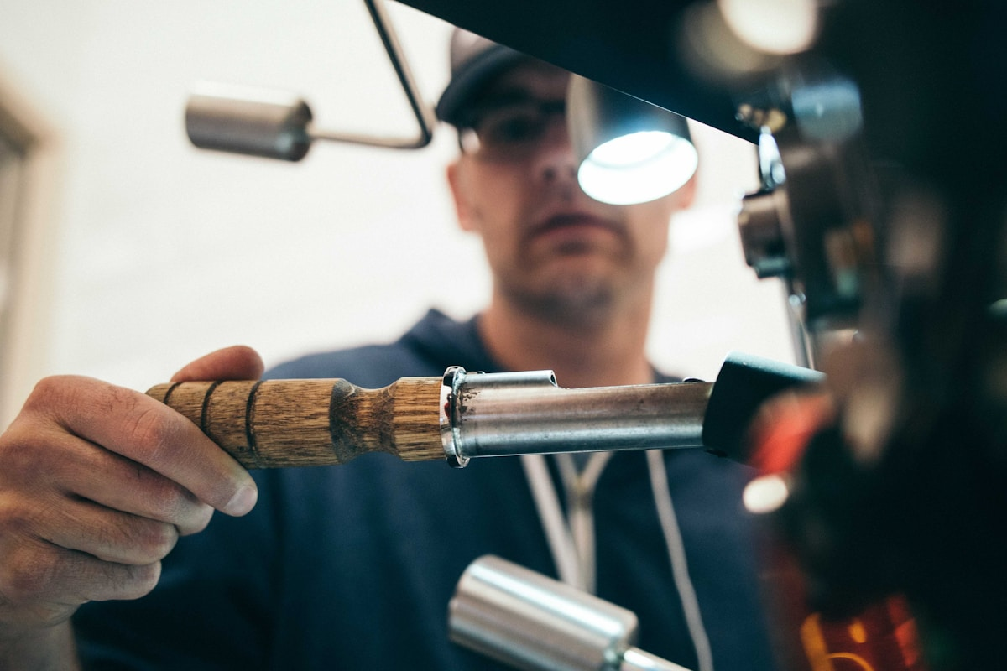
IOCL VALUE PROP
Why This Partnership Delivers for IOCL
EPR Compliance — Zero CapEx
SERVO Dealer Network Monetisation
SERVO must blend RRBO per CPCB mandate. Source from Santosh, skip building own re-refinery.
Dealers become collection points, earn per-litre fees. Deepens dealer relationships.
Captive Group II+ Supply in North India
Import Substitution Alignment
No certified Group II+ RRBO producer in North India. Santosh fills this gap.
Group II+ currently imported. Domestic RRBO from Santosh reduces forex outflow.
Circular Economy Credential
Trusted Promoter — 23+ Year Track Record
IOCL-Re MOU (Mar 2026) commits to Group II+ circular economy. Santosh makes it real.
Lalit Bindal has been an IOCL SSI for 23+ years. This is an existing partnership.
Santosh Petrochemical Innovations Pvt. Ltd. · Confidential

Slide 18

NEXT STEPS
Let's Build India's Circular Oil Economy Together
1
Site Visit
IOCL team visits Ghaziabad plant — inspect commissioning progress & technology
2
Technical Review
Share DPR, lab data, REVA process docs with IOCL R&D (Faridabad)
3
MOU / Letter of Intent
Non-binding MOU covering RRBO offtake volumes, feedstock, investment framework
4
Commercial Agreement
Binding offtake agreement, pricing formula, EPR transfer mechanism — target Q2 FY26
Lalit Bindal — Managing Director
santoshgzb@yahoo.com · +91 98101 21438 · www.santosh-petrochemical.com
Santosh Petrochemical Innovations Pvt. Ltd. · Confidential

