Slide 1
Analytical CRM Development for a Bank
Ankur Bhatia

Slide 2
INTRODUCTION
Customer churn, the rate at which customers stop using a company's products or services, is a crucial metric for banks.
It directly impacts revenue and profitability.
In this presentation, we will analyze our bank's customer churn rates, focusing on gender, recent years, customers with credit cards, number of products used, credit score-wise churn count, and geography-wise churn count.
Our goal is to identify factors contributing to churn and propose strategies to improve customer retention and satisfaction.

Slide 3
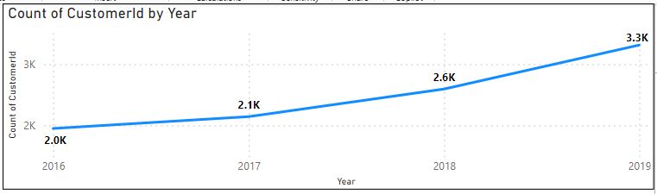
Churn Churn Rate Trends Trends
Analysis:
Significant increase in 2017 Stabilized in 2018 and 2019
Recommendation:
Monitor closely for emerging trends.
Implement targeted strategies for stability.

Slide 4
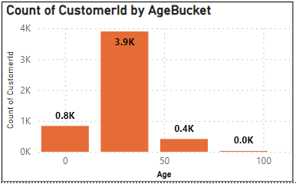
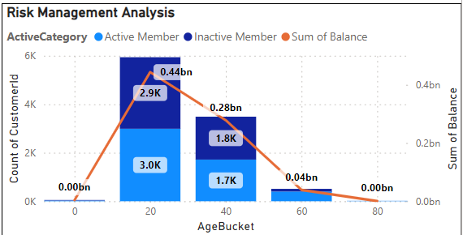
Churn Analysis by Age
Age 0-30: 837 customers, mostly inactive.
Age 30-60: 3,899 customers with balanced active (2,990) and inactive (2,948) members; high balances.
Age 60-90: 413 customers, mostly active. Age 90+: 2 customers, mainly active.
Conclusion: Higher inactivity in younger and older age groups; focus retention strategies here. Middle-aged customers have significant balances; maintain engagement.

Slide 5
Suggestions:
Targeted Marketing and Communication:
Develop campaigns focused on their financial goals.
Highlight services like retirement planning and investment options.
Personalized Offers and Services:
Offer tailored product bundles and exclusive discounts.
Personalized Offers and Services:
Offer tailored product bundles and exclusive discounts.
Improved Customer Service:
Enhance support for older customers.
Train reps to address their unique concerns.
Product Bundling and Cross-Selling:
Create bundled offerings to encourage multiple product usage.

Slide 6
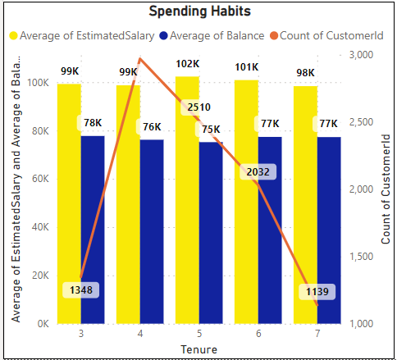
PRODUCT AFFINITY STUDY
Commonly Used Products: Over 50% of customers use 1 or 2 products.
Cross-Selling Potential: Targeted promotions for customers using 1 product.
Active Customer Engagement: Focus on engaging active customers for cross-selling.
Optimizing Cross-Selling Strategies: Tailored marketing campaigns and bundled product offerings.

Slide 7
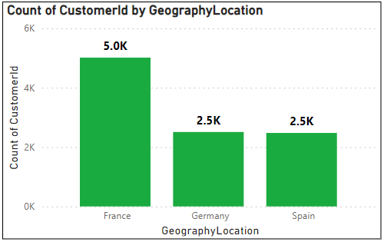
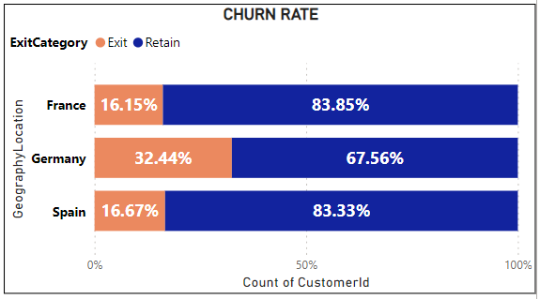
Geographic Market TrendsMarket Trends
Regional Distribution of Customers:
France: Highest number of customers.
Germany and Spain: Potential growth opportunities.
Churn Rates:
Germany: Highest churn rate at 32.44%.
France and Spain: Retained over 80% of customers.
Economic Indicators:
Correlation with customer churn rates and
account activity.

Slide 8
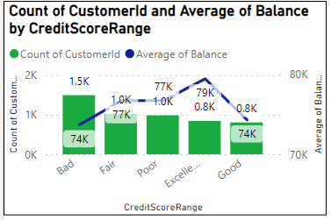
Customer Lifetime Value Forecast
Credit Card Usage and Exit Rates:
Lower exit rates among credit card holders.
Female customers have slightly higher exit rates.
Tenure and Financial Metrics:
Stable financial behavior over time.
Credit Score and Account Balance:
Higher credit scores linked to higher average balances.
Credit score not sole determinant of account balance.

Slide 9
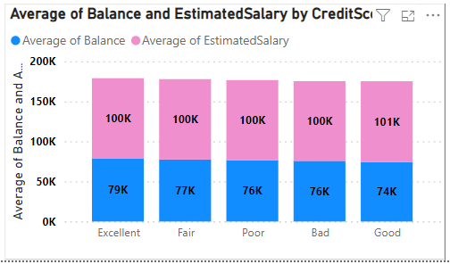
Marketing Campaign Effectiveness
Customer Segmentation:
Customers are segmented based on credit score ranges, including Bad, Fair, Poor, Excellent, and Good.
This segmentation allows for a more targeted approach in understanding customer behavior and preferences.
Campaign Effectiveness Over Time:
2016-2019 Exit Rate Variations: Highest exit rate in 2017 at 15.72%. Exit rate decreased to 13.82% in 2019.
Indicates fluctuations in customer churn in response to marketing efforts. Evaluating exit rates before and after campaign implementations to measure their direct impact.

Slide 10
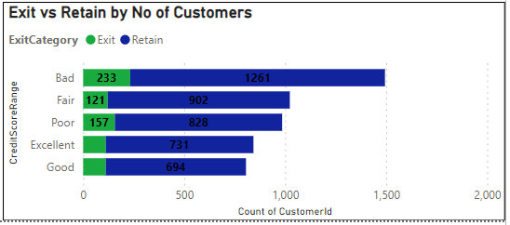
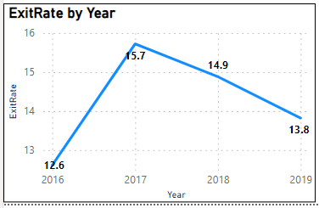
Financial Profile Analysis:
Customers with higher credit scores generally have higher average account balances and estimated salaries.
Financial profiles provide insights into the potential financial stability and satisfaction levels of different segments.
Comparative Analysis:
Fair credit score segment showed a decrease in exit rate from 15.72% in 2017 to 14.88% in 2018, indicating a positive impact of targeted campaigns.
By comparing exit rates and financial profiles before and after campaign periods, we can identify which campaigns were successful.
Key Attributes of Successful Campaigns: Common elements of effective campaigns include targeted messaging, personalized offers, and tailored engagement strategies. Campaigns with these attributes showed lower exit rates and higher customer acquisition rates.

Slide 11
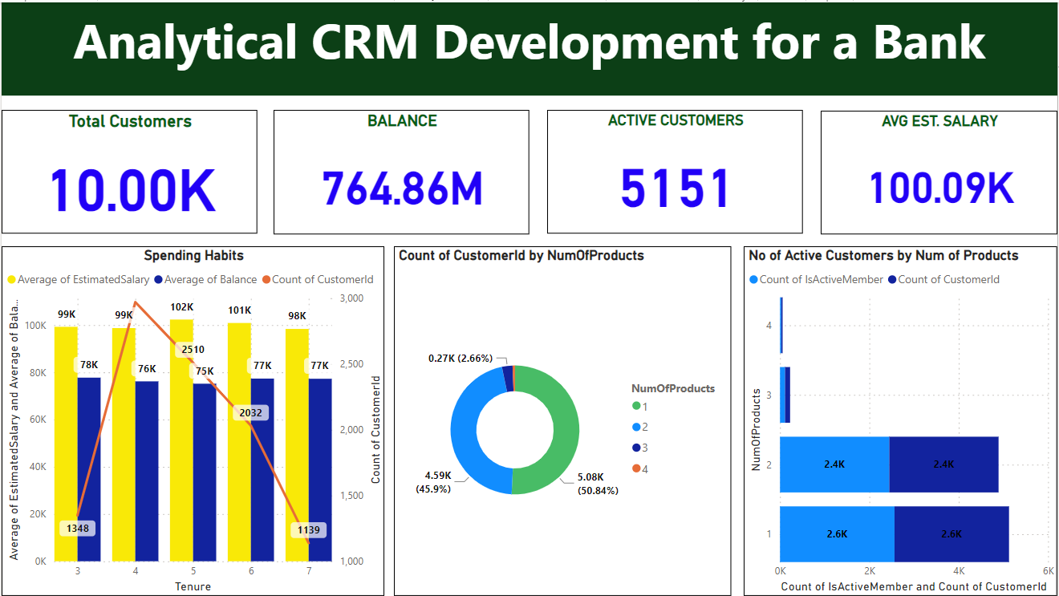
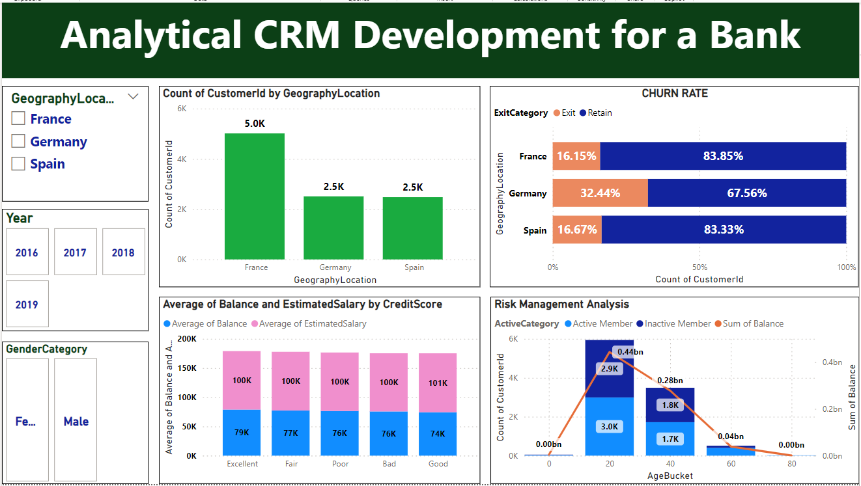
DASHBOARDS

Slide 12
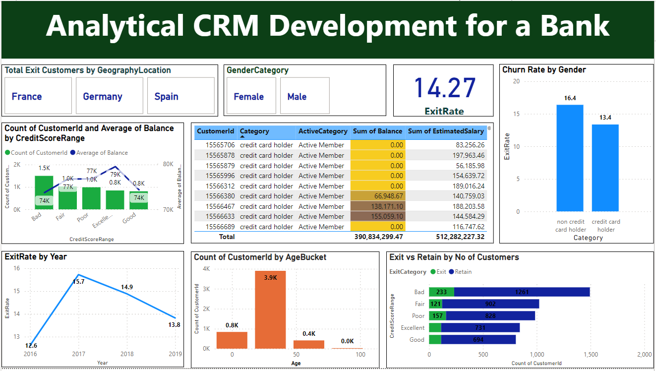
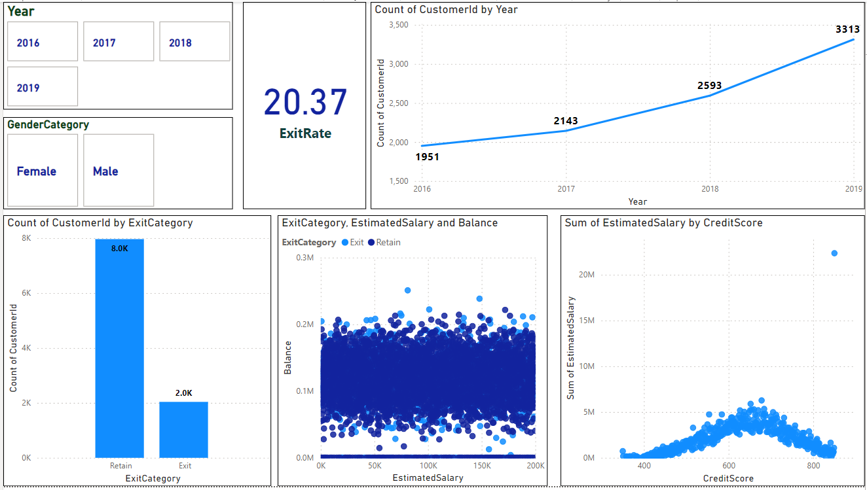

Slide 13
CONCLUSION
The bank has experienced a consistent churn rate over the years, despite a steady increase in customer acquisition.
Customers with lower credit scores and those using fewer products are more likely to churn.
Age groups Old and Middle have the highest churn rates, indicating specific retention challenges.
Improving customer engagement, enhancing customer service, and offering competitive products/services are key strategies to reduce churn.
Targeted marketing and personalized offers can help retain customers in critical age and credit score groups.
Overall, by focusing on customer engagement, service enhancement, and targeted strategies for specific customer segments, the bank can reduce churn, improve customer retention, and foster long-term customer loyalty.

Slide 14


