Slide 1
Price Per Unit Comparator Application Proposal

Slide 2
Motivation
Are you trying to get on top of your expenses?
Find it difficult to compare prices at the grocery store while on the go?
Is it cheaper to buy 2 liters of milk for 7 SR or 1.5 liter for 5 RS or 1.2 liter for 4 RS?
Wish you could figure out all this information easily from your shopping list?
Can you calculate them quickly using calculator?
Price Per Unit Comparator will be your best friend while shopping.

Slide 3
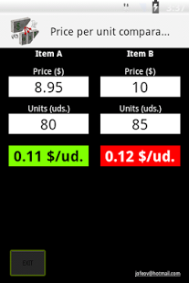
Old Example

Slide 4
Old Example Limitations
The old application won’t let you compare more than two items.
There is no shortcuts for frequent users.
You cant compare the items from your previous shopping trips, that’s it the application won’t keep the history of items best prices.
If the user enter unexpected input it will go undetected.
The application cant handle multiplied quantities like (4 packs of cheese every pack has 8 pieces that is 50g).

Slide 5
What Is Possible Improvements?
The user will be able to compare more than two items.
The appellation will keep track of the best price for each item (history).
Enable shortcuts to help frequent users control the program more efficiently.
Less GUI elements with more functionality.
Detect input error and notify the user.
More flexibility on the quantity number (user can use ‘x’ , ‘+’ )

Slide 6
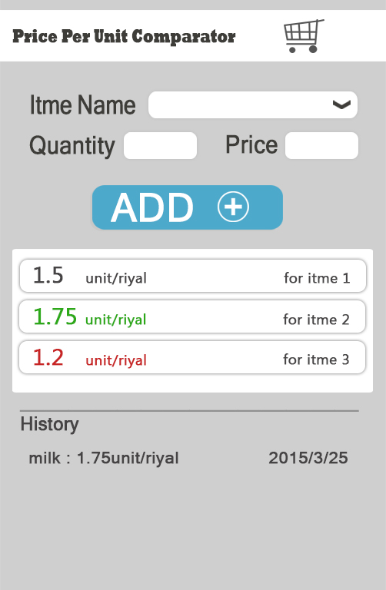
Proposed Example

Slide 7
Students Participating The Project
Faisal Alothman
Abdullah Alosaimi
Talal Alnogithan
Abdulelah Alshomimry
Ayed Alqarni

