Slide 1
2014 IEEE International Conference on Internet of Things (iThings 2014),
Green Computing and Communications (GreenCom 2014),
and Cyber-Physical-Social Computing (CPSCom 2014)
Estimating Contextual Situations
using Indicators from Smartphone Sensor Values
Stefan Forsström and Victor
Kardeby Department of Information and Communication Systems Mid Sweden University, Sundsvall SE-85170, Sweden

Slide 2

Introduction
Situation-aware (context-aware):
Can change behavior depending on the situation of user
How?
Use various sensors, e.g. accelerometer sensor
Some concerns:
Battery consumption, accuracy in underground or indoor situations, e.g. GPS
Notes:
很多做這種情境感測的都會使用強力的感測器像 GPS

Slide 3
Our goal
1. Be able to estimate the situation < 100ms:
To support real-time applications
To avoid unpredictable accidents
2. Be reliable (over 90% accuracy):
Let applications can make right decision
3. Be able run the estimation on limited hardware and with low resource consumption:
To deploy on IoT devices

Slide 4
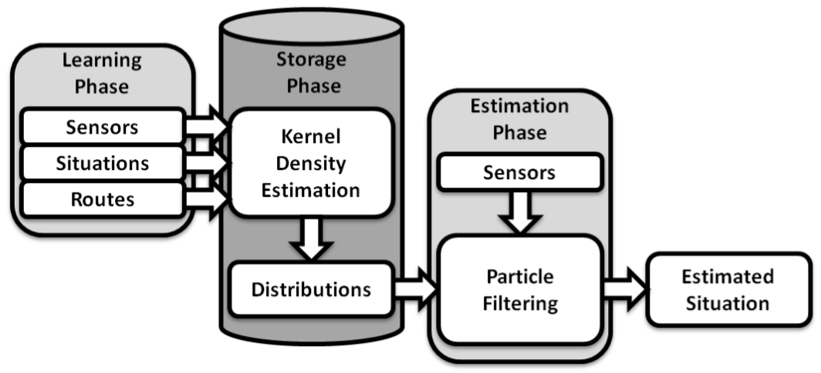
Architecture
Record situations and corresponding sensor values
Store these values and optimize
Estimate the situation with the distributions and current sensor values

Slide 5






Differences from others
No reduction in dimensionality
Use only raw sensor values
No preprocessing of the data
Focus on low cost sensor and simple computation

Slide 6






Kernel Density Estimation
kernel density estimation
Let $x_{1}, x_{2},…, x_{n}$ are IID
$σ$: standard derivation
smooth parameter (h > 0)
(bandwidth)
kernel function
(here is Gaussian)
To estimate the PDF (Probability Density Function) of a random value
Use finite set of IID (Independent and Identically Distributed) samples
To estimate the unknown distribution of the sensor values for a specific situation
based on rule-of-thumb
Notes:
https://zh.wikipedia.org/wiki/機率密度函數
https://zh.wikipedia.org/wiki/独立同分布
https://en.wikipedia.org/wiki/Kernel_density_estimation
https://en.wikipedia.org/wiki/Kernel_(statistics)#Kernel_functions_in_common_use
https://zh.wikipedia.org/wiki/正态分布
PDF 機率密度函數：描述一個隨機變量，在某個確定的取值點附近的可能性的函數
IID 獨立同分布：指一組隨機變量中每個變量的概率分布都相同，且這些隨機變量互相獨立
kernel function 取高斯，也就是標準常態分布，平均值為 0，變異數為 1 的情況
但事實上 KDE 要使用何種 kernel 最好依舊是研究議題
h 有些會叫 bandwidth，因為是將分布切成 h 的寬度去處理
這邊的 h 基本上是基於經驗法則得到的，在此是高斯常用的 h
最後是展開後的 KDE

Slide 7


Particle Filtering
A MCMC (Monte Carlo Markov Chain) method to estimate Bayesian model
Use numerous particles that traverse the model to find which particle is most probable at the correct state
current sensor value distribution
situation model
guessed situation weight
all available sensor weights
Notes:
https://zh.wikipedia.org/wiki/粒子濾波器
https://zh.wikipedia.org/wiki/马尔可夫链蒙特卡洛
https://zh.wikipedia.org/wiki/蒙地卡羅方法
蒙地卡羅法是透過有限個隨機採樣點來評估未知目標
粒子濾波就是透過蒙地卡羅法，利用有限個具有權重的粒子來近似目標
馬可夫鏈基本上是指狀態間轉換的過程，下一狀態的機率只能由當前狀態決定
兩者結合就是將原本隨機取得的數字，改成允許與前一數字具有某種關係
也就是後面的數字可以從前面的數字運算得來，但又不失去隨機的特性

Slide 8
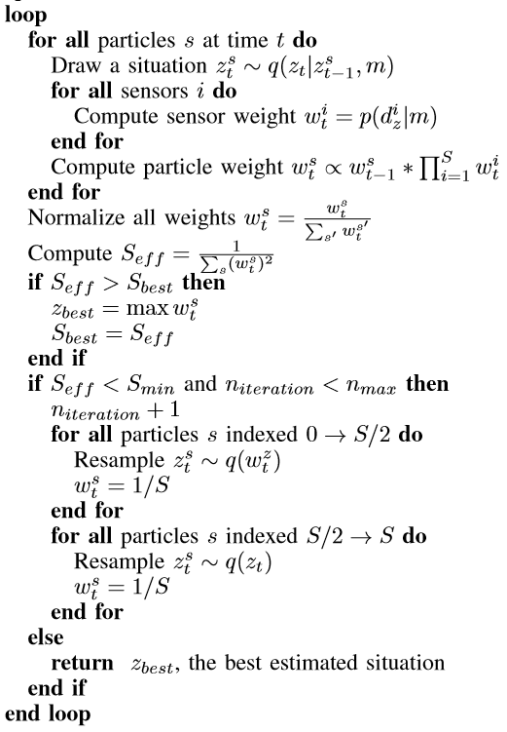
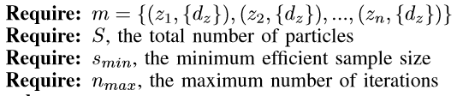

proposal distribution
Particle Filtering
Based on Metropolis–Hastings Algorithm
$z$: situation
$d$: distribution
threshold
Notes:
https://zh.wikipedia.org/wiki/梅特罗波利斯－黑斯廷斯算法
對於每個粒子，都從提議分布 q 中抽選一個情境 z
透過每個 sensor 得到對應情境的權重
如此每個例子都會得到對應的情境權重，再正規化確保加總為 1
Seff 有效粒子數，值越小表示粒子之間權重差距越來越大，表示退化越嚴重
因此使用 Seff 作為閥值，小於表示退化嚴重，對粒子進行重採樣
保持粒子總數不變，一般的做法是權重大的多保留一些，權重小的重新採樣
在此是分成兩半，一半專注在高權重的情境，一半則是不在乎權重重新選取情境
最後每個粒子都設為相同權重
重取樣的情境越集中，抽到的機率與權重都會受到一定影響

Slide 9
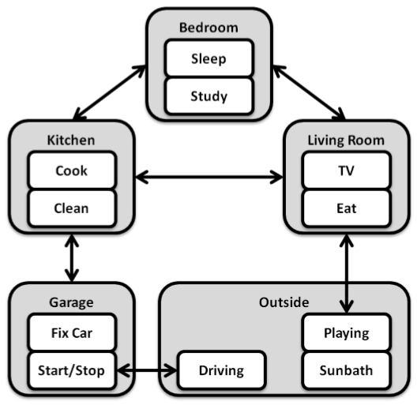
Simulation
Sensors:
Coarse latitude and longitude
Coarse altitude
Light
Atmosphere pressure
Ambient noise
Y axis orientation
Time of day

Slide 10
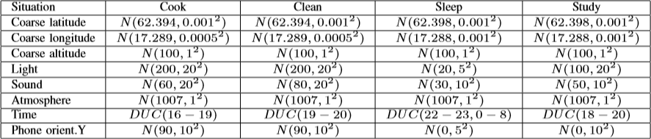
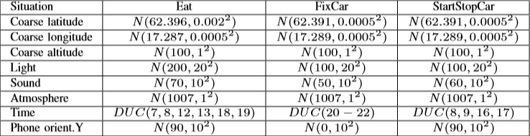
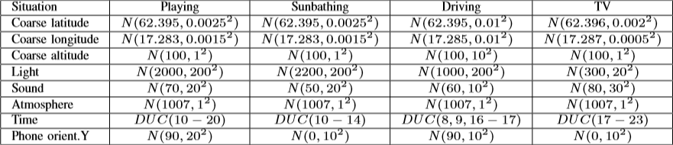
Simulation
N: normal distribution
DUC: discrete uniform distribution of category
Too intuitive and not comprehensive
Light
Orientation
Lat / Lon
Altitude
Time
Notes:
Light：光線強就表示戶外
Orientation：基本上只有直立與橫放的情況
Lat / Lon：大多在家情境幾乎沒差
Altitude：海拔也幾乎不會變
Time：時間區間不夠彈性

Slide 11
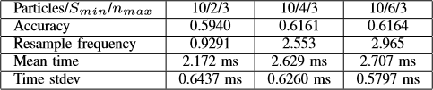
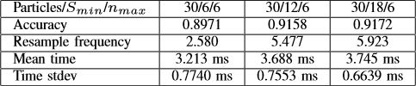
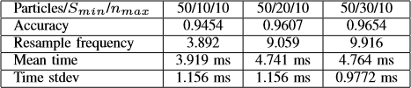
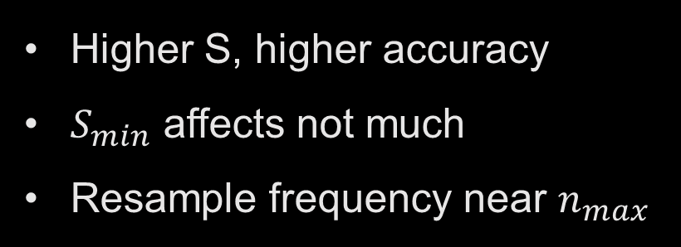
10 particles
Results
30 particles
Higher S, higher accuracy
$S_{min}$ affects not much
Resample frequency near $n_{max}$
50 particles
Simulation on computer

Slide 12
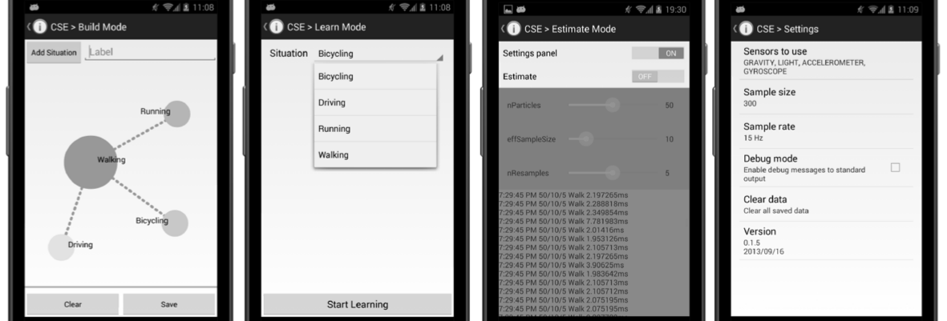
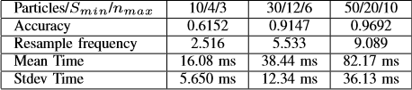
Build mode: create situation model and set up the transitions
Learn mode: teach the system sensor values corresponding to specific situation
Estimate mode: estimate the situation based on latest sensor values
Samsung Galaxy Nexus (2011) as a limited device

Slide 13

My Concerns
No proof of power consumption
Simulations on computer is limited
No detailed simulation about smartphone
The necessity of using particle filter

Slide 14
Roadmap
Simulation on computer
Simulation on recent cellphone
Simulation on legacy devices
Based on approaches:
Same approach i.e. particle filter
Other classification method, e.g. decision tree
Based on sensors:
Use less / more sensors and evaluate accuracy

Slide 15





Future Work
MQTT, Zigbee, Bluetooth…
applications
estimate situation
estimate situation
simulation

