Slide 1
PrimeTime!
Josh Randall and Anurag Banerjee

Slide 2
Primality Checking Algorithms
Deterministic:
Trial division
Pocklington test
AKS test
Probabilistic
Miller-Rabin test
Fermat test

Slide 3
Trial Division Algorithm
For a number to check, N
Compute N%a for every prime up to sqrt(N)
To find every prime, for each odd number, x, above 2, compute the x modulus for all the primes up to sqrt(x)
If any modulo of N are 0, N must be composite
Otherwise, N must be prime

Slide 4
Multithreading Trial Division
Must find all primes up to sqrt(N)
Keep atomic count, each thread getAndAdds 2
Threads concurrently keep a list of current numbers being checked, so they can each check whether any dependencies exist from other threads
Threads modulo their number, a, by each prime less than sqrt(a). Any primes, p, are subjected to N%p to check the overall N for compositeness
If no factors of N are found at or below sqrt(N), then N is prime.

Slide 5
AKS Algorithm
First, the algorithm does some quick probabilistic checks to check for compositeness, such as
N = a^{b} , for any a,b>1
Then, a value r is computed as a bounds for the problem
O_{r}(N) > log²(N), O_{r}(N) is multiplicative order of N%r
Another check is run using this r bound
1 < gcd(a,N) < N, for any a<r
Then, the algorithm starts the real prime testing using this value of r

Slide 6
AKS Algorithm (cont.)
We compute the polynomial (x + a)^{N}
This expression involves N+1 coefficients
This step takes the large majority of the computing time for the algorithm, so this is the step we multithreaded
To determine if N is prime for sure, we need to check that
(x + a)^{N} = x^{N} + a (mod x^{r}-1, N), for values of a
In this notation, both mods are applied to both sides
1 <= a <= sqrt(φ(r))log(n), where φ is Totient Function

Slide 7
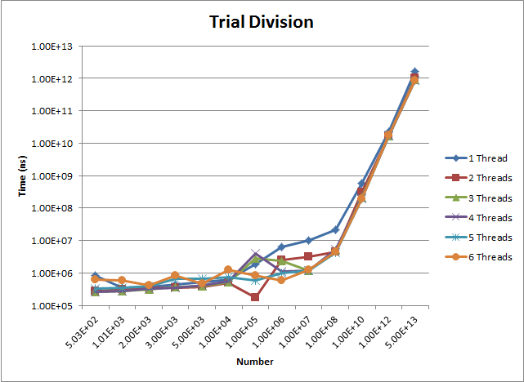
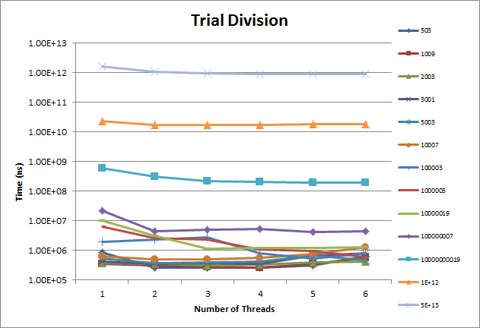
Trial Division Results

Slide 8
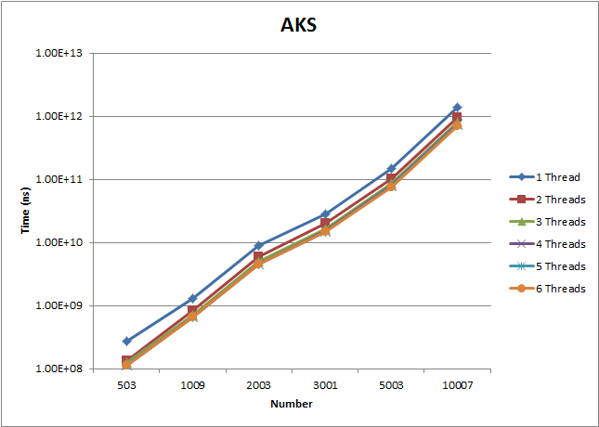
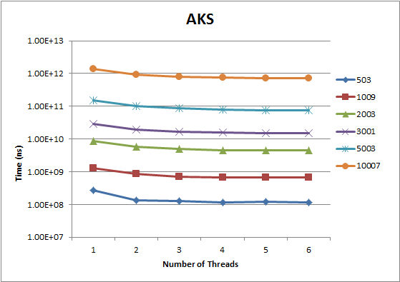
AKS Results

Slide 9
Conclusion

