Slide 1

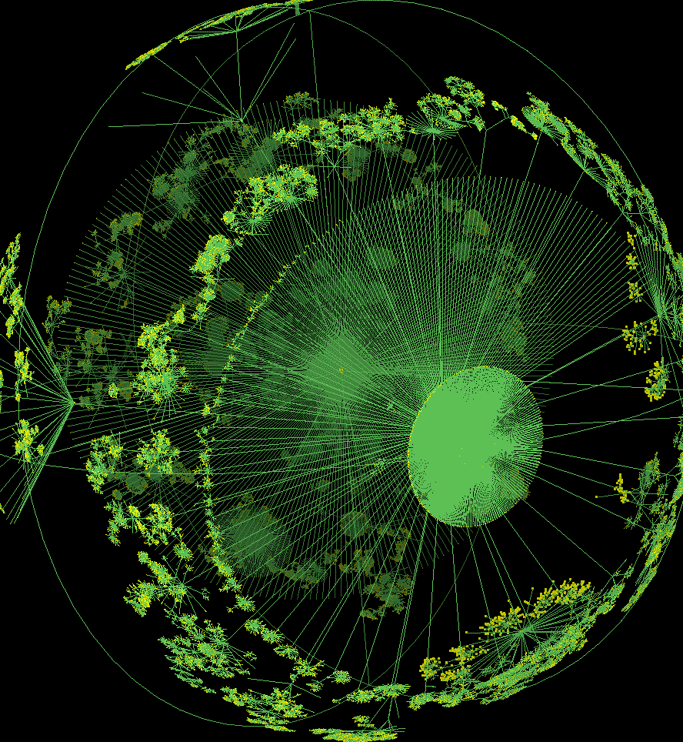
Galloway & Thacker
Protocol, Control, and
Networks. 2004.
Group 6 - Marc, Sjoerd, John

Slide 2
Protocol
Totalizing control apparatus
Two-fold: both the apparatus that facilitates networks and a logic that governs how things are done within that apparatus
Surveillance vs Speed bumps

Slide 3
Protocological Control
Contradictory: at once distributing agencies in a complex manner, while at the same time concentrating rigid forms of management and control
Protocols serve to provide the condition of possibility, and protological control the means of facilitating that condition.

Slide 4
Information
Information is the substance of protocol.
Protocol always implies some way of acting through information
Both immaterial and materializing, abstract and concrete, an act and a thing.

Slide 5
Networks
Not simply made up of a certain number of elements connected to one another, but is constituted by, qualified by, the connectivity of the nodes
Metastable sets of variable relationships in multi-node, multi-edge configurations
Protocological control enables the network, protocol enables protocological control, and information enables protocol

Slide 6
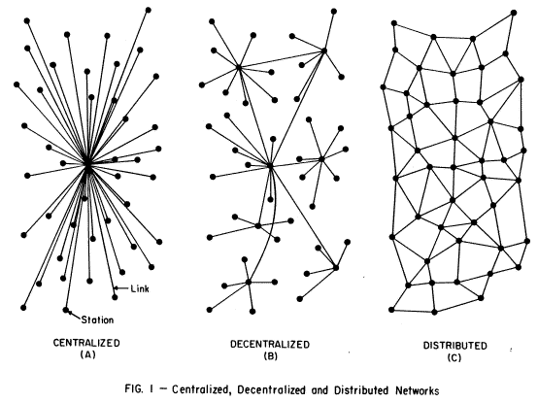
Network Topologies

Slide 7
Graph Theory
Graphs or networks are diagrams of force relationships (edges) effected by discrete agencies (nodes)
Convergence of heterogenous phenomena under universal, mathematical principles
What it omits: dynamism, time

Slide 8
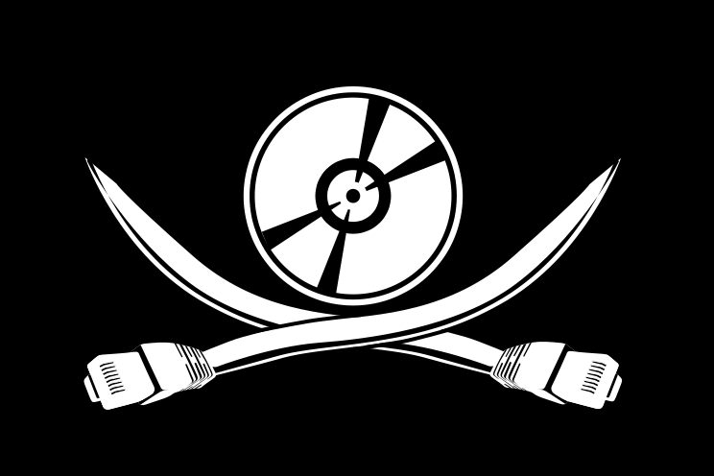
Overlapping Topologies
Gnutella: its technical protocol doesn't merely affect its own network. It also affects external networks.

Slide 9
Internet Protocol
Layered
Virtues:
  Robustness, contingency, interoperability, flexibility, heterogeneity, pantheism.
Division between transport layer and Internet layer creates conditions for a distributed network
Accept everything, no matter what source, sender, or destination.

Slide 10
Biological Protocol
Gene expression, cell metabolism, and membrane signaling.
Forms the basis for all biological networks
Molecular interactions are understood to construct networked relationships
DNA computer: generates a network of networks to compute an answer

Slide 11
Counter Protocol
Not really “counter” anything
Particular types of implementations and intensification of protocological control
Hypertrophy: push it further than it is meant to go
“Life resistance”
Focus on the quality of edges

Slide 12
Discussion Points
What are the implications of pervasive protocological control? How can we understand more clearly what it means and how it co-opts us?
What is “life resistance” as Galloway and Thacker envision it?
Does real-time network monitoring satisfy their critique that graph theory isn't suitable for displaying dynamism over time?

