Slide 1
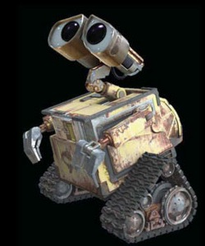

Robotics: Computer Science
Building Brains for Bodies
by
Rodney A. Brooks and Lynn Andrea Stein
Published in the Netherlands in the first issue of Autonimous Robots (Springer, 1994)
Notes:
Cybernetics is a broad, generic and still used term. It applies to many different sciences, but is united is their study in the control of systems.
Robotics a part of computer science, also known as ‘Pure Cybernetics’ field of study, while
the system of control is studied as a concept to discover it’s the basic underlying principles.

Slide 2
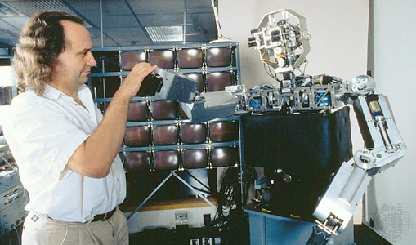
About the authors
Rodney A. Brooks:
Robotics pioneer and former director of the Artificial Intelligence Lab at MIT
Lynn A. Stein:
Computer scientist at the MIT AI lab.
Notes:
Rodney A. Brooks has written a lot of highly influential papers on robotics, starting in the eighties. However, the impact of his current work is not generally described in the available literature. He is instead mentioned for his influential work in pioneering behavior based robotics. Lynn Andrea Stein has since moved on, apparently applying much of what she learned at the MIT AI lab to a new system of teaching computer science based around an "alternative conceptualization of computation in terms of interactive architectures." (http://faculty.olin.edu/~las/)

Slide 3
Building bodies for brains
-A research paper for building a Humanoid robot.
-A subjectivitst approach: abstract cognition and body-based consiousness
-A new form of mental processing: a physical symbol system
-Biologically inspired humanoid with sensory inputs
Notes:
Building bodies for brains outlines a proposal for research done at the Artificial Intelligence Lab at MIT.
Their goal is to explore a then-emergent trend in multiple separate disciplines that rejects the objectivist approach to abstract cognition by building a humanoid robot.
Since the days of Turing, symbolic processing was the main approach to create intelligent machines. Brooks, however, started focusing on sensory inputs and symbol-like behaviour in an architecture which was more biologically inspired and addresses sensorimotor and basic perceptual tasks. In the paper they write about creating a physical symbol system that will determine the humanoids' behaviour. While symbolic reasoning is a component of their system, their proposal hopes to generate a robot that produces "symbol-like behavior...without instantiating symbols directly."

Slide 4
Building the robot
-A detailed description of the setup of the actual build of the robot
-Parallel computing
-From layering to subsumption architecture
-A modular set of behaviour
Notes:
While discussing a subject of potential philosophical import, this paper really only contains a detailed description of the setup of the actual build of the humanoid. The hardware as well as software implementation is outlined. First, the writers reflect on their earlier experience with similar projects. Some previous obstacles were on the scale of the ambitious projects which "caused too many compromises." Research groups had to split into multiple groups since the different sorts of development didn't work out when relying on building just one consistent robot. Ultimately, the failures of some previous smaller projects turned out as valuable lessons as they've managed to build more robust robots, taking more and more time to develop something workable.
This construction of hardware enables the developers and, ultimately, the cyborg to process the 'vast amounts' of inputs and sequentually anticipate depending on the behavioural architecture. T
The point of the hierarchy is to standardizise and categorize the different contextual actions and algorithms: "Each of the layers was behavior producing piece of network in its own right (..) An explore layer did not need to explicitly avoid obstacles, as the designer knew that a previous avoid layer would take care of it." This resolves not only some of programming tasks splitting it up in different smaller projects, but also presents efficient modular set of behavior.

Slide 5
Behaviour based robotics
“intelligence cannot be separated from the subjective experience of a body.”
-a “necessary substrate” to explore the validity of this new approach
-continously act on immediate sensory data
-More human-like behaviour
Notes:
robot designed to continuously act on immediate sensory data would display more "human-like behavior” than “robots designed to construct an elaborate world model.”

Slide 6
BEAM robotics
-Biology, Electronics, Aesthetics, and Mechanics
-“Forget the brain, let us just focus on a simple stimulus-response based ability within a machine.”
-even more pure “continuous action on immediate sensory data”
-Mechanical creatures through minimalistic electronics
Notes:
BEAM robotics
A compelling extension to this line of investigation lies within the BEAM robotics community. BEAM (for Biology, Electronics, Aesthetics, and Mechanics) robotics, which emerged as a result of the ideas proposed by behavior-based robotics, takes a much more minimalistic approach. Without integrating any microprocessors whatsoever (at least in the “pure” approach) in their design, BEAM robots display remarkably complex behavior while utilizing an even more pure “continuous action on immediate sensory data” approach than Brooks and Stein use by removing the necessity of microprocessors and memory for intelligent behavior.
It uses minimalist electronics to create elegant mechanical creatures that parallel their natural counterparts in many ways.

Slide 7
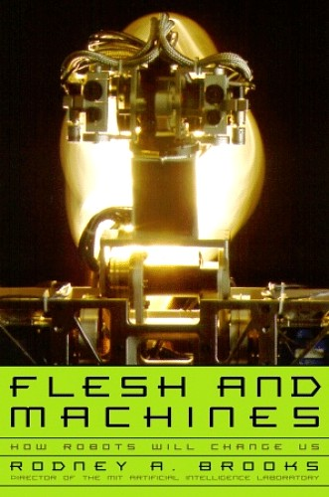
Rodney Brooks still writes
Why create robots?
We are the robots, ourselves!
"human nature can be seen to possess the essential characteristics of a machine."
Notes:
BEAM robotics
A compelling extension to this line of investigation lies within the BEAM robotics community. BEAM (for Biology, Electronics, Aesthetics, and Mechanics) robotics, which emerged as a result of the ideas proposed by behavior-based robotics, takes a much more minimalistic approach. Without integrating any microprocessors whatsoever (at least in the “pure” approach) in their design, BEAM robots display remarkably complex behavior while utilizing an even more pure “continuous action on immediate sensory data” approach than Brooks and Stein use by removing the necessity of microprocessors and memory for intelligent behavior.
It uses minimalist electronics to create elegant mechanical creatures that parallel their natural counterparts in many ways.

Slide 8
Points for discussion
-Is the lack of any philosophical discussion regarding the quest to build the 'ultimate humanoid' in this paper in itself a statement?
-Does developing an intelligence with sensors, wires, and microchips in order to extrapolate theories about human consciousness make sense?
-Does neglecting body-less AI because of their "less human" interactions signal a latent xenophobia?
Notes:
Is the lack of any philosophical discussion regarding the quest to build the 'ultimate humanoid' in this paper in itself a statement? While avoiding overly long philosophical discussion makes sense in what amounts to a technical design, is it responsible that the article avoids mentioning any philosophical debates on the topic of developing an AI humanoid?
Does developing an intelligence with sensors, wires, and microchips in order to extrapolate theories about human consciousness make sense?
Does neglecting body-less AI because of their "less human" interactions signal a latent xenophobia?

