Slide 1
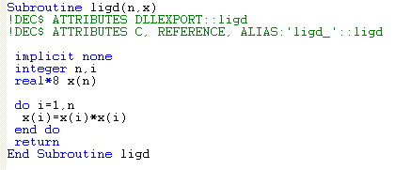
Some History
Before S

Slide 2
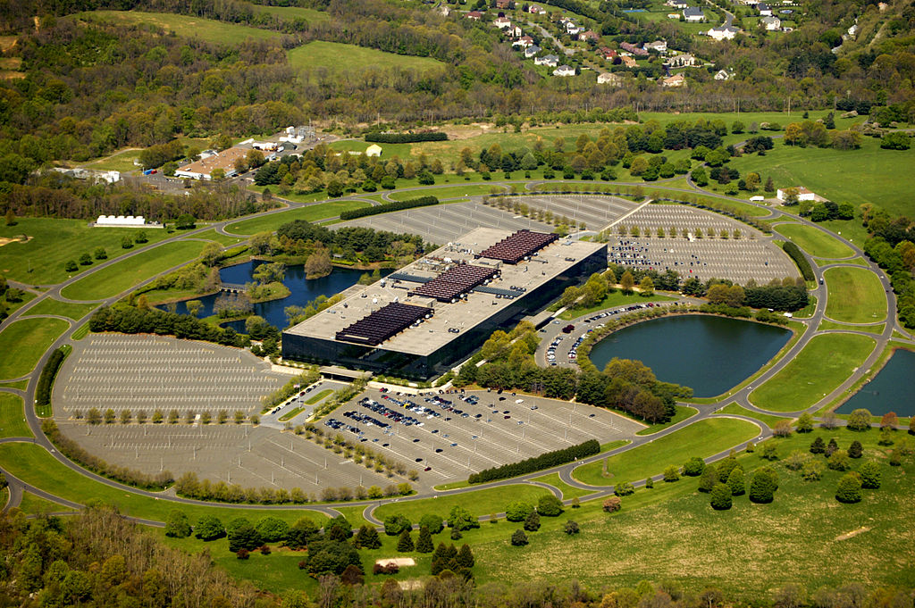
Some History
Bell Labs, Holmdel, New Jersey (since moved)

Slide 3

Some History
1976: John Chambers invents S
1979: S ported to UNIX
1988: ‘New S’

Slide 4



Some History

Slide 5


1993: R is Invented!
Ross Ihaka
Robert Gentleman

Slide 6
R Features
An interpreted language
Supports vectors, matrices, arrays, dataframes, lists
Supports matrix arithmetic
Extensible object system, including objects for regression models, time series, geo spatial coordinates
No scalar. Represented as a vector with length 1

