Slide 1

Getting started
Should have python, git and pip installed
Install numpy and matplotlib
Download NLTK
www.nltk.org/install.html
sudo pip install -U nltk
Test NLTK
python
import nltk
Download data
python
import nltk
nltk.download()
In NLTK downloader:
Under corpora, download:
gutenberg, brown, state_union, stopwords, words
Under models, download:
averaged_perceptron_tagger, maxent_ne_chunker, punkt
GitHub code and readme download:
https://github.com/ab6/Codemash2016-NLPprecompiler

Slide 2
Introduction to NLP using NLTK and Python
Amber McKenzie
Codemash
January 5, 2016

Slide 3





Who am I?
Notes:
Without getting into the existential question, I’ll give you some superficial information about me.

Slide 4
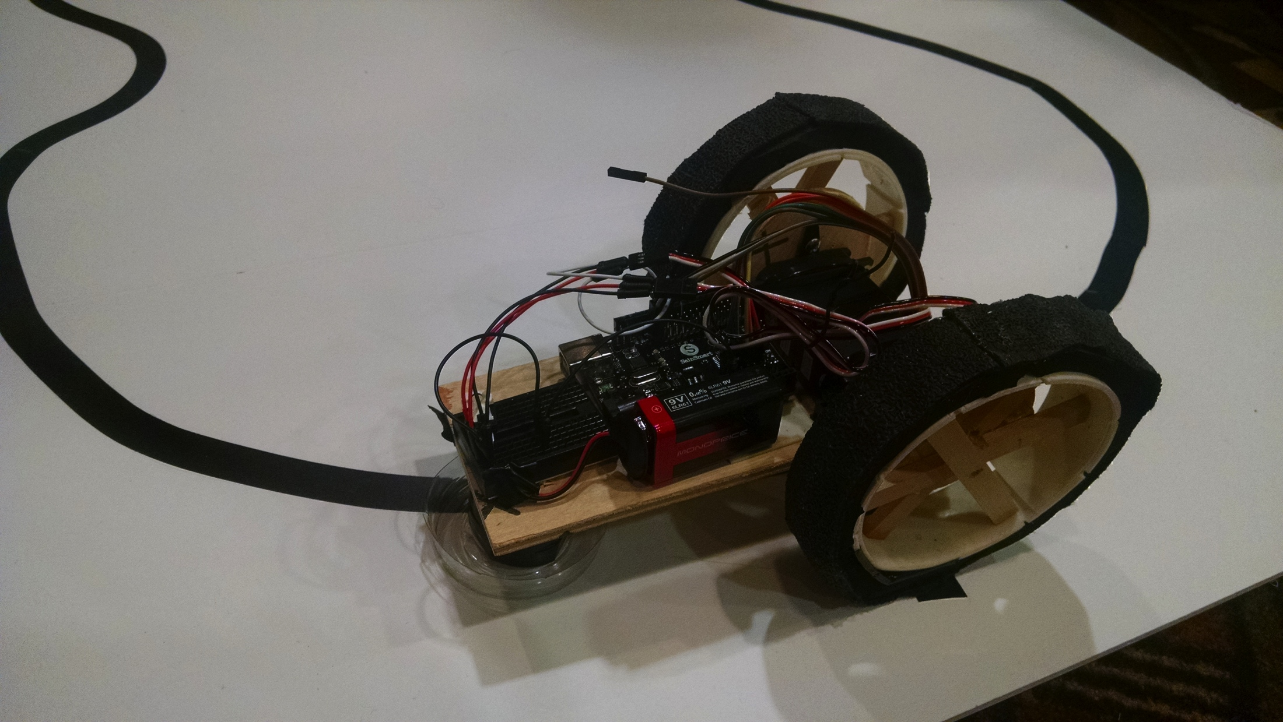
Contact information
Amber McKenzie, Ph.D.
Data Scientist
PYA Analytics
Knoxville, TN
www.pyaanalytics.com
mckenzie.amber@gmail.com amckenzie@pyaanalytics.com
https://nlprunner.wordpress.com

Slide 5
Resources
NLTK book
http://www.nltk.org/book/
Matplotlib tutorial
http://matplotlib.org/users/pyplot_tutorial.html
Other resource links on the module write-ups

Slide 6
Agenda
Introduction to Natural Language ToolKit (NLTK)
Module 1: document classification
Module 2: historical text analysis
GitHub code and readme download:
https://github.com/ab6/Codemash2016-NLPprecompiler

Slide 7
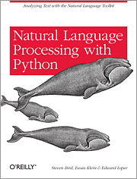
Natural Language ToolKit (NLTK)
Suite of text processing libraries
Number of available pre-built models and corpora
Easy to get started with basic NLP
Building blocks for more robust applications
Both linguistic and statistical analysis libraries
www.nltk.org

Slide 8
NLTK data
Over 50 different data sources available:
News: Brown, Reuters
Historical: State of the Union and inaugural addresses
Literary: Project Gutenberg, Shakespeare
Product reviews
Web text and twitter
http://www.nltk.org/nltk_data/

Slide 9
NLP, data analysis, and ML
State of the art in NLP is trending towards statistical and supervised learning methods
NLP techniques used to extract features of text in data analysis and machine learning applications
Deep learning used to model underlying processes behind language

Slide 10
Text features
Words
Existence and frequency
Types: word features and functions
Specific: concepts and entities
Stopwords
Phrases and collocations
What words occur together
Google’s ngram corpus

Slide 11
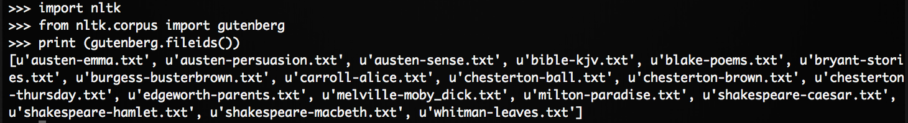
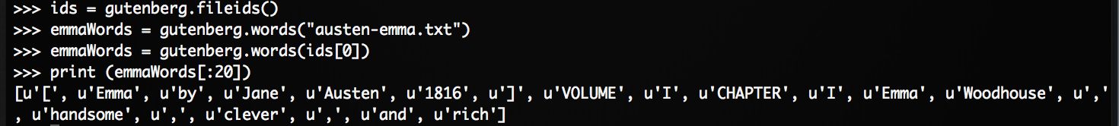
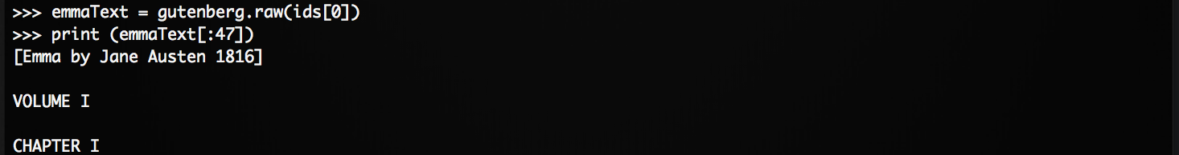
NLTK Intro – data access

Slide 12
Text representation
Bag-of-words vs. frequency counts
Frequency distributions
Stopword lists
Term frequency-inverse document frequency (TF-IDF)
Features are dictated by the data and the target application
For some applications, frequencies are useful. For others, just a binary representation of words is good
Other linguistic features include morphology, capitalization, part-of-speech

Slide 13
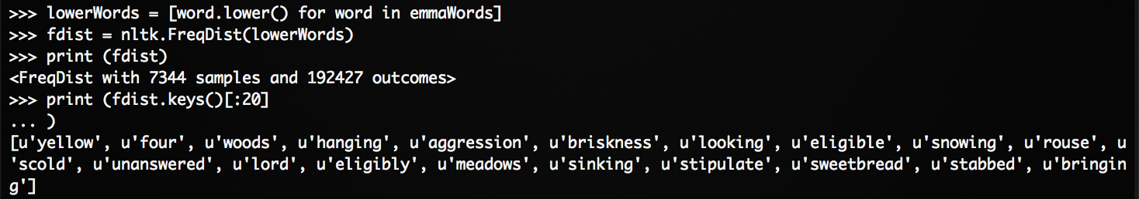
FreqDist

Slide 14
Basic NLP
Tokenization
Considerations: white space, hyphens, apostrophes, etc.
Sentence segmentation
Part-of-speech tagging (POS)
Syntax
Used to identify relationships between concepts
Named entity recognition (NER)
With or without categories

Slide 15
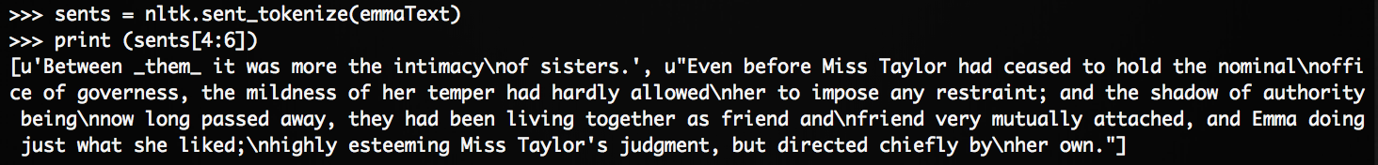
Tokenization and sentence segmentation
*Note the new-line characters.

Slide 16
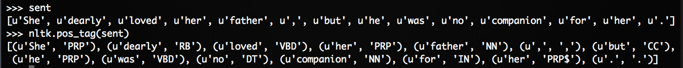
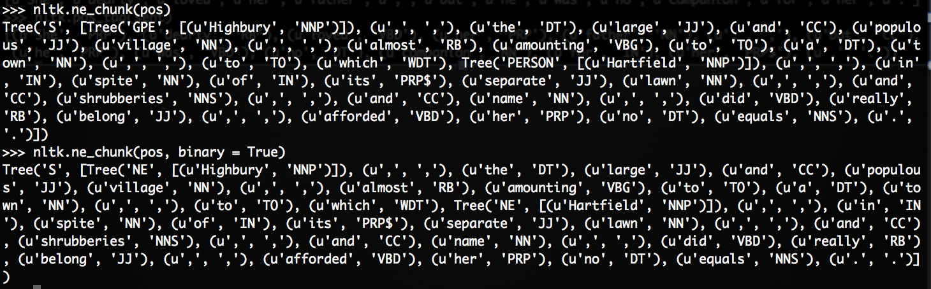
POS tagging and NER

Slide 17
Modules
Module explanation and solutions provided in GitHub repo
Explanation
High level overview
Fine-grained steps
Hints and resources
Solutions
Code for core requirements
Helper functions for Module 2 provided also
GitHub code and readme download:
https://github.com/ab6/Codemash2016-NLPprecompiler

Slide 18
Module 1: doc classification
Brown corpus: documents and category tags
Identify set of feature words
Create bag-of-words representation
Breaking into training and test set
Create and test model

Slide 19
Module 2: historical data analysis
Data: State of the Union addresses
Goal: Conduct text-based data analysis using a variety of features
Methods
Length of words, unique words
Bigrams
Named entities
Additional analyses
Part of speech frequencies
Sentiment
Categorical grouping

Slide 20
Information extraction process
Raw text
(string)
Sentences
(list of strings)
Tokens/
Words
(list of lists of strings)
Sentence
Segmentation
Tokenization
Part-of-speech tagging
Entity, relation, entity
(tuple list)
Chunks with entities
(list of trees)
Tokens tagged with pos
(tuple list)
Relation
Detection
Entity Detection

Slide 21
Contact information
Amber McKenzie, Ph.D.
Data Scientist
PYA Analytics
Knoxville, TN
www.pyaanalytics.com
mckenzie.amber@gmail.com amckenzie@pyaanalytics.com
https://nlprunner.wordpress.com

