Slide 1
Assignment 4
Pulmonary Disease Detection
Deadline: 2021/12/23 23:59

Slide 2
Goal
Build a convolutional neural network to predict the pulmonary disease of patients from their chest X-ray (CXR) images.
You need to deal with limited and imbalanced data.

Slide 3
Dataset: MIMIC-CXR
MIMIC-CXR dataset is a large publicly available dataset of chest X-ray (CXR) images.
The dataset contains 377,110 JPG format images and structured labels derived from the 227,827 free-text radiology reports associated with these images.
In this assignment, we randomly extract 12,500 images for you.

Slide 4
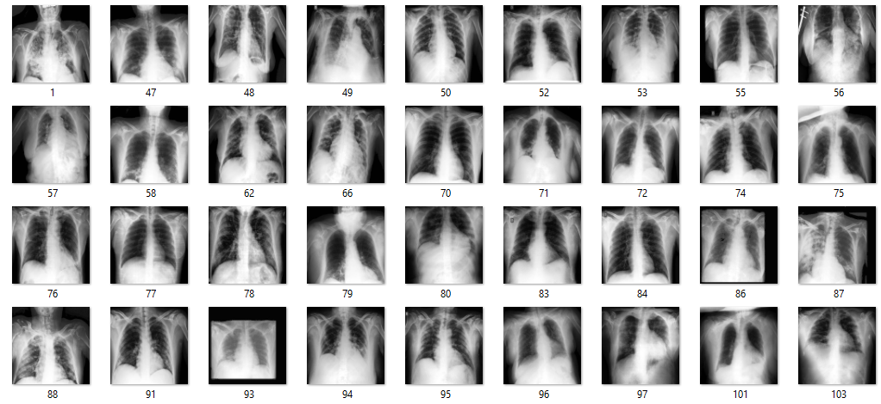
Dataset
Please keep the data confidential!
There are 10,000 images in the training set, 1,000 images in the validation set and 1,500 in the testing set.
2 demographic features (age and gender) are provided for all patients.
7 pulmonary disease labels for patients in training and validation set.
All CXR images has been processed with histogram equalization and down-sampled to 128 by 128.

Slide 5

Dataset
You can find the data on elearn platform.
Training and validation data are in the folder name as “public”.
Testing data are in the folder name as “private”.
The file name of each image contains an index and the split.
Labels and demographic features for training and validation data are provided in csv files.
The index of each row corresponds to the file name of the image.
You can refer to the data loading example.

Slide 6
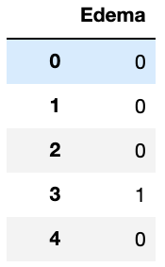
Basic-prediction (50%)
It is a binary classification problem.
0: negative; 1: positive
Use the training data to predict whether the patient has “Edema”.
In this part, any existing model architectures are prohibited, but functions for constructing models are allowed. You should design you own model architecture.
You will get all 50 points if your prediction achieves f1-score greater than 0.6 in the testing set.

Slide 7
Basic-report (10%)
Describe how you design your own model architecture.
Describe how you choose hyperparameters (eg. optimizer, learning rate).
Describe difficulties you encountered.
Summarize your implementation.
No more than 1 page.
Don’t screenshot any codes or copy paste.

Slide 8
Bonus (10%)
If you use the demographic data such as age and gender to improve the model performance and f1-score achieve 0.65, you will get extra 10 points as bonus.
Illustrate how you combine image data with demographic data in the report and submit an extra prediction for bonus part.
Value | Age | Gender
0 | 0-20 | Male
1 | 20-40 | Female
2 | 40-60
3 | 60-80
4 | 80-
Notes:
年紀

Slide 9
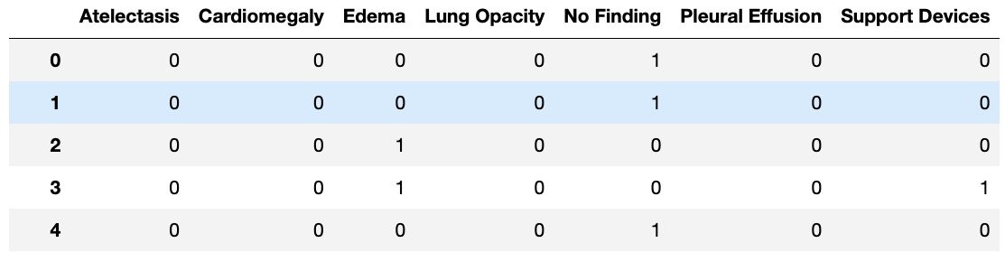
Advanced-prediction (35%)
It is a multi-label classification problem.
Use the training data to predict 7 labels.
In this part, any state-of-the-art model architectures are allowed.
Points in this part will be given based on the weighted f1-score of your prediction in testing set.

Slide 10
Advanced-report (5%)
Describe how you design or choose your own model architecture.
Describe how you choose loss function and optimizer.
Describe difficulties you encountered.
Summarize your implementation.
No more than 1 page.
Don’t screenshot any codes or copy paste.
Write it after the basic part in the same report file.

Slide 11
Submission format-prediction
All predictions should be binary (0 or 1), you can choose your own threshold or I will round it up if your predictions is not in binary form.
The index of your prediction should match the index of images.
The format of prediction is provided.
For basic part, submit your prediction in a single csv file name as [Student_ID]_basic_prediction.csv
[Student_ID]_bonus_prediction.csv (if you implement)
For advanced part, submit your prediction in a single csv file name as [Student_ID]_advanced_prediction.csv.

Slide 12
Submission format-report, code
Name your report as [Student_ID]_report.pdf.
No more than 2 pages (1 for basic part, 1 for advanced part). If you implement bonus part, an extra page is acceptable.
Zip all your codes in 1 zip file, and name as [Student_ID]_code.zip
Put all your stuff into one zip file name as [Student_ID].zip, including basic prediction, bonus prediction, advance prediction, code, and report.

Slide 13
Notification
It is an individual assignment.
We do not provide any template, but we provide a sample code for loading images.
You can use any framework as you like, such as tensorflow, or pytorch. Colab is recommended.
0 point will be given in the following conditions.
Use SOTA model in the basic part.
late submission.
Incorrect prediction format.
Incorrect file name.
Plagiarism.
Notes:
問問題要明確 沒辦法debug

Slide 14
Contact & supplements
Ryan Wang ryanatnthu114@gmail.com
Don’t ask me for debugging.
Be polite!
Tensorflow example: https://www.tensorflow.org/tutorials/images/classification
Pytorch example: https://pytorch.org/tutorials/beginner/blitz/cifar10_tutorial.html

