Slide 1
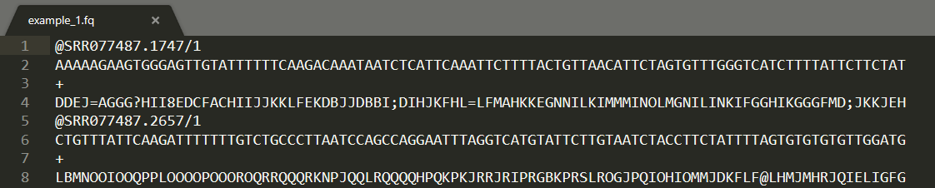
1. Sequence identifier
2. Raw sequence letters
3. Plus sign
4. Quality score ; = 26

Slide 2
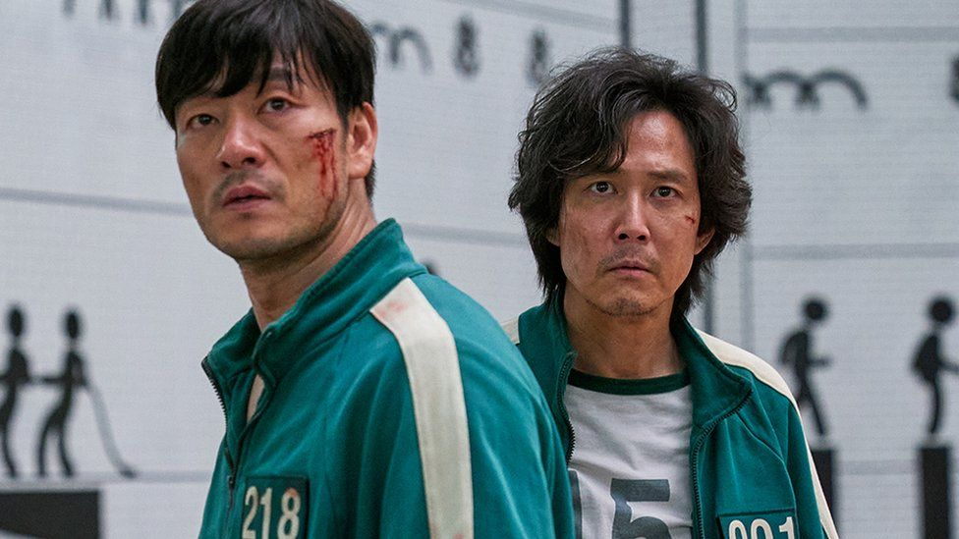
LET’S FIND SOME VARIANTS
CAN’T WE JUST SPEND TWO HOURS ON MEMES?
NO.

