Slide 1

MACHINE LEARNING COURSE PROJECT
Anomaly Detection &
Customer Segmentation
Using Unsupervised Machine Learning & Deep Learning
Team Members
Ibrahim Al-Khataybeh
ID 180465
Abdullah Abu Amara
ID 180595
Abdullah Abualigah
ID 168990
Dataset: Credit Card Fraud Detection • 284,807 transactions

Slide 2








Project Overview & Objectives
This project applies advanced machine learning and deep learning techniques to analyze high-dimensional transaction data, identify hidden patterns, cluster behaviors, and detect anomalies using both classical ML and neural network approaches.
Preprocess & Scale
Reduce Dimensions
Visualize Structure
Cluster with DBSCAN
Clean and prepare a real-world high-dimensional dataset
Apply PCA to compress features while preserving variance
Project data into 2D using t-SNE to reveal hidden patterns
Detect dense regions and noise points automatically
Detect Anomalies
Build Deep Network
Compare Approaches
Evaluate & Interpret
Use One-Class SVM to flag outliers from normal-only training
Train an Autoencoder with TensorFlow / Keras for reconstruction
Benchmark classical ML against deep learning side-by-side
Score with Precision, Recall, F1, ROC-AUC and visual diagnostics
Core Techniques
PCA · t-SNE · DBSCAN · One-Class SVM · Autoencoder (TensorFlow + Keras)
Python · scikit-learn · TensorFlow / Keras · pandas · NumPy · Matplotlib · Seaborn · Optuna
Anomaly Detection in Credit Card Transactions
2 / 13

Slide 3
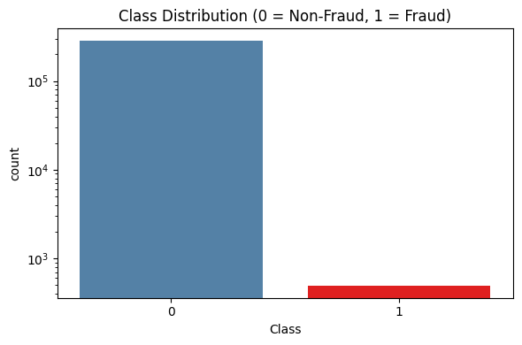
Dataset: Credit Card Fraud Detection
Class Distribution (log scale)
284,807
Total transactions
31
Features (Time, V1–V28, Amount, Class)
492
Fraud transactions (Class = 1)
0.173%
Fraud rate — highly imbalanced
Preprocessing
Zero missing values across all 31 features
Log-transform on Amount; StandardScaler on Time
Stratified 90 / 10 train–validation split
Anomaly Detection in Credit Card Transactions
3 / 13

Slide 4
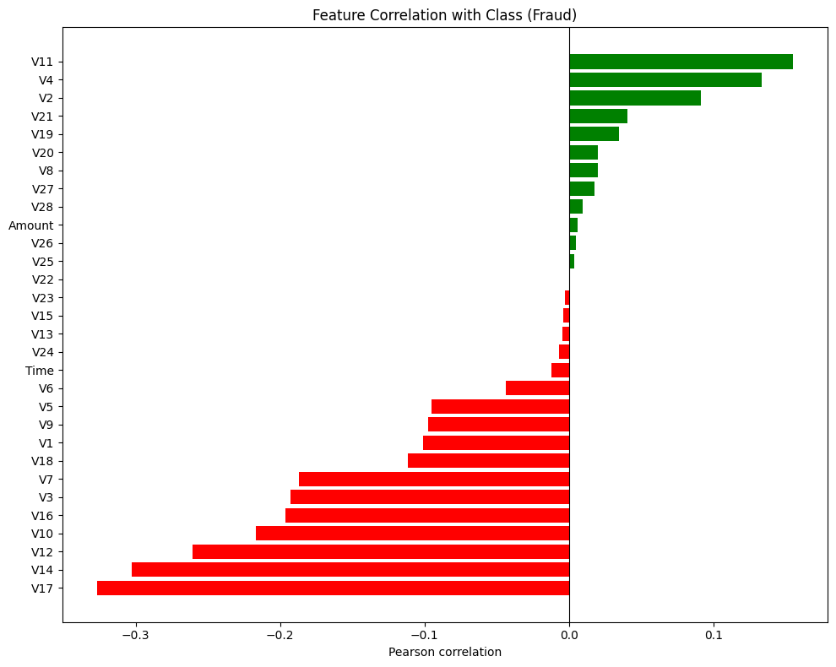
Feature Correlation with Class (Fraud)
Pearson correlation of every feature with the Class target
Why look at correlations?
Pearson correlation captures the strength of linear association between each anonymized feature and the fraud label. This guides feature awareness before unsupervised modelling.
Strongest negative correlates
V17 · V14 · V12 · V10
Lower values of these features align with fraudulent transactions.
Strongest positive correlates
V11 · V4 · V2
Higher values of these features tend to coincide with fraud.
Most features show weak linear correlation with the target — motivating non-linear methods (t-SNE, DBSCAN, Autoencoder) for detection.
Anomaly Detection in Credit Card Transactions
4 / 13

Slide 5
Six-Phase Methodology
1
Phase 1
2
Phase 2
3
Phase 3
Data Preprocessing
PCA
t-SNE Visualization
Cleaning, scaling, stratified split
Dimensionality reduction at 95 % variance
2-D projection across imbalance ratios
4
Phase 4
5
Phase 5
6
Phase 6
DBSCAN Clustering
One-Class SVM
Autoencoder (DL)
Density-based detection of noise points
Boundary learning from normal data only
Reconstruction-error anomaly detection
Anomaly Detection in Credit Card Transactions
5 / 13

Slide 6
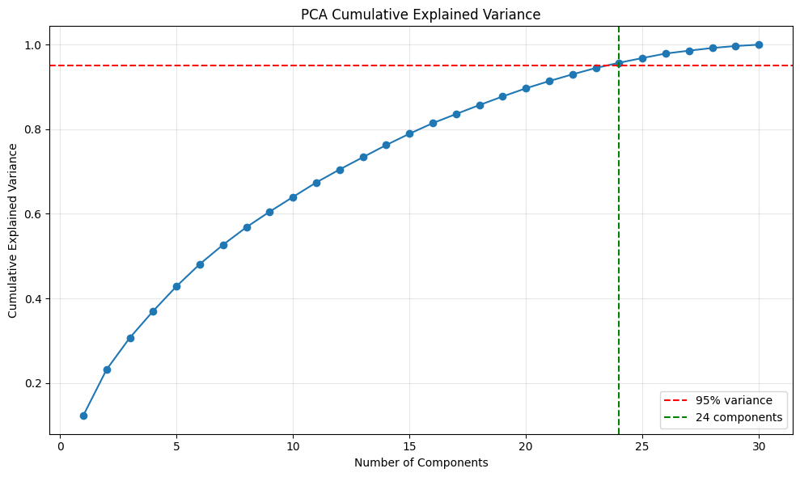
Phase 2 — Dimensionality Reduction with PCA
Objective
Cumulative Explained Variance
Compress 30 input features while preserving information, removing redundancy, and accelerating downstream models.
24
principal components
retain ≥ 95 % of total variance
Reduction: 30 → 24 features
Output: PCA-transformed training matrix
Used as input for DBSCAN & sampling-based visualization
The 95 % threshold is reached at component 24, after which marginal gain becomes negligible.
Anomaly Detection in Credit Card Transactions
6 / 13

Slide 7
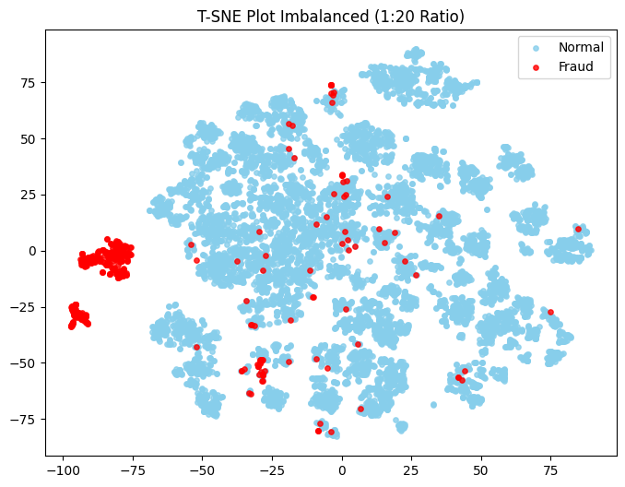
Phase 3 — t-SNE Visualizing Hidden Structure
Why t-SNE?
PCA preserves global variance but compresses non-linear structure. t-SNE reveals local neighbourhoods, making fraud clusters visually identifiable.
Distinct fraud cluster
A dense red cluster forms in the lower-left region, well-separated from the normal manifold.
Scattered fraud points
Other fraud cases blend into normal clusters — these are the hard, ambiguous cases for detectors.
Ratios tested
Experiments at 1:1, 1:4, 1:10, 1:20 normal-to-fraud sampling to study separability under imbalance.
t-SNE projection at 1:20 normal-to-fraud sampling ratio.
Anomaly Detection in Credit Card Transactions
7 / 13

Slide 8
Phases 4–5 — DBSCAN & One-Class SVM
DBSCAN — Density-Based Clustering
One-Class SVM — Boundary Learning
Experiment | min_samples | eps | F1 (fraud)
1 : 1 | 46 | 12.0 | 0.380
1 : 4 | 53 | 11.0 | 0.401
1 : 10 | 69 | 9.0 | 0.469
1 : 20 ★ | 93 | 7.0 | 0.765
Experiment | Precision | Recall | F1 | ROC-AUC
1 : 1 ★ | 0.910 | 0.939 | 0.924 | 0.923
1 : 4 | 0.808 | 0.894 | 0.849 | 0.920
1 : 10 | 0.710 | 0.883 | 0.787 | 0.923
1 : 20 | 0.608 | 0.876 | 0.718 | 0.924
Best configuration
Hyperparameters
Sampling ratio 1:20 • min_samples = 93 • eps = 7.0
kernel = RBF • ν = 0.01 • γ = 'auto'
Auto-tuned via k-distance graph + grid search
Noise points (label = −1) flagged as fraud candidates
Best F1-fraud of 0.765 at 1:20 ratio
Trained exclusively on normal transactions
Decision function thresholded at 0 (predict = −1 ⇒ fraud)
Best F1-fraud of 0.924 at 1:1 sampling ratio
Anomaly Detection in Credit Card Transactions
8 / 13

Slide 9
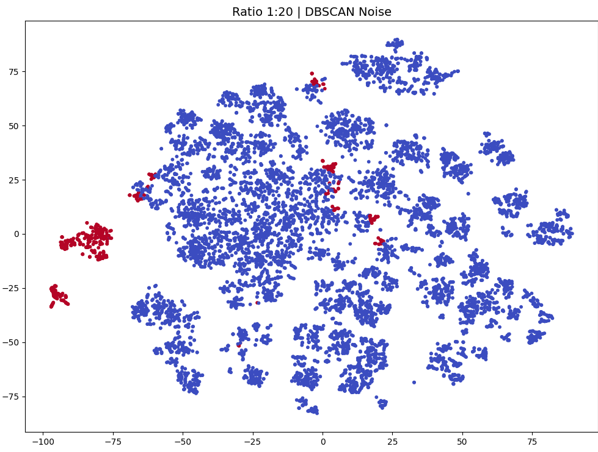
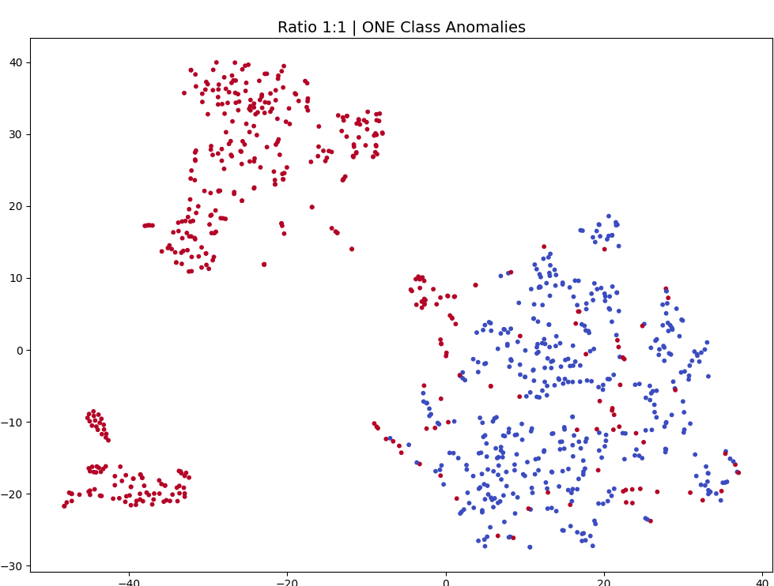
DBSCAN vs One-Class SVM — Spatial View at Best Ratios
t-SNE projections of validation data with anomalies flagged by each detector at its best-performing sampling ratio. Red points are the predicted anomalies.
DBSCAN · best ratio 1 : 20
One-Class SVM · best ratio 1 : 1
min_samples = 93 · eps = 7.0 · F1 = 0.765 · Recall = 0.824
kernel = RBF · ν = 0.01 · F1 = 0.924 · Recall = 0.939
Red = noise points (label = −1) flagged as fraud.
Red = points predicted as −1 (anomalies) by the trained boundary.
Anomaly Detection in Credit Card Transactions
9 / 13

Slide 10
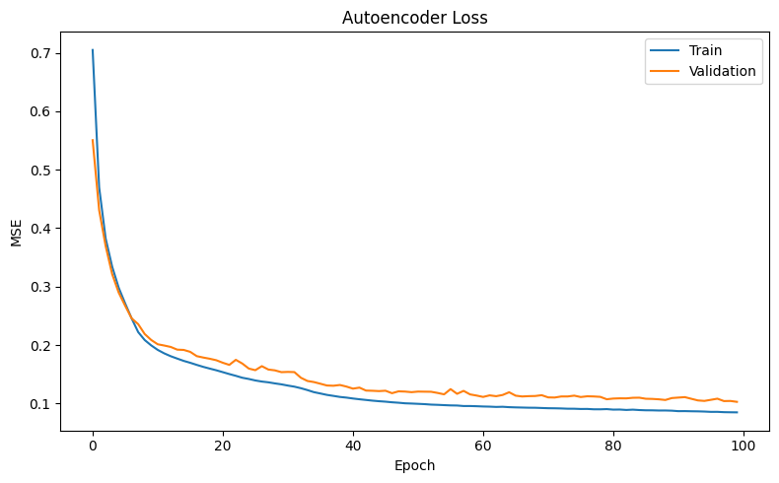
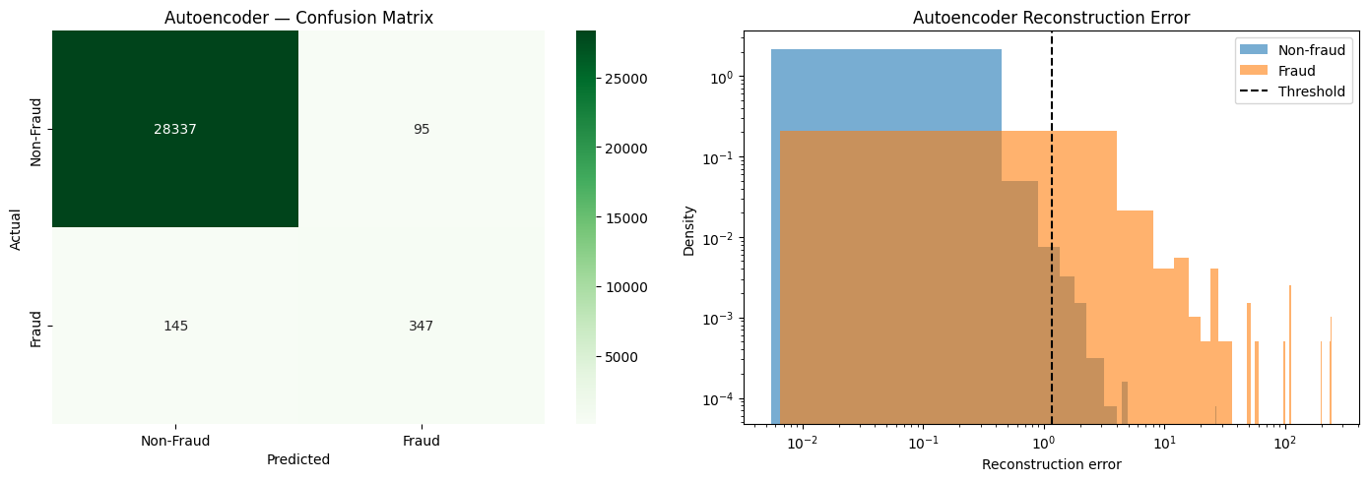
Phase 6 — Autoencoder (TensorFlow / Keras)
Architecture (Optuna-tuned)
Training & Validation Loss
30 → 34 → 28 → 16 → 12 → 16 → 28 → 34 → 30
Symmetric over-complete encoder–decoder with a 12-unit bottleneck.
Trainable parameters: 5,422
Trained on normal transactions only; fraud flagged via reconstruction error.
Training Configuration
Loss
Mean Squared Error (MSE)
Confusion Matrix · Reconstruction Error
Optimizer
Adam
Epochs
100 (Early Stopping, patience = 10)
Batch size
512
Train/Val split
90 % / 10 % on normal class only
Threshold
PR-curve tuned → 1.170
Optuna search
layer1, layer2, layer3, layer4 (categorical)
Anomaly Detection in Credit Card Transactions
10 / 13

Slide 11
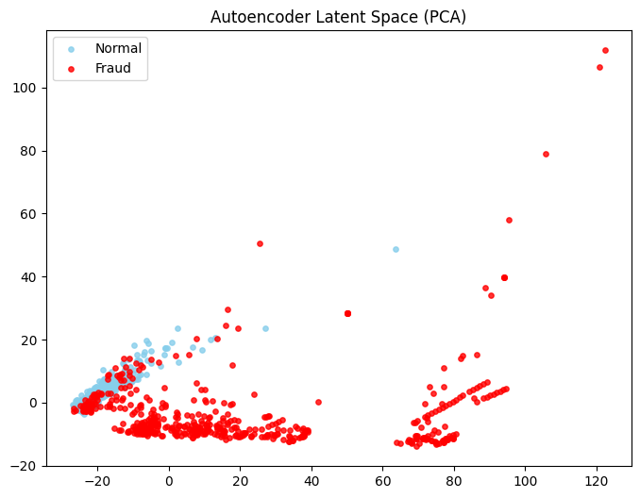
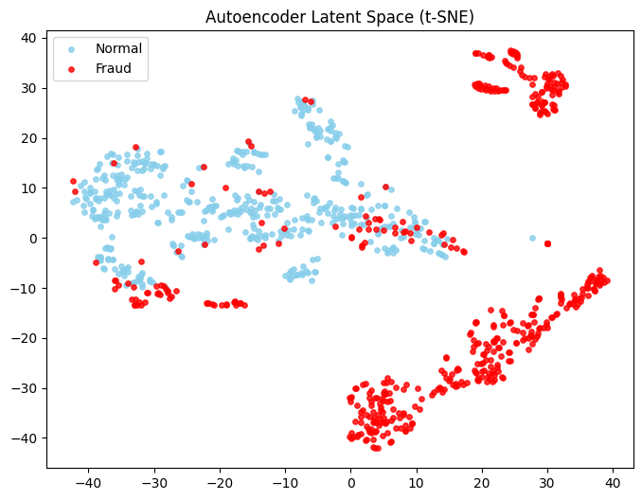
Learned Latent Representations
The trained Autoencoder's 12-unit bottleneck is extracted as a feature encoder. Its outputs are projected into 2-D using PCA and t-SNE to inspect whether fraud and normal transactions become linearly separable in the learned latent space.
Encoder source: Autoencoder bottleneck layer · Latent shape: (28,924 × 12) · Projections: PCA & t-SNE
PCA projection of latent space
t-SNE projection of latent space
Linear projection — partial separation visible.
Non-linear projection — fraud forms distinct clusters.
Anomaly Detection in Credit Card Transactions
11 / 13

Slide 12
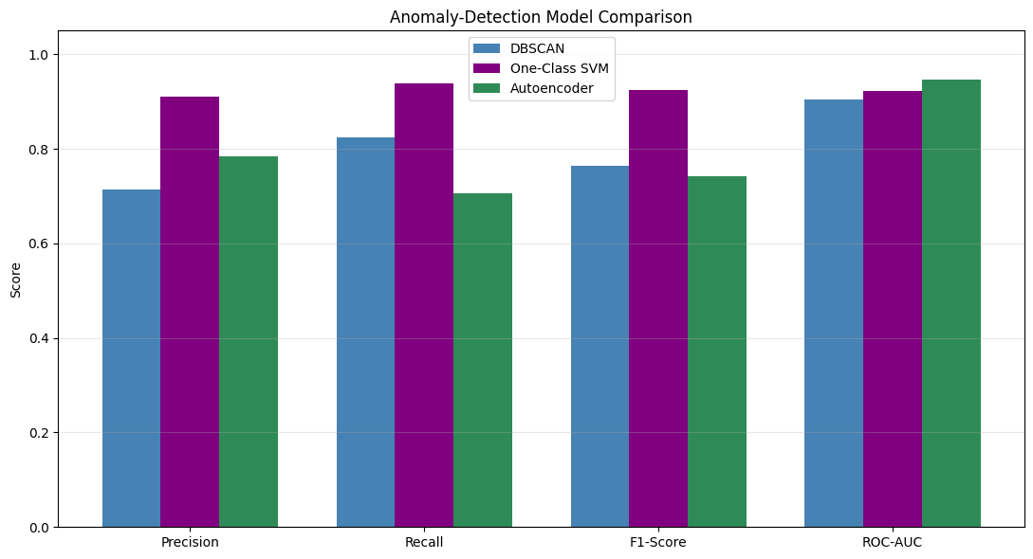
Final Model Comparison
Best F1-score
Best ROC-AUC
Best Recall
0.924
0.946
0.939
One-Class SVM
Autoencoder
One-Class SVM
Performance Summary
Model | Precision | Recall | F1 | ROC-AUC
DBSCAN | 0.714 | 0.824 | 0.765 | 0.904
One-Class SVM | 0.910 | 0.939 | 0.924 | 0.923
Autoencoder | 0.785 | 0.705 | 0.743 | 0.946
One-Class SVM achieves the highest F1 and Recall, while the Autoencoder leads in ROC-AUC. DBSCAN trails on Precision but remains competitive on Recall.
Anomaly Detection in Credit Card Transactions
12 / 13

Slide 13
Conclusions
01
Multiple approaches tested
02
Performance trade-offs
DBSCAN, One-Class SVM, and an Autoencoder evaluated under identical sampling ratios for a fair comparison.
Each algorithm displayed distinct strengths — model choice depends on the precision-vs-recall priority of the deployment.
03
Preprocessing matters
04
Hybrid strategy recommended
Feature scaling, log-transformation of Amount, PCA, and stratified splitting significantly shaped final results.
Combining ensemble methods or stacking outputs from complementary detectors could further improve detection reliability.
Final recommendation
One-Class SVM (F1 = 0.924) for balanced detection · Autoencoder (ROC-AUC = 0.946) for threshold-driven deployment.

