Slide 1
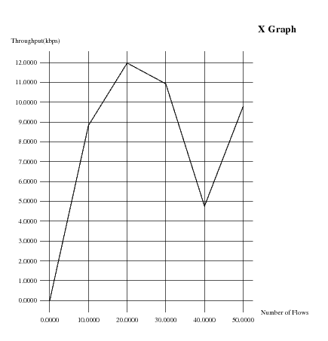
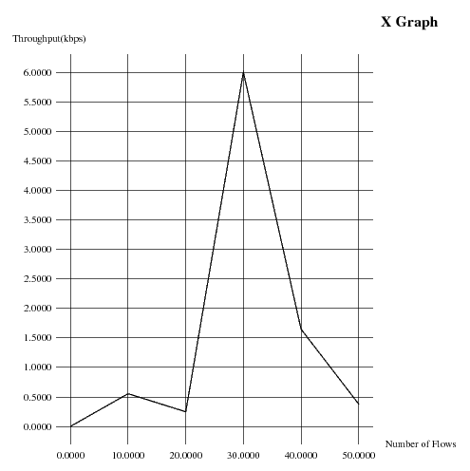
Throughput Comparison- 802.15.4
Existing
Modified

Slide 2
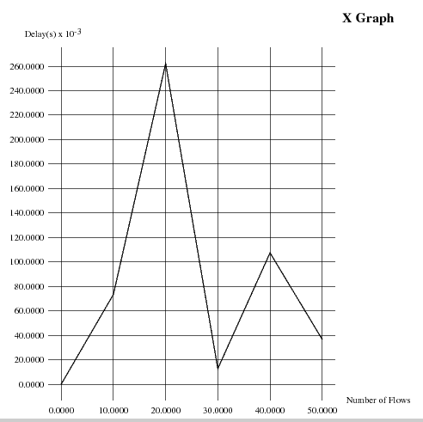
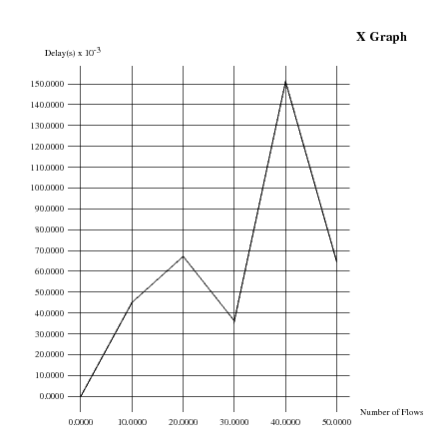
Delay Comparison – 802.15.4
Existing
Modified

Slide 3
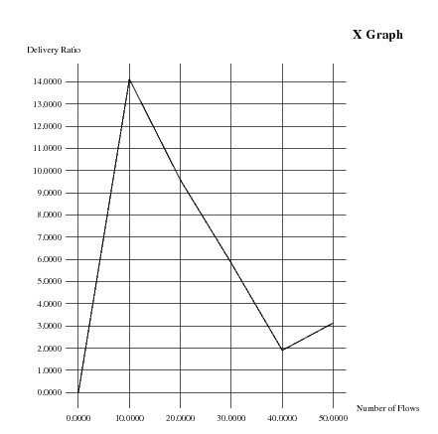
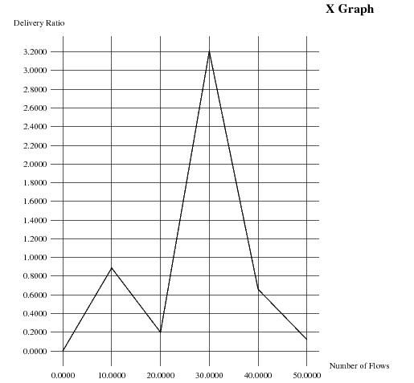
Delivery Rate Comparison – 802.15.4
Existing
Modified

Slide 4
Throughput Comparison – 802.15.4
Existing
Modified

Slide 5
Throughput Comparison – 802.11
Existing
Modified

Slide 6
Throughput Comparison – 802.11
Existing
Modified

Slide 7
Throughput Comparison – 802.11
Existing
Modified

Slide 8
Throughput Comparison – 802.11
Existing
Modified

Slide 9



