Slide 1
EMIL Seminar Paper Presentation
Eric Kim
Embedded Machine Intelligence Lab (EMIL)
School for Computing and Augmented Intelligence (SCAI)
Ira A. Fulton Schools of Engineering
Arizona State University

Slide 2
Paper Details
Title: Designing Reinforcement Learning Algorithms for Digital Interventions: Pre-Implementation Guidelines
Authors: Anna L. Trella, Kelly W. Zhang, Inbal Nahum-Shani, Vivek Shetty, Finale Doshi-Velez and Susan A. Murphy

Slide 3
Introduction
Guideline for RL Designs
PCS (Predictability, Computability, Stability) framework
Guidelines for designing simulation frameworks for use with PCS
Application of PCS in RL w/ Oralytics

Slide 4
Quick Rundown of RL
RL is a field of machine learning where the goal is to learn how to make the best sequence of decisions
Parameters: Decision Times, State, Action, Reward, Update
Model Fitting: Best fit to maximize reward function
Action Selection: Based on current State, learned info about the model (user) do some Action at Decision time

Slide 5
PCS Framework
3 key principles for reliable/reproducible data
Mainly used in Data Science
Predictability: Predict a future based on data analysis
Computability: Reasonable time to compute result
Stability: Consistency of results w/ regards to data/analysis changes

Slide 6
Significance
RL is used in many fields, however there is a high cost in creating studies of RL use in the field.
Design decisions for RL programs, once developed, cannot be changed during the study. Therefore, any mistakes in the design process cannot be corrected.
RL requires many design decisions: robustness, ability to learn, consistent run time, time/budget and useful/readable results.
Solution: extend PCS framework to RL design

Slide 7
Why
PCS has been extended for other platforms already (casual inference, network analysis, algorithm interpretability, all supervised learning not reinforcement)
One problem…
PCS doesn’t exactly translate to RL design development
So we extend PCS to RL, with a focus on stability/effectiveness w/ real world constraints

Slide 8
Solution
Predictability -> Personalization: Metric used to determine how “personalized” a RL algorithm has become for a model. Based on Average of Users’ Rewards (over time)/ 25th percentile of said rewards or average rewards over multiple time point (day 1, day 2, etc.)
Computability: Same as PCS but add additional constraints like timely access to reward/state information, budget, data used to inference other possible outcomes
Stability: Same as PCS but add RL algorithm must be stable when running and that it can perform in a variety of real-world environments. Ex. User heterogeneity, Rewards can vary over time, High noise environments

Slide 9
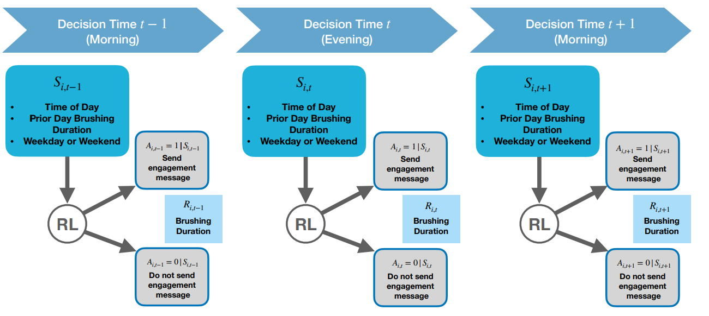
Case Study: Oralyitics Model

Slide 10
Case Study: Oralytics Model
Oralytics is a digital intervention for improving oral health.
Experiment (per individual): 1 Electric toothbrush w/ integrated sensors, Oralytics application, 2 decision times (day/night), rewards (with unlikely repeats), 70 users, 10 weeks, 2 years, 4 user recruitment rate per week, ROBAS 2 (no interventions) & domain experts used to design algorithm.
Utilized extended PCS for RL in designing
Common problems found in many RL studies: algorithm cannot be changed after deployment, online algorithm (state may not update as frequently or at all), limited budget, need to draw other non related conclusions using results

Slide 11
Case Study: Oralytics Model Design
Decision Time: Morning/Evening windows specified by user
Reward: Couldn’t choose quality because it isn’t consistently available data. Brushing duration in seconds (120)
Algorithm Update Time: weekly (computability considerations)
Algorithm: Contextual Bandit Algorithm
Bayesian Framework: Thompson sampling, gives the ability to incorporate prior data and domain expertise into initialization
Constrained Action Selection Probabilities: 0.35 - 0.75, expert advice
Reward Approximation Function: Bayesian Linear Regression (action centering) & Bayesian zero-inflated Poisson (model is inflated with zero duration brushing)
Cluster Size: K = 4 (Partial Pooling) most balanced

Slide 12
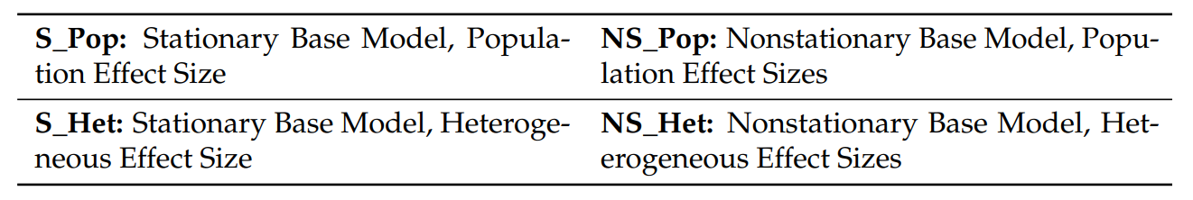
Case Study: Oralytics Model Simulation
3 Models
Zero-inflated Poisson (single population level model)
Hurdle with square root transform
Hurdle with log transform
One of these three models was chosen for the user, based on root mean squared error
Each user also has 4 environmental variants

Slide 13
Case Study: Oralytics Conclusion
BLR was better then ZIP: BLR was best for both average and worst users
Larger cluster sizes were superior: faster learning, less noise and improved reward optimization
Next time use BLR with action centering and larger cluster sizes
Simulation environment requires more diversity in user and noise, noise variance was fixed for BLR which is unrealistic

Slide 14
Conclusion
Oralytics was developed following the extended PCS for RL
Adaption was both successful and effective
Addressed challenges noise, user heterogeneity, etc.
PCS can be used as a practical tool for guiding the design/evaluation of algorithms in real world settings.
There are still some problems, like the simulation environments can have more variety and the results need more generalization. This method can be further refined to address these issues.

Slide 15
Reference
Trella, A.L.; Zhang, K.W.; Nahum-Shani, I.; Shetty, V.; Doshi-Velez, F.; Murphy, S.A. Designing Reinforcement Learning Algorithms for Digital Interventions:Pre-Implementation Guidelines. Algorithms 2022, 15, 255. https://doi.org/10.3390/a15080255

