Slide 1
﻿A General Search-Based Framework for Generating Textual Counterfactual
AAAI’24 Technical Track on Natural Language Processing I

Slide 2
Motivation
Most CF generation methods are GenAI models with a custom loss function tailored to meet certain requirements. Challenge arises when these requirements are altered. To accommodate these changes GenAI needs to go through expensive retraining.
Perturbs the input features minimally, yields a new feature vector. Such an operation is not applicable in textual domain.
Often time these CF methods are not model agnostic. Work with differentiable models only

Slide 3
Goals
Most CF generation methods are GenAI models with a custom loss function tailored to meet certain requirements. Challenge arises when these requirements are altered. To accommodate these changes GenAI needs to go through expensive retraining.
Adapt to a dynamic user-specified constraints with no retraining needed
Perturbs the input features minimally, yields a new feature vector. Such an operation is not applicable in textual domain.
Design a search-based but fast method to generate counterfactuals
Often time these CF methods are not model agnostic. Work with differentiable models only
Make it model-agnostic

Slide 4
Goals
﻿Domain-independent (sentiment analysis/product review/spam detection), can work for any text classification task.
Another scheme also allows to exploit domain-specific knowledge, through specialized operators, for improved performance.
Adapt to anytime algorithm. The more time you give it, the better result you will get.
Put not constraint on the text length

Slide 5


Method
Operators
Mask filling operator
Finetune a masked language model (MLM) for each target class
Mask each word in the sentence, use the MLM to fill the masks
This home looks beautiful and expensive
This home looks beautiful and expensive
This home looks beautiful and expensive
. . .
This home looks beautiful and expensive
Outputs a set of replacements and their corresponding scores
Finetuned MLM fills in
Finetuned MLM fills in

Slide 6
Method
1. Mask filling operator
Finetune a masked language model (MLM) for each target class
To add words, insert a mask token between every two words
This This home This looks This beautiful This and This expensive
MLM outputs suggested filling
Similarly, use MLM as a word removing operator
Finetuned MLM fills in

Slide 7
Method
2. Differential word (DW) bank operator
﻿To preserve grammatical correctness, replace words with differentiating words of the same part of speech (POS)
﻿For a given POS, create a bank of words for each class, that differentiate that class from the others
﻿Conduct a multinomial test to see if the words in bank are significantly over-represented in texts. Only keep top k over-represented words in the bank
For each POS, each class, use a semantic embedder to transform words into vectors. Use MANOVA to if the class cluster means are significantly different (sanity check to understand if these words can really change the meaning)
During operation, reduce branching factor by identifying which POS gives maximum leverage towards the target class

Slide 8
Method
3. Antonym operator
For domain specific cases, use prior knowledge
Use WordNet antonyms to replace a given word with its antonym

Slide 9
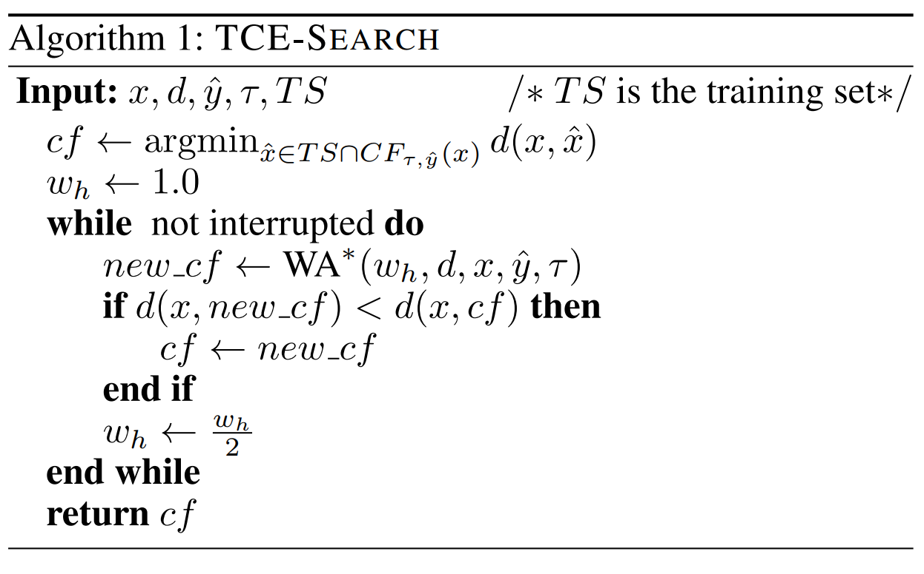
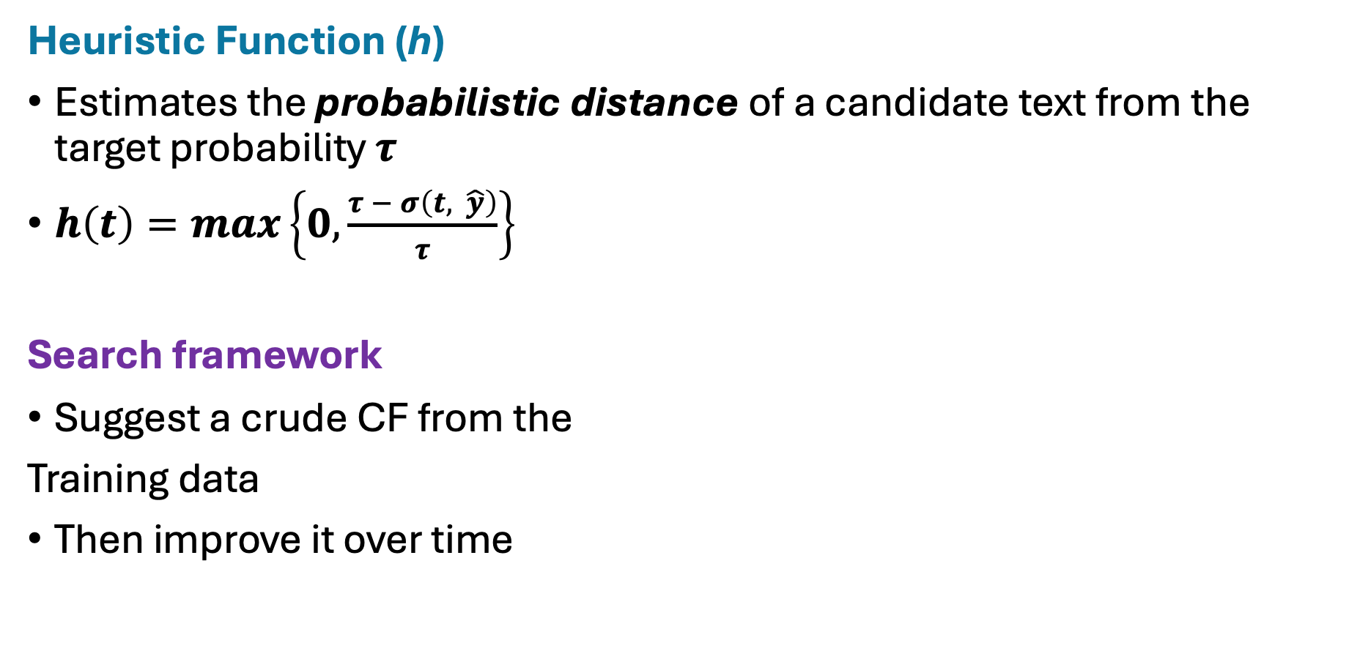
Method
﻿Heuristic Function (h)
Estimates the probabilistic distance of a candidate text from the target probability $τ$
$h\left(t\right)=max\left\{0,\frac{τ − σ\left(t, \hat{y}\right)}{τ}\right\}$
Search framework
Suggest a crude CF from the
Training data
Then improve it over time

Slide 10
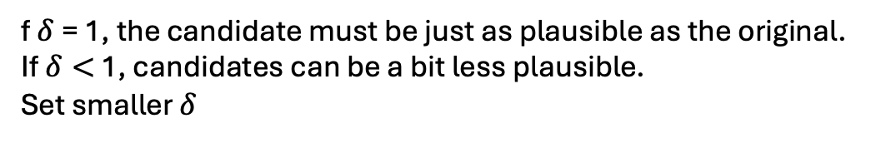
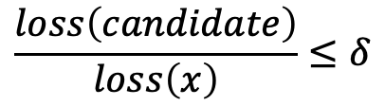
Refining
﻿Plausibility Enforcement
﻿There is a possibility that operators will take the CF out of context (from movie review to product review) and violate the plausibility requirement
A language model (LM) is fine-tuned on valid data D, so it's good at telling how "natural" or "likely" a sentence is.
Every generated candidate from modification is scored by the LM — using its language-modeling loss (how surprising that sentence is to the model)
The original example x is already in D, so its loss is a benchmark for plausibility.
Compute LM loss for:
Original example: loss(x)
Each modified candidate: loss(candidate)
$$\frac{loss\left(candidate\right)}{loss\left(x\right)}≤δ$$
f $δ$= 1, the candidate must be just as plausible as the original.
If $δ<$ 1, candidates can be a bit less plausible.
Set smaller $δ$

Slide 11

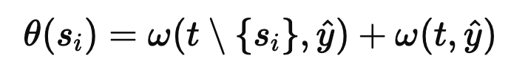
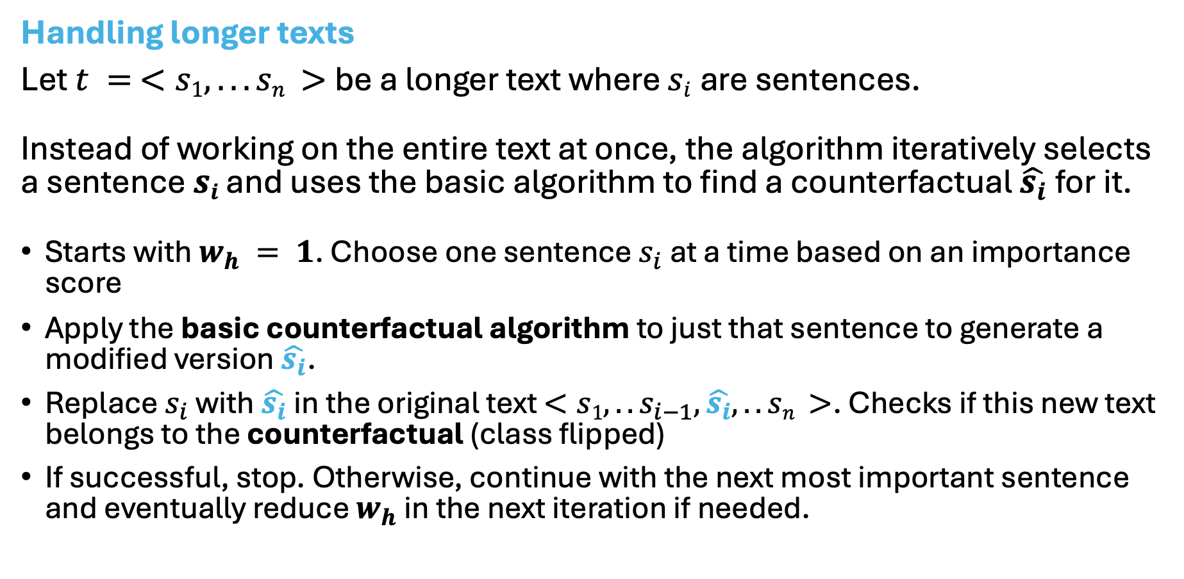
Refining
Handling longer texts
﻿Let $t =$ $<s1, . . . sn >$be a longer text where $si$are sentences.
﻿Instead of working on the entire text at once, the algorithm iteratively selects a sentence $si$ and uses the basic algorithm to find a counterfactual $\hat{s_{i}}$for it.
Starts with $w_{h} = 1$. Choose one sentence $s_{i}$at a time based on an importance score
Apply the basic counterfactual algorithm to just that sentence to generate a modified version $\hat{s_{i}}$.
Replace $s_{i}$ with​ $\hat{s_{i}}$in the original text $<s1, ..s_{i−1},\hat{s_{i}},.. sn >$. Checks if this new text belongs to the counterfactual (class flipped)
If successful, stop. Otherwise, continue with the next most important sentence and eventually reduce $w_{h}$ in the next iteration if needed.
Importance score:

Slide 12
Experiment
8 datasets:
Yelp. Yelp business reviews.
Amazon: Video game reviews on Amazon.
SST: Stanford sentiment treebank.
Science: Comments from Reddit on scientific subjects.
Genre. Movie plot descriptions labeled by genre.
AGNews: AG’s news articles labeled by topic.
Airline. Tweets about flight companies.
Spam: ﻿SMS labeled either as spam or as legitimate
MLM finetuned only once per training set

Slide 13
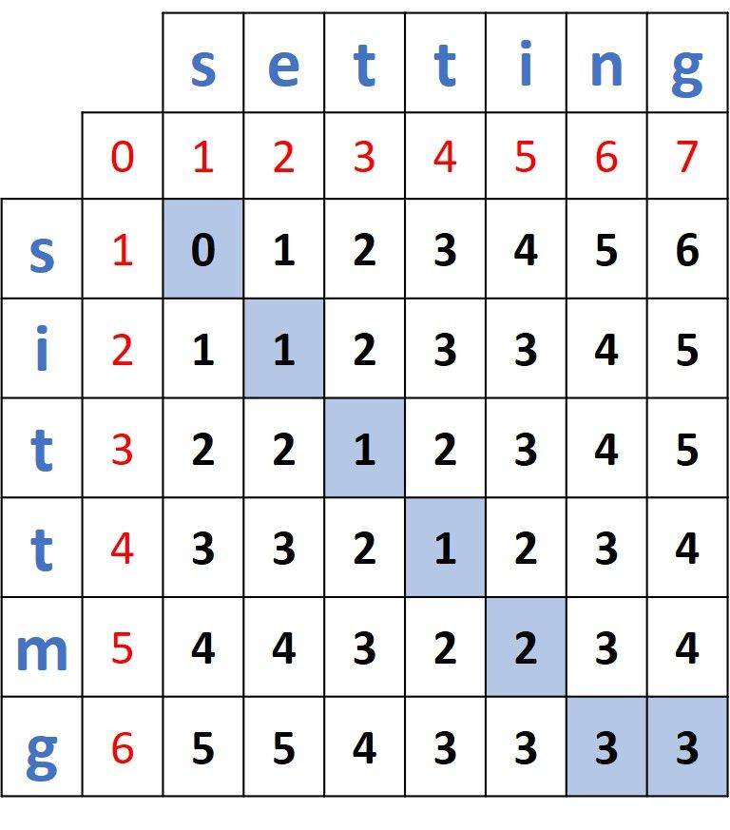
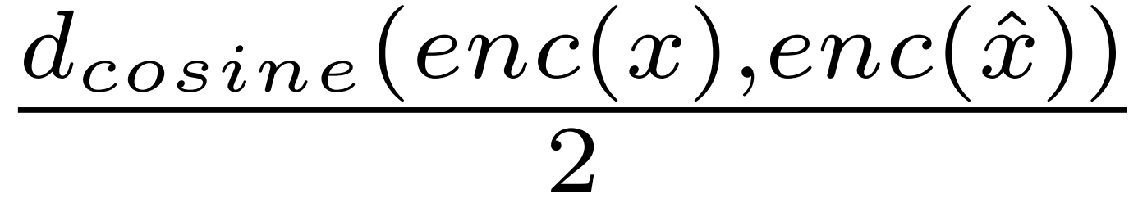
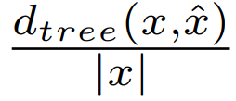
Experiment
Metrics
﻿1. Normalized word-level Levenshtein distance
﻿2. Normalized cosine distance
3. ﻿Normalized syntactic tree distance
Computational cost measured based on # expensive calls (calling LM and MLMs)
Levenshtein distance
how structurally different two sentences are, based on their syntactic parse trees (i.e., their grammatical structures)
﻿When dealing with texts longer than a single sentence, sum the distances of the sentences

Slide 14
Experiment
Configuration
﻿• A random forest was used as the black box classifier.
• The full version of framework was utilized, with all introduced operators to explore the search space.
• TCE-SEARCH was given a budget of 2000 expensive calls (EC).
• Levenshtein distance was used as the distance function in optimization
• The classification confidence threshold is 0.5.
• No text length limitation was imposed on the datasets.

Slide 15
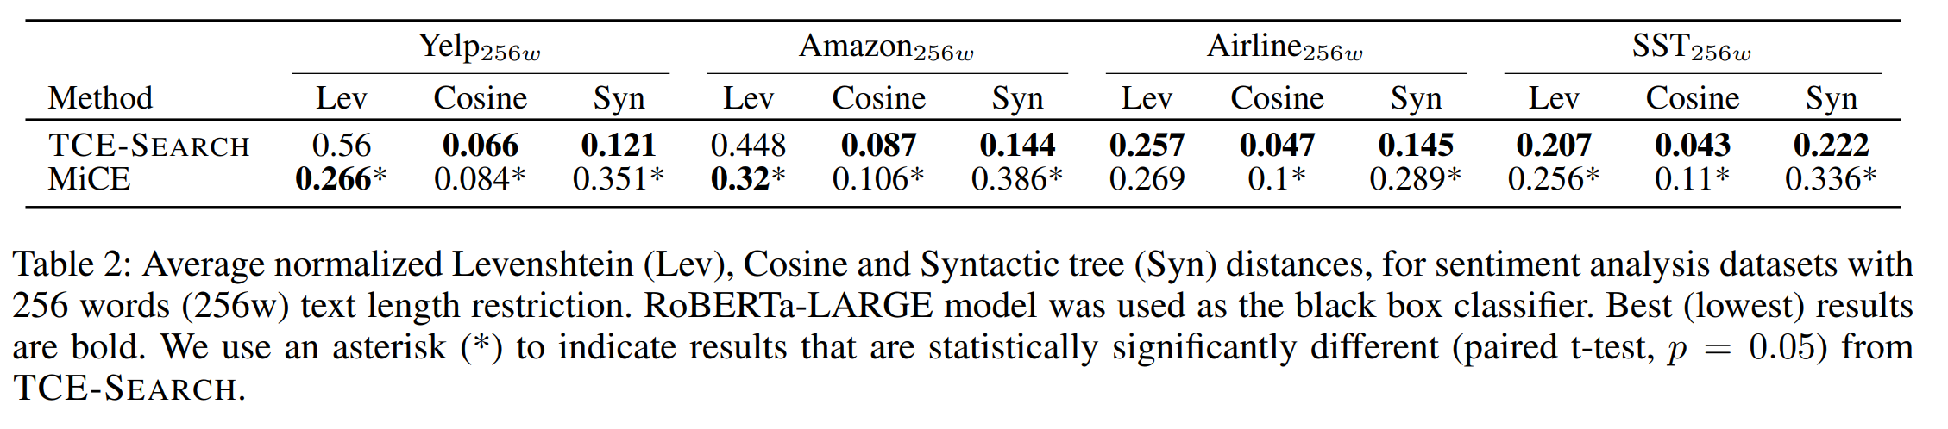
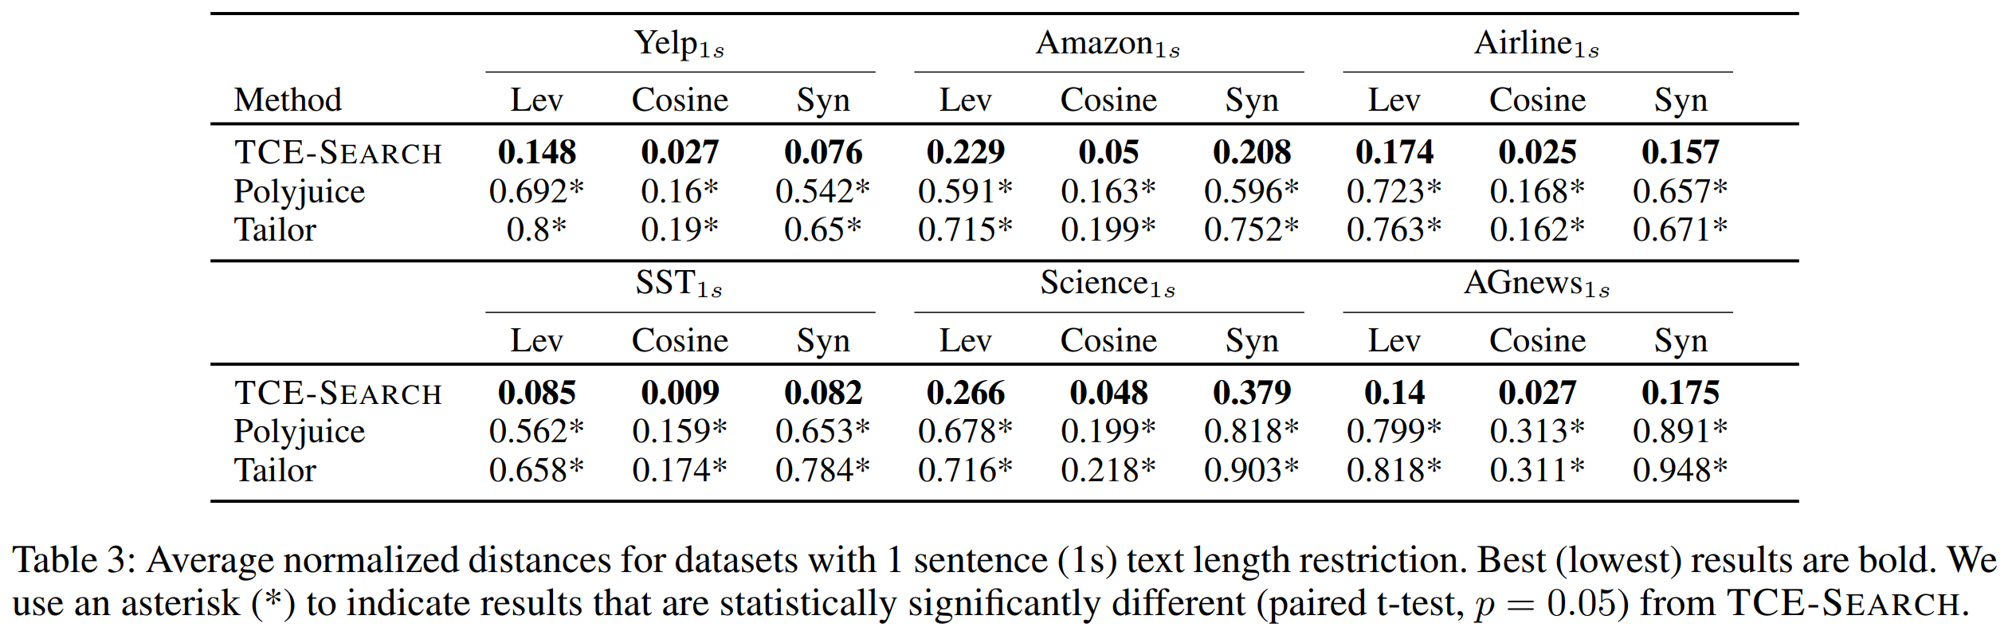
Results

Slide 16
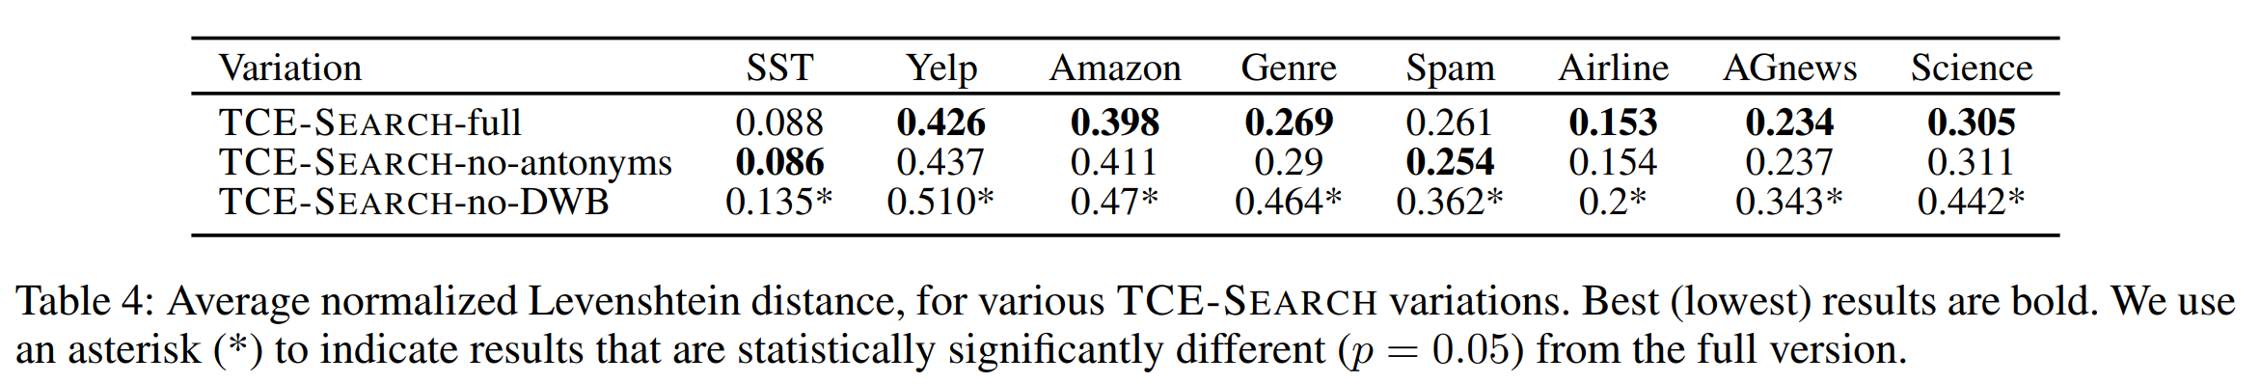
Ablation study
Comparison of different operators’ presence

Slide 17
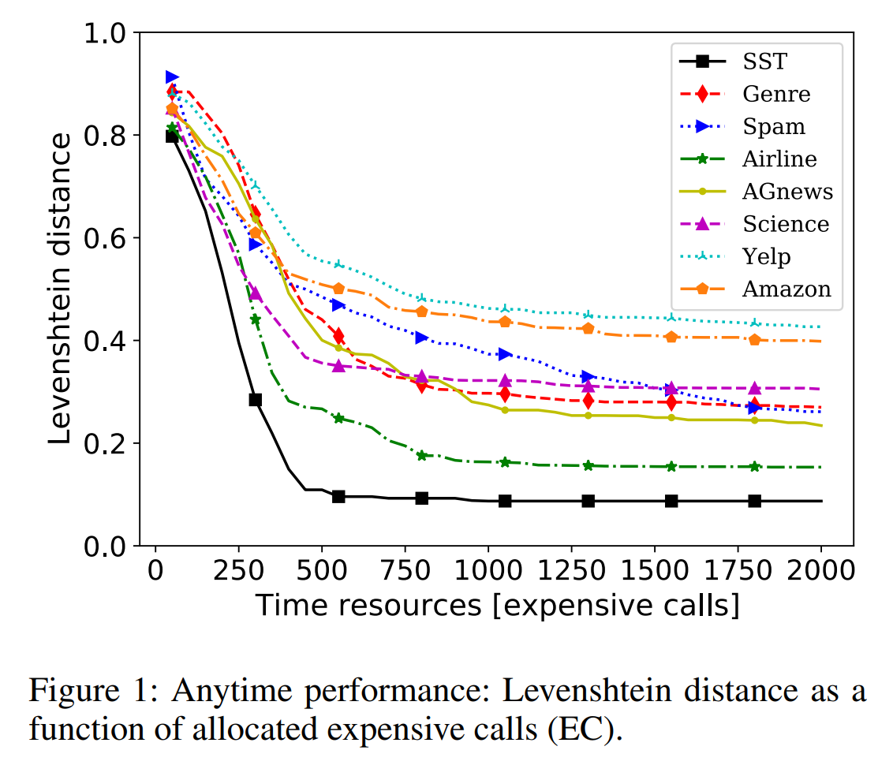
Ablation study

Slide 18
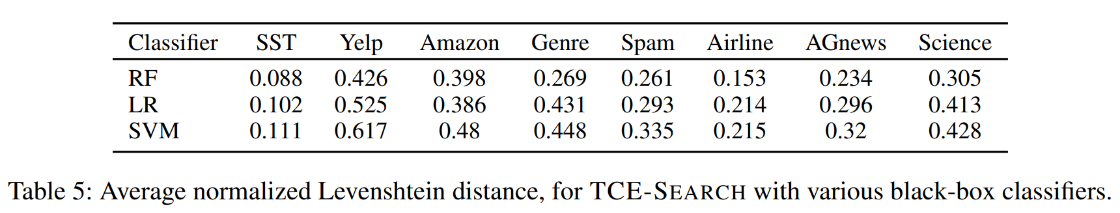
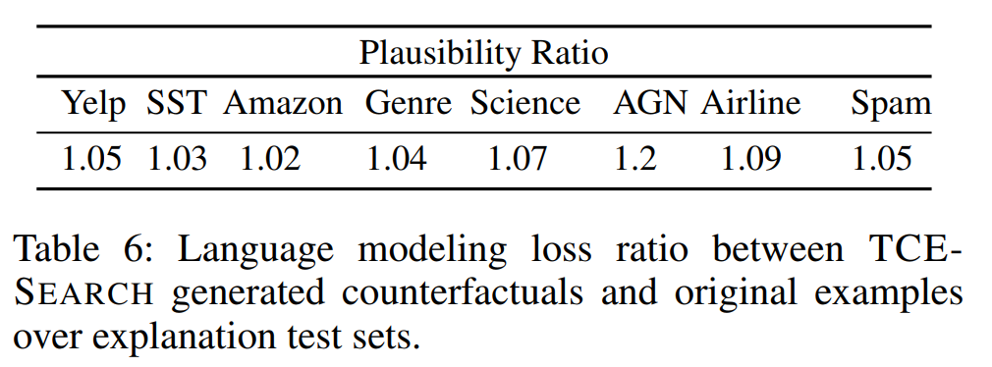
Ablation study
Robustness when different black-box classifiers are used
Plausibility

