Slide 1
Stress Detection using Context-Aware Sensor Fusion from Wearable Devices
IEEE Internet of Things Journal, , 2023
Cited by: 53
Presenter: Nooshin Taheri
10/8/2025

Slide 2
Background & Limitations of Existing Stress Detection Methods
Wearable health devices are increasingly used for stress detection, relying on multiple physiological sensors (e.g., ECG, EDA, EMG, BVP, TEMP).
Stress detection methods face two major challenges:
Lack of robustness – sensor measurements are noisy and degrade model performance.
Lack of adaptation – static model architectures cannot adjust to changing sensing conditions (the noise context).
Stress classification techniques:
Deep learning models can capture temporal patterns in sensor data.
Classical machine learning models are more commonly used in stress detection.
Classical models are simpler and less computationally demanding, making them better suited for on-device deployment in wearable systems.
Limited coverage: Single sensor modalities capture only part of the stress response.
Static fusion: Combining all sensors without context can worsen accuracy.
➡️ Gap: A context-aware, adaptive fusion framework is needed to dynamically select reliable sensors based on their noise context.

Slide 3
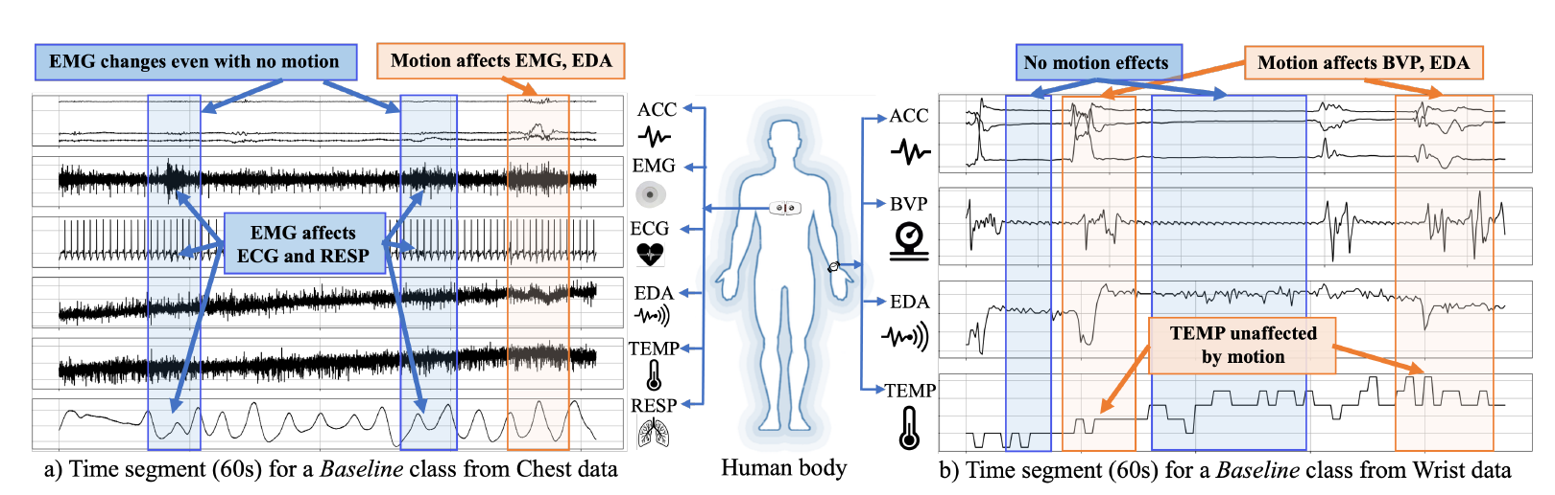
Why Context-Aware Sensor Fusion Is Needed
The context of noise on sensors varies depending on the location of the wearable device.
Sensor noise varies by device location → Motion affects wrist sensors, while muscle contractions affect chest sensors.
Blind fusion can mislead the model ➜ A context-aware fusion approach is needed to adapt to changing noise conditions.

Slide 4
Contributions
Introduced SELF-CARE
a generalized selective sensor fusion framework for stress detection from wearable devices.
Proposed context identification
models the noise context (motion for wrist, muscle contraction for chest) to adaptively select reliable sensors.
Developed a novel late-fusion method
uses a Kalman filter to incorporate temporal dynamics and improve classification stability.

Slide 5
Problem Formulation – Need for Adaptive Sensor Selection
The noise context varies by device location — wrist sensors are affected by motion, chest sensors by muscle contractions.
Fixed (static) models treat all sensors equally → performance drops when some signals are noisy.
The system must adaptively choose which sensors to fuse depending on the current context.
SELF-CARE formulates stress detection as a context-driven adaptive fusion problem, rather than a static classification task.
Introduces two key modules:
Gating model (π): detects the current noise context from ACC (wrist) or EMG (chest).
Selection mechanism (ρ): picks the best subset of models/sensors (φ*).
Goal: maximize stress detection accuracy by using only the most reliable sensors at each moment.

Slide 6
Overview of the SELF-CARE Framework
Goal: Detect stress adaptively by selecting the most reliable sensors based on noise context.
Step 1 – Preprocessing:
Filter raw signals to reduce noise and align data across sensors.
Step 2 – Context Identification:
Extract features from motion (ACC) or muscle activity (EMG).
Gating model decides which sensor combinations (branches) to use.
Step 3 – Classification:
Each branch (set of sensors) has its own ML classifier (Random Forest / AdaBoost).
Step 4 – Fusion via Kalman Filter:
Combines outputs from selected branches.
Incorporates temporal dynamics for smoother, more accurate stress prediction.

Slide 7
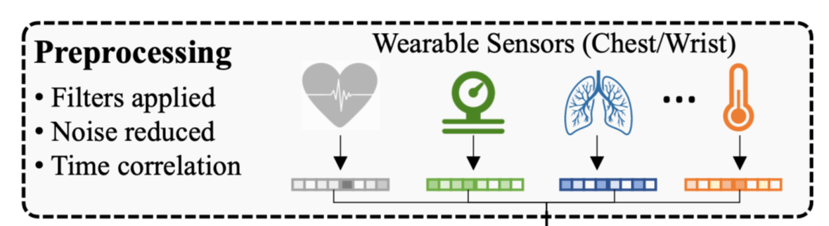
Preprocessing – Signal Preparation
Removes noise from raw physiological signals using filters (e.g., Butterworth, FIR, Savitzky-Golay).
Standardizes data collected from multiple sensors (chest and wrist).
Segments signals into fixed time windows (e.g., 60 s with 5 s overlap) for model input.
Enhances signal quality so later modules can extract meaningful physiological features.
Ensures all sensors are time-aligned for accurate feature correlation and fusion.

Slide 8
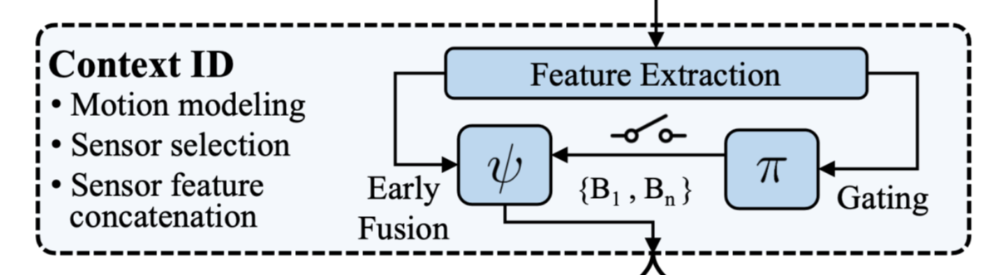
Context Identification
Goal: Detect the current noise context (motion or muscle activity) to decide which sensors are reliable.
Input: Raw sensor signals (ACC for wrist, EMG for chest).
Output: The best sensor branch(es) to use for stress detection.
Main Components:
Feature Extraction
Gating Model (π)
Performance–Computation Trade-off (δ)
Early Fusion (ψ)

Slide 9
Context Identification
Feature Extraction
Extracts ACC (wrist) or EMG (chest) features to capture motion or muscle activity.
Models the noise context, not stress itself.
Provides input to the gating model for sensor selection.
Other sensor features are extracted after the gating decision.
Gating Model (π)
Decision Tree predicts which sensor branch is most reliable.
Uses ACC/EMG features as input.
Wrist: chooses among 3 Random Forest branches (WB1, WB2, WB3).
Chest: chooses among 5 AdaBoost branches (CB1, CB12, CB14, CB24, and CB27 for 3-class; CB5, CB7, CB9, CB13, and CB20for 2-class).
Lightweight & adaptive — enables real-time context-aware selection.

Slide 10
Context Identification
Performance–Computation Trade-off (δ)
Balances accuracy vs. device efficiency.
δ ∈ [0, 1] determines how many branches are selected:
δ = 0: only the top-probability branch (fast, low power).
Higher δ: more branches included (higher accuracy, more computation).
Early Fusion (ψ)
For each selected branch, features from its sensors are concatenated into a single vector.
These fused features are then passed to their branch classifiers (e.g., Random Forest, AdaBoost).

Slide 11
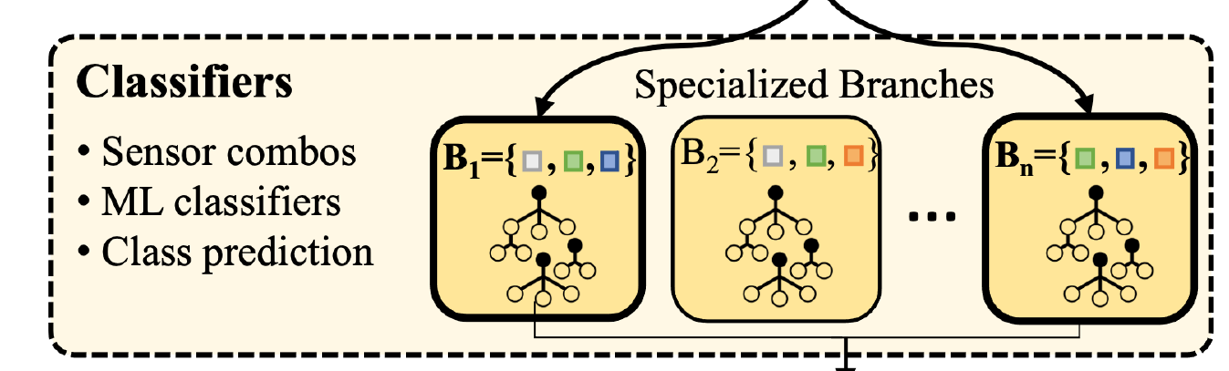
Branch Classifiers – Specialized Sensor Models
Each branch (B₁, B₂, …, Bₙ) is a separate classifier trained on a specific sensor combination.
Wrist devices: use Random Forest classifiers.
Chest devices: use AdaBoost classifiers.
Each branch predicts the stress class (baseline/ stress/ amusement).
The gating model activates one or more branches based on the detected context.
These outputs are later fused using the Kalman filter for the final stress prediction.

Slide 12
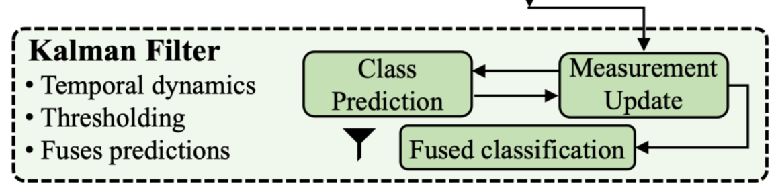
Late Fusion – Kalman Filter
Combines outputs from all selected branch classifiers.
Uses Kalman filtering to model temporal dynamics — considers how stress levels evolve over time.
Performs prediction and measurement update steps to refine class probabilities.
Applies thresholding to handle noisy or uncertain predictions.
Produces a final fused classification that is smoother and more accurate than simple voting.

Slide 13
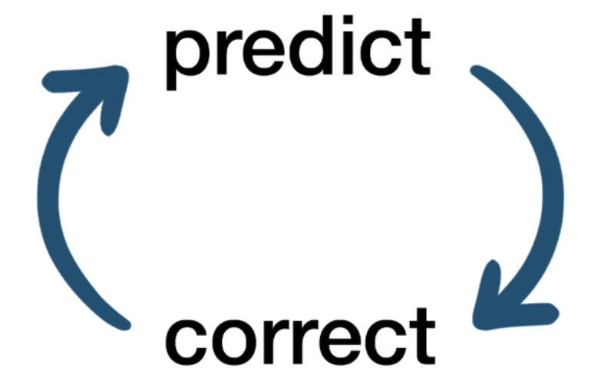
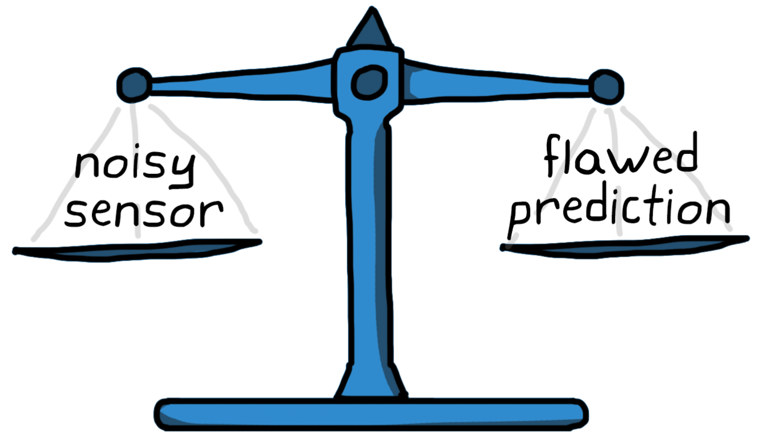
Kalman Filter
Used when we have noisy or uncertain measurements.
It predicts what the next value should be (based on the past), then updates that prediction using the new data.
Gives more weight to reliable readings and less to noisy ones.
Produces a smooth, realistic trend instead of sudden jumps.

Slide 14
Result
Traditional models fuse all sensors blindly, but SELF-CARE selectively fuses them based on context and uses Kalman filtering to smooth predictions, which leads to more stable and accurate stress detection.
Fig. 5: Overall performance comparison of related works using LOSO validation on wrist data 2-Class. Results show that SELFCARE outperforms the related works, branch classifiers, and other traditional late fusion methods in terms of both macro F1 and accuracy.

Slide 15

Thanks

Slide 16
Back –up slides

Slide 17
What happens before the Kalman filter
After context identification, the gating model chooses which branches to activate — for example, WB1 and WB2 for wrist sensors.
Each branch is a classifier (like a Random Forest) that gives probabilities for each stress class. Let’s assume it’s a 3-class problem → Baseline, Stress, Amusement.
🧠 Example
If the gating model selects WB1 and WB2, you get these predictions:
Branch | Baseline | Stress | Amusement
WB1 | 0.6 | 0.3 | 0.1
WB2 | 0.5 | 0.4 | 0.1
Each branch gives a vector of probabilities, like
$$Y_{1}=\left[0.6 , 0.3 , 0.1\right], Y_{2}=\left[0.5 , 0.4 , 0.1\right]$$

Slide 18
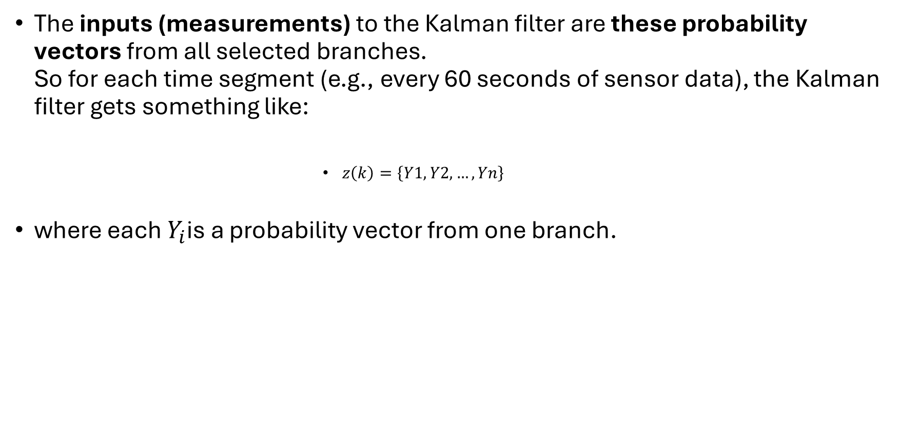
What the Kalman filter receives
The inputs (measurements) to the Kalman filter are these probability vectors from all selected branches. So for each time segment (e.g., every 60 seconds of sensor data), the Kalman filter gets something like:
$z\left(k\right)=\left\{Y1​,Y2​,…,Yn​\right\}$
where each $Y_{i}$is a probability vector from one branch.

Slide 19
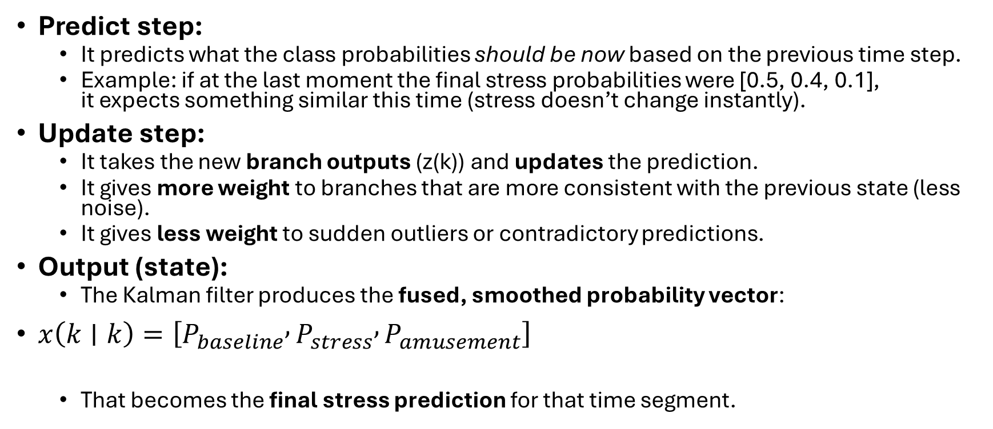
What the Kalman filter does
Predict step:
It predicts what the class probabilities should be now based on the previous time step.
Example: if at the last moment the final stress probabilities were [0.5, 0.4, 0.1], it expects something similar this time (stress doesn’t change instantly).
Update step:
It takes the new branch outputs (z(k)) and updates the prediction.
It gives more weight to branches that are more consistent with the previous state (less noise).
It gives less weight to sudden outliers or contradictory predictions.
Output (state):
The Kalman filter produces the fused, smoothed probability vector:
$x\left(k∣k\right)=\left[P_{baseline} , P_{stress} , P_{amusement}\right]$
That becomes the final stress prediction for that time segment.

Slide 20
🔍 example (numerical)
At time t₁
WB1 → [0.6, 0.3, 0.1]
WB2 → [0.5, 0.4, 0.1]
Kalman output → [0.55, 0.35, 0.1]
At time t₂
WB1 → [0.1, 0.8, 0.1] (maybe noise spike)
WB2 → [0.4, 0.5, 0.1]
(it doesn’t jump to 0.8 stress immediately)
Kalman output → [0.45, 0.45, 0.1 ]
At time t₃
WB1 → [0.2, 0.7, 0.1]
WB2 → [0.3, 0.6, 0.1]
Kalman output → [0.35, 0.55, 0.1] (gradually increasing — smooth transition)

