Slide 1

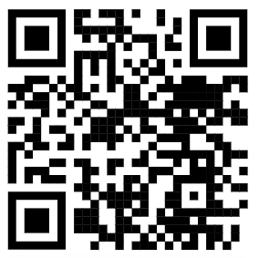
Topic: Scoping Reviews
Eric Kim
Embedded Machine Intelligence Lab (EMIL)
College of Health Solutions, Arizona State University
www.ghasemzadeh.com

Slide 2
What is a scoping review?
Definition
  Type of knowledge synthesis that follows a systematic approach to map evidence on a topic and identify main concepts, theories, sources, and knowledge gaps.
Purpose
  Clarify the scope & boundaries of chosen research area
  Identifies key concepts, data sources and current methods
  Finds gaps that need more research
Focus
  Breadth over depth
  Coverage over field, not drawing conclusions
  Organizing current research, not judging the quality
What it is not
  Systematic Review: Critical evaluations of study quality, effectiveness and conclusions
  Meta-Analysis: Same as above, but combine numerical results to produce single outcome

Slide 3
Why do a scoping review?
To understand a research area quickly
To see what has been studied
  Avoid re-invention cases
To identify gaps and find where new research is needed
  Confirm your idea is novel
Clarify and narrow a research question
Justify why a new study might be needed
Supporting early-stage work
Particularly useful when a field is broad, complex, or poorly defined

Slide 4
When should you do a scoping review?
When a research area is broad or poorly defined
When you are starting a new project
  Especially when you have little to no prior knowledge
When studies use different methods or data sources
  Can help pin down common methods/data sources
When you want to identify gaps in research
When you want to justify the direction of future work
Best done early in research

Slide 5
Scoping Review vs Other types
Scoping Review
  Broad topic
  Maps existing vs what is missing
  Used to understand a field
Systematic Review
  Answers a specific research question
  Evaluates the quality of studies
  Used to draw conclusions about the effectiveness of a study
Meta-Analysis
  Combines numerical results from other studies
  Produced a single quantitative estimate (x studies with same outcome had similar results)
Narrative Review
  Informally selected papers (like these seminars)
  Non-structured (not reproducible)

Slide 6
Scoping Review Tools
Literature Search
  PubMed, IEEE Xplore, Google Scholar, Scopus Web of Science, arXiv, etc...
  Collect papers from official sources
Reference Management
  Zotero (free), EndNote, Mendeley
  Store papers and remove duplicates
Screening
  Rayyan
  Web Screening UI for title/abstracts with inclusion/exclusion decision
Data Extraction/Tracking
  Excel/Google Sheets
Guidelines
  PRISMA-ScR https://www.prisma-statement.org/scoping
  Common guideline used to ensure reproductible, standardized reviews
Notes:
Mention Librarians

Slide 7
Example: My Scoping Review – Intro
Research Area
  Wastewater-based epidemiology (WBE) for Covid-19
Motivation
  Working with prof. Scotch on epidemiology and AI/ML
  WBE offers enough data to utilize AI/ML methods
  Circumvents need for patient data
Goal of Scoping Review
  Map existing WBE x Covid-19 studies
  Find common approaches and modeling strategies
  Highlight the gaps and inconsistencies that exists currently
Why Scoping Review
  New field to explore (cross-disciplinary)
  Broad field to explore (lots of Covid-19 papers)
  Looking to see what is being used and what has not been done

Slide 8
Example: My Scoping Review – Search and Overview
Databases
  PubMed, IEEE Explore, Google Scholar
Timeframe and Scope
  2020 – present
  English language papers
  Preprints included (important since some aren’t published or get revised)
Search Focus
  Wastewater-based Epidemiology
  Covid-19
  Modeling, estimation or prediction of epidemiological outcomes
Screening Approach
  Deduplication in Zotero
  Title + Abstract Screening in Rayyan
  Population-Concept-Context (PCC) – predefined Inclusion and Exclusion criteria
Criteria
  County-level or larger (interested in macro level modeling)
  Quantitative evaluation (no theoretical or correlation, grounded in results)
  Wastewater data is the primary model input (focus on WBE)

Slide 9
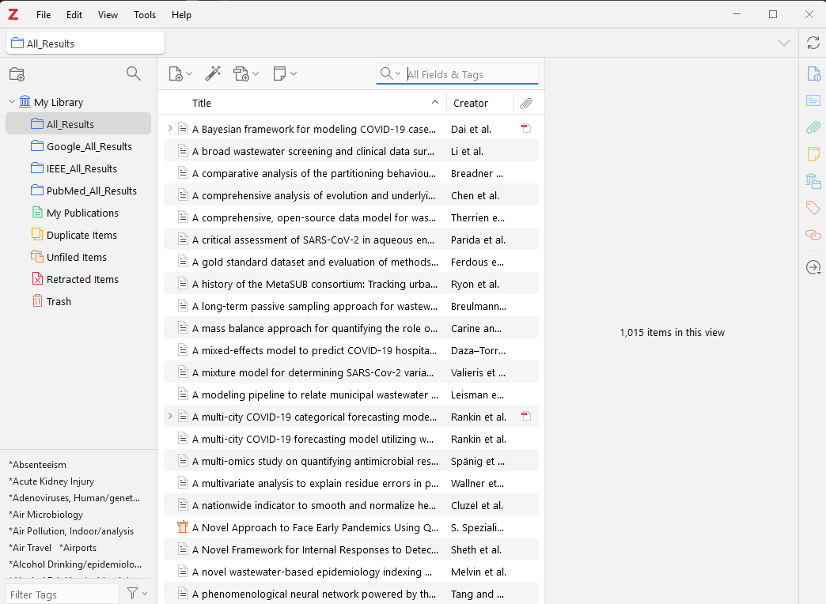
Example: My Scoping Review - Zotero
Zotero
https://www.zotero.org/

Slide 10
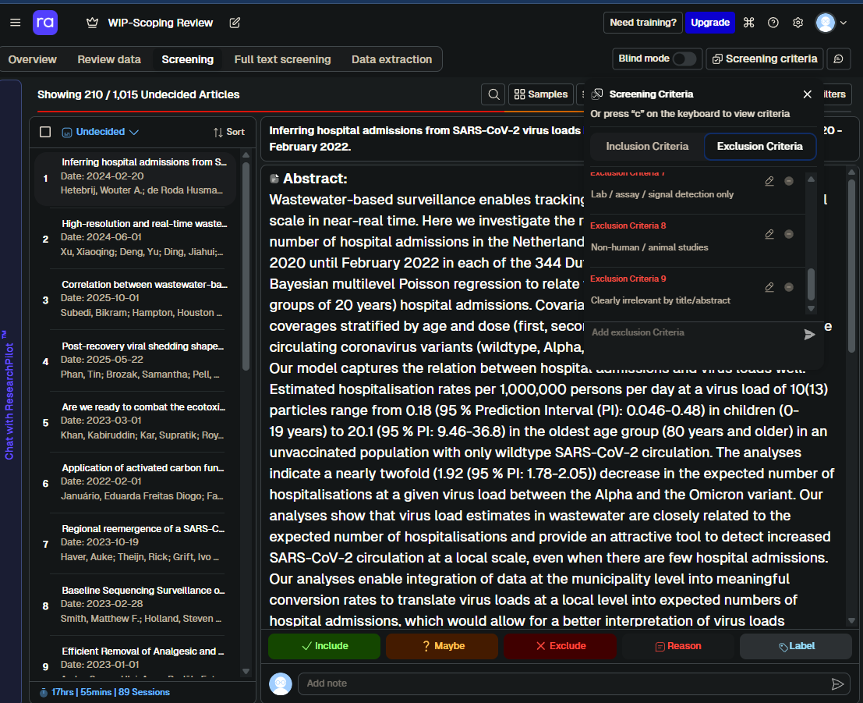
Example: My Scoping Review - Rayyan
Rayyan
https://new.rayyan.ai/

Slide 11
Example: My Scoping Review – Results so far
210 / 1015 articles completed initial screening by this presentation (title + abstract)
120 included, 103 maybe (no abstract), 582 excluded
Population and Scale
  Most studies focus on scales smaller than counties (cities, universities, hospitals, etc.)
  Few studies do multi-region or large-scale generalization
Wastewater Data
  SARS-CoV-2 RNA measurement is most commonly used
  Most common method of normalization is PMMoV (Pepper Mild Mottle Virus – common virus)
  Besides PMMoV, wide variety of normalization methods
  Wide variety of wastewater collection methods
Model outcomes
  Focus on case counts
Evaluation Practices
  Quantitative evaluation generally provided (when modeling has been done)
*Less results on what I know is common (for papers I am looking for), since more papers were excluded than included

Slide 12
Example: My Scoping Review – Challenges and Lessons Learned
Ambiguity in Abstracts
  Many papers have abstracts that don’t have enough detail to make a judgement
  Moving papers to “maybe” requires a full read of the paper later (more work)
Time and Effort
  Screening takes a LONG time
  Mind numbing work, especially if reading for longer stretches of time
Inconsistent Reporting
  Some papers have all the data you need, others don’t
  Cannot make assumptions based on previous papers
Search Criteria
  My search criteria was too broad (keywords used for search)
  Ended up with odd papers like Bluetooth in sewers
Tool Limitations
  Deduplication isn’t perfect, especially when the paper shows up again with slight rewording
  Rayyan exclusion with reasons need to be expanded to your needs (custom rejection reasons)

Slide 13
Key Takeaways
Scoping Reviews are a structured way to map a research field
Best used early in a project to understand the scope and gaps in the field
Goal is coverage and clarity (learning)
Helps justify whatever research idea you might have (or help you decide on a new one)
Clear criteria and transparent screening is required
High time investment, high value return

