Slide 1


Paper: Advances in Wastewater-Based Epidemiology for Pandemic Surveillance: Methodological Frameworks and Future Perspectives
Eric Kim
Embedded Machine Intelligence Lab (EMIL)
College of Health Solutions, Arizona State University
www.ghasemzadeh.com

Slide 2
What is WBE?
Public health surveillance using wastewater
Detects pathogen biomarkers shed by infected individuals
Infers population-level infection trends
Complements clinical surveillance and may provide early warning
Notes:
The paper defines WBE as a surveillance approach that monitors community health by analyzing biological markers in wastewater rather than testing individuals directly. It evaluates aggregated signals collected from sewer systems.
Public health surveillance is the continuous, systematic collection, analysis, interpretation, and dissemination of health-related data to monitor and prevent disease, injury, and other health threats in populations.
Ex. Infectious Disease Surveillance | Monitoring COVID-19 cases by the Centers for Disease Control and Prevention or Tracking influenza (flu) activity through hospital reports
Chronic Disease Surveillance | Cancer registries tracking incidence rates or National surveys measuring diabetes prevalence
Environmental Health Surveillance | Air quality monitoring for pollution or Testing drinking water for contaminants
Infected individuals shed pathogens, such as SARS-CoV-2 RNA, through feces. These biological markers enter wastewater systems and can be detected and quantified using laboratory methods like qPCR and sequencing.
Because wastewater aggregates contributions from the sewer-connected population, measured pathogen concentrations reflect overall infection prevalence and temporal trends within a defined catchment area.
Usually this is a town, city or county.
This also means that we can determine infections rates in a city WITHOUT having to test each individual person or rely on clinical case reporting.
The paper emphasizes that WBE complements traditional clinical surveillance.
Because we still need data, like hospitalization rates and clinical case counts, to assess the disease severity and population level outcome.
It captures signals from symptomatic and asymptomatic individuals (because sometimes people don’t feel or look like they are infected) and can sometimes detect infection trends before increases are reflected in reported case data.

Slide 3
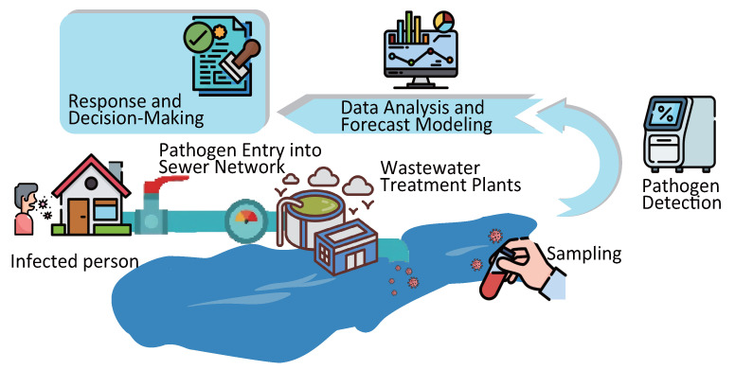
Framework of Wastewater-Based Epidemiology
Sampling: collecting representative wastewater from a defined population
Pathogen detection: measuring biological markers in collected samples
Data analysis: transforming measurements into infection trend estimates
Reproduced from Kitamura K., et al., Microorganisms, 2025, 13(5):1169. https://doi.org/10.3390/microorganisms13051169. Licensed under CC BY 4.0.
Notes:
Sampling defines the population being monitored.
For example, a sewer catchment for the city of Tempe should correspond to the city of Tempe. Instead of Phoenix.
Or if we were doing the county of Maricopa, using only the sewer catchment for Tempe would be incorrect.
Pathogen detection defines what pathogen we are looking for and how we measure it in the lab.
For example, if we want to monitor COVID-19, the lab must test specifically for SARS-CoV-2. If the test instead targets influenza, the results would describe flu activity, not COVID-19.
In other words, sampling tells us who the signal represents, while pathogen detection tells us what disease the signal represents.
Data analysis encompasses preprocessing and predictive modeling.
Data that we get from the lab have to be normalized and adjusted for use.
For example, measured viral concentrations may be adjusted for wastewater flow rate or population size so that values are comparable over time.
This helps ensure that an increase in concentration reflects a real rise in infections, rather than changes in dilution or sampling conditions.
After preprocessing, statistical or forecasting models can be applied to identify trends, detect outbreaks early, or predict future case counts.

Slide 4
Sampling and Pathogen Detection
Sampling depends on location, timing, and frequency
Composite and grab sampling methods are used
qPCR quantifies viral RNA in wastewater
Sequencing enables variant identification and monitoring
Notes:
The main key factors in sampling are location, timing, and frequency.
Location refers to where wastewater is collected.
Samples are taken from defined wastewater catchments, such as treatment plants, that serve a large portion of the population.
Clear catchment definition determines which population the infection signal represents.
Timing refers to when samples are collected.
Wastewater flow varies throughout the day, so collection time affects how representative the sample is.
Sampling strategies account for daily usage patterns.
Like when most people use the bathroom/use toilets/sinks (for peak viral load)
Frequency refers to how often samples are collected.
This depends on the illness being monitored and surveillance goals.
During COVID-19, sampling was often conducted multiple times per week, and sometimes daily, to track infection trends closely.
There are two primary collection methods.
Composite sampling collects wastewater over a defined time period and provides a more representative average signal.
Grab sampling collects at a single point in time and reflects conditions at that specific moment.
Composite sampling was commonly used during COVID-19 surveillance.
After collection, pathogen detection is performed.
After collection, pathogen detection is performed.
Quantitative PCR, or qPCR, is a laboratory method that detects and amplifies specific segments of viral genetic material.
In this case, it targets SARS-CoV-2 RNA present in the wastewater sample.
By amplifying and measuring the amount of viral RNA, qPCR provides an estimate of how much virus is present in the community’s wastewater.
Sequencing goes further by determining the actual genetic sequence of viral material in the sample.
Amplicon sequencing targets specific regions of the viral genome to identify mutations in known areas, while metagenomic sequencing analyzes all genetic material present in the sample without targeting specific regions.
By reading the genetic code, sequencing allows identification of mutations and tracking of circulating variants within the population, including detection of emerging strains.

Slide 5
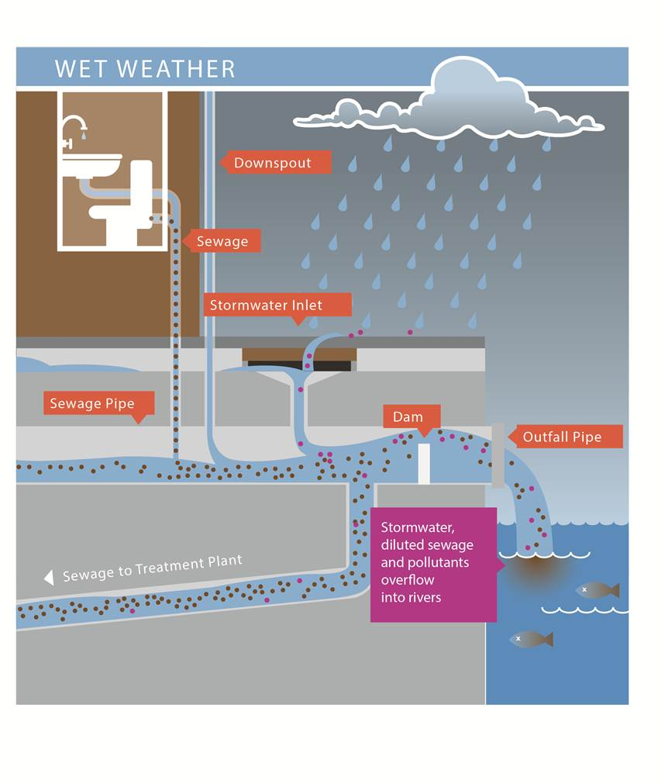
Data Preprocessing
Raw wastewater measurements are not directly comparable
Normalization adjusts for dilution and wastewater variability
Environmental and system factors must be accounted for
Processed data becomes suitable for modeling
Image by Cleantwaterguru24, “Illustration of a combined sewer system (combined sewer overflows),” licensed under CC BY-SA 3.0.
Notes:
The paper explains that raw viral RNA measurements from wastewater cannot be directly interpreted as infection levels.
Concentrations vary due to changes in wastewater flow, rainfall, and other external factors, making raw values difficult to compare across time or locations.
As you can see here, wastewater systems don’t just consist of sewage, but it can also include rainwater and runoff.
Normalization is applied to adjust for dilution and variability in wastewater composition.
Factors such as changes in flow rate or stormwater input can artificially increase or decrease measured viral concentrations.
Adjusting for these effects improves comparability of the signal.
Environmental and infrastructural factors influence viral persistence and measurement reliability.
The paper notes that temperature, wastewater system characteristics, and other confounders affect RNA degradation and detection consistency.
These must be considered before analysis.
A little bit complicated for me, but high temperatures, like the ones we regularly experience in Arizona, makes covid-19 in wastewater decay faster!
After cleaning, normalization, and adjustment for confounders, the data better reflects true infection changes rather than wastewater system noise.

Slide 6
Predictive Modeling
Models link wastewater signals to epidemiological outcomes
Regression and statistical models are widely used
Machine learning models capture complex patterns
Model outputs estimate prevalence and forecast trends
Method | Applicable Conditions | Advantages | Limitations
Simple Moving Average | Smoothing short-term date | Simple, stable, and easy to implement | Slow response to emergencies
Locally Estimated Scatterplot Smoothing | Long-term and nonlinear data | No need to set parameters in advance | High computational complexity
Artificial Neural Networks | Large amounts of data and time-consuming process | Extract data features through deep structures | Time-consuming and poor interpretability of the results
Random Forest | High-dimensional data with missing data or nonlinear relationships | Prevent overfitting | Relatively inefficient, resource-intensive, and difficult to interpret
Bayesian Model | Sample data are insufficient in low-dimensional spaces | Quantify the credibility of each possible outcome | Relies on the choice of priors and assumptions
Notes:
Models in WBE start with the goal of *quantitatively relating wastewater measurements* (e.g., virus RNA concentration over time) to observed epidemiological outcomes, such as reported infection cases, hospitalizations, or outbreak indicators.
Predictive modeling transforms the processed wastewater data into interpretable public health signals that can support decision-making.
Regression and simpler statistical approaches are widely used as baseline models.
These include linear regression and similar frameworks that assume a direct, approximately linear relationship between wastewater biomarker levels and clinical indicators.
These models are interpretable and computationally efficient, making them useful for initial trend estimation or when data volumes are limited.
Machine learning models like support vector regression, random forests, and neural networks are used when the relation between wastewater data and infection trends appears nonlinear or influenced by multiple interacting factors. These models can incorporate multiple features (e.g., time, environmental covariates) and can adapt to more complex signal patterns.
The paper highlights that predictive modeling increasingly integrates machine learning techniques as part of advanced analytics.
Model outputs typically include *estimated infection prevalence* in the community, *predicted case counts at future time points*, and *early outbreak signals*.
Some models can also assess temporal dynamics and short-term trend forecasts.
The goal is to use wastewater surveillance data to predict epidemiological trends and support early warning systems.

Slide 7
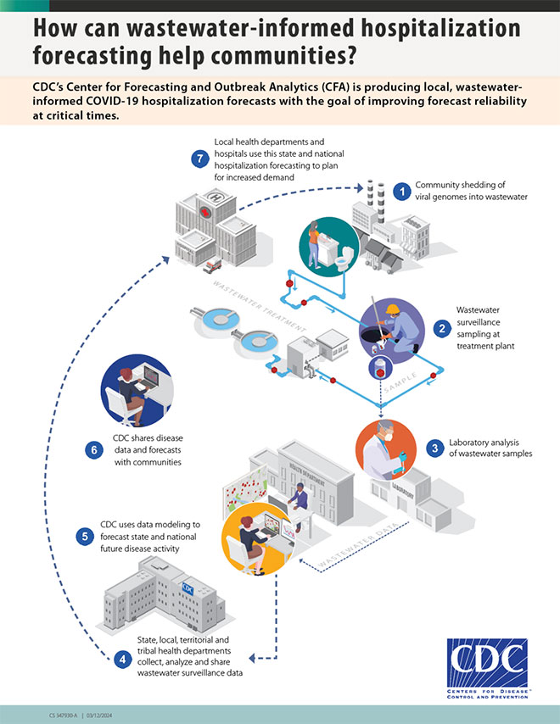
Applications
Early detection of infection increases
Trend monitoring over time
Variant identification and surveillance
Capturing asymptomatic and unreported cases
Support for public health decision-making
Notes:
The paper explains that wastewater viral concentrations can increase before rises in reported clinical cases.
Because individuals shed viral RNA regardless of testing status, wastewater monitoring can provide earlier signals of outbreak growth.
WBE enables continuous monitoring of infection trends over time.
By tracking changes in viral concentration, public health officials can observe whether infection levels are increasing, stabilizing, or declining within a defined population.
Sequencing of wastewater samples allows identification of mutations and monitoring of circulating variants.
This supports tracking of strain dynamics and detection of emerging variants at the community level.
Because wastewater aggregates signals from the entire sewer-connected population, it captures contributions from symptomatic, asymptomatic, and untested individuals.
This reduces dependence on clinical testing behavior.
The paper emphasizes that these capabilities make WBE a complementary surveillance system that informs public health responses, resource allocation, and outbreak preparedness.
Look at CDC diagram.

Slide 8
Challenges and Limitations
Lack of standardized protocols across regions
Environmental and system-driven variability
RNA degradation and measurement uncertainty
Resource and infrastructure requirements
Ethical considerations in community surveillance
Notes:
There is no universal standard for how wastewater is sampled, processed, or reported.
Different locations use different sampling frequencies, laboratory methods, and normalization strategies.
This makes results difficult to compare across regions and reduces consistency in interpretation.
It might sound simple to make a single protocol to follow, but there are many factors to consider.
Like equipment used, environment, type of disease and the most important of them all – which measurement system.
Measured viral concentrations are influenced by rainfall, changes in wastewater flow, and sewer system characteristics.
These factors can dilute or concentrate samples, making it difficult to distinguish true infection changes from system-related variability.
Viral RNA in wastewater can degrade due to temperature and environmental conditions.
This degradation affects measurement accuracy and adds uncertainty to the interpretation of viral concentrations.
Sequencing technologies and advanced modeling approaches require specialized laboratory equipment, trained personnel, and computational resources.
These technical demands can limit implementation, particularly in settings with limited infrastructure.
Although wastewater data does not identify individuals, it represents defined communities.
Surveillance at the community level raises questions about responsible data use, transparency, and public communication.

Slide 9
Personal Relevance
Understanding the full WBE pipeline before modeling
Identifying current challenges in wastewater surveillance
Situating Random Forest within existing modeling approaches
Questions?
Notes:
Before building predictive models, I was advised to understand the entire wastewater-based epidemiology pipeline.
This paper provided a structured overview of sampling, detection, preprocessing, modeling, and system-level challenges, giving me a clearer understanding of how each component affects downstream analysis.
The paper also highlights existing challenges in WBE, including variability, lack of standardization, and uncertainty in measurement.
These issues directly impact modeling reliability and must be considered when developing predictive frameworks.
Meaning, if I can solve problems earlier, like in the sampling step, I have to design a robust model that can take that into account.
Finally, the paper outlines the range of statistical and machine learning methods currently used in WBE, including regression, support vector regression, random forest, Bayesian methods, and neural networks.
This situates Random Forest within a broader modeling landscape and informs how I approach its use in COVID-19 wastewater modeling.
It also highlights a movement toward machine learning models, which is what my interests are in.

Slide 10
Citation
Zhu, W., Wang, D., Li, P., Deng, H., & Deng, Z. (2025). Advances in Wastewater-Based Epidemiology for Pandemic Surveillance: Methodological Frameworks and Future Perspectives. Microorganisms, 13(5), 1169. https://doi.org/10.3390/microorganisms13051169
Notes:
Before building predictive models, I was advised to understand the entire wastewater-based epidemiology pipeline.
This paper provided a structured overview of sampling, detection, preprocessing, modeling, and system-level challenges, giving me a clearer understanding of how each component affects downstream analysis.
The paper also highlights existing challenges in WBE, including variability, lack of standardization, and uncertainty in measurement.
These issues directly impact modeling reliability and must be considered when developing predictive frameworks.
Meaning, if I can solve problems earlier, like in the sampling step, I have to design a robust model that can take that into account.
Finally, the paper outlines the range of statistical and machine learning methods currently used in WBE, including regression, support vector regression, random forest, Bayesian methods, and neural networks.
This situates Random Forest within a broader modeling landscape and informs how I approach its use in COVID-19 wastewater modeling.
It also highlights a movement toward machine learning models, which is what my interests are in.

