Slide 1

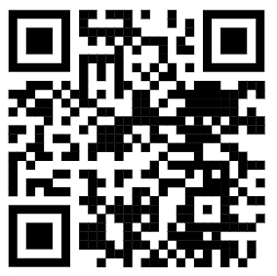
Topic: Finishing a Scoping Review
Eric Kim
Embedded Machine Intelligence Lab (EMIL)
College of Health Solutions, Arizona State University
www.ghasemzadeh.com
Notes:
Last time I talked about how to do a scoping review and basically covered about as far as I personally got.
Since then I’ve managed to approach the final stages. Yay~
These last stages I also thought were important (and I’ve been only reading wastewater related papers so…) I’ll be covering essentially the second half of the scoping review.

Slide 2
Where I left off last time…
Brief Recap
Completed my search strings
Completed my search
Deduplication completed
Initial screening was in progress
Now
Initial screening complete
Finial screening complete
Paper chaining in progress
Data extraction in progress
Data synthesis in progress
Paper writing in progress
Notes:
OK.
So last time I had picked a topic, made the appropriate search strings, did the search, deduplicated it and was doing the initial screening.
Now I’ve finished the initial screening and went onto to better things.
Mainly actually reading and digesting the papers.
So if the first half I covered was about exploring and getting a rough feel of the topic,
This latter half would actually be getting to know about the topic.
The final screening is what it says on the tin, you do a final screening of the papers you approved so far.
Like you actually fully read them through, or at least make sure it fulfills your requirements.
Paper chaining is searching for more papers through the ones you approved.
Data extraction and synthesis means to extract data from the paper and put it together in an informative way.
Then you take all this and write a paper.

Slide 3
Screening Criteria
Population Concept Context (PCC) - Inclusion/Exclusion Criteria
Population: Human populations defined by well-characterized population units for which COVID-19 epidemiological outcomes are reported and can be meaningfully aligned with the wastewater catchment(s) used for inference.
Concept: Machine learning–based models that use wastewater data as inputs to estimate or predict COVID-19 epidemiological outcomes within the context of wastewater-based epidemiology…
Context: Studies conducted within the domain of wastewater based epidemiology, where wastewater derived data is used as a central data source for modeling of COVID-19 epidemiological outcomes…
Pre-Screening Rules
Exact Exclusion Reasons (In Order)
Notes:
So… I don’t quite remember if I showed you guys the screening criteria for my scoping review.
Anyone remember?
*If they did, skip. If not continue*
Ok. So basically, the way you approach the criteria for a scoping review, following the PRISMA standard, is to create a PCC.
What I have here on the slide is the VERY basic portion, I’ll show you all the actual PCC I am using.
Essentially, the PCC is a way for you to target the specific papers you are looking for. What kind of population is the paper talking about, this doesn’t necessarily mean like human vs animal, but could be like specific population groups. Concept is just what subject you are looking at. Finally, context is what kind of well, the context in which the subject your looking for should be in.
Then on my document I also have the pre-screening rules and exact reasons of exclusion.
It’s very important that the PCC, screening rules and exclusion reasons are VERY clear.
When you get to writing the paper based off the screening, you are essentially writing all this out AND defending your logic as to why you wording something in a specific way.
Open the Scoping Document.
Here you can see in my PCC that I have listed exactly what kind of requirements have to be met for each section.
Read out parts of PCC..
So ok, so in the PCC I have things that I explicitly include and others that I exclude. There is also a section for maybe that is relevant for
Pretty sure I showed you all the search strings…
Now I have the pre-screening rules. I also learned that these pre-screening rules are essentially rules that I follow for both initial and final screening. Might be because of how detailed mine is, because otherwise you would be refining it as you go. (Which if you do then you have to do your screening again…)
Then I have exact exclusion reasons, ideally every single one of your papers should fit in one of the categories you set. This is also important because later on your make a flow chart of how many papers were excluded due to reason a/b and so on, therefore this is really nice to have.

Slide 4
Final Screening & Data Extraction
Final Screening Approaches
Screen all the way
Screen and extract data
No More Maybe Papers
Make a new rule
Create an interpretation of an existing rule
Data Extraction Template
Notes:
So, the final screening.
There are two ways to go about this.
Just read your papers and attempt to finish the screening.
or
Read your papers and extract data as you go.
Both ways are fine, personally I find that extracting as you go makes more sense.
The reason I say that is because the data you extract is essentially the reasons why a paper is included in your scoping review.
You cannot have any papers that are considered “maybe” at this stage.
So if you have some papers that could go either way at this point, like in the situation I am, you need to make a new rule or interpret the rules you made strictly.
For example, I have papers that are “maybe” because of alignment with population and sewage watersheds.
After THOROUGH research, I’ve found that of my 20~ish (maybe included) papers, I have to exclude almost half of them due to no clear alignment.
A paper that covers a small percentage of the population without an indication that the study applies to only that population isn’t valid for me.
Some form of aggregation or clear alignment is required.
Finding these alignments was pretty frustrating for me, because sometimes the language might be evasive. (Also kind of tells you the quality/focus of the work).
I personally chose to do data extraction at the same time, mainly because it helped me figure out this catchment alignment situation.
Data extraction also requires some form of template. You need to extract the same set of data between papers. You can also include a section for notes.
*Show them your extraction template*

Slide 5

Data Synthesis
Not just summarization
Find patterns
Find trends
Find inconsistencies
Find gaps
Notes:
So once you finish your final screening and data extraction, you work on data synthesis.
I’ve done a little work on this, mainly since I am working on a very rough draft of the scoping review.
This should kind of naturally happen as you read papers, although this step is when you actually start writing those realizations down.
There is no template for this point, thank god.
So, I haven’t really written these down yet, but here is data synthesis of the papers that’s been going on in my head.
There is no standard benchmark to compare most of these studies for
A majority of these papers are either grouped toward the start or end of covid
Clarity of results actually depend on the start/end publish date
Many papers “further recommend ML” development, even if the paper is doing some form of ML
And so on.
This is probably very surface level synthesis, but going through the templates for data extraction should clearly reveal some of this stuff.
*Show them the thing again*

Slide 6
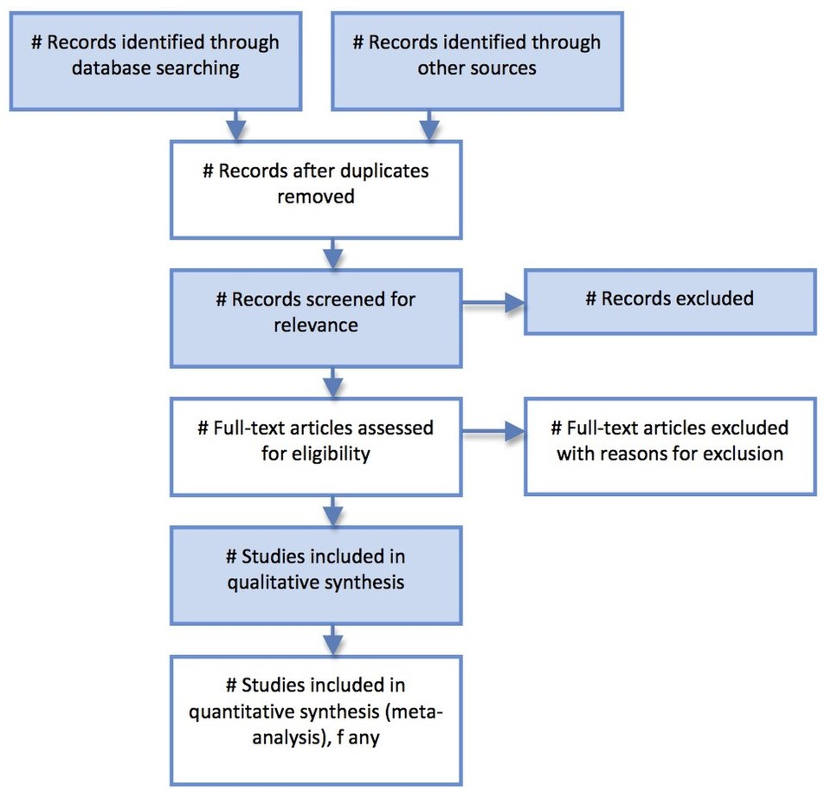
Paper Writing
Methods
Use Your Work So Far!~
Defend Your Reasoning
Flow Charts
Extraction & Synthesis
Atizinha, CC BY-SA 4.0 <https://creativecommons.org/licenses/by-sa/4.0>, via Wikimedia Commons
Notes:
Finally!
We are at actually writing the paper.
So from my experience with how the design of the PRISMA standard is set up.
It seems like most of the work is front loaded.
All the exact standards and templates that you’ve had to develop up to this point, you are including in your paper.
You give it all in detail, along with appropriate defense/reasoning for each point.
This section makes up a large portion of your paper.
Remember how I said there should be exclusion criteria recorded?
Well this PRISMA chart to the right is the reason for that.
I haven’t filled this out yet, since I am still going through some of my papers, but this diagram is a simple image of how you distilled your papers for the scoping review.
Finally, the extraction and synthesis steps generate the meat of the scoping review.
The first half is basically describing what you did and defending it.
The second half is reporting the results and insighted gained from it.
This is where all the notes for the synthesis come in handy.

Slide 7
Closing Notes
Would I do this again?
Was it useful?
Questions?
Notes:
I would like to not do this again. Lol
I definitely was useful, but the learning curve was a little steep.
Particularly when jumping into a topic that I have no idea about.
I still don’t understand some of the things discussed in the papers, besides a general idea like
X,Y,Z are all ways to analyze samples or A,B,C are common methods used.
Actually, writing the paper or at least coming up with the idea for a rough draft wasn’t too hard when I got everything together.

