Slide 1
A foundation model for generalizable disease detection from retinal images
Impact Factor of 50.5
456 Citations
Accepted: 18 August 2023
GitHub

Slide 2
Introduction to RETFound
✅ Medical AI can detect eye and systemic diseases using retinal images
❌ Existing models:
Require lots of expert-labeled data
Are task-specific
Lack generalizability across clinical tasks
Notes:
However, the scarcity of experts with domain knowledge cannot meet such an exhaustive requirement,
leaving vast amounts of medical data unlabelled and unexploited.

Slide 3
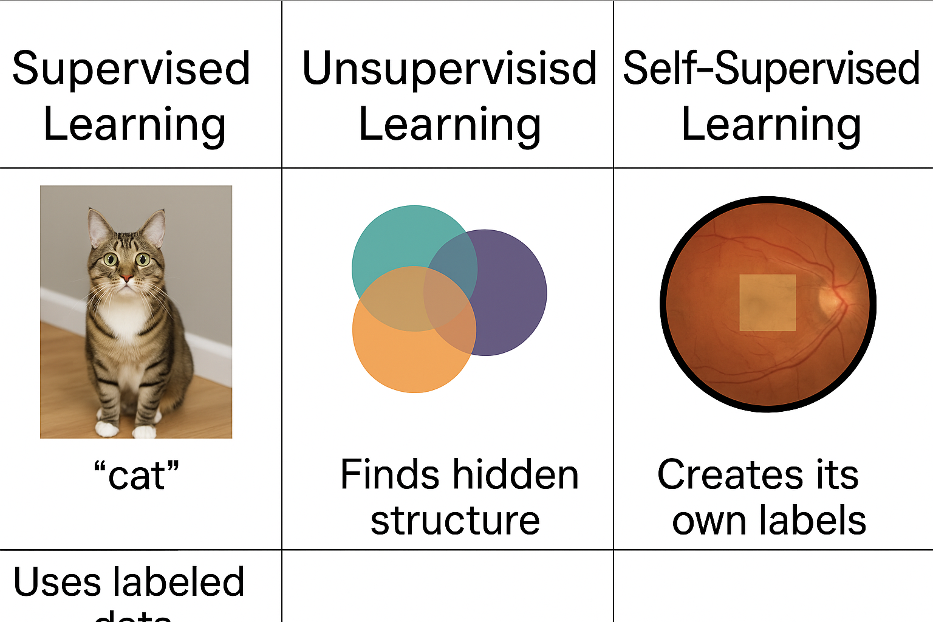
RETFound:
Use in RETFound
Trained on 1.6 million unlabelled retinal images
Uses Self-Supervised Learning (SSL)
Fine-tuned with minimal labeled data for many downstream tasks
SSL is a machine learning method that learns from unlabeled data by solving artificial “pretext tasks”
✅ For downstream fine-tuning
❌ Not used
✅ For pretraining on 1.6M unlabelled retinal images
Notes:
Supervised Learning: “This is the most traditional approach. The model learns from labeled data — for example, images that are tagged as ‘cat’ or ‘dog.’ It’s very powerful but depends heavily on having large, high-quality labeled datasets, which is often a limitation in medical domains.”
Unsupervised Learning: “This method doesn’t use any labels. Instead, it tries to find patterns or structure in the data — like grouping similar images together. It’s useful for exploring data or clustering, but it doesn’t directly learn to predict anything.”
Self-Supervised Learning (SSL): “This is in between. It also uses unlabeled data, but it creates its own labels by setting up pretext tasks — like hiding part of an image and asking the model to predict it. This helps the model learn meaningful features, which can later be fine-tuned with just a small amount of labeled data. That’s exactly what RETFound uses.”
A pretext task is a fake or artificial task used in self-supervised learning (SSL). It's not the final goal, but it's designed to help the model learn useful features from data without any labels.
🔍 Why do we use pretext tasks?
Because in SSL, we don’t have labeled data (like “diseased” or “not diseased”).
So instead, we:
🔁 Create a task from the data itself, so the model learns by solving it.

Slide 4
The Two Main Types of SSL
1. Contrastive SSL
2. Generative SSL

Slide 5
1. Contrastive SSL
Goal: Teach the model to tell which images are similar and which are different.
How:
1. Take one image Call it Image A.
2. Make two slightly different versions of it (Cropping, Brightening, Rotating)
Now you have:
A1 = first version of the image
A2 = second version of the same image
These two are called a positive pair — they come from the same source.
3. Also pick a completely different image (Image B)
That becomes a negative example
Popular methods: SimCLR, MoCo, DINO, SwAV
A1 vs B (different image) | Push apart their representations (make them different)
A1 vs A2 (same image) | Pull together their feature representations (make them similar)

Slide 6
2. Generative SSL
Goal: Teach the model to understand the structure of an image by making it rebuild or predict missing parts.
How:
Take an image → mask part of it (e.g., 75% of the pixels).
Ask the model to guess what the missing parts should look like.
Popular method: Masked Autoencoder (MAE) ← used in RETFound
The model must understand what the whole retina should look like to successfully fill in the blanks — so it learns detailed anatomical and disease-related features.

Slide 7
How RETFound was created
1. Start with Self-Supervised Learning (SSL)
They used Masked Autoencoder (MAE) SSL method
They created two separate RETFound models using two types of images

Slide 8
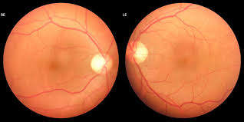
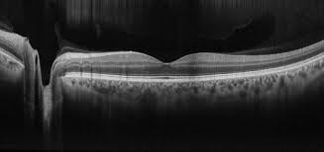
Retina Images:
Colour Fundus Photography (CFP) → It's a regular 2D color photo of the back of the eye (retina). → Shows blood vessels, optic nerve, and surface features.
Optical Coherence Tomography (OCT) → It's like an ultrasound, but uses light instead of sound to create cross-sectional images. → Shows detailed layers inside the retina — useful for spotting things like swelling or degeneration.

Slide 9
Why it matters?
✅ The retina is part of the brain — literally an extension of the central nervous system (CNS).
By looking at the optic nerve and inner layers of the retina, doctors and AI models can observe signs of brain-related diseases — without needing brain scans or surgery.
That’s why it’s helpful in studying neurodegeneration, like:
Alzheimer’s
Parkinson’s
Multiple sclerosis
It’s non-invasive = no needles, no radiation, just a camera flash.
✅ The blood vessels in the retina reflect the health of blood vessels throughout your body.
If those vessels are stiff, swollen, or twisted, it can signal:
Heart disease
Kidney problems
Hypertension
This is because all blood vessels are part of the same system — changes in one part (the eye) can reflect changes elsewhere.
Notes:
the optic nerve and inner retinal layers provide a non-invasive view of
central nervous system tissue19–21, and thus a window into neurodegeneration.
Similarly, retinal vascular geometry provides insights into other
vascular organ systems22–25, such as the heart and kidneys
use it to
promote the detection of many diseases.

Slide 10
How RETFound was created (Continued)
Two-Stage Pretraining
Stage 1: Natural Images
Pretrained using ImageNet-1k (1.4 million natural images)
Helped the model learn basic visual patterns (edges, shapes, textures)
Stage 2: Retinal Images
Then continued SSL training using 1.6 million unlabeled retinal images
904,170 CFP images
736,442 OCT images
Once RETFound was pretrained, they fine-tuned it by labeled datasets for various tasks

Slide 11
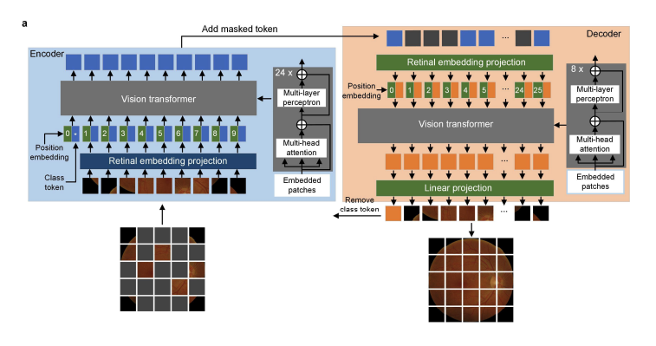
RETFound Architecture – Masked Autoencoder for Retinal Image Pretraining
Notes:
The encoder uses a large vision Transformer58
(ViT-large) with 24 Transformer blocks and an embedding vector size
of 1,024, whereas the decoder is a small vision Transformer (Vit-small)
with eight Transformer blocks and an embedding vector size of 512
Encoder (Left, blue section)
Input: A retinal image that has been split into patches, and 75% of them are masked (hidden).
The unmasked patches (shown in color) are sent into the Vision Transformer (ViT) encoder.
The encoder processes these visible patches with:
Position embeddings
Retinal embedding projection
Class token (used in pretraining tasks, later discarded)
✅ Goal: Extract high-level feature representations from the visible (unmasked) patches.
2️⃣ Decoder (Right, orange section)
The decoder receives:
The encoded visible patches from the encoder
Plus dummy placeholders for the masked patches
These are passed into a smaller Vision Transformer (fewer layers)
The decoder tries to reconstruct the full original image, including the missing (masked) patches
✅ Goal: Learn to infer the full image from partial information — encouraging the model to understand the global structure of the retin

Slide 12
How RETFound was created
2. Supervised Fine-Tuning for Clinical Tasks
the decoder is removed, and the encoder is fine-tuned on labeled medical tasks

Slide 13
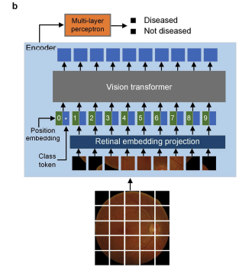
RETFound Fine-Tuning for Disease Prediction
Notes:
In adapting to downstream tasks, we only need the encoder (ViT-large)
of the foundation model and discard the decoder
What’s different from before?
During pretraining, RETFound was learning by guessing missing parts of an image.
During fine-tuning, RETFound is learning to predict disease, using labeled examples.

Slide 14
Tasks were grouped into 3 categories:
🧿 1. Ocular Disease Diagnosis
→ Detect if a person currently has an eye disease (e.g., diabetic retinopathy, glaucoma)
🔮 2. Ocular Disease Prognosis
→ Predict if an eye disease will develop in the future (e.g., will the other eye develop wet-AMD in 1 year?)
❤️🧠 3. Systemic Disease Prediction (Oculomics)
→ Use eye images to predict the future risk of body-wide diseases like:
Stroke
Heart failure
Heart attack (myocardial infarction)
Parkinson’s disease
Notes:
Wet Age-related Macular Degeneration

Slide 15
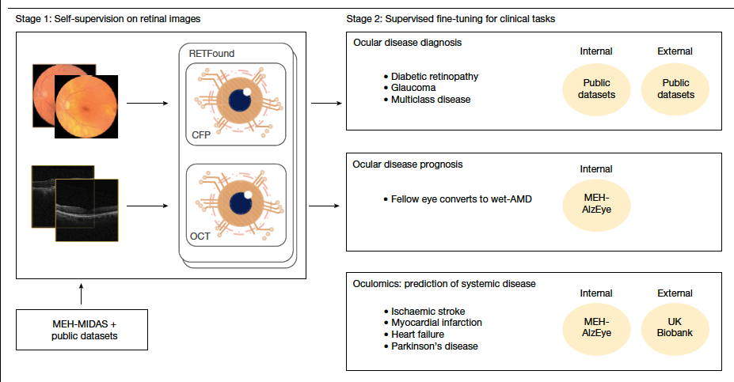

Slide 16
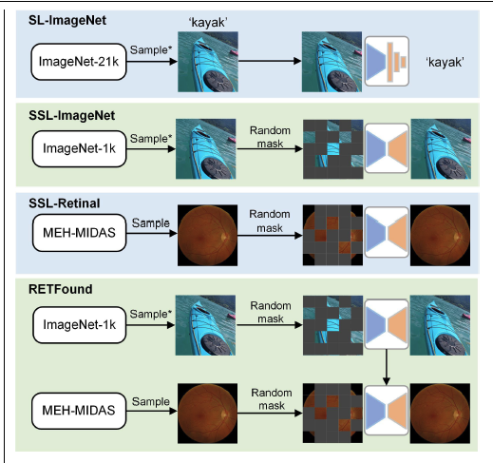
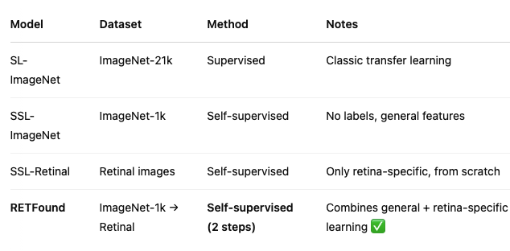
comparison models
Notes:
All models use differing pretraining
same model architecture as well as fine-tuning processes for downstream tasks
RETFound
trains the model on retinal images via SSL from the weights of SSL-ImageNet.

Slide 17
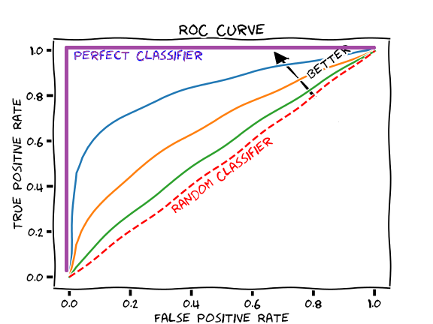
Evaluation
AUROC = Area Under the Receiver Operating Characteristic Curve
AUPR = Area Under the Precision-Recall Curve
Notes:
Area Under the Receiver Operating Characteristic Curve
Measures how well the model can separate positive and negative classes.
Looks at how true positives vs. false positives change across thresholds.
✅ Higher AUROC = better model at ranking positives above negatives
📊 Good for balanced datasets.
Area Under the Precision-Recall Curve
Focuses only on the positive class.
Shows trade-off between:
Precision: How many predicted positives are actually correct
Recall (Sensitivity): How many actual positives the model found
✅ Best for imbalanced datasets (like rare diseases)

Slide 18
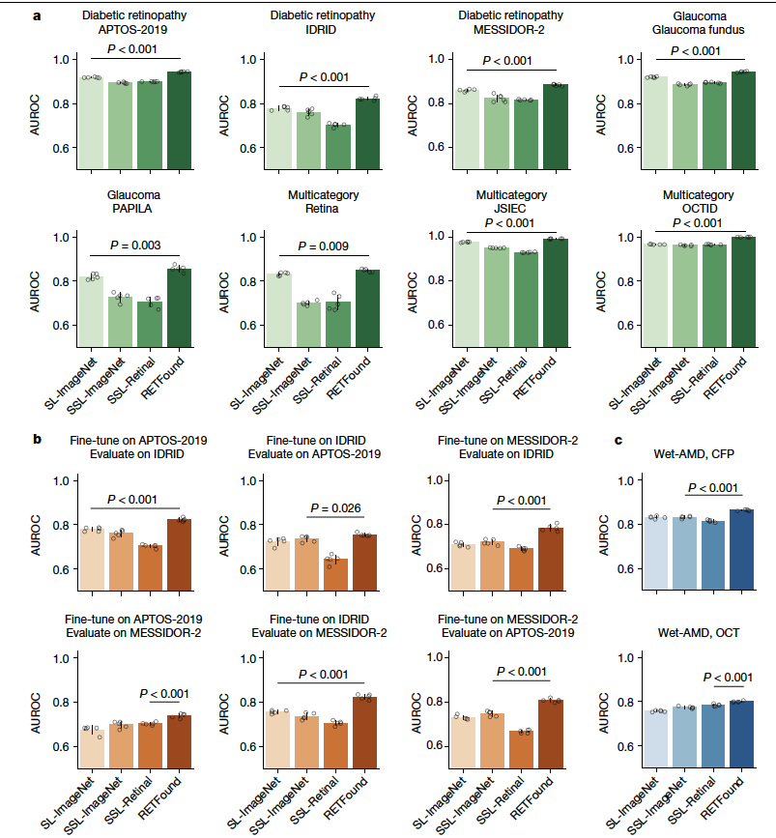
Performance on ocular disease diagnostic classification
b) External evaluation.
c) Performance on ocular disease prognosis.

Slide 19
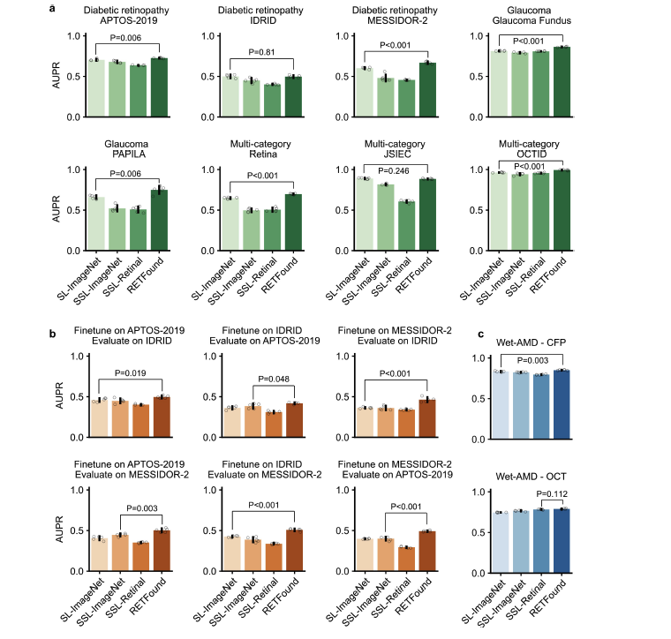
Performance (AUPR) on ocular disease diagnostic classification.
c) Performance on ocular disease prognosis.

Slide 20
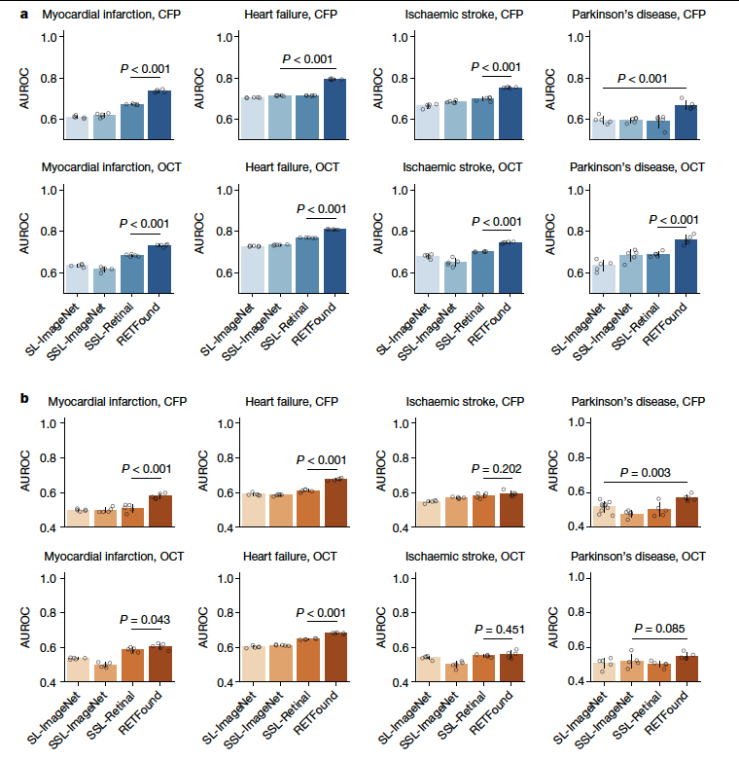
Performance on 3-year incidence prediction of systemic diseases with retinal images.

Slide 21
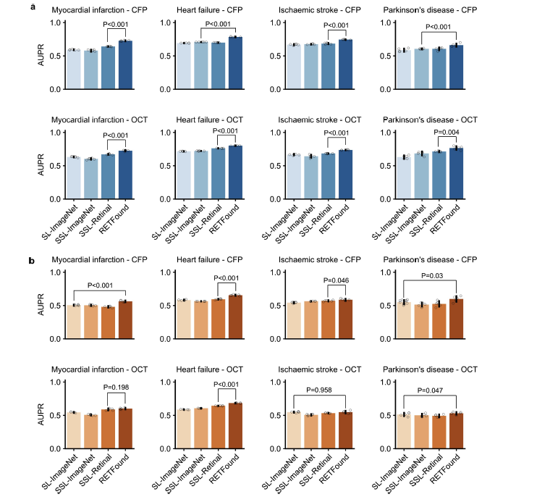

Slide 22
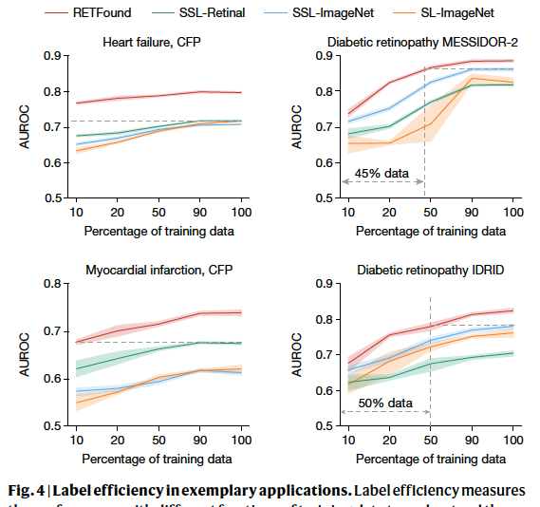
Label efficiency for disease detection
Label efficiency refers to the amount of training data and labels required to achieve a target performance level for a given downstream task
save about 80% of the training time

Slide 23
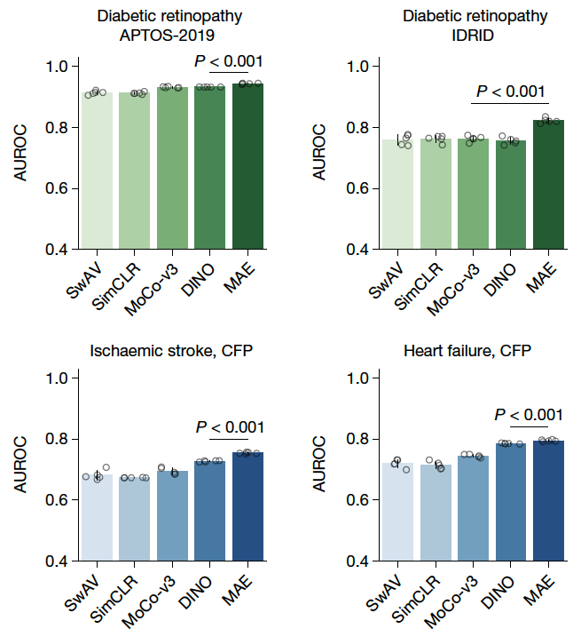
SSL strategies for RETFound
Notes:
masked
autoencoder

Slide 24
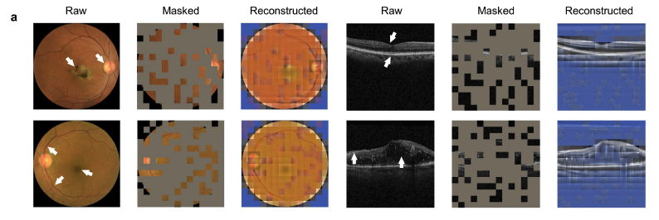
used an advanced explanation tool (RELPROP42) to visualize the salient regions of images conducive to classifications made by fine-tuned models in downstream tasks

Slide 25
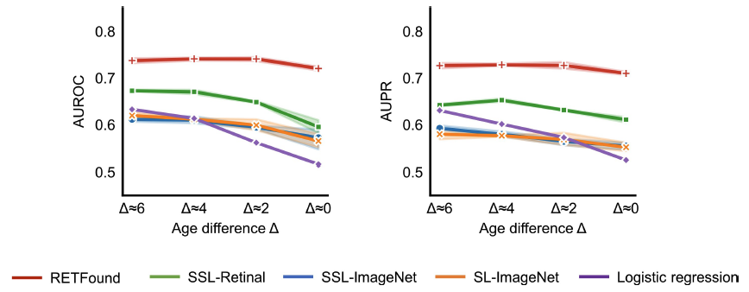
Robustness to age distribution shifts
when a disease is related to age, it’s hard to tell whether a model is predicting the disease or just the person’s age.
Experiment Overview
Task: Predict myocardial infarction from retinal images
Disease group: Fixed (mean age = 72.1)
Control groups: Four healthy groups with mean ages:
66.8, 68.5, 70.4, and 71.9
Models might just learn to predict age, not actual disease
RETFound learned anatomical structure changes, not just age
Notes:
Age is confounding factor

Slide 26
Questions?
Thank you

