Slide 1
Enhancing early detection of cognitive decline in the elderly: a comparative study utilizing large language models in clinical notes
October 12, 2024
Cited by 8
Notes:
This paper is published in eBioMedicine

Slide 2
Background: Large language models (LLMs) have shown promising performance in various healthcare domains, but their effectiveness in identifying specific clinical conditions in real medical records is less explored.
This study aims to evaluate the performance of LLMs in detecting signs of cognitive decline within real electronic health record (EHR) clinical notes, using this as a case study to explore their effectiveness and compare their error profiles with those of traditional models trained on domain-specific corpora. It compares GPT-4 and Llama 2 against traditional AI models. Additionally, it explores different prompt engineering strategies to improve model accuracy

Slide 3

Dataset Used
Clinical notes from real patients diagnosed with Mild Cognitive Impairment (MCI) Four years before MCI diagnosis (ICD-10-CM code G31.84, 2019).4,949 training samples and 1,996 test samples. Notes were labeled as positive or negative for cognitive decline based on expert-defined criteria
Used a secure, HIPAA-compliant cloud environment to deploy and evaluate LLMs on electronic health record (EHR) data.
Two LLMs tested:GPT-4 (via Microsoft Azure OpenAI API, proprietary model)
Llama 2 (13B) (via Amazon EC2, open-source model)

Slide 4
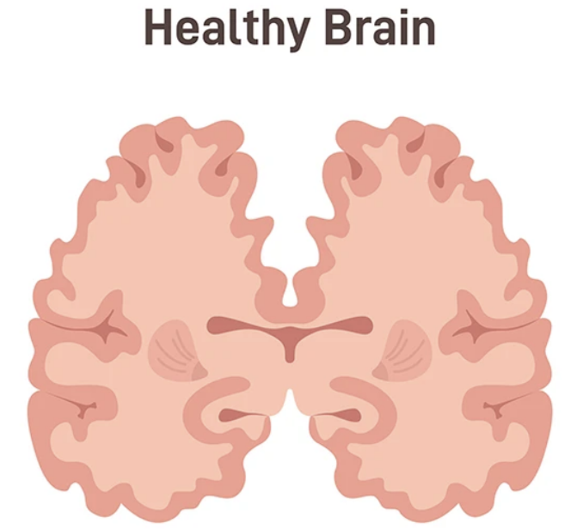
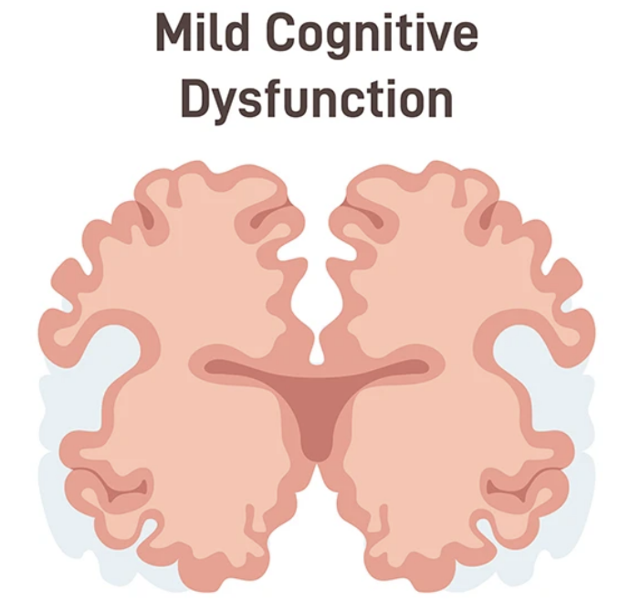
📌 Defining Cognitive Decline
Included patients at any stage of cognitive decline:
Subjective Cognitive Decline (SCD) → Self-reported memory issues.
Mild Cognitive Impairment (MCI) → Detectable but not disabling.
Dementia → Severe cognitive impairment.
Indicators for Cognitive Decline: ✅ Symptoms – Memory loss, confusion. ✅ Medical Diagnoses – MCI, Alzheimer’s Disease. ✅ Cognitive Assessments – Mini-Cog test. ✅ Treatments – Cognitive-linguistic therapy.
Negative cases (Not classified as cognitive decline): ❌ Temporary impairments – Forgetfulness from medication (e.g., codeine). ❌ Reversible impairments – Post-surgery, stroke-related memory loss. ❌ Uncertain cases – If records lacked clear evidence of decline.

Slide 5
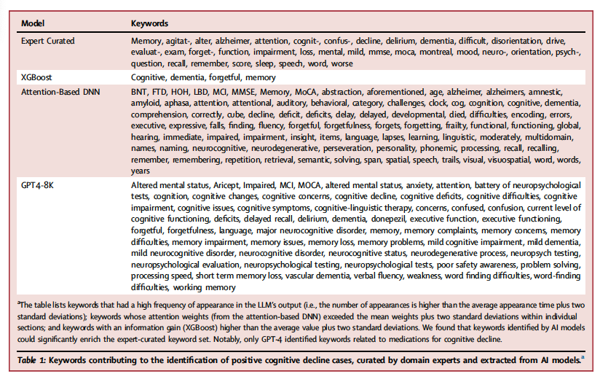
✔️ Expert-curated keywords provide clinical reliability but are limited. ✔️ XGBoost captures general cognitive decline terms. ✔️ DNN models detect medical assessments and symptoms. ✔️ GPT-4 finds the broadest range of relevant terms, including medications
This table presents keywords that were used to identify cognitive decline in clinical notes. It compares keywords selected by human experts (Expert-Curated) with those extracted by different AI models (XGBoost, Attention-Based DNN, GPT-4-8K)

Slide 6
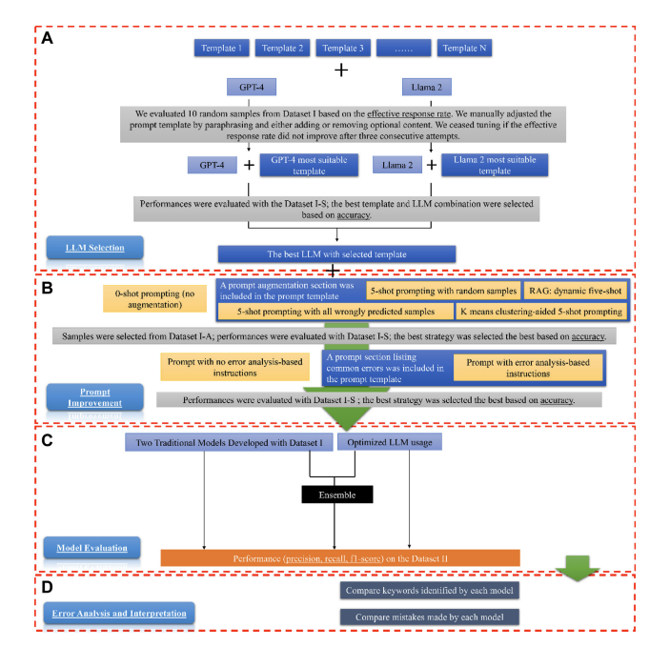
Notes:
a template refers to a structured prompt given to the LLMs to help them analyze clinical notes accurately.

Slide 7
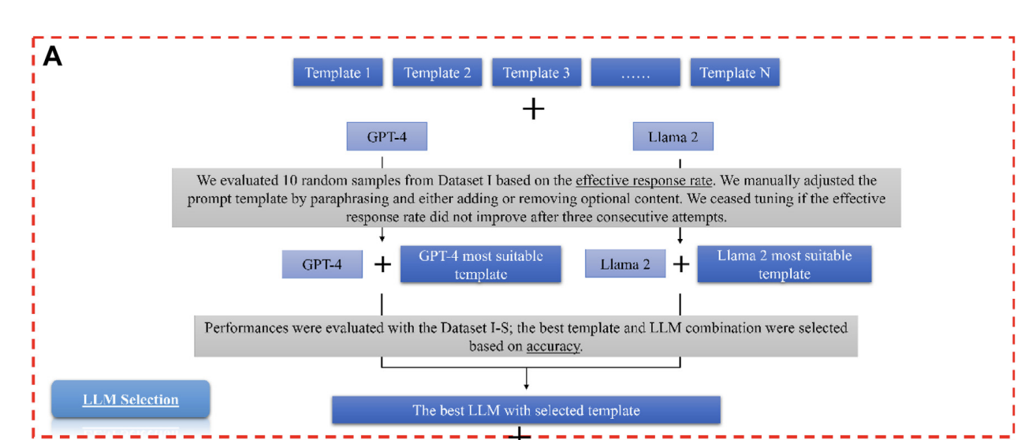

Slide 8
prompt engineering process
💡 Goal: Find the best LLM (GPT-4 or Llama 2) and the most effective prompt template for detecting cognitive decline from clinical notes.
Step 1: LLM Selection (Figure Section A)
The researchers created multiple prompt templates (Template 1, Template 2, etc.).Each template had different wording, structure, and instructions to test which way of asking questions worked best
Each LLM was tested with multiple templates.The goal was to find which LLM + Template combination produced the most accurate results

Slide 9
Measuring Performance Using 10 Random Samples
Dataset: 10 clinical notes were randomly selected from Dataset I.
Evaluation Criteria: ✅ Did the AI correctly detect cognitive decline? ✅ Did the AI highlight relevant keywords? ✅ Did the AI follow the required JSON format?
The results were classified into three categories:
1️⃣ Effective & Parseable: AI correctly classified the case & formatted output properly. 2️⃣ Effective but Not Parseable: AI correctly classified, but the response was not structured correctly. 3️⃣ Not Effective: AI misclassified the case or did not provide useful information.
If a prompt didn’t work well, it was reworded and retested.This iterative tuning process continued until the best template was found.
✔️ Outcome: GPT-4 + Optimized Prompt Template was chosen as the best setup for further testing.

Slide 10
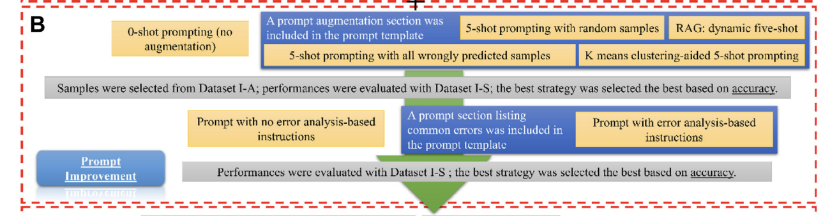

Slide 11
Step 2: Prompt Improvement (Figure Section B)
This step aims to improve the AI's accuracy by optimizing the prompt structure and selecting the best examples for few-shot learning.
The researchers tested two major techniques: 1️⃣ Prompt Augmentation (Few-Shot Selection Strategies) – Choosing the best five examples to guide the AI. 2️⃣ Error Analysis-Based Instructions – Helping the AI avoid common mistakes.

Slide 12
1️⃣ Prompt Augmentation – Few-Shot Selection Strategies
💡 What is Few-Shot Prompting?
Instead of asking the AI a question without guidance, you provide five examples of correct answers.
This helps the AI learn patterns before making a prediction.
The researchers tested four ways to pick these five examples

Slide 13
🔹 Strategy 1: Hard Prompting – Random Selection
✅ How It Works:
Five examples were picked randomly from the dataset.
The AI learned from these examples before making predictions.
❌ Weakness:
The examples might be too similar or irrelevant, leading to poor generalization.
In This Study:
Randomly picking five clinical notes might not cover all cognitive decline cases, confusing the model.
Example 1: "Patient forgets to take medications regularly. MoCA score: 18/30." → Cognitive Decline = YES
Example 2: "Patient reports occasional forgetfulness but performs well in daily activities. Memory test normal." → Cognitive Decline = NO

Slide 14
🔹 Strategy 2: Hard Prompting – Targeted Selection
✅ How It Works:
Five examples were chosen where the AI previously failed.
These examples directly address the model’s weaknesses.
✔️ Advantage:
Helps AI fix past mistakes, especially in borderline cases where symptoms were subtle but still significant.
❌ Weakness:
If only difficult cases are included, the AI might overfit to rare situations and struggle with easy ones.

Slide 15
🔹 Strategy 3: Hard Prompting – K-Means Clustering-Aided Selection
✅ How It Works:
Used clustering (K-Means) to group similar cases together.
One representative case from each cluster was selected.
✔️ Advantage:
Ensures the five examples are diverse, covering different types of cognitive decline cases.
❌ Weakness:
Requires extra computation

Slide 16
Retrieval-Augmented Generation (RAG) is an AI technique that enhances text generation models by retrieving relevant information before generating a response. Instead of just relying on pre-trained knowledge, RAG searches a database for relevant documents, extracts useful information, and then generates a more accurate and context-aware response
🔹 Strategy 4: RAG – Dynamic Five-Shot Selection (Best Method)
✅ How It Works:
RAG (Retrieval-Augmented Generation) dynamically retrieves the five most relevant cases for each input.
Uses K-Nearest Neighbors (KNN) + OpenAI’s text embeddings to find the closest matches.
✔️ Advantage:
The AI always sees the most relevant examples, improving accuracy.
❌ Weakness:
Requires more computation than static methods.

Slide 17
A new clinical note says: "Patient reports short-term memory loss but scores normally on MMSE. MRI shows mild hippocampal atrophy."
RAG searches the dataset and retrieves five cases with similar symptoms:
Example 1: "Mild memory decline reported. MRI: mild hippocampal atrophy." → Cognitive Decline = YES
Example 2: "Short-term memory loss with normal MMSE but abnormal PET scan." → Cognitive Decline = YES
Example 3: "Forgetfulness with borderline MoCA score. PET shows early Alzheimer’s markers." → Cognitive Decline = YES
Example 4: "Normal MMSE, but MRI shows brain volume loss in temporal lobe." → Cognitive Decline = YES
Example 5: "Confusion episodes increasing, despite no major cognitive test abnormalities." → Cognitive Decline = YES

Slide 19
2️⃣ Error Analysis-Based Instructions
💡 What is This?
The researchers analyzed where the AI made mistakes.
Then, they explicitly told the AI to avoid these mistakes in the prompt.
🔹 Strategy 1: Prompt Without Error Analysis
The AI received no extra guidance about past mistakes.
Common errors were repeated

Slide 20
🔹 Prompt With Error Analysis-Based Instructions (Best Method)
✅ How It Works:
Combined error guidance + dynamic example selection (RAG).
The AI avoided past mistakes AND saw the most relevant training cases.
✔️ Advantage:
Best performance in reducing false positives and false negatives.
💡 Example: The AI frequently misclassified temporary forgetfulness as cognitive decline.
Without error analysis-based instruction: "Patient forgets appointments sometimes but takes sedative medication." → Cognitive Decline = YES (incorrect).
With error analysis-based instruction: "DO NOT classify forgetfulness from medication as cognitive decline!" "Patient forgets appointments but takes sedative medication." → Cognitive Decline = NO (correct).
✔️ Result: The AI stopped making this mistake and improved its accuracy.

Slide 22
Model Comparison & Evaluation
📌 Models Compared
LLMs: GPT-4, Llama 2
Traditional AI: XGBoost, Attention-Based DNN (CNN + BiLSTM + Attention)
Ensemble Model: Combined all models using majority voting
📌 Evaluation Metrics
✔ Precision, Recall, F1 Score, Specificity, NPV 📌 Key Findings
✅ LLMs performed well, but did not outperform traditional models alone ✅ Ensemble model improved accuracy by reducing individual model errors ✅ Error analysis refined LLM performance using explicit correction instructions
💡 Conclusion: Combining LLMs with structured models enhanced diagnostic accuracy in detecting cognitive decline.

Slide 23
Dataset | Purpose | How It Was Used
Dataset I | LLM Selection | Tested different LLMs + prompt templates (GPT-4 vs. Llama 2)
Dataset I-S | Prompt Augmentation | Compared prompting strategies (zero-shot, five-shot, RAG, error analysis)
Dataset I-A | Example Selection | Selected five-shot examples for training (random, targeted, clustering, RAG)
Dataset II | Final Model Evaluation | Tested final models (GPT-4, XGBoost, DNN, Ensemble)

Slide 24
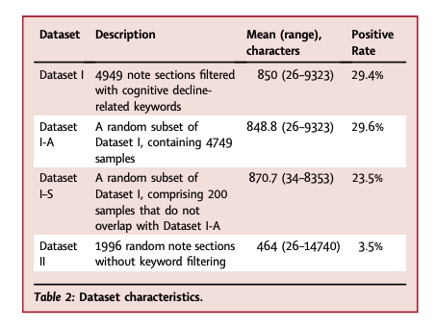

Slide 25
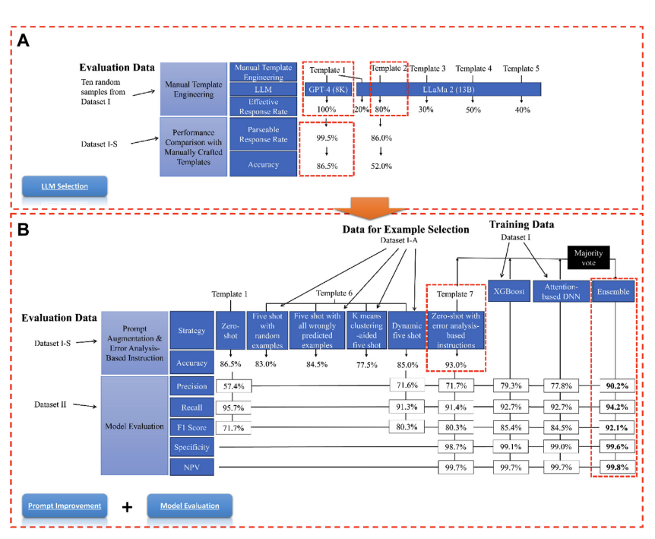
Result

Slide 26
Model | Precision | Recall | F1 Score | Specificity | NPV
GPT-4 + Template 7 | 71.1% | 91.4% | 80.3% | 98.7% | 99.7%
XGBoost | 79.3% | 92.7% | 85.4% | 99.1% | 99.7%
Attention-Based DNN | 77.8% | 92.7% | 84.5% | 99.0% | 99.7%
Ensemble Model (Best) | 90.2% | 94.2% | 92.1% | 99.6% | 99.8%

Slide 27
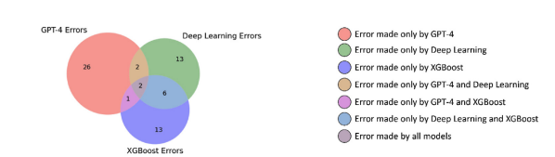
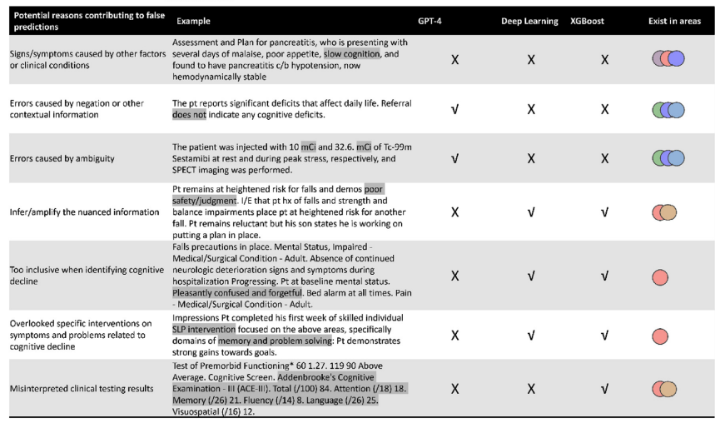
✔️ All models struggled with interpreting clinical notes correctly. ✔️ GPT-4 performed better with negation/context but sometimes overinterpreted details. ✔️ Deep Learning and XGBoost handled structured test results better but struggled with ambiguous text. ✔️ The ensemble model helped reduce individual model weaknesses.

Slide 28
Conclusion: Combining LLMs with traditional AI models creates a stronger, more reliable system for detecting cognitive decline in clinical setting
Thanks
Questions?

