Slide 1
Self-Supervised Learning of Pretext-Invariant Representations
Ishan Misra, Laurens van der Maaten
(Facebook AI Research Team)
Presenter: Shovito Barua Soumma
Date: April 16, 2024
CVPR 2020, [1312 Citations as today]
Notes:
Presenter: Shovito Barua Soumma

Slide 2
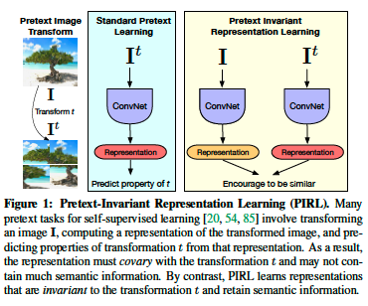
Background
Performance of SSL depends on pretext task
Traditional SSL leads to covariant representations that vary with transformations.
PIRL aims to learn invariant representations using pretext tasks by making representations similar for transformed versions of the same image
implement this by using a jigsaw puzzle-solving task as Pretext
Notes:
The system learns to recognize the original image regardless of how the pieces are shuffled.
PIRL outperforms previous self-supervised methods on several benchmarks and even supervised pre-training for object detection.

Slide 3
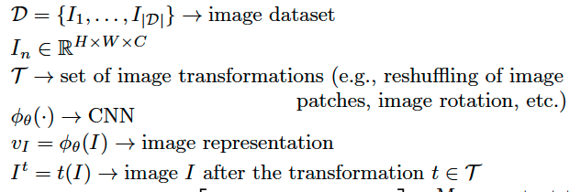
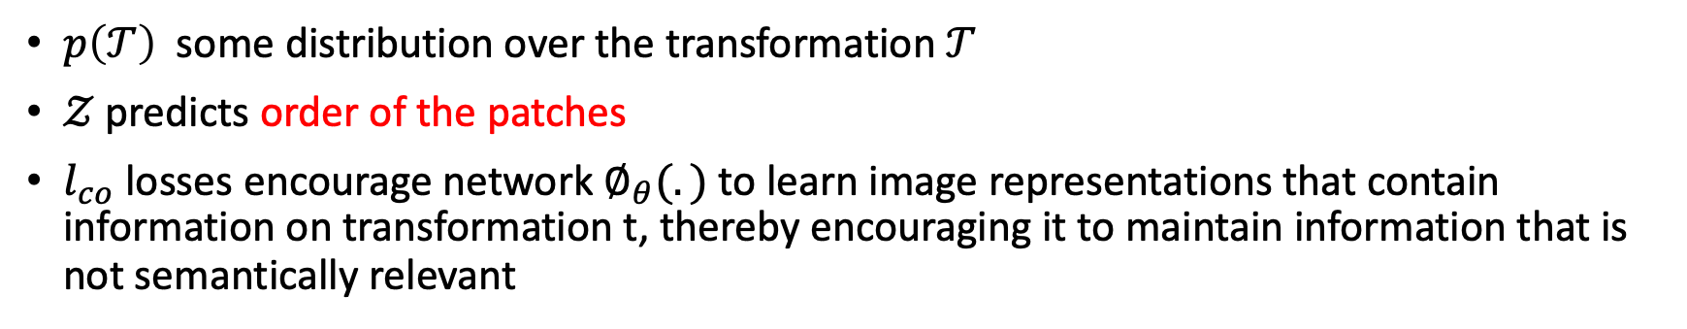
Prior Approach
$p\left(𝒯\right)$some distribution over the transformation $𝒯$
$𝒵$ predicts order of the patches
$l_{co}$ losses encourage network $∅_{θ}(.)$ to learn image representations that contain information on transformation t, thereby encouraging it to maintain information that is not semantically relevant

Slide 4
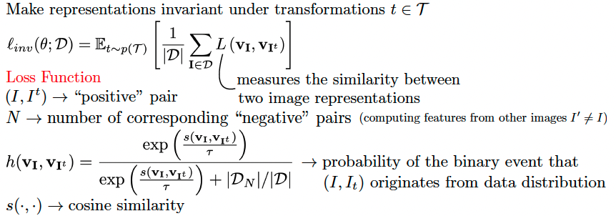
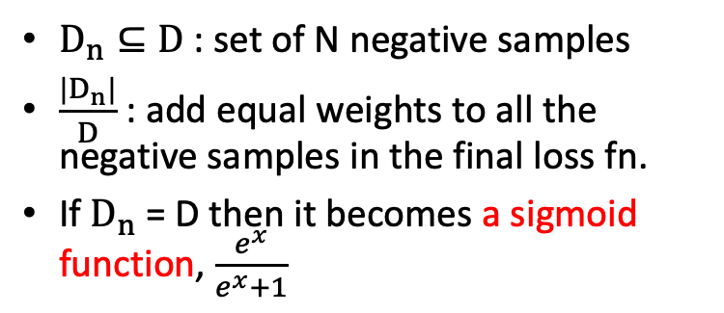
Invariant Loss Func.
$D_{n}⊆D$ : set of N negative samples
$\frac{|D_{n}|}{D}$ : add equal weights to all the negative samples in the final loss fn.
If $D_{n}$ = D then it becomes a sigmoid function, $\frac{e^{x}}{e^{x}+1}$

Slide 5
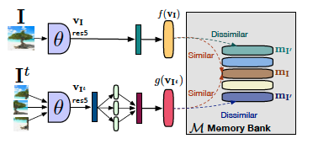
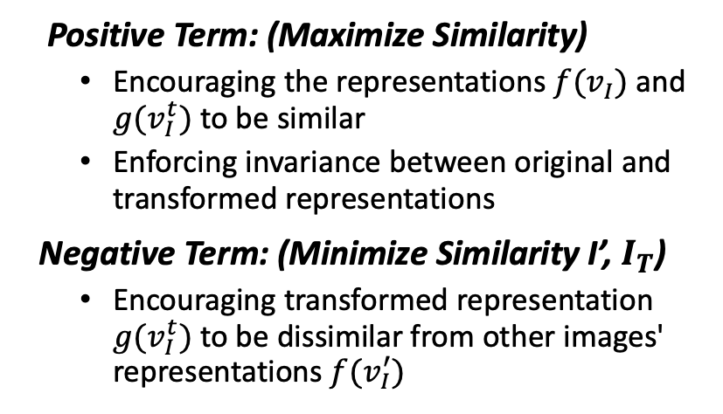
Invariant Loss Func.
Positive Term: (Maximize Similarity)
Encouraging the representations $f(v_{I})$ and $g(v_{I}^{t})$ to be similar
Enforcing invariance between original and transformed representations
Negative Term: (Minimize Similarity I’, $I_{T}$)
Encouraging transformed representation $g(v_{I}^{t})$ to be dissimilar from other images' representations $f(v_{I}^{′})$
Notes:
Noise Contrastive Estimator: Concept from NLP
Two words are positive if they are coming from the same corpus
Avoid Trivial Solution
The use of different heads helps in enforcing the idea of invariance. The head �g can learn transformations that are necessary to make the representation of ��It​ similar to that of �I processed by head �f.

Slide 6
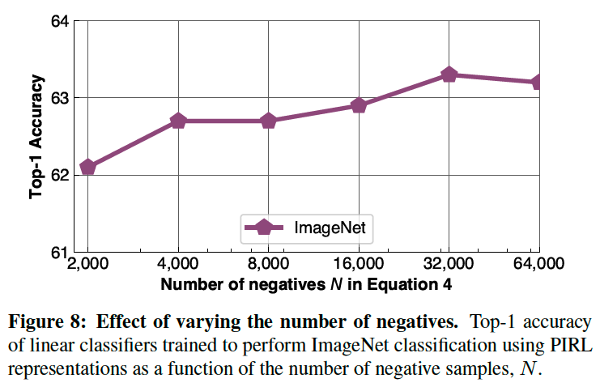

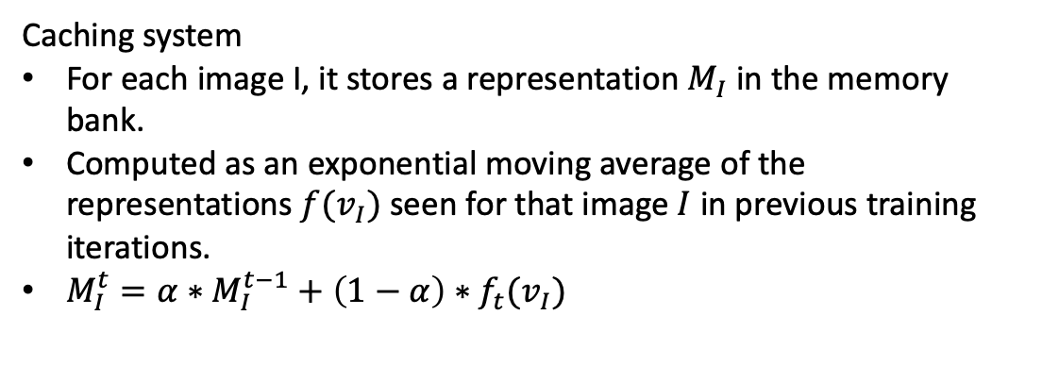
Memory Bank
$$M_{I^{′}}$$
Caching system
For each image I, it stores a representation $M_{I}$ in the memory bank.
Computed as an exponential moving average of the representations $f(v_{I})$seen for that image $I$ in previous training iterations.
$M_{I}^{t}={α∗M}_{I}^{t−1}+\left(1−α\right)∗f_{t}(v_{I})$

Slide 7

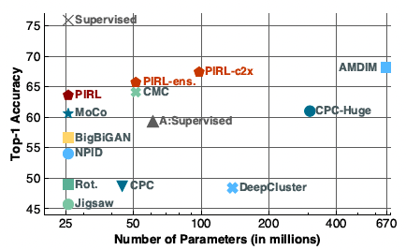
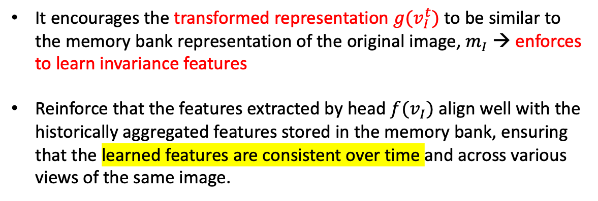
Memory Bank
$$M_{I^{′}}$$
It encourages the transformed representation $g(v_{I}^{t})$ to be similar to the memory bank representation of the original image, $m_{I}$ → enforces to learn invariance features
Reinforce that the features extracted by head $f(v_{I})$ align well with the historically aggregated features stored in the memory bank, ensuring that the learned features are consistent over time and across various views of the same image.

Slide 8
Memory Bank
$$M_{I^{′}}$$
λ : balance between focusing on aligning the transformed and original image representations Vs ensuring consistency of the original image representation with its historical data.
By tuning λ, one can control the emphasis on learning invariance (when λ is higher) Vs maintaining a stable and consistent representation in the face of ongoing training (when λ is lower).

