Slide 1
LEARNING REPRESENTATIONS FROM EEG WITH DEEP RECURRENT-CONVOLUTIONAL NEURAL NETWORKS P Bashivan, I Rish, M Yeasin, N Codella
Published as a conference paper at ICLR 2016
Citations: 816
Presenter: Nooshin Taheri
2/27/2024

Slide 2
Background
EEG signal measures brain activity through scalp voltage changes.
It includes multiple time series across different locations on the cortex.
EEG signals are similar to speech signals in that the most salient features reside in the frequency domain, but EEG signals have an additional spatial dimension.
Individual cognitive capacity shapes mental task performance.
Exceeding cognitive capacity leads to overload, causing confusion and reduced learning.
For this reason, recognizing cognitive load is crucial for applications like brain-computer interfaces, human-computer interaction, and tutoring services.
Working memory is the small amount of information that can be held in mind and used in the execution of cognitive tasks.
Notes:
EEG is a widely used noninvasive neuroimaging modality that operates by measuring changes in electrical voltage
Every individual has a different cognitive capacity which leads to determines his/her ability in performing mental tasks.
Increasing cognitive demand (load) beyond an individual’s capacity leads to an overload state causing confusion and diminished learning ability.
Working memory is a cognitive system with a limited capacity that can hold information temporarily.

Slide 3
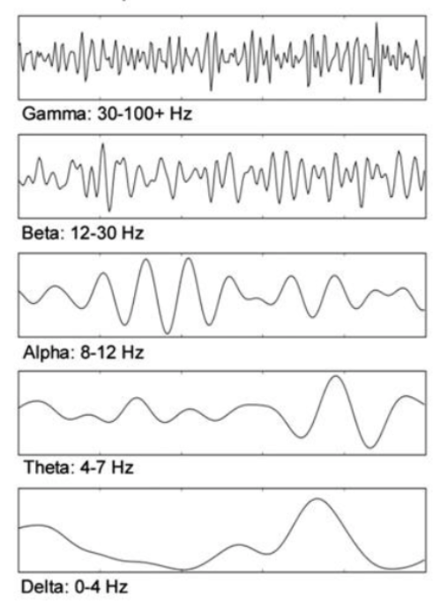
EEG frequency bands and their general associations:
Delta Waves (0.5–4 Hz): Deep sleep
Excessive delta in awake adults can indicate brain issues.
Theta Waves (4–8 Hz): Drowsiness, creativity, meditation.
Excessive theta can suggest ADHD or mental fog.
Alpha Waves (8–13 Hz): Physical and mental Relaxation.
High alpha suggests relaxation; low alpha indicates stress or anxiety.
Beta Waves (13–30 Hz): Active thinking, focus, anxiety.
High beta indicates stress; optimal beta is associated with focused activity and cognitive tasks.
Gamma Waves (30–100 Hz): High-level processing, complex problem solving.
High gamma is associated with perception and mental activity.
Notes:
Delta: brain injuries, learning problems, or difficulty thinking.

Slide 4
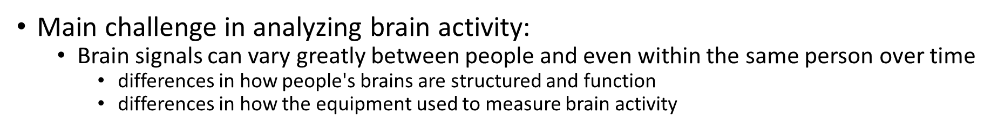
Challenges and Aim:
Aim: design a model to
preserve the spatial, spectral, and temporal structure of EEG
Finding features that are less sensitive to variations and distortions within each dimension:
ConvNets to extract spatial and spectral invariant representations from each frame data
Adopt the LSTM network to extract temporal patterns in the frame sequence
Notes:
to extract features that are more robust to variations and distortions within each dimension.
like EEG caps fits on each person's head. These factors can lead to differences in the observed patterns of brain activity, making it hard to create a model that accurately interprets these signals across different individuals and situations.

Slide 5
MAKING IMAGES FROM EEG TIME-SERIES
Fast Fourier Transform (FFT) is performed on the time series for each trial to estimate the power spectrum of the signal.
Three frequency bands: theta (4-7Hz), alpha (8-13Hz), and beta (13-30Hz)
The sum of squared absolute values within each of the three frequency bands was computed and used as a separate measurement for each electrode.
Aggregating spectral measurements for all electrodes ignores the inherent structure of the data in space, frequency, and time.
Instead: Transform measurements into a 2-D image to preserve spatial structure, and use multiple color channels for spectral dimension.
Finally, we use the sequence of images derived from consecutive time windows to account for temporal evolutions in brain activity.
Notes:
The most salient features reside in frequency domain
cortical activity related to memory operations primarily exists in three frequency bands .
Instead, we propose to transform the measurements into a 2-D image to preserve the spatial structure and use multiple color channels to represent the spectral dimension.

Slide 6
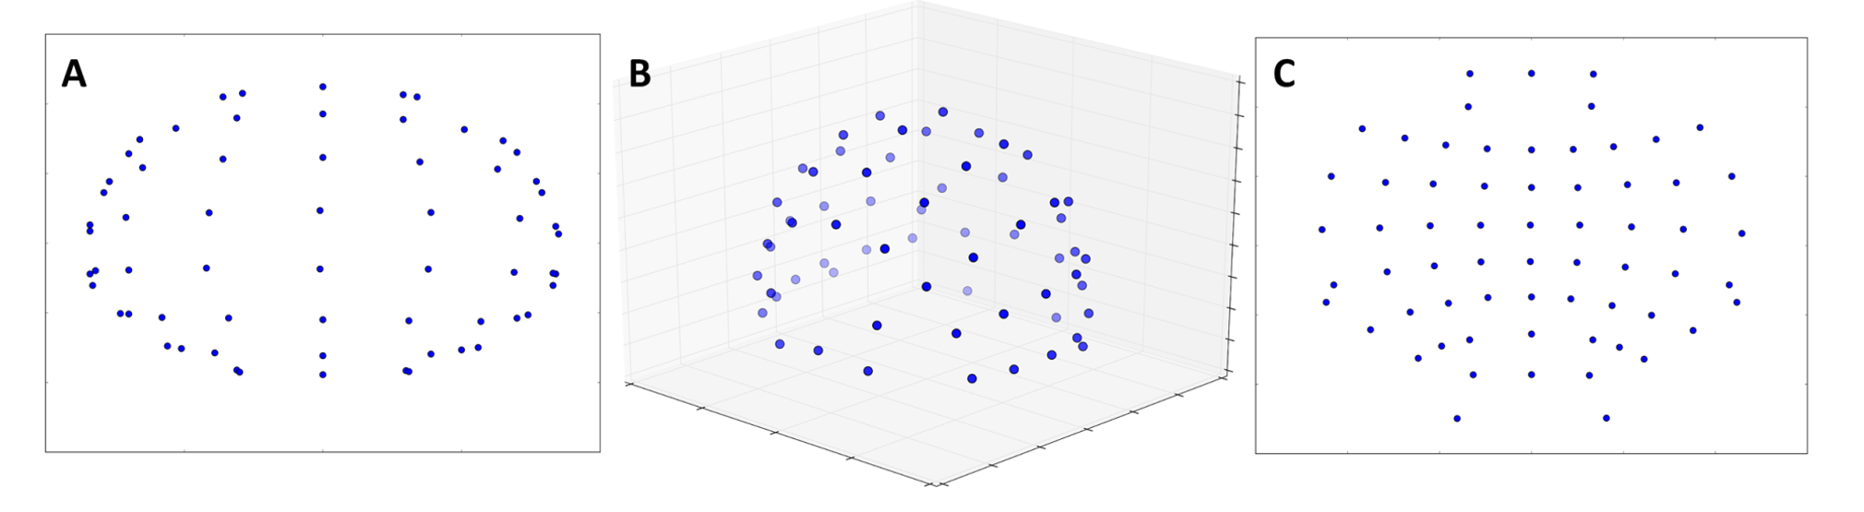
MAKING IMAGES FROM EEG TIME-SERIES
Applying AEP (Polar Projection): project the location of electrodes from a 3-dimensional space onto a 2-D surface.
Apply Clough-Tocher scheme for interpolating the scattered power measurements over the scalp and for estimating the values in-between the electrodes over a 32 × 32 mesh.
Repeat the procedure for each of the three frequency bands and create three topographical activity maps
Form a color image by merging the three spatial maps
Notes:
In order to transform the spatially distributed activity maps as 2-D images.
distances from the center of projection to any other point are preserved.
the image represent the spatial distribution of activities over the cortex.
To estimate the brain's electrical activity in areas between these electrodes, the paper uses the Clough-Tocher scheme. This method is a form of interpolation, which is a way to estimate unknown values between known data points.

Slide 7
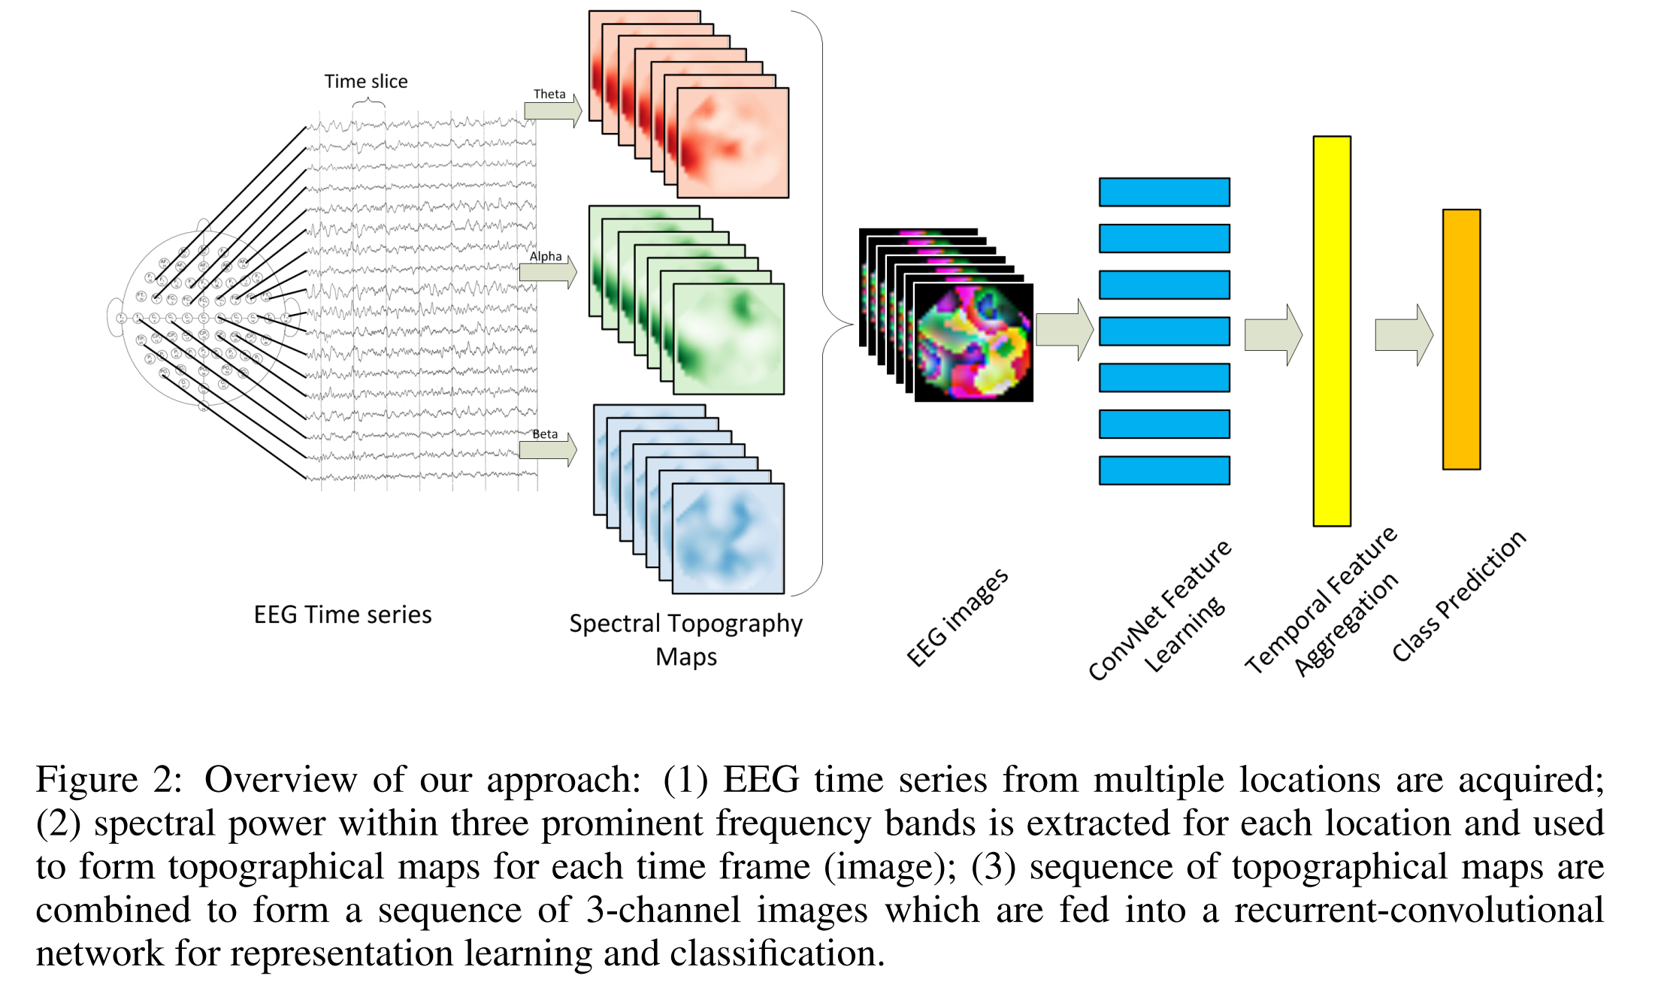
Overview of the proposed approach
Notes:
We adopted a recurrent-convolutional neural network to deal with the inherent structure of EEG data. ConvNets were used to deal with variations in space and frequency domains due to their ability to learn good two-dimensional representation of the data. Wherever needed, the extracted representations were fed into another layer to account for temporal variations in the data.

Slide 8
Examined the EEG dataset from two approaches
Single-frame approach: a single image was constructed from spectral measurements over the complete trial duration. The constructed image was then used as input to the ConvNet.
The purpose of this approach was to find the optimized ConvNet configuration.
2) Multi-frame approach: each trial is divided into 0.5-second windows and constructed an image over each time window, delivering 7 frames per trial. The sequence of images was then used as input data to the recurrent-convolutional network
Notes:
Evaluate two primary approaches to the cognitive state classification problem.
In the first approach (single-frame) we extracted the power features by applying FFT on the complete duration of each trial leading to single 3-channel image corresponding to each trial.
The second approach included dividing each trial to multiple time windows and extracting power features for each window separately leading to conservation of temporal information rather than averaging them out into single slice of activity map.

Slide 9
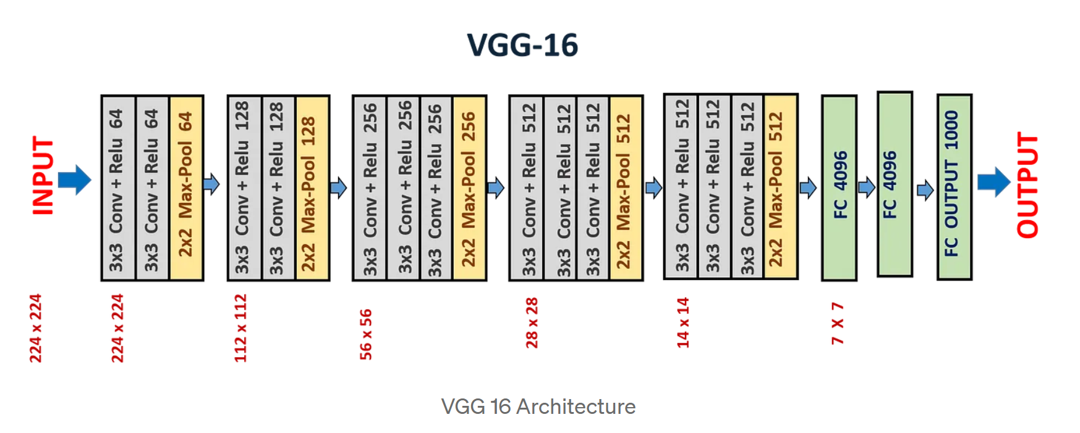
CONVNET ARCHITECTURE
The architecture mimics the VGG network:
stacked convolutional layers
small receptive fields of size 3 × 3
stride of 1
ReLU activation function
padded with 1 pixel
Stacked convolutional layers followed by maxpool layer
Max-pooling is performed over a 2 × 2 window with stride of 2 pixels
Number of kernels within each convolution layer increases by a factor of two for layers located in deeper stacks
Notes:
They followed the VGG architecture for selection of number of filters in each layer and grouping convolution layers with small receptive fields

Slide 10
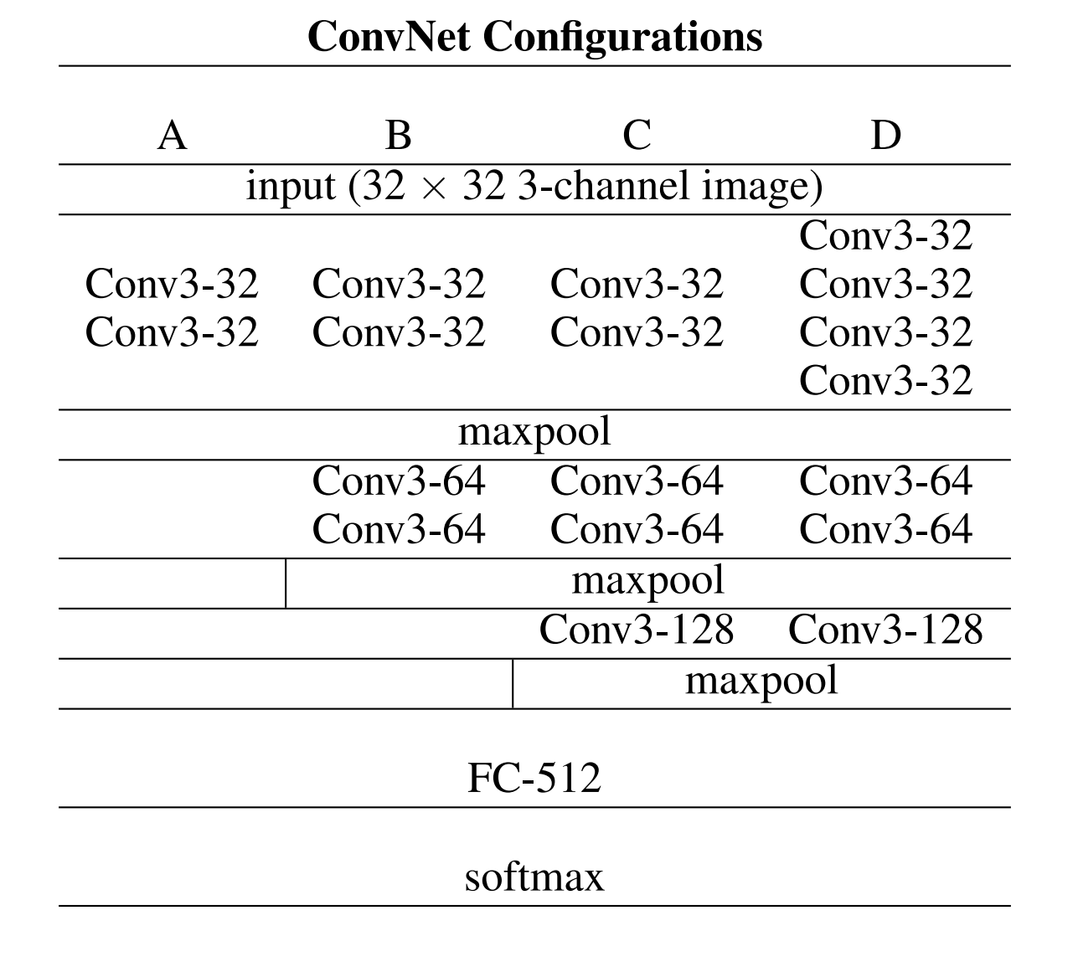
SINGLE-FRAME APPROACH
Computed power features throughout the trial.
EEG trials transformed into single images.
Evaluated various ConvNet depths
Table 1: Evaluated ConvNet configurations for single-frame approach. The convolutional layer parameters are denoted as conv<receptive field size>-<number of kernels>.
Notes:
1.For this approach the single EEG image was generated by applying FFT on the whole trial duration (3.5 seconds).
2.We first studied a simplified version of the problem by computing the average activity over the complete duration of trial.
3. computed all power features over the whole duration of trial.
4. Following this procedure, EEG recording for each trial was reduced to a single multi-channel image.
5. they evaluated ConvNet configurations of various depths, as described in Table 1
6.configuration A involves only two convolutional layers (Conv3-32) stacked together, followed by maxpool layer.
7. configuration B adds on top of architecture A two more convolutional layers (Conv3-64), followed by another maxpool.
8. configuration C adds one more convolutional layer (Conv3-128) followed by maxpool.
9. configuration D differs from C by using 4 rather than 2 Conv3-32 convolutional layers at the beginning.
10. ;. Finally, a fully-connected layer with 512 nodes (FC-512) is added on top of all these architectures, followed by softmax as the last layer

Slide 11
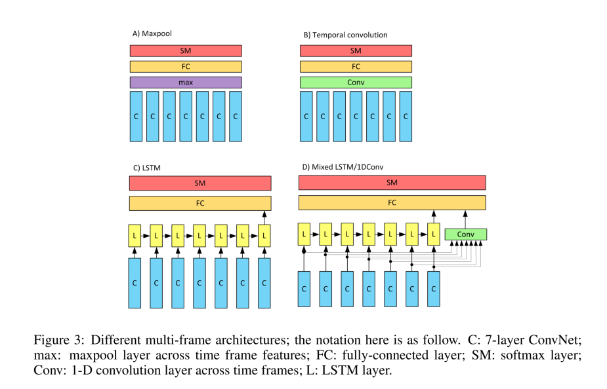
Multi-FRAME APPROACH
Using the best-performing ConvNet architecture.
Outputs of all ConvNets are reshaped as sequential frames and used to investigate temporal sequence in maps.
Evaluate three approaches to extracting temporal information:
Max-pooling: This model performs max-pooling over ConvNet outputs across time frames.
Temporal convolution: This model applies a 1-D convolution to ConvNet outputs across time frames.
Long Short-Term Memory (LSTM): Experimented with up to two LSTM layers, optimal results with one layer of 128 cells.
Notes:
We experimented with up to two LSTM layers and various number of memory cells in each layer and obtained the best results with one layer consisting of 128 cells.

Slide 12
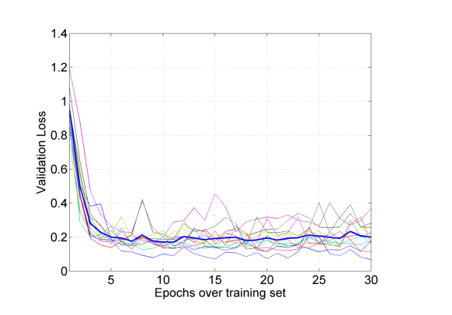
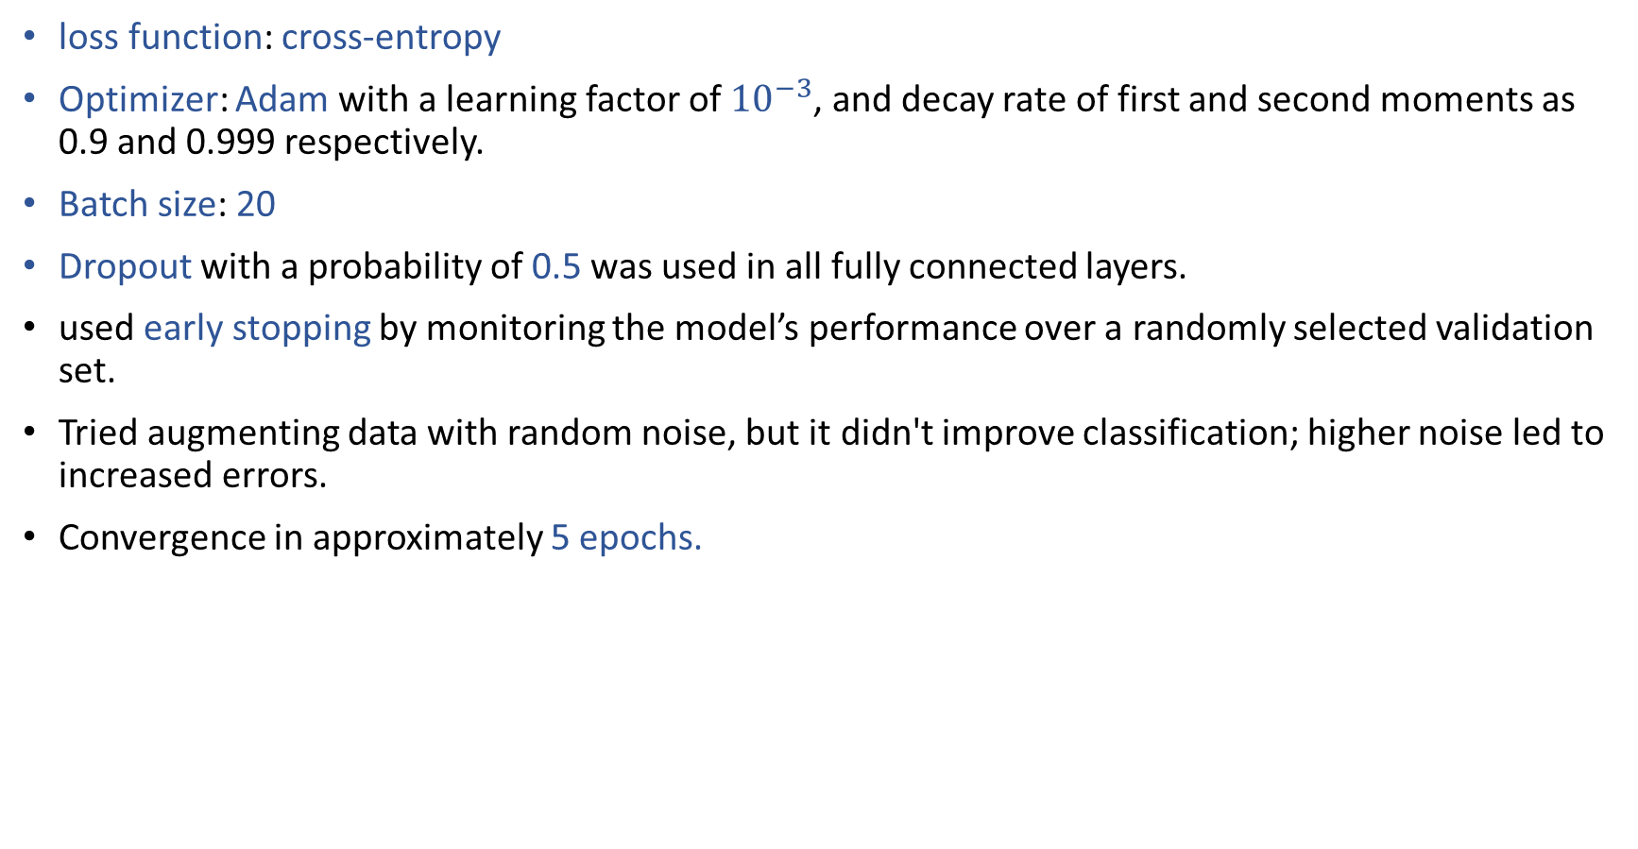
Adjustments:
loss function: cross-entropy
Optimizer: Adam with a learning factor of ${10}^{−3}$, and decay rate of first and second moments as 0.9 and 0.999 respectively.
Batch size: 20
Dropout with a probability of 0.5 was used in all fully connected layers.
used early stopping by monitoring the model’s performance over a randomly selected validation set.
Tried augmenting data with random noise, but it didn't improve classification; higher noise led to increased errors.
Convergence in approximately 5 epochs.
Notes:
another commonly used approach for addressing the unbalanced ratio between number of samples and number of model parameters is to artificially expand the dataset using data augmentation.
We did not use image flipping or zooming when augmenting the data due to distinct interpretation of direction and location in EEG images They tried training the network with augmented data generated by randomly adding noise to the images. (However, augmenting the dataset did not improve the classification performance and higher noise values increased the error rates.)
the network converges after about 5 epochs

Slide 13
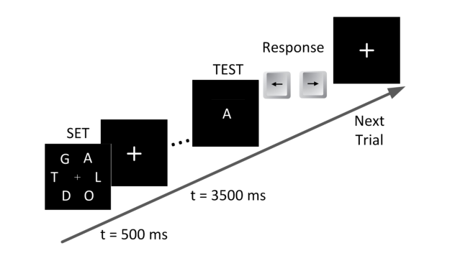
Working memory experiment diagram
13 participants, 64 electrodes, sampling frequency of 500 Hz
English characters, 0.5s display.
TEST shown after 3 seconds.
Each, 240 experiment repetitions
Randomly: 2, 4, 6, 8 trial characters.
Recorded brain activity during the period in which individuals retained the information in their memory (3.5 seconds) was used to recognize the amount of mental workload.
The classification task: Recognize character count
Included only correct response data
leave-subject-out cross-validation approach
Notes:
increasing number of characters more mental resources are required to retain the information. 1. An array of English characters was shown for 0.5 second
2. A TEST character was shown three seconds later and participants indicated whether the test character was among the first array (’SET’) or not by press of a button.
3. The number of characters in the SET for each trial was randomly chosen to be 2, 4, 6, or 8. (The number of characters in the SET determines the amount of cognitive load )
4. each of the conditions containing 2, 4, 6, 8 characters is considered as loads 1-4 respectively.
5. Recorded brain activity during the period in which individuals retained the information in their memory (3.5 seconds) was used to recognize the amount of mental workload.
6. The classification task is to recognize the load level corresponding to set size (number of characters presented to the subject) from EEG recordings
7. A total of 3120 trials were recorded. Only data corresponding to correctly responded trials were included in the data set which reduced the data set size to 2670 trials.
8. In each of the 13 folds, all trials belonging to one of the subjects were used as the test set. A number of samples equal to the test set were then randomly extracted from rest of data for validation set and the remaining samples were used as training set.

Slide 14
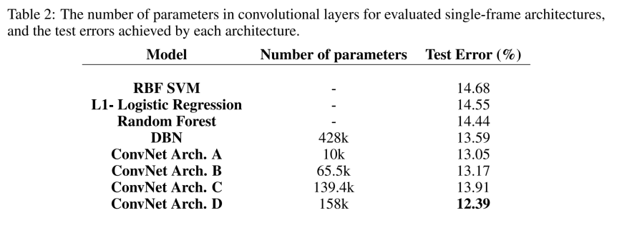
SINGLE-FRAME CLASSIFICATION Results
The purpose of this part was to empirically seek the best performing ConvNet architecture working on images generated from complete EEG time series.
Increasing layers to seven slightly improved test set error rates
Choose architecture D for its equal or better error rates, especially for hard-to-classify subjects(up to 12% decrease in error rates).
Notes:
2. We can see that increasing the number of layers to seven slightly improved the achievable error rates on the test set.
3.While the difference in the error rates between the four configurations was not statistically significant, we chose architecture D because of its equal or better error rates on the subset of subjects that were considered hard to classify (up to 12% decrease in error rates).
our claim is that mapping EEG data into a 2D image (specially with equidistant projections) leads to considerably better classification of cognitive load levels as compared to standard, non-spatial approaches that treat EEG simply as a collection of time series.

Slide 15
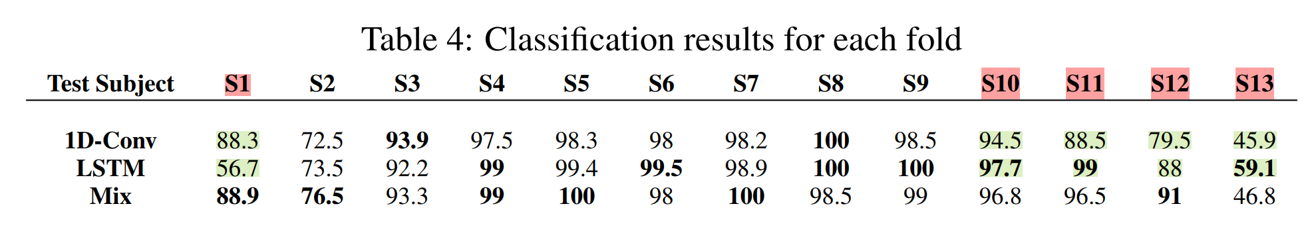
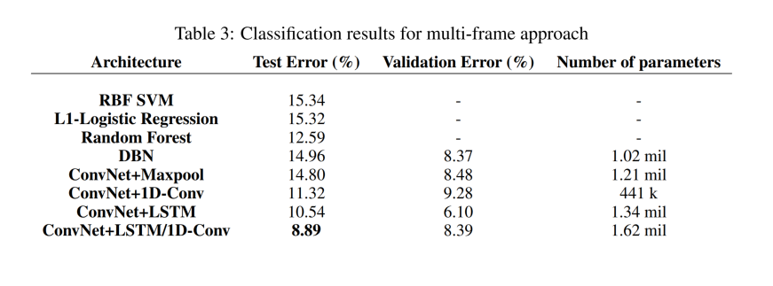
MULTI-FRAME CLASSIFICATION Results:
Used ConvNet architecture D from the previous step
Explored four approaches for aggregating temporal features from multiple frames.
Using temporal convolution and LSTM significantly improved the classification accuracy.
Close examination for each individual: Both methods achieve near-perfect accuracies for eight participants; differences arise for the remaining five
Observation led to combining temporal convolution and LSTM for best results on the dataset.
Comparison of baseline models: Slightly lower test errors in single-frame setup due to negative effects of increased features in the multi-frame case, despite regularization.
Incorporating temporal dynamics improves our model's classification performance, showcasing its effectiveness in learning from time-dependent changes.
Notes:
A closer look at the accuracies derived for each individual, reveals that while both methods are achieving close to perfect classification accuracies for eight of the participants, most of the differences originated from differences in accuracy for the remaining five individuals.
This observation motivated us to use a combination of temporal convolution and LSTM structures together in single structure which led to our best results on the dataset.
Comparing the performance of baseline models in multi-frame and single-frame cases, test errors were slightly lower for the single-frame setup. This difference is mostly because of the negative effect of increased number of features in multi-frame case which happens despite the existence of regularization term in all baseline methods.
incorporating temporal dynamics (multiple frames over time) in our model increasingly improves the classification performance which demonstrates the effectiveness of our model in learning from time-dependent changes.

