Slide 1
Real-Time Patient Adaptivity for Freezing of Gait Classification Through Semi-Supervised Neural Networks
Val Mikos; Chun-Huat Heng; Arthur Tay; Nicole Shuang Yu Chia; Karen Mui Ling Koh; Dawn May Leng Tan; Wing Lok Au
Presenter: Shovito Barua Soumma
Date: February 20, 2024
Published In 16th International Conference on Machine Learning and Applications (ICMLA), 2017
Notes:
The paper's significant contributions include applying CNNs for PD motor state classification using a clinician-labeled dataset from 30 PD patients, proposing data augmentation methods for wearable sensor data,

Slide 2
Freezing of Gait
Medical status of PD patients
Hard to detect – large variability in patients’ walking styles
Patient Independent model has low accuracy
Their Goal:
Patient Dependent Model using semi supervised method
2 step training
Mazilu et. al | Sen=66%, spec=95%
B¨achlin et al. | Sen=73%, spec=86% | After tuning the parameters (for patient-specific) performance increased by 11%

Slide 3
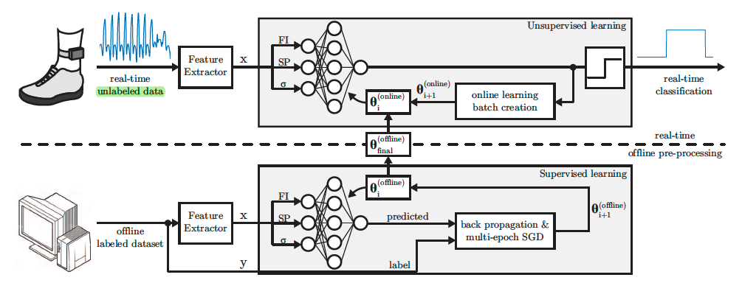
Method
Semi supervised
Offline training (supervised) → Patient Independent Base Model
Online Training (unsupervised) → Target Patient
Leave One Out for Cross Validation (LOOCV) for Test
Notes:
we propose a patient-adaptive FoG classifie which exploits the stream of unlabeled data generated during
usage. Therefore, the need to label a new patient’s data is
eliminated. Using supervised learning, a patient-independent
neural network is designed to serve as a base model, which
is then adapted to a patient in real-time through unsupervised
learning with unlabeled data.

Slide 4


Extracted Features
Freezing Index: Frequency related irregularities
During Fog: Tremor arise→ increase high frequency → captured in Freeze Band
Normal Gait: avg peak 1Hz, captured in Locomotor Band (LB)
Stride Peak: Capture the swing of leg from angular velocity
To smooth the curve: 4th Order low pass butter worth Filter (fc=10Hz)
Notes:
The z-axis refers to the patient’s frontal plane.
Formula provided looks at three consecutive samples of angular velocity (��wz​) along the z-axis (frontal plane)
if the angular velocity at the previous sample (�−1i−1) is greater than both the sample before it (�−2i−2) and the sample after it (�i
Wide swings are inherent to regular gait patterns, but during FoG episodes
these swings considerably subside. Hence, smaller SP values are used as an indicator of FoG.
For a smooth and stable output, a peak should exceed at least 0.1 rad/s to count as a valid peak. Furthermore, a 4th order low-pass Butterworth
filter with fc of 10 Hz is employed to smoothen the angular velocity signal before evaluating Equation (2).

Slide 5

Extracted Features
3. Standard Deviation

Slide 6


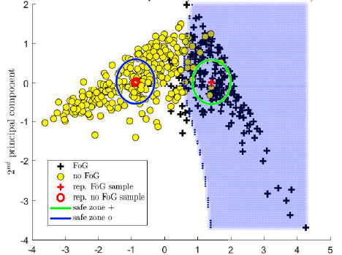

Online Learning Batch Creation (Contd)
Representative Samples: Obtained from training lableled data ${\{x}_{i},y_{i}\}$
Select positive samples → close mean of all positive samples
Select NEGATIVE samples → close mean of all NEGATIVE samples
Safe Zone Radius: $\frac{d_{pos}−d_{neg}}{4}$

Slide 7

Online Learning Batch Creation
Low toggling Rate:
Fog has low toggling rate : probability of a sample belonging to the same class as the preceding one is high.
10 most recent samples → mean prediction

Slide 8
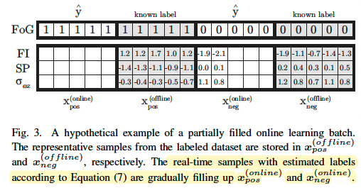
Online Learning Batch Creation (Contd.)
Batch Size is n
n/2 is already filled from the offline labeled data (Make sure at least 50% data are correct)
Remaining half of the slots are filled (FIFO) from the stream of unlabeled data
Make sure that the batch is not biased
Once the batch is full online learning triggered

Slide 9
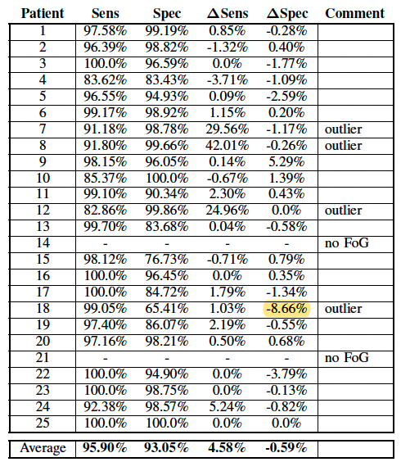
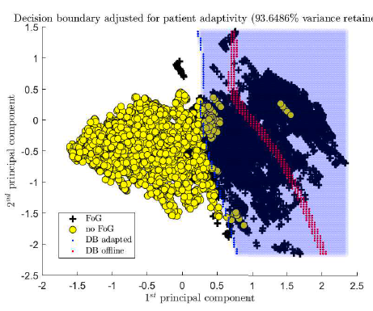
Result

