Slide 1
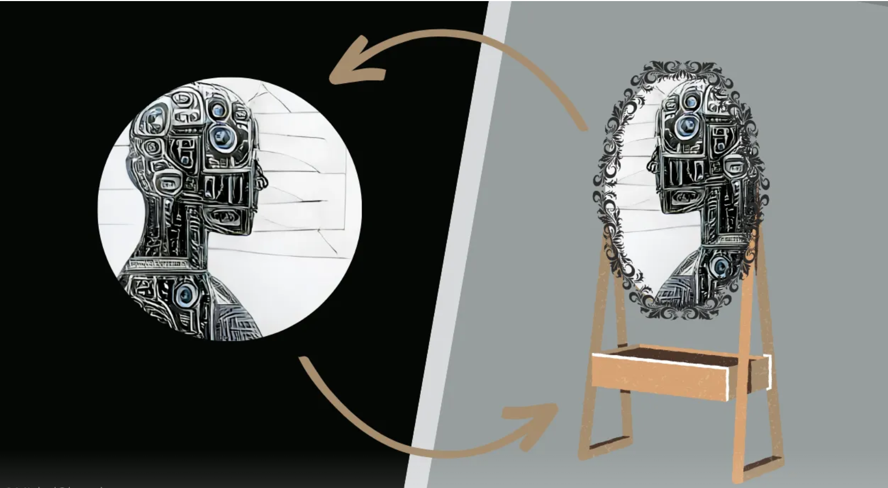
Contrastive Representation Learning for Electroencephalogram Classification
Machine Learning for Health, 2020
Citation: 140
Presenter: Nooshin Taheri
5/21/2024

Slide 2
Why self-supervised learning:
Advanced machine learning techniques need large, labeled EEG datasets because EEG is complex and is usually contaminated with significant artifacts.
EEG data collection and labeling are expensive.
Combining datasets is infeasible due to inconsistent experimental paradigms.
Publicly available labeled EEG data is limited and existing datasets are small and incompatible.
Self-supervised learning (SSL) enables learning from varied EEG setups and trials.
SSL is useful with limited labeled data and costly manual labeling.
Unlike traditional supervised models that begin with random initial parameters—weights, kernels, and biases—which require extensive labeled data to optimize effectively, SSL utilizes unlabeled data to pre-train these parameters.
This pre-training enhances model accuracy by providing a more accurate starting point for parameter tuning and accelerates the learning process by reducing reliance on labeled data.

Slide 3
OVERVIEW OF SELF-SUPERVISED LEARNING
There are two steps in self-supervised learning: Pretext Task and Downstream Task.
The ‘pretext task’:
Creates a good model starting point using both labeled and unlabeled data.
This task helps develop initial model parameters and useful data features.
These features capture general data characteristics, not specific details.
For EEG data, features might capture overall brain activity patterns, not specific conditions like seizures.
The ‘downstream task’:
Refines the model with labeled data.
The last layer adjusts to work well with existing layers.
Fine-tune the entire model by adjusting all layers.
Unlike traditional supervised learning, SSL uses initial parameters from the pretext task, not random.
This inherited setup improves performance, especially with scarce labeled data, by leveraging the broad understanding from the pretext task.

Slide 4
CONTRASTIVE PRETEXT TECHNIQUES:
Contrastive pretext techniques identify differences between augmentations of input data, labeled or not.
Augmented inputs are paired with the original data to form contrastive pairs.
Pairs can include one original and one augmented input or two different augmentations of the same input.
These pairs train the model using a contrastive loss function.
The objective is to maximize the agreement between positive pairs (instances from the same sample) and minimize the agreement between negative pairs (instances from different samples)

Slide 5
About this paper
Present a framework for learning EEG signal representations via contrastive learning.
Modify the SimCLR framework for time-series data to learn EEG representations.
Extract features from a single channel at a time, allowing recombination of multi-channel recordings and fusion of datasets.
Apply the pre-trained encoder on three classification tasks:
Emotion Recognition (ER) on the SEED dataset.
Normal/Abnormal Classification (NAC) on the TUH dataset.
Sleep-stage scoring (SSS) on the SleepEDF dataset.

Slide 6
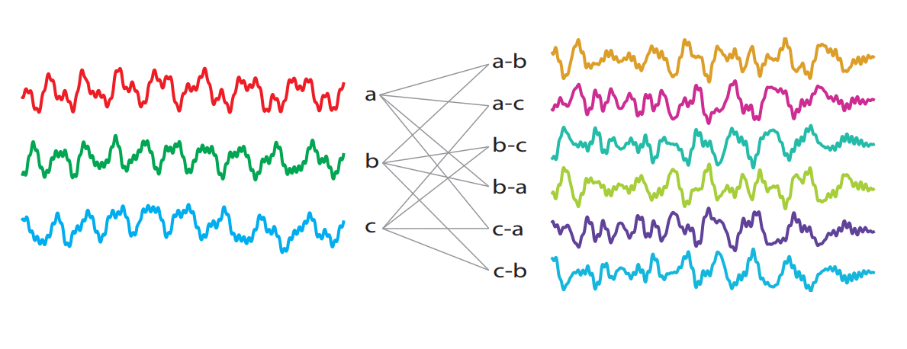
Channel recombination and preprocessing
To learn the representation of a single-channel
Combine different datasets to obtain a larger one:
(1) TUH Normal/Abnormal EEG, (2) SEED dataset,
(3) Sleep EDF, (4) Texas State University Resting State dataset, and (5) ISRUC-Sleep dataset
Recombine channels in a multi-channel recording to obtain more valid channels.
Preprocessing :
Resampled all datasets to 200Hz.
Applied a fifth-order band-pass Butterworth filter (0.3-80 Hz).
Removed high-voltage channels (higher than 500 µVs) as artifacts.
Train the encoder with 20-second channel chunks.
Notes:
The approach concerns extracting features from a single channel at a time as opposed to considering all channels simultaneously
Self-supervised learning via deep neural networks requires large amounts of data. Most EEG datasets are relatively small and incompatible with one another.
By subtracting two channels, one obtains a new channel that represents the voltage difference between the two sensors, resulting in another physiologically valid channel. This is referred to as re-referencing

Slide 7
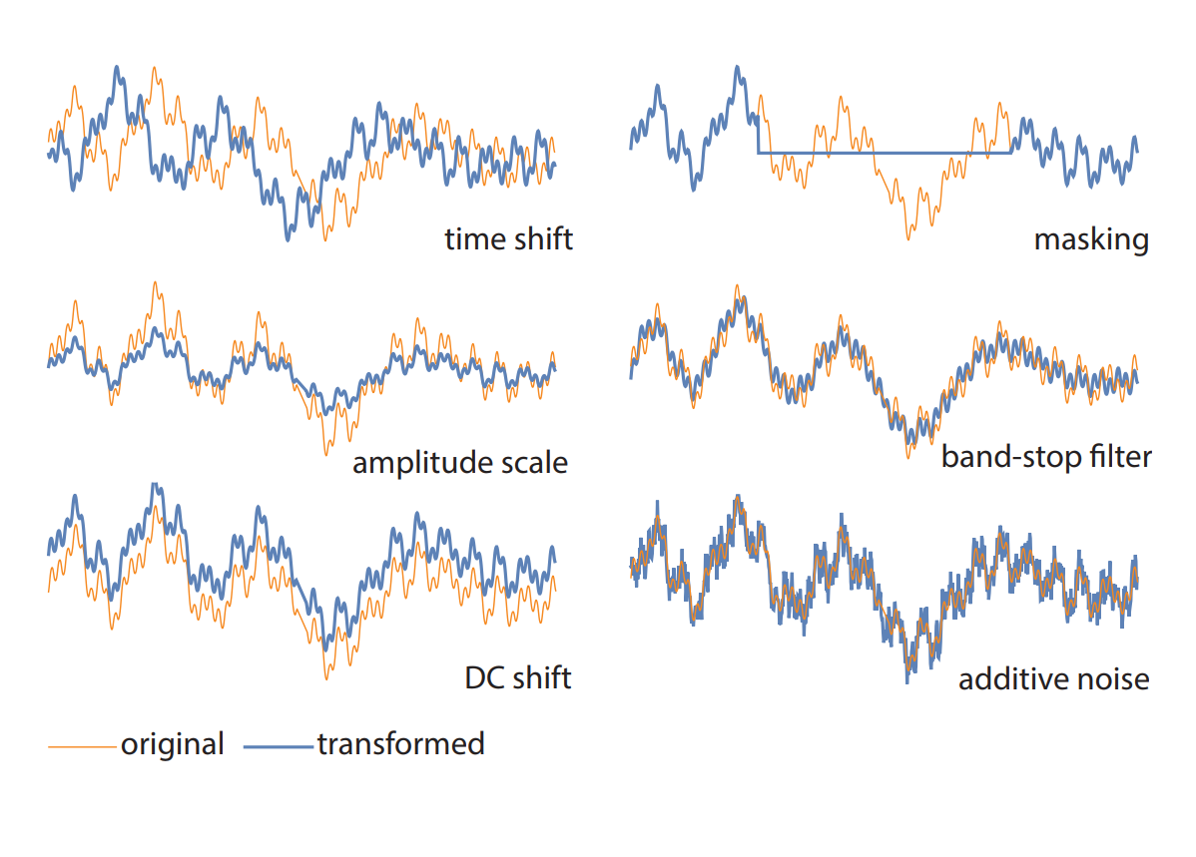
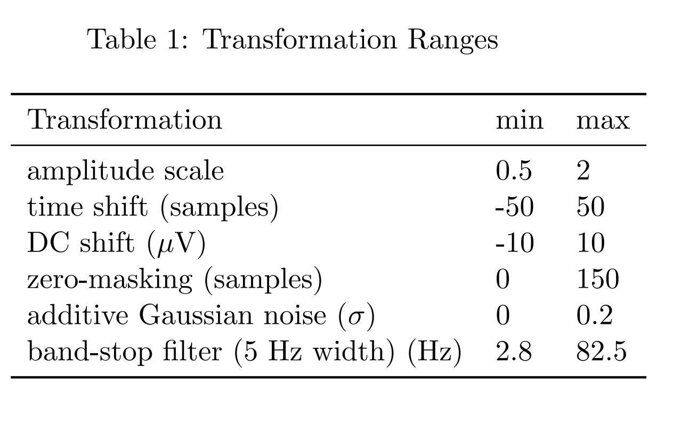
Channel augmentations:
A key ingredient of contrastive learning is a set of augmentations (or transformations) that do not alter the semantic information of data.
A contrastive learning algorithm learns representations that are maximally similar for augmented instances of the same data point and minimally similar for different data points.
The objective is to learn features that reflect the high-level content of EEG signals.
Consulted neurologists on EEG data augmentations.
Notes:
In contrast to images where the set of augmentations is intuitive and easily verifiable by the human eye, it is not clear what augmentations could be beneficial for EEG. We consulted practicing neurologists and EEG researchers to select a set of transformations that leave the semantic information in EEG channels intact.
The strength of each transformation is randomized on a specific range recommended by neurologists.
Table 1 shows the range of transformations used to train the contrastive encoder
consulted four neurologists to identify a set of augmentations that do not change the interpretation of EEG data.

Slide 8
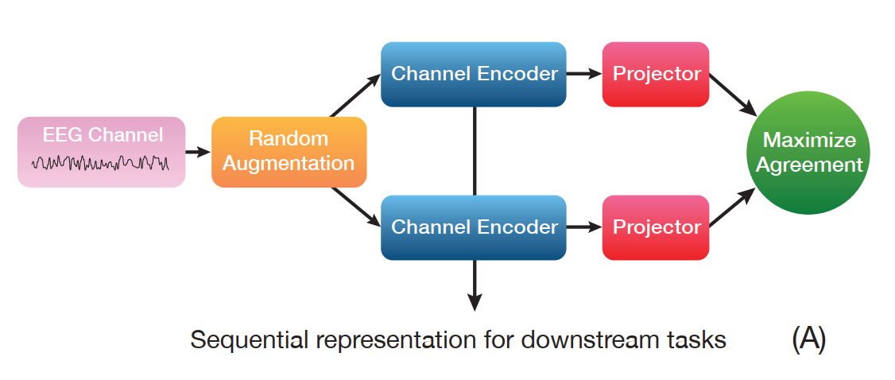
Learning algorithm
SeqCLR (Sequential Contrastive Learning of Representations) → Similar to SimCLR
learns features by maximizing the similarity between differently augmented transformations of the same channel through a contrastive loss.
This model consists of four modules:
Channel Augmenter
Channel encoder
Projector
Contrastive loss
Channel Augmenter
Randomly transforms a mini-batch of N channels into 2N augmented channels.
Randomly applies two augmentations to each channel, resulting in a positive pair.

Slide 9
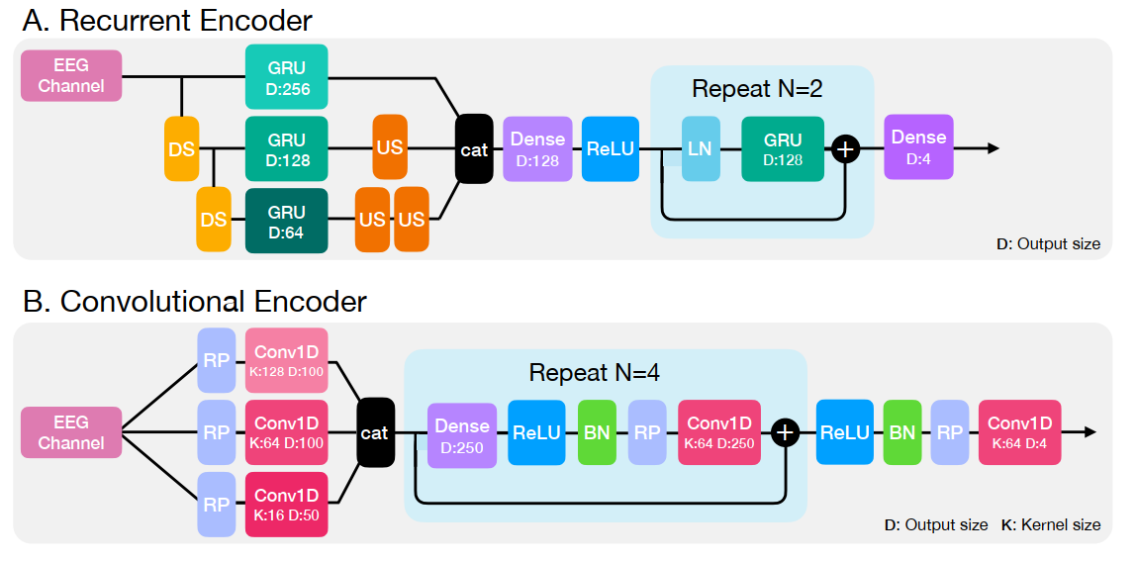
Channel encoder:
Transforms an input channel into four feature channels, maintaining the same length for each.
This feature allows encoding of sequences of varying lengths suitable for different downstream tasks.
Encoder Architectures
Recurrent Encoder:
multi-scale input approach
employing downsampling and upsampling to allow GRU units to capture features at various time scales.
includes two recurrent residual units.
Convolutional Encoder:
Employs reflection padding to match the kernel size of the convolution layers, ensuring the output length matches the input length.
includes four convolutional residual units.
Notes:
For example, emotion recognition tasks use 1-second segments, while sleep staging tasks use 30-second epochs.
Encoder Architectures
Recurrent Encoder: Uses a multi-scale input approach, employing downsampling and upsampling to allow GRU units to capture features at various time scales. This encoder includes two recurrent residual units.
Convolutional Encoder: Employs reflection padding to match the kernel size of the convolution layers, ensuring the output length matches the input length. This encoder comprises four convolutional residual units.

Slide 10
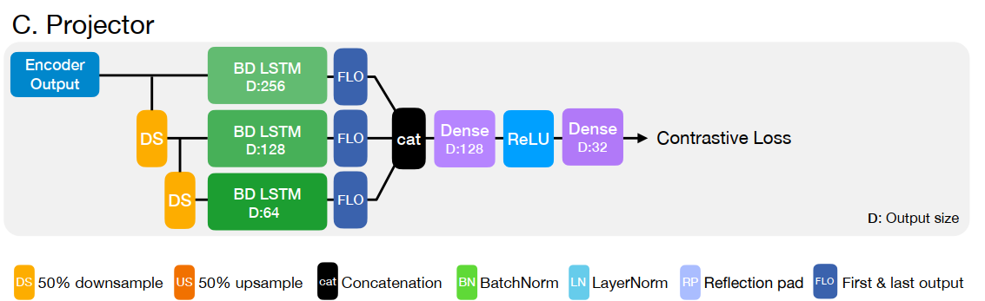
Projector:
Transform the output of the encoder into a 32-dimensional point
Uses downsampling and bidirectional LSTM units
The final outputs of each direction are concatenated and fed into dense layers with a ReLU activation in between.

Slide 11
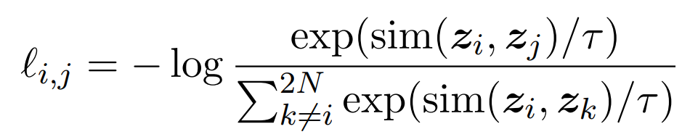

Contrastive loss:
Assuming that $z_{i}$ and $z_{j}$ are the outputs of the projector for the positive pair of $x_{i}$ and $x_{j}$, the NT-Xent loss term for the positive pair is defined as:
where sim(u; v) is the cosine similarity of u and v and τ is the temperature parameter

Slide 12
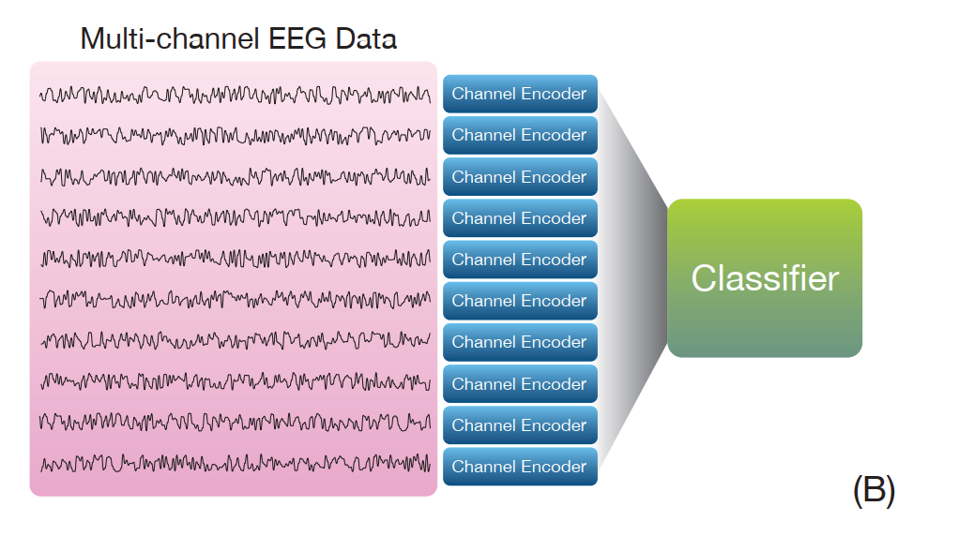
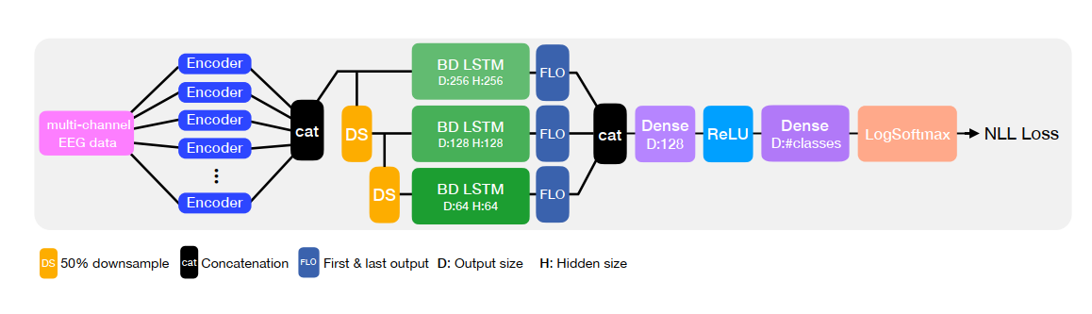
Classifier:
For downstream classification tasks, the projector is discarded, and a classifier almost identical to the projector with two differences is used:
(1) the output dimension of the last dense layer is set to the number of classes
(2) a LogSoftmax layer is added afterward.
The input is the concatenation of the output of the encoder for all input channels of a multi-channel recording.

Slide 13
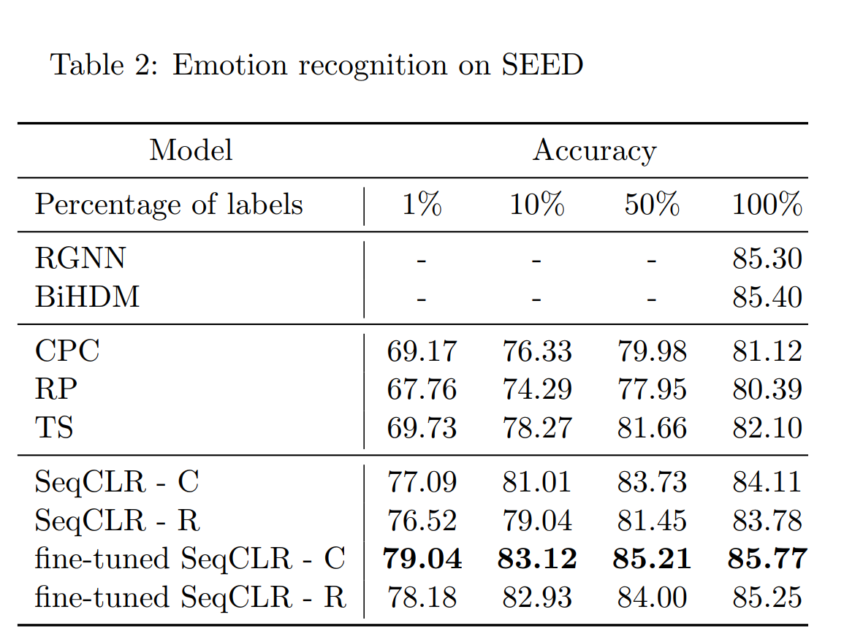
Results on emotion recognition:
Conducted experiments on SEED dataset
EEG data of 15 subjects recorded in 62 channels.
The data was recorded when participants watched emotional videos chosen from movies in three categories of emotions, namely negative, neutral, and positive.
Pass each channel through the encoder and concatenate the 4-dimensional output sequence.
The input of the classifier is a 4 * 62-dimensional sequence of length 200.
Table 2 shows the results of the experiments. The rows marked with SeqCLR-C (convolutional) and SeqCLR-R (recurrent) show the results without fine-tuning where the encoder parameters were frozen during training.
The proposed method improves other self-supervised algorithms by a large gap. Moreover, when fine-tuned on the entire dataset, SeqCLR achieves 85.77% accuracy, slightly higher than the current state-of-the-art supervised model (BiHDM).

Slide 14
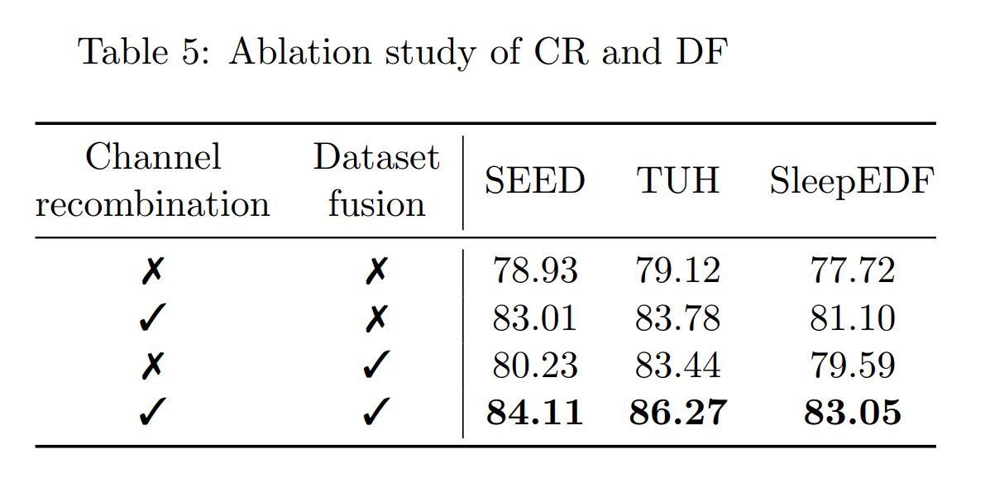
Ablation study of channel recombination and dataset fusion
we used channel recombination (CR) and dataset fusion (DF) to obtain a larger training set for self-supervised learning.
The table shows the effect of removing each of these steps on the accuracy of the classifiers without fine-tuning.
In particular removing channel recombination had a stronger effect in all three tasks.

Slide 15
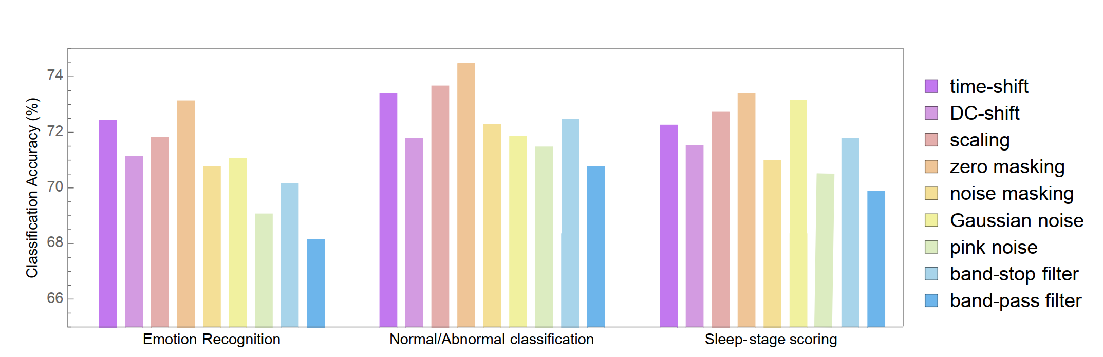
Choosing effective augmentations:
Set up a classification task with the convolutional SeqCLR architecture,
only using a single augmentation at a time.
trained nine encoders and tested them on the three classification tasks.
froze the encoder parameters, for training the classifiers
We observed that the six augmentations, namely (1) zero-masking, (2) amplitude scaling, (3) time-shift, (4) Gaussian noise, (5) DC-shift, and (6) band-stop filter perform significantly better in extracting useful features for the downstream tasks.

Slide 16
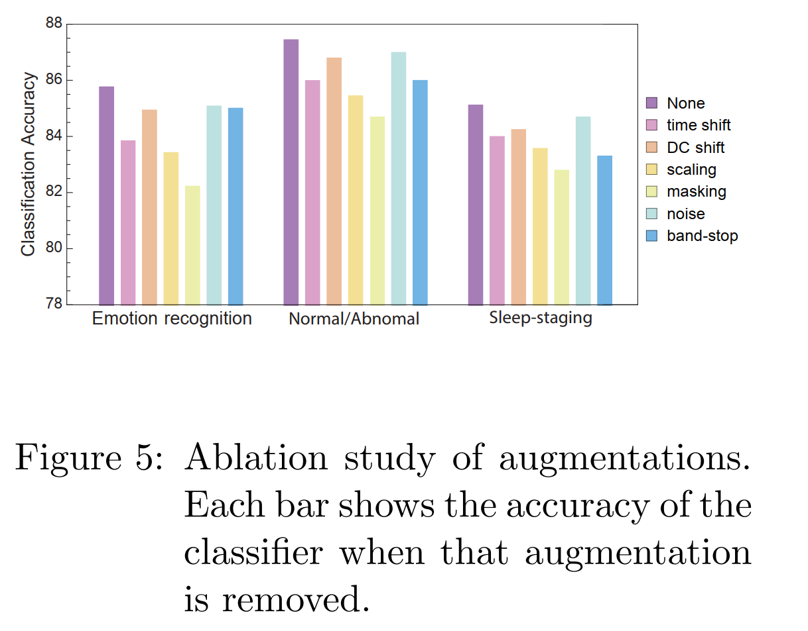
Ablation study of augmentations:
masking and scaling are the most effective augmentations across the three classification tasks.
Additive noise and DC shift have the least effect on the performance of the classifiers

Slide 17
Conclusion
Presented a self-supervised framework, SeqCLR, for learning EEG signal representations.
Adapted the SimCLR framework to time-series data to boost sample-efficiency and classification accuracy across three specific tasks:
Emotion recognition on the SEED dataset
Normal/abnormal classification on the TUH dataset
Sleep-stage scoring on the SleepEDF dataset
Achieved improved performance over other baseline self-supervised models and, with fine-tuning, surpassed current state-of-the-art supervised models in emotion recognition and sleep staging.
Implemented six augmentations, identifying masking and scaling as particularly critical for feature extraction in downstream tasks.
Demonstrated that self-supervised and contrastive learning is effective for deriving valuable representations from EEG data.

