Slide 1
A Transformer-Based Approach Combining Deep Learning Network and Spatial-Temporal Information for Raw EEG Classification
IEEE Transactions on Neural Systems and Rehabilitation Engineering, 2022
Cited by 204
Presenter: Nooshin Taheri
6/25/2025

Slide 2
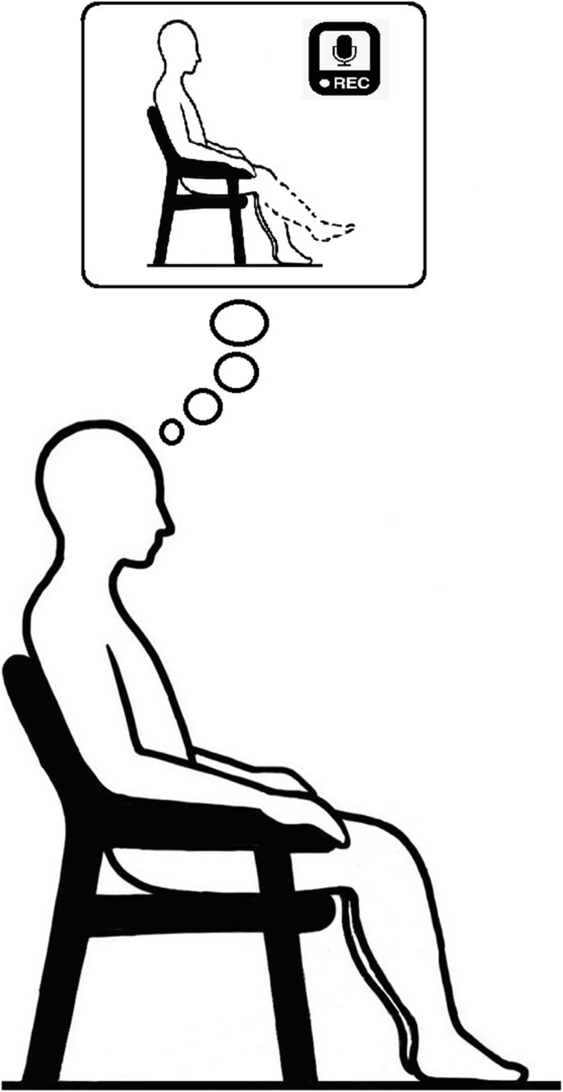
Introduction
Motor Imagery (MI) is a widely used paradigm in EEG-based Brain-Computer Interface (BCI) systems. It requires subjects to imagine movements (e.g., left or right hand), without actual motion.
Accurate classification of MI-EEG signals is crucial for enabling BCIs to assist with tasks such as rehabilitation and motor function recovery in patients.
However, MI-EEG data is challenging to work with due to:
High temporal resolution
Low spatial resolution
Low signal-to-noise ratio
High inter-subject variability
EEG signals inherently contain spatial dependencies (across channels) and temporal dependencies (across time), both of which are essential for accurate classification.
Some methods rely heavily on Convolutional Neural Networks (CNNs) to extract both spatial and temporal features (depending on the type of kernel used), but CNNs often struggle to capture global dependencies, limiting their effectiveness on complex EEG tasks.
To better model temporal dynamics, some models combine CNNs with Recurrent Neural Networks (RNNs).
Transformers can model both spatial and temporal relationships globally through an attention mechanism, making them ideal for EEG analysis.

Slide 3
Contributions of This Study
propose an end-to-end Transformer framework that is capable of processing raw EEG data while retaining the spatiotemporal characteristics that are important for model visualization.
Novel Transformer-Based Models Designed five architectures to classify raw MI-EEG data:
s-Trans: Spatial Transformer
t-Trans: Temporal Transformer
s-CTrans: Spatial CNN + Transformer
t-CTrans: Temporal CNN + Transformer
f-CTrans: Fusion of spatial & temporal CNN + Transformer
Integration of Positional Embedding (PE) Explored 3 PE strategies (relative, channel-correlation, learned),
Interpretable Attention Visualization Visualized attention weights across electrodes.

Slide 4

Dataset & Preprocessing
Dataset: PhysioNet EEG Motor Movement/Imagery
109 subjects, 64 electrodes, 160 Hz sampling rate
Tasks: left/right fist (L/R), both fists against both feet (F), and rest with eyes open(O)
Each trial lasted 8 seconds
Used 3s and 6s EEG segments for 2-(L/R), 3-(L/R/O), and 4-class (L/R/O/F) classification
Preprocessing:
Z-score normalization applied to each EEG trial
Added small random noise (α = 0.01) to improve generalization and avoid overfitting
Data segmented from the motor imagery period
Notes:
Each trial lasted 8 seconds, from which 3-second (first 3s of the MI period) and 6-second (entire MI period + 1s before and after) segments were extracted for training and testing.

Slide 5
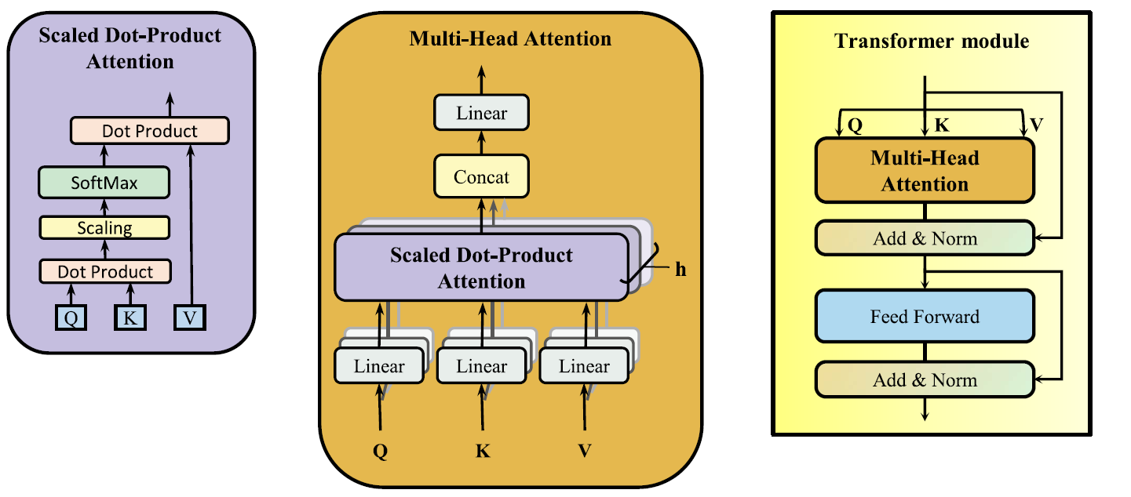
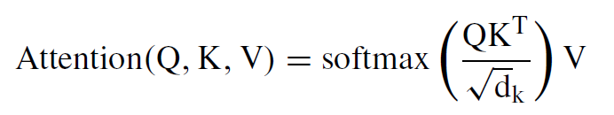
Structure of the transformer module
Multi-head attention consisted of several “Scaled Dot-Product Attention” layers, allowing the model to jointly focus on information from different representation subspaces at different locations.

Slide 6
Model Architecture
8 attention heads were employed in this study, and solely embedded the encoder part of the Transformer into the EEG classification.
Three types of PE were explored:
Relative Positional Encoding – uses sine & cosine functions to represent positions.
Channel Correlation Encoding – based on cosine distance between electrodes.
Learned Positional Encoding – trainable embedding matrix updated during training.
The number of Transformer layers was varied from 1 to 6, and using 3 layers achieved the best classification performance.

Slide 7
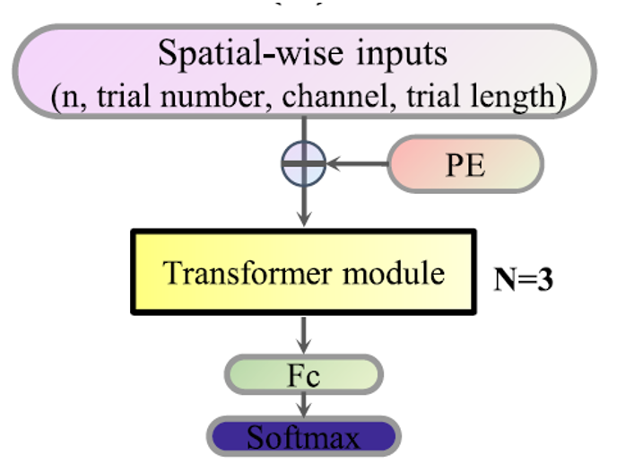
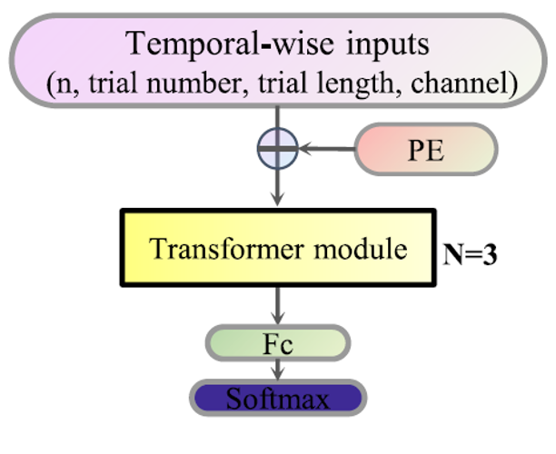
Spatial and Temporal Transformer Models
Spatial Transformer (s-Trans)
EEG data along the time axis from each channel were regarded as features, and the Transformer module calculated the correlations between different channels.
Temporal Transformer (t-Trans)
EEG data along the channel axis at the same time point were regarded as features, and the model calculated the correlations between different time points.

Slide 8
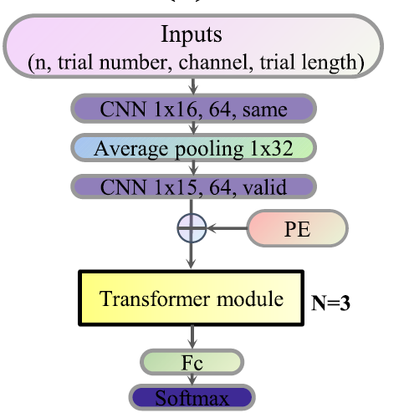
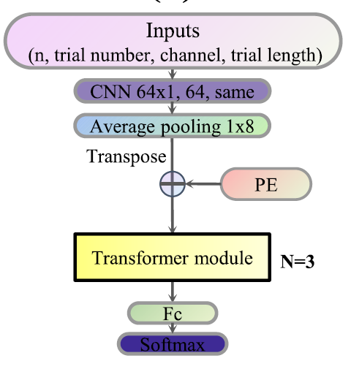
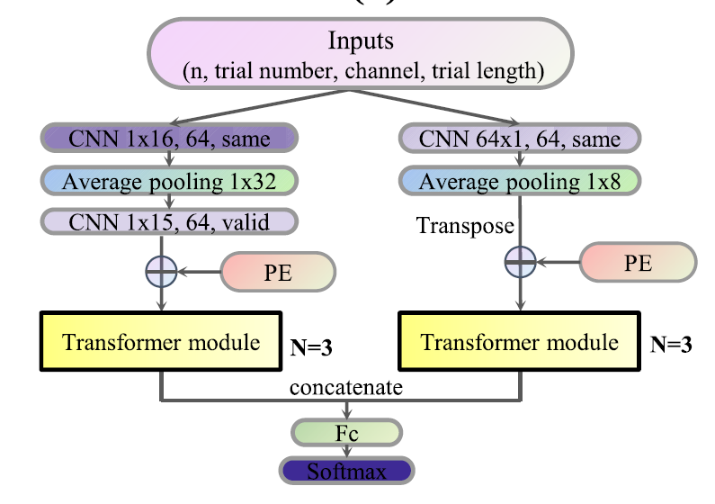
CNN + Transformer Models
s-CTrans
t-CTrans
Combined CNN’s local feature extraction with Transformer’s global attention to enhance EEG classification.
Three hybrid models were proposed:
s-CTrans: CNN for temporal features, Transformer for spatial attention
t-CTrans: CNN for spatial features, Transformer for temporal attention
f-CTrans: Parallel fusion of spatial and temporal branches
CNN layers reduce dimensionality and extract robust features before passing them to the Transformer.
f-CTrans

Slide 9
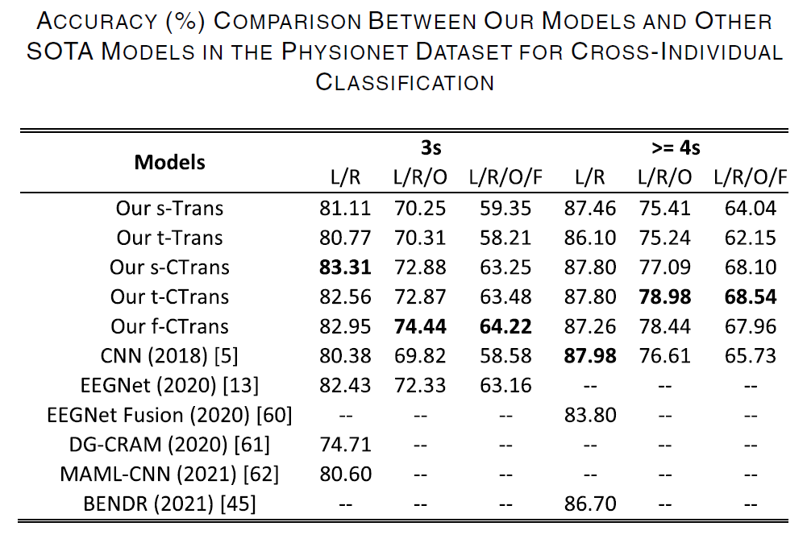
Classification Results
Using 3-second EEG data, the best accuracies achieved were:
83.31% (2-class), 74.44% (3-class), 64.22% (4-class) → Outperformed all baseline models.
Using 6-second data, performance improved further:
87.80%, 78.98%, and 68.54% for 2-, 3-, and 4-class tasks respectively.
f-CTrans performed best on 3s data (3/4-class), while t-CTrans was best on 6s data.
The EEG data with a longer period produced higher classification accuracy.

Slide 10
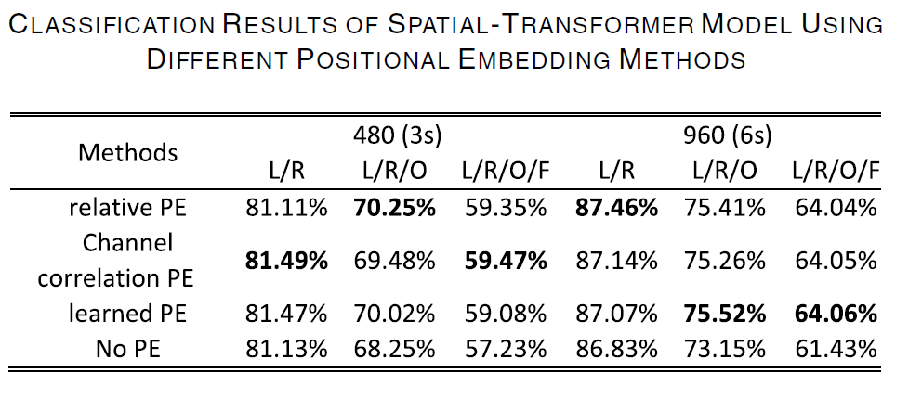
Effect of Positional Embedding (PE)
Three PE methods (relative, channel-correlation, learned) were tested using the s-Trans model.
All PE methods outperformed the no-PE baseline for both 3s and 6s EEG data.
Learned PE showed slightly better accuracy but required more training parameters.
Adding positional embeddings improves classification accuracy, even if modestly.

Slide 11
Conclusion & Future Directions
Developed five Transformer-based models for motor imagery EEG classification.
Achieved state-of-the-art accuracy across 2-, 3-, and 4-class tasks using raw EEG.
Fusion model (f-CTrans) performed best on short input (3s), showing robustness and efficiency.
Models are suitable for real-time BCI applications and can be extended to other EEG tasks like disease diagnosis or neurorehabilitation.
Future Optimizations:
Use multi-scale attention to better capture EEG features with varying time-scales.
Prune uninformative attention heads to reduce computational cost and enhance model robustness.

