Slide 1
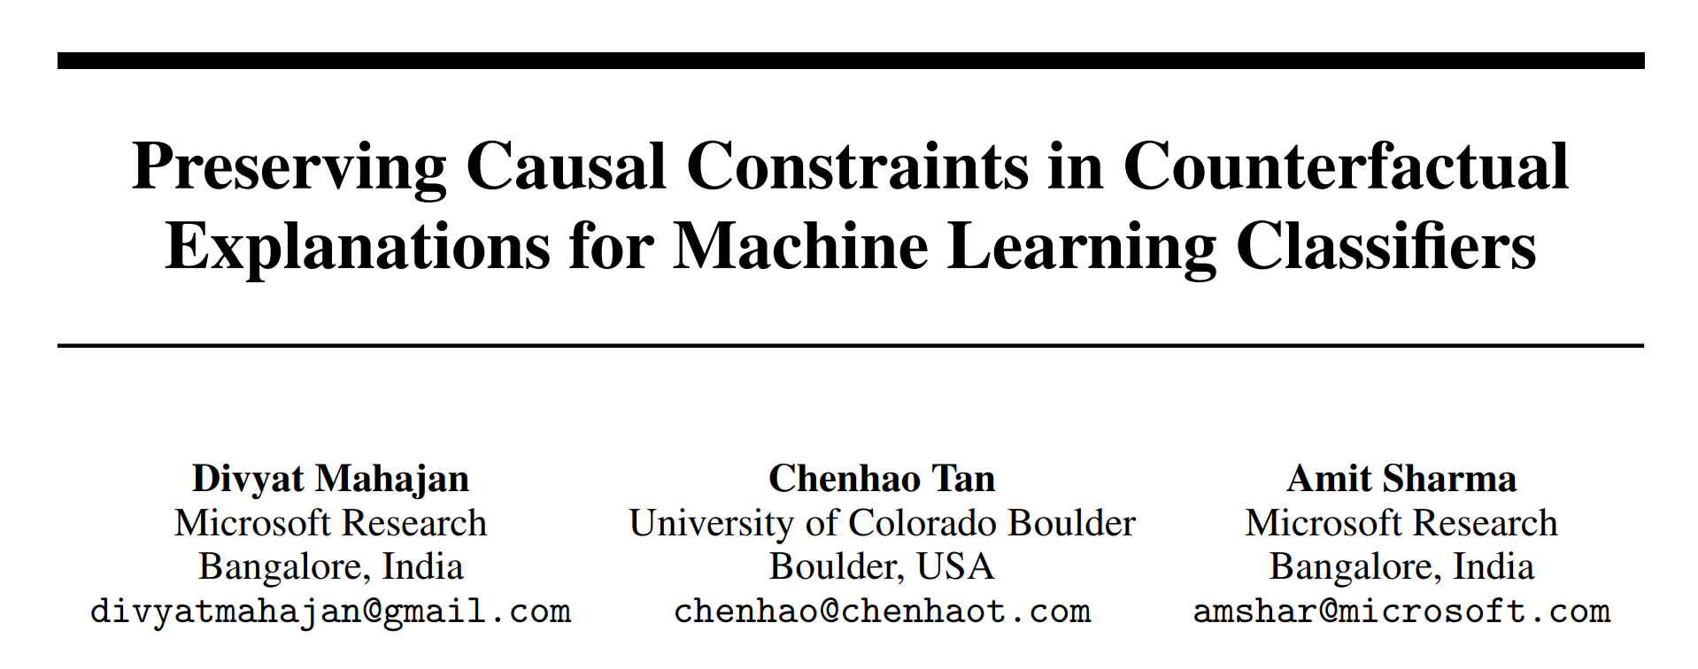
﻿CausalML: Machine Learning and Causal Inference for Improved Decision Making Workshop, 33rd Conference on Neural Information Processing Systems (NeurIPS 2019), Vancouver, Canada
cited 261 times

Slide 2
Facts
Came out in 2019
Pioneer paper for realistic CF generation
Some authors were in the group that published DiCE
An upgrade to DiCE: DiCE does not care about realism
This paper cares about creating CFs that are realistic, feasible to generate
Compared against CEML that doesn’t care about realism
Age | BMI | BP | Steps | Distance | BGL | label
30 | 24 | 126 | 1800 | 0.8 | 7.2 | -
Age | BMI | BP | Steps | Distance | BGL | label
30 | 24 | 120 | 7000 | 0.5 | 5.5 | +

Slide 3
Motivations
Feasibility issues
Causality issues
Global feasibility issues: feasibility issue + causality issue
Local feasibility issues: ﻿globally feasible and satisfies user-level constraints (Actionable)
 | Age | Education | Salary | Married?
Loan denied | 27 | Bachelor | 80k | No
Loan approved | 300 | Bachelor | 90k | No
 | Age | Education | Salary | Married?
Loan denied | 27 | Bachelor | 80k | No
Loan approved | 27.5 | PhD | 120k | No

Slide 4
Contributions
Preserves causality in the CFs, ﻿includes many constraints not considered in prior work.
﻿addresses feasibility with a new Distance metric that uses structural causal model
﻿if feasibility constraints are not available, it learns feasibility constraints from user feedback.

Slide 5
Contributions
Model-based CF
﻿Model-approx CF
﻿Example-Based CF

Slide 6
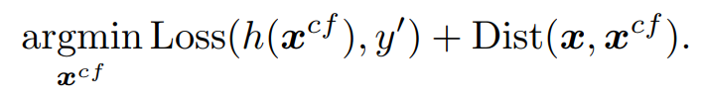
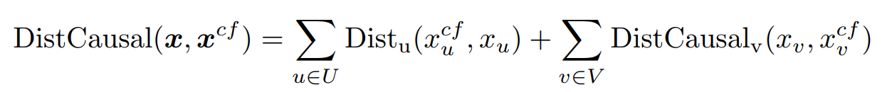
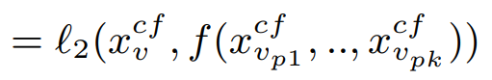
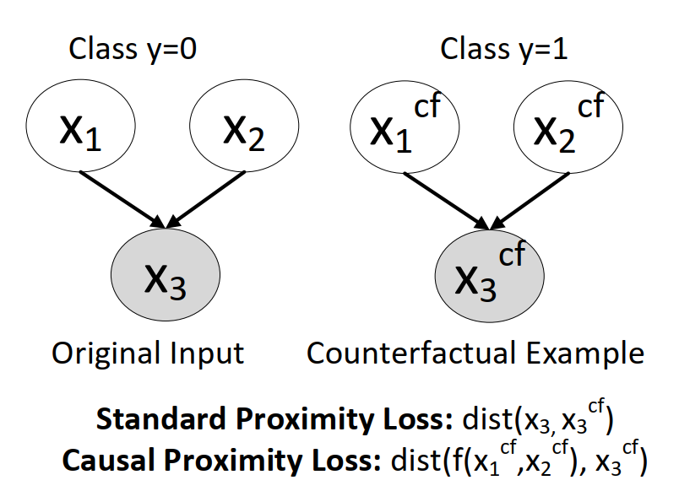

Model-based CF
Basic approach to CF generation:
l1 or l2 distance
replace
Exogenous
vars
Endogenous
vars
l1 or l2 distance
$$x_{3}^{cf}\left(glucose\right)=f\left[x_{1}^{cf}\left(exercise\right),x_{2}^{cf}\left(insulin\right)\right]+ε$$
$$l_{2}(x_{1}^{cf}\left(exercise\right), x_{1}\left(exercise\right))$$
$${l_{2}(x}_{2}^{cf}\left(insulin\right), x_{2}(insulin))$$
$${l_{2}(x}_{3}^{cf}\left(exercise\right),f(x_{1}^{cf}\left(exercise\right),x_{2}^{cf}\left(insulin\right)))$$

Slide 7


Model-approx CF
﻿Unary constraints
Variables that can only increase
﻿Binary constraints
Base optimizer
Regular VAE
Base optimizer

Slide 8
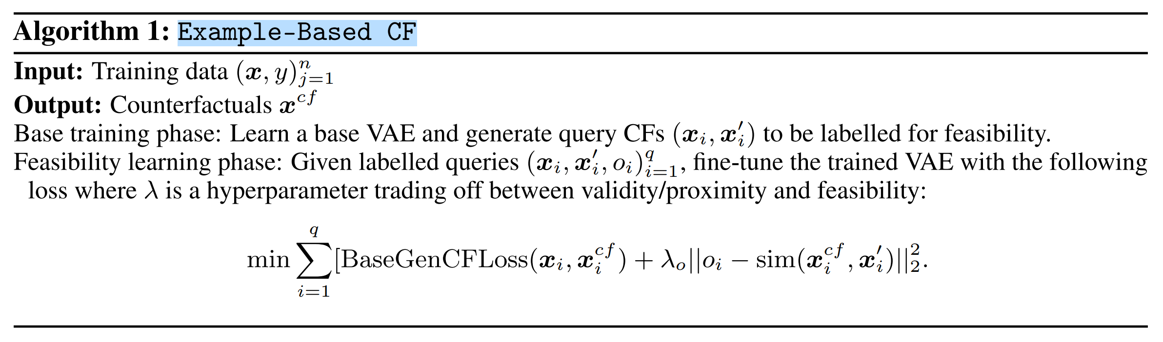
﻿Example-Based CF

Slide 9
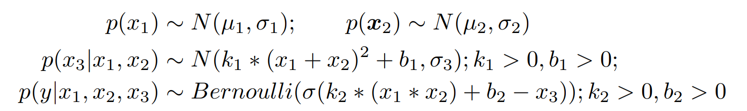

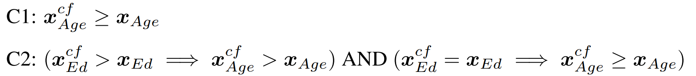
Experiement
﻿Datasets
﻿Simple-BN (10,000)
﻿Sangiovese (10,000, ﻿14 features, one categorical removed)
﻿Adult (15,691, ﻿y = 0 (Low Income) and y = 1 (High Income))

Slide 10
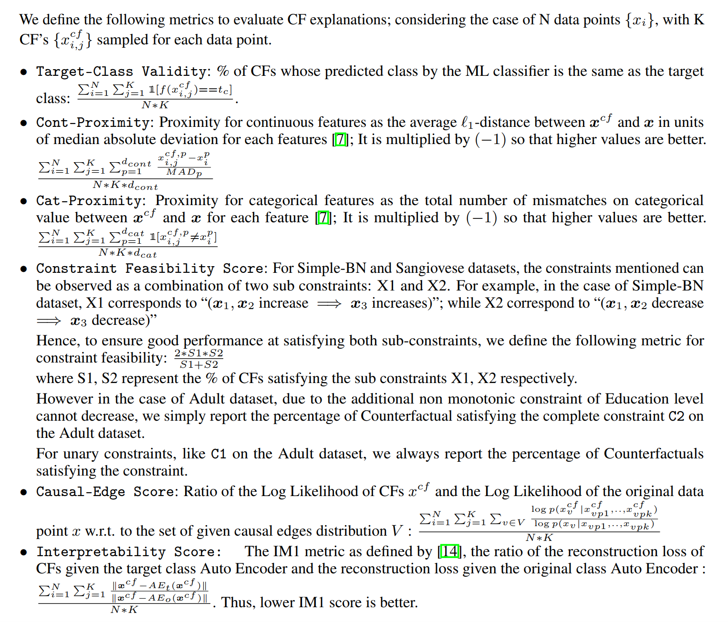
Evaluation
how causally consistent the counterfactuals are by comparing their log-likelihoods under a learned causal structure
how well the CFs align with the target class in terms of representation learning

Slide 11
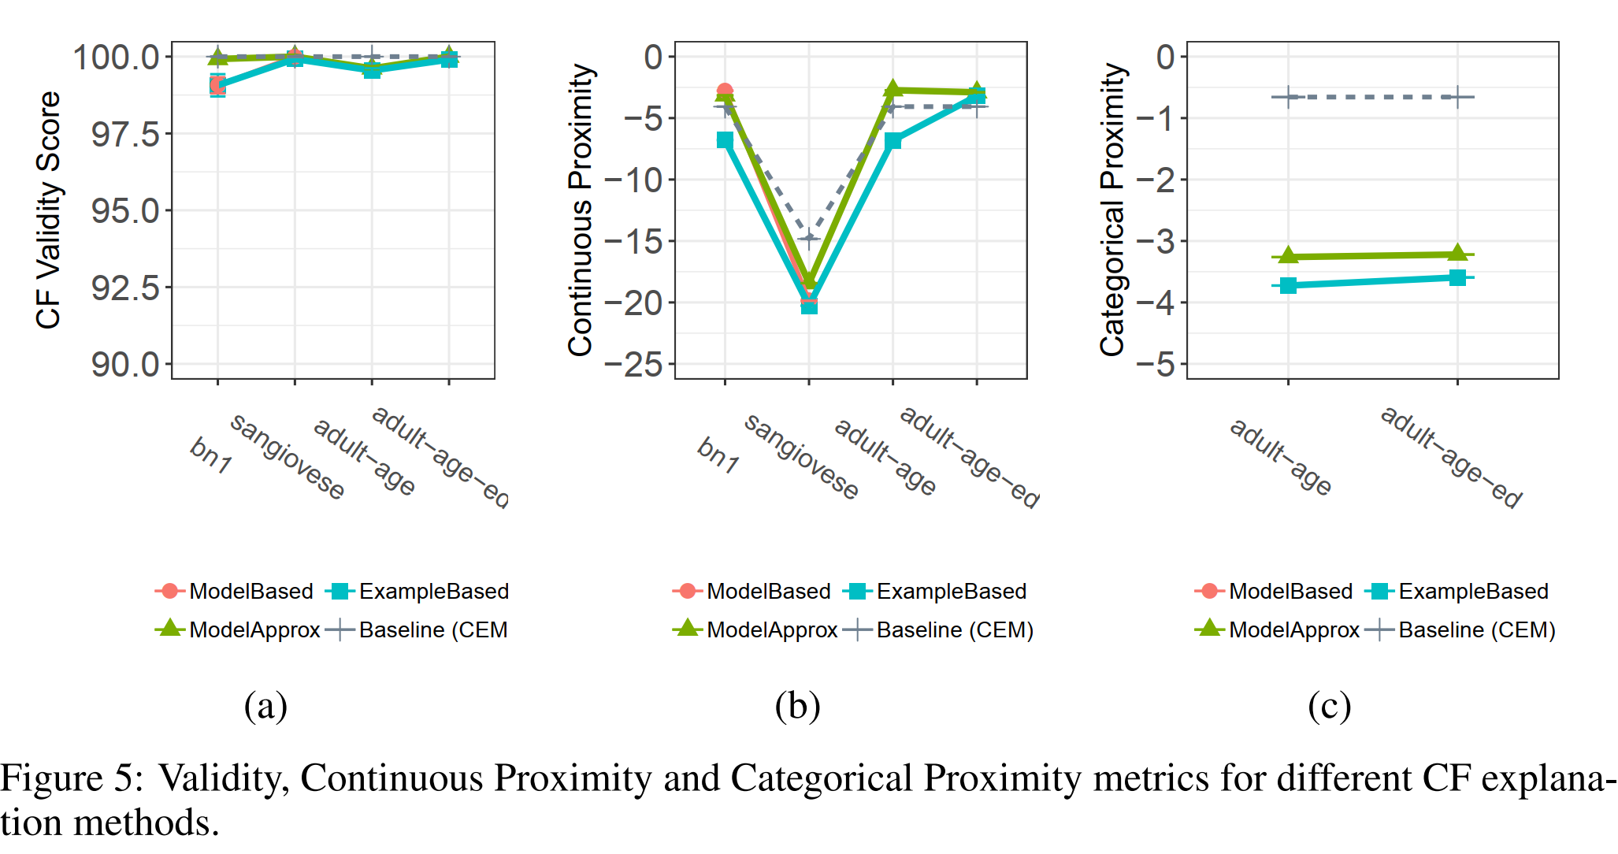
Results

Slide 12
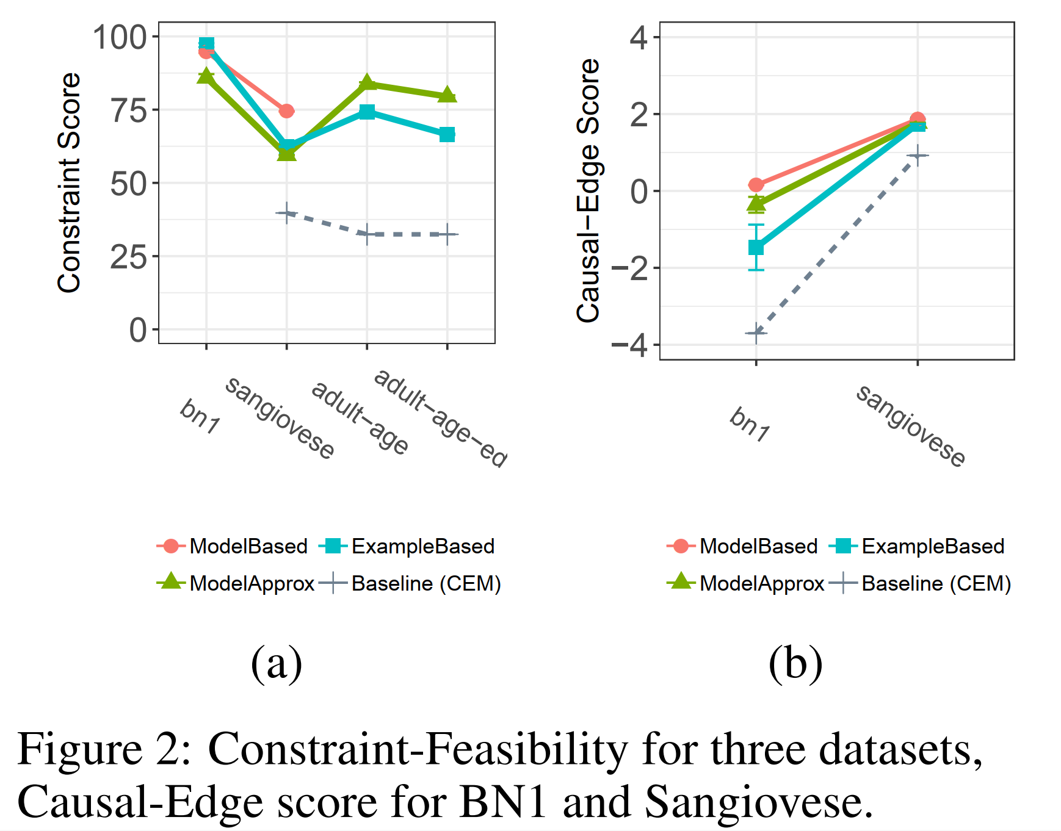
Results

Slide 13
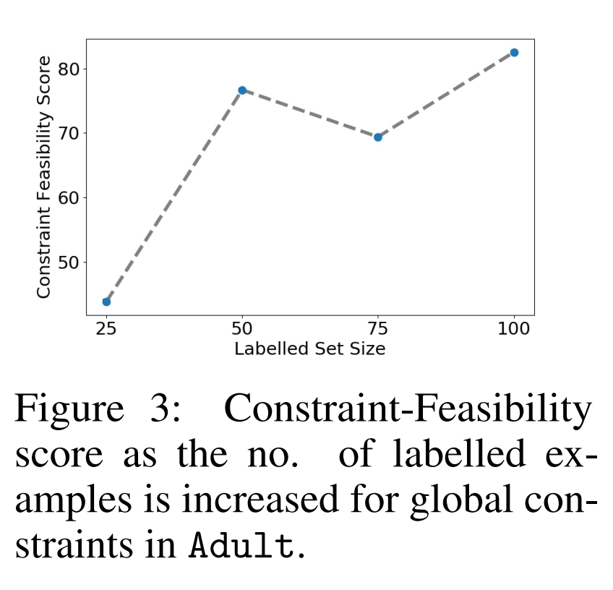
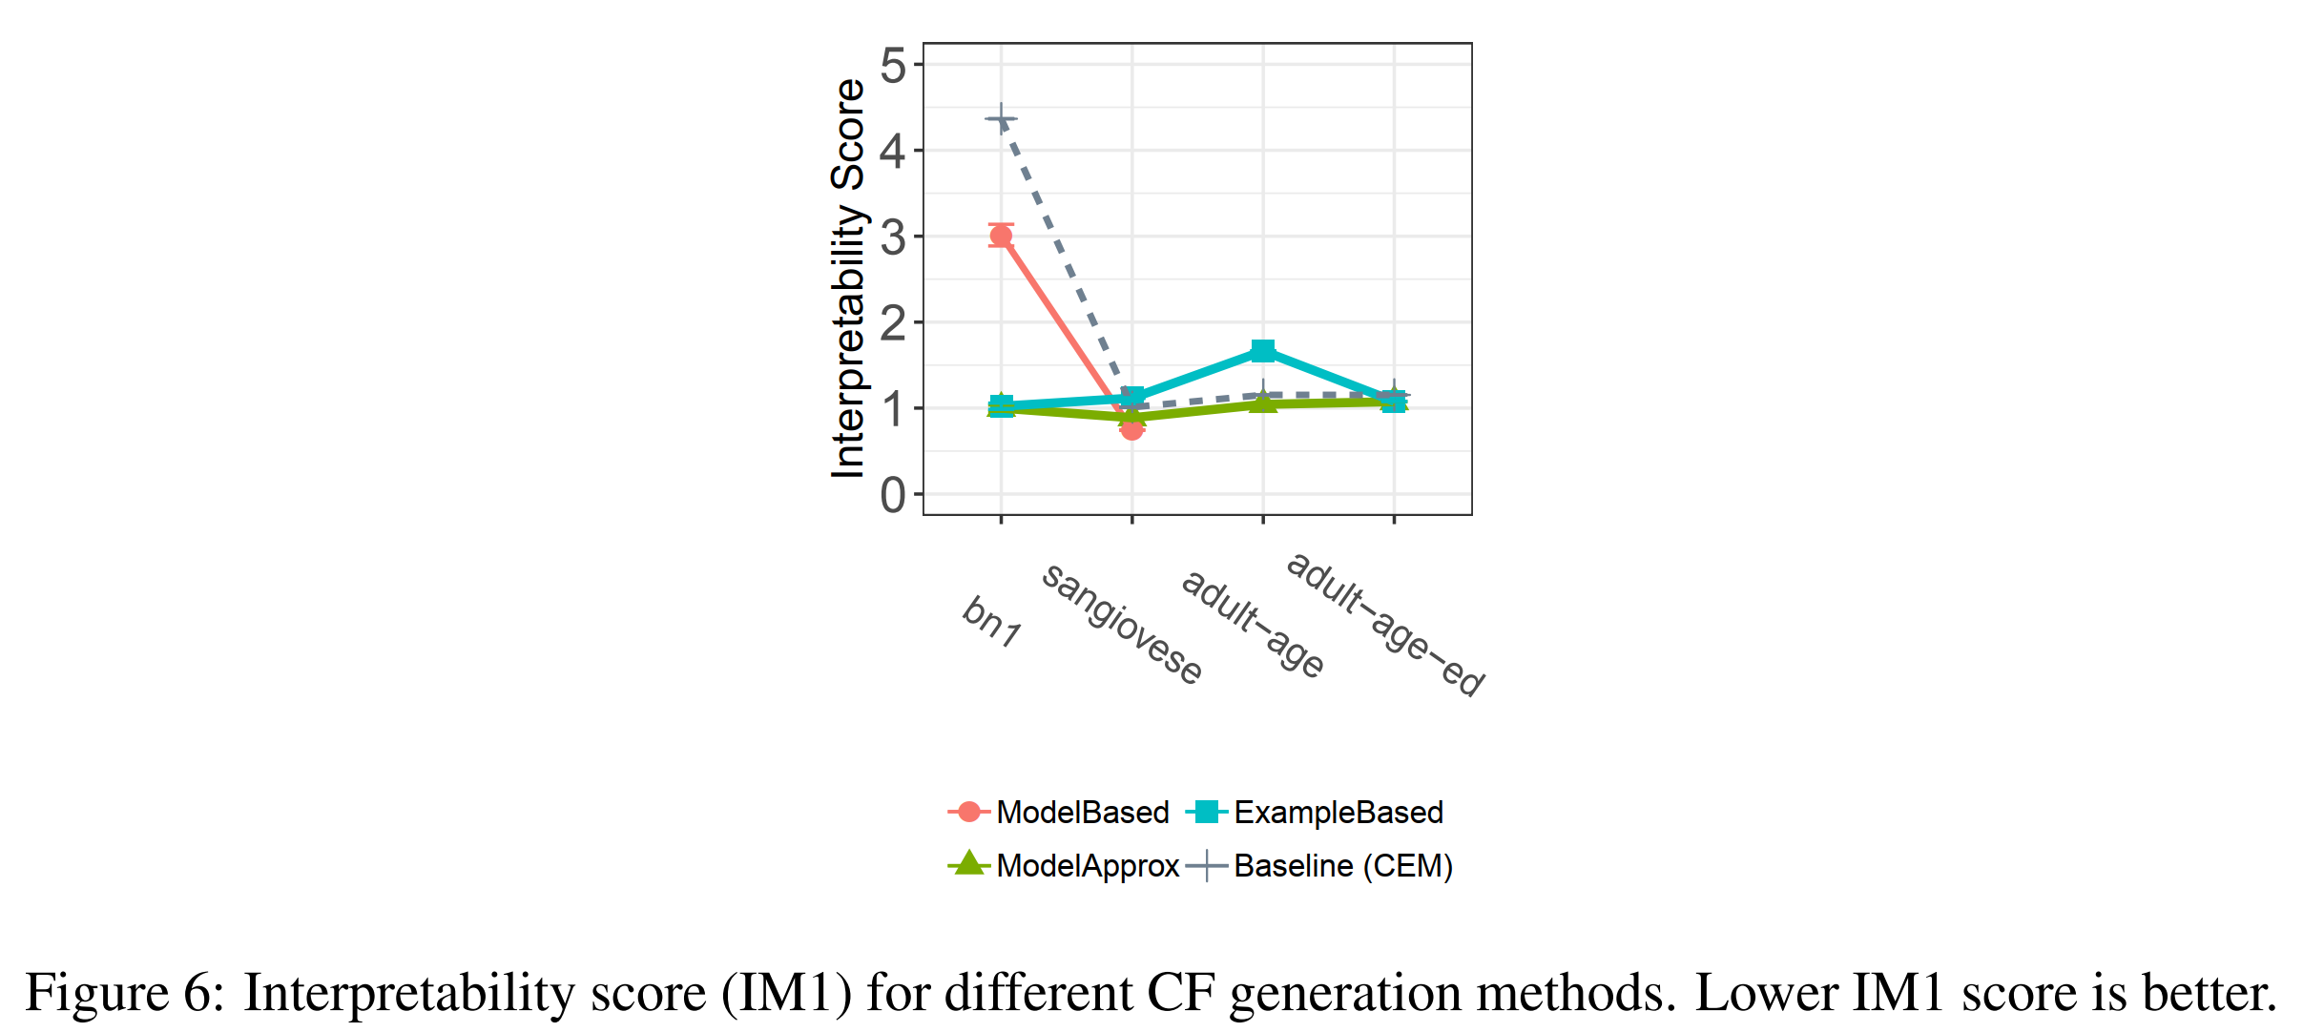
Results

Slide 14
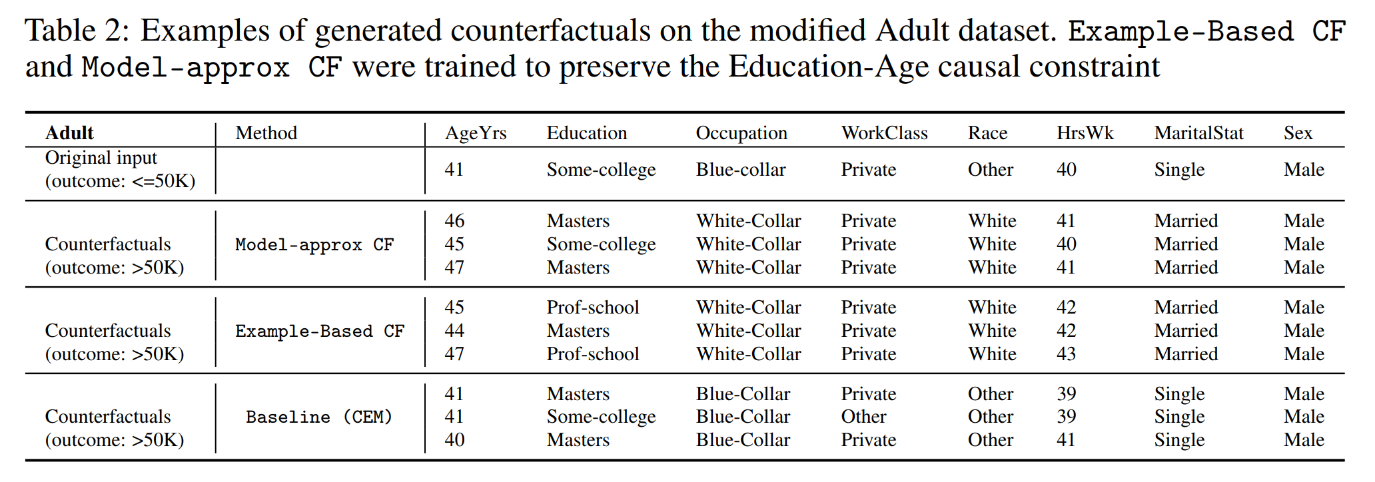
Results

