Slide 1
Digital-twin based optimization of bolus insulin dosing in pediatric type 1 diabetes: an in silico feasibility study
E. Pellizzari1, G. Cappon1, G. Sparacino1, A. Deodati2, R. Schiaffini2, S. Cianfarani2, and A. Facchinetti1
Presenter: Shovito Barua Soumma
Date: July 23, 2025
IEEE EMBC 2025

Slide 2
Introduction
T1D: A condition where the body cannot make insulin, so insulin must be taken manually.
Improve insulin therapy for children with T1D using a personalized, adaptive algorithm powered by Digital Twins (DTs)

Slide 3
Findings
Existing insulin bolus calculators are:
Static: do not adapt to patient’s changing physiology over time
Based on fixed formulas or heuristics
Insufficient for pediatric T1D: Their behavior changes over time due to hormone
No personalization
Proposed a digital twin–driven optimization for insulin therapy [Personalized Treatment]

Slide 4
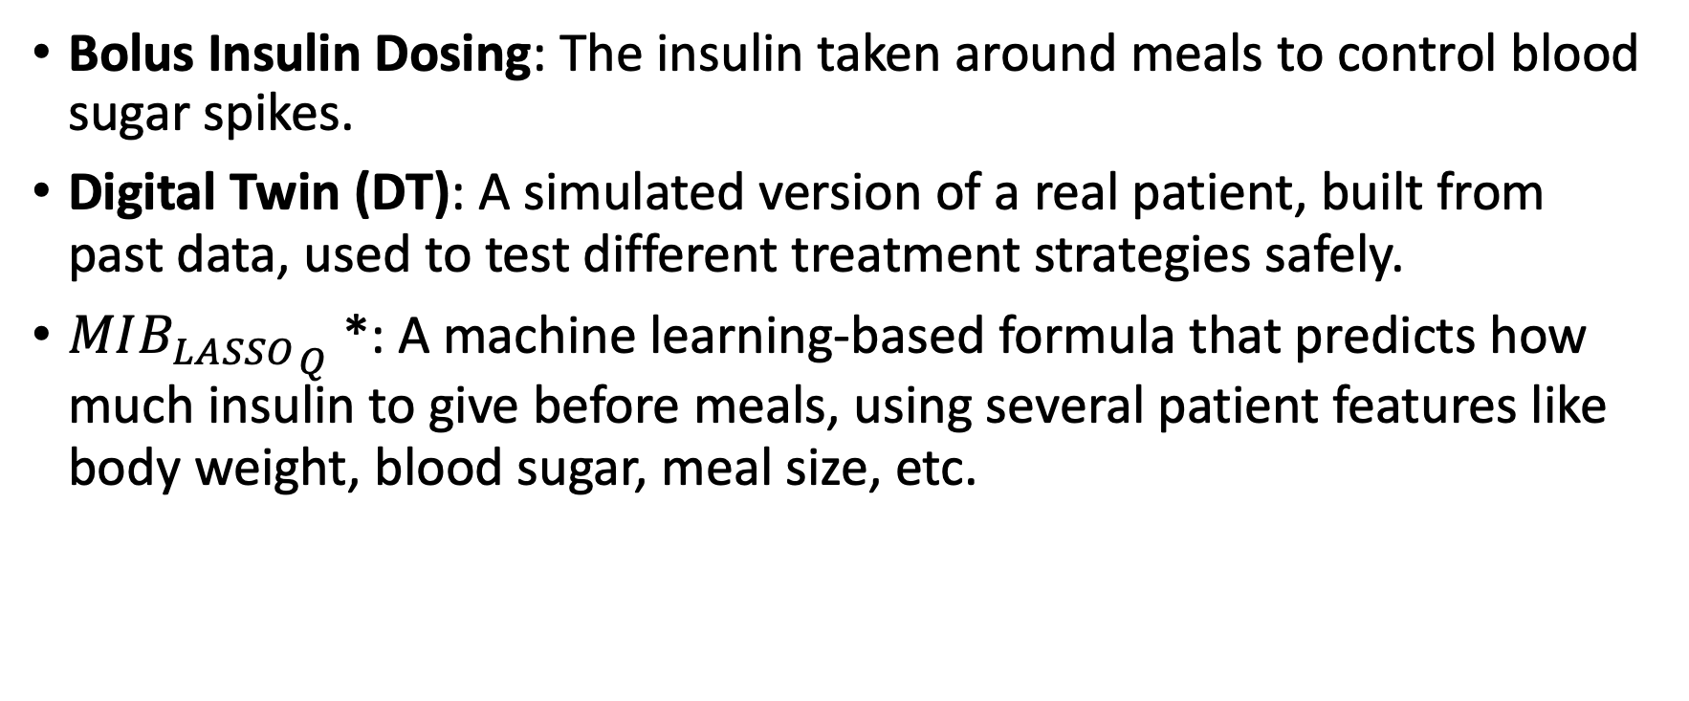
Key Idea
Bolus Insulin Dosing: The insulin taken around meals to control blood sugar spikes.
Digital Twin (DT): A simulated version of a real patient, built from past data, used to test different treatment strategies safely.
$MI{B_{LASSO}}_{Q}$*: A machine learning-based formula that predicts how much insulin to give before meals, using several patient features like body weight, blood sugar, meal size, etc.
*G. Noaro et al., “Machine-learning based model to improve insulin bolus calculation in type 1 diabetes therapy,” IEEE Transactions on Biomedical Engineering, vol. 68, no. 1, pp. 247–255, 2020.

Slide 5

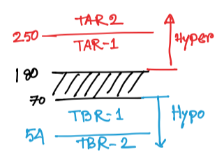
Key Idea
Glycemia Risk Index (GRI): A score that measures how risky a patient’s blood sugar levels are (too high or too low).

Slide 6
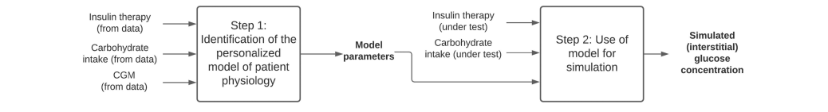
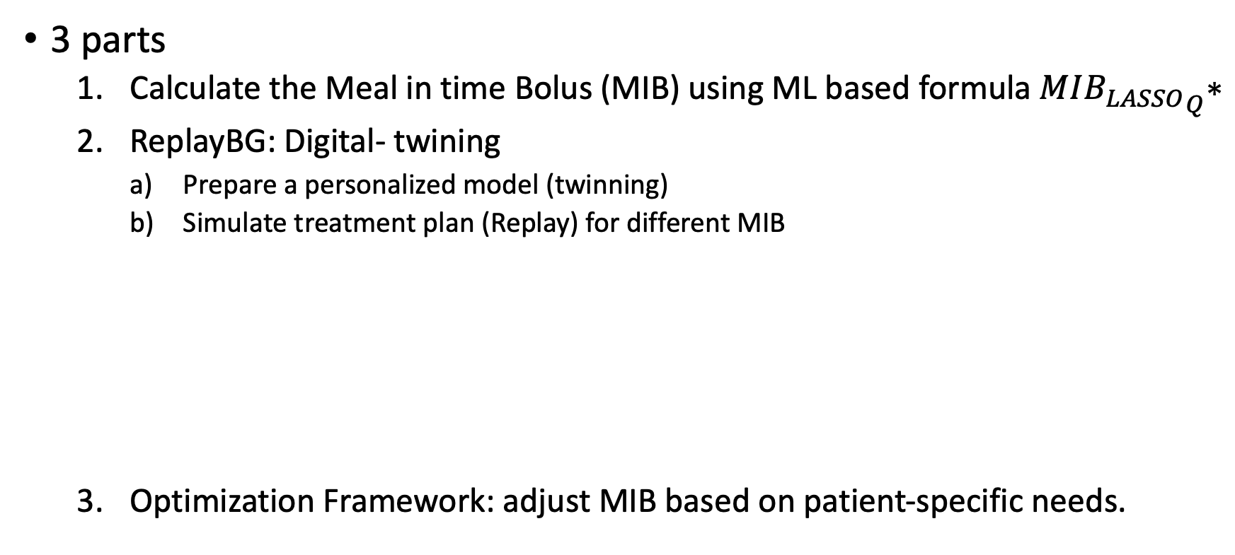
Method
3 parts
Calculate the Meal in time Bolus (MIB) using ML based formula $MI{B_{LASSO}}_{Q}\text{∗}$
ReplayBG: Digital- twining
Prepare a personalized model (twinning)
Simulate treatment plan (Replay) for different MIB
Optimization Framework: adjust MIB based on patient-specific needs.
*G. Noaro et al., “Machine-learning based model to improve insulin bolus calculation in type 1 diabetes therapy,” IEEE Transactions on Biomedical Engineering, vol. 68, no. 1, pp. 247–255, 2020.
Notes:
(i) identification of the personalized model of the patient’s glucose-insulin dynamics (referred to as “twinning”),
and (ii) use of the identified model for simulation (referred to as “replay”).
DT, is used to predict the hypothetical glucose concentration profile that would have been obtained, in the same individual and in the same time
window, from the adoption of an alternative therapy, i.e., in our case, different MIB inputs.

Slide 7
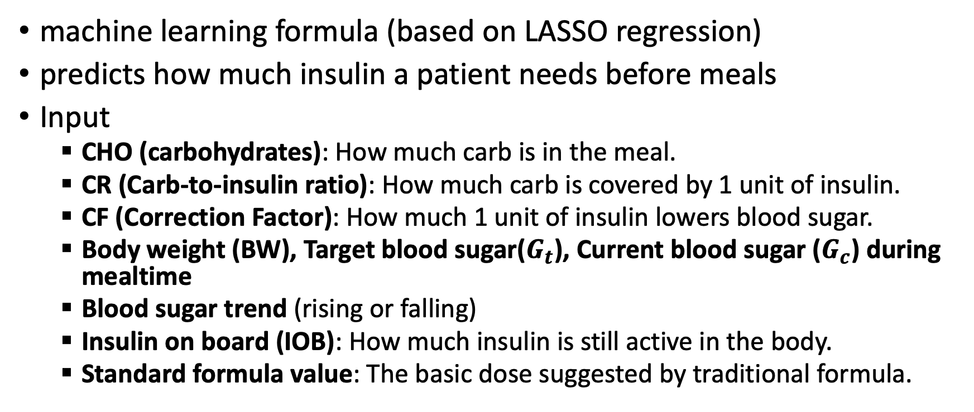
MIB Calculation
machine learning formula (based on LASSO regression)
predicts how much insulin a patient needs before meals
Input
CHO (carbohydrates): How much carb is in the meal.
CR (Carb-to-insulin ratio): How much carb is covered by 1 unit of insulin.
CF (Correction Factor): How much 1 unit of insulin lowers blood sugar.
Body weight (BW), Target blood sugar($G_{t}$), Current blood sugar ($G_{c}$) during mealtime
Blood sugar trend (rising or falling)
Insulin on board (IOB): How much insulin is still active in the body.
Standard formula value: The basic dose suggested by traditional formula.

Slide 8

MIB Calculation
Trained on expanded feature set using quadtratic values
Normalized, mean removal

Slide 9
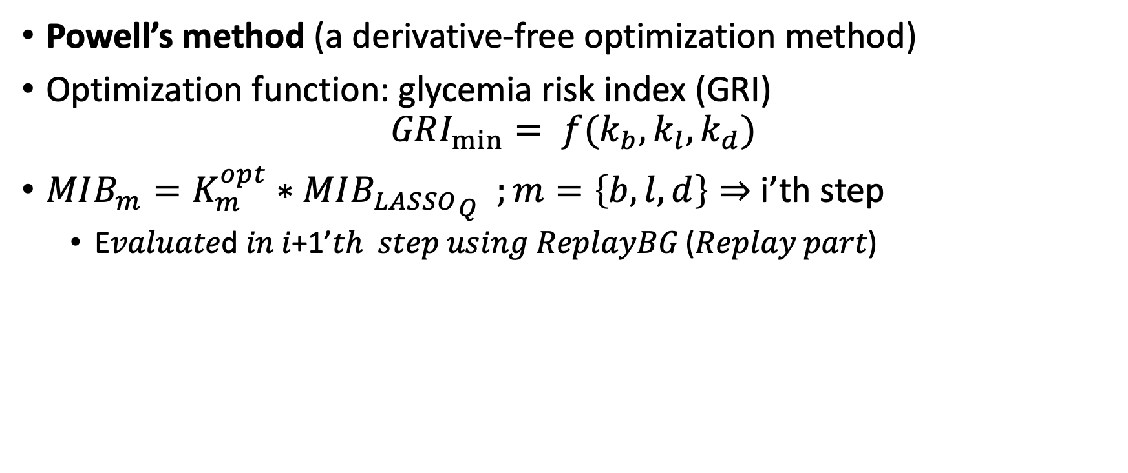
Optimization Framework
Powell’s method (a derivative-free optimization method)
Optimization function: glycemia risk index (GRI)
i’th step
E𝑣𝑎𝑙𝑢𝑎𝑡𝑒d 𝑖𝑛 𝑖+1’𝑡ℎ 𝑠𝑡𝑒𝑝 𝑢𝑠𝑖𝑛𝑔 𝑅𝑒𝑝𝑙𝑎𝑦𝐵𝐺 (𝑅𝑒𝑝𝑙𝑎𝑦 𝑝𝑎𝑟𝑡)

Slide 10
Assessment Criteria
5 Pediatric patients
Each has 145 days of CGM data
Total CGM: 724 days
therapy adjustments were then simulated on a biweekly basis
24 weeks
12 intervals
2weeks
1,2
2weeks
23,24
Interval-1
Interval-12

Slide 11
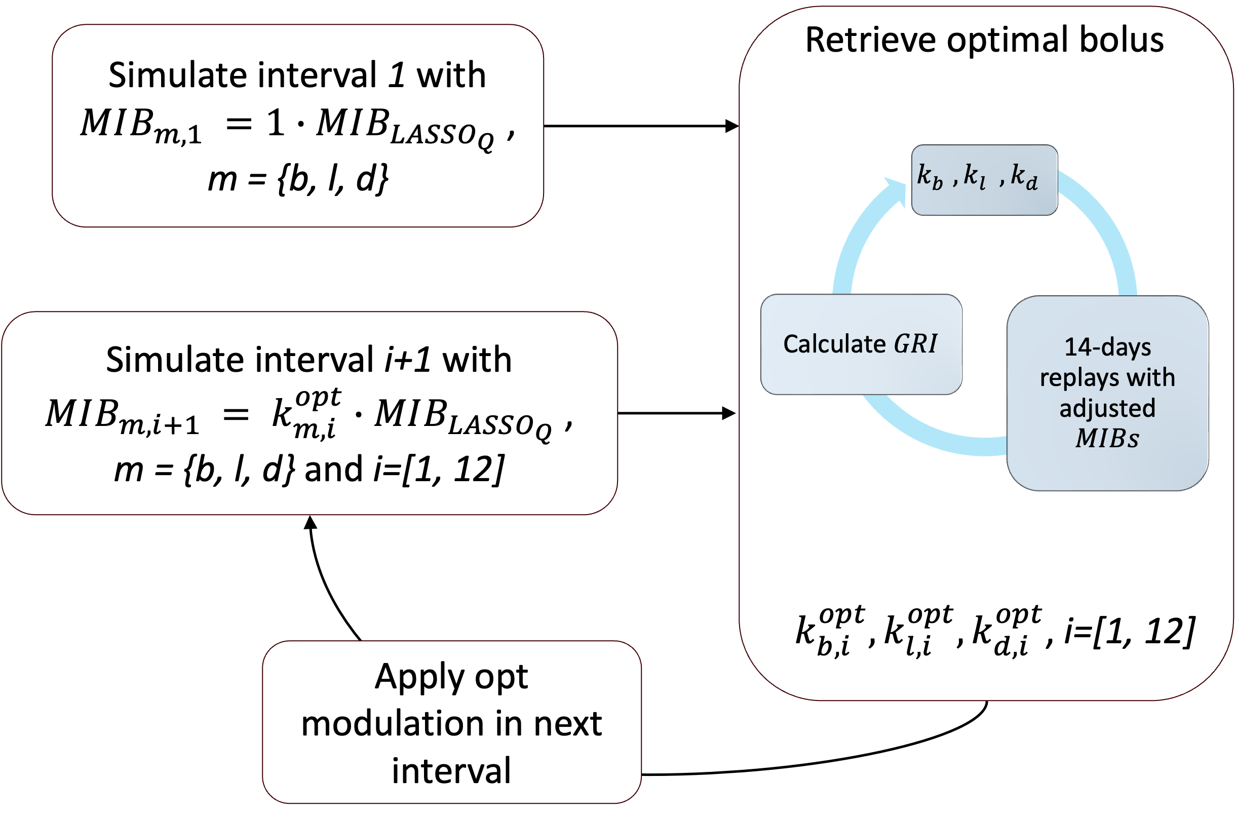
Silico Clinical Trial

Slide 12
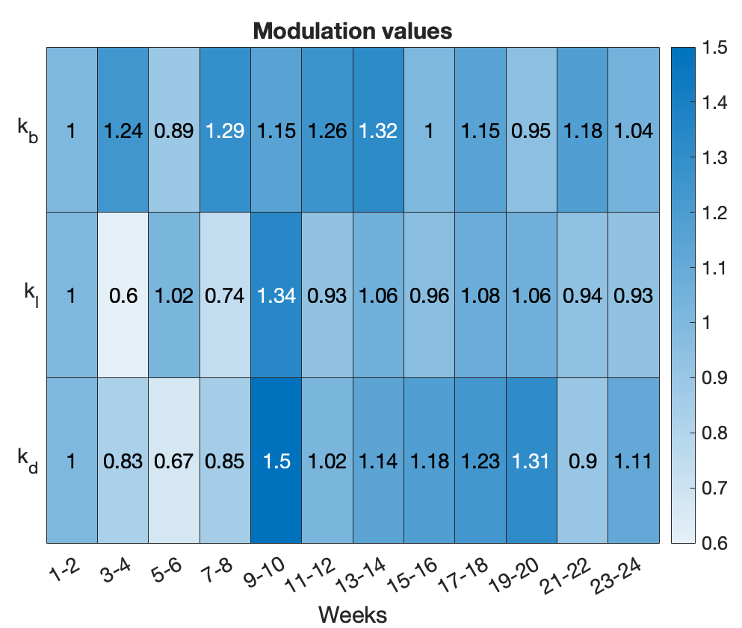
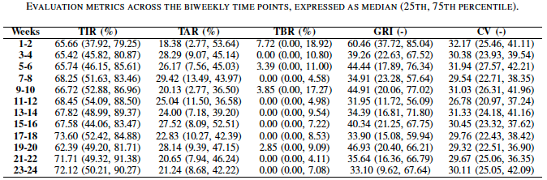
Results

Slide 13

Thank You

